Slide 1
3) Equations and inequalities
3.1) Linear simultaneous equations
3.2) Quadratic simultaneous equations
3.3) Simultaneous equations on graphs
3.4) Linear inequalities
3.5) Quadratic inequalities
3.6) Inequalities on graphs
3.7) Regions

Slide 2
3.1) Linear simultaneous equations
Chapter CONTENTS

Slide 3
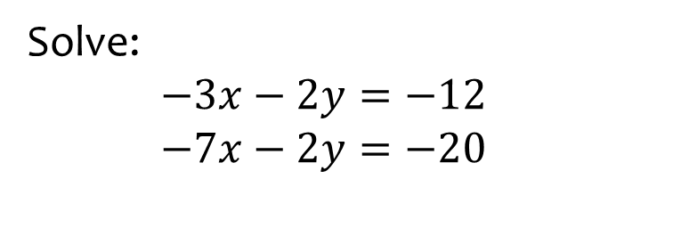

Worked example
Your turn
Solve:
$$−5x−2y=−26$$
$$−5x−4y=−32$$
$$−2x−3y=−17$$
$$−5x−3y=−20$$
Solve:
$−3x−2y=−12$
$−7x−2y=−20$
$$x=2, y=3$$

Slide 4
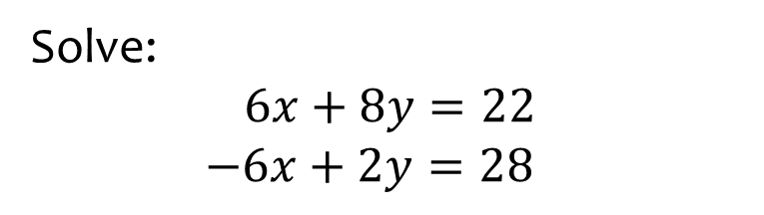

Worked example
Your turn
Solve:
$$5x+4y=23$$
$−5x+2y=19$
$$5x+3y=23$$
$2x−3y=5$
Solve:
$$6x+8y=22$$
$−6x+2y=28$
$$x=−3 , y=5$$

Slide 5
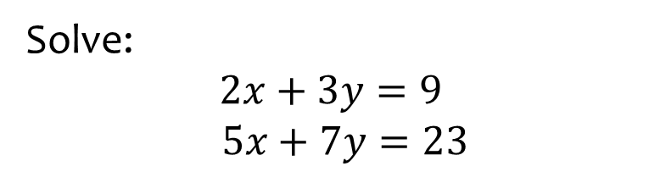

Worked example
Your turn
Solve:
$$2x+3y=11$$
$$3x+y=13$$
$$3x+2y=9$$
$$5x+7y=4$$
Solve:
$$2x+3y=9$$
$$5x+7y=23$$
$$x=6 , y=−1$$

Slide 6
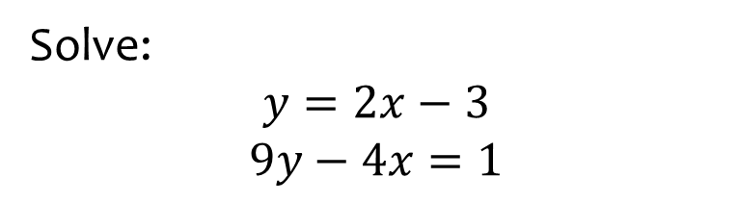
Worked example
Your turn
Solve:
$$y=4x−9$$
$$5y−3x=23$$
Solve:
$$y=2x−3$$
$$9y−4x=1$$
$$x=2, y=1$$

Slide 7
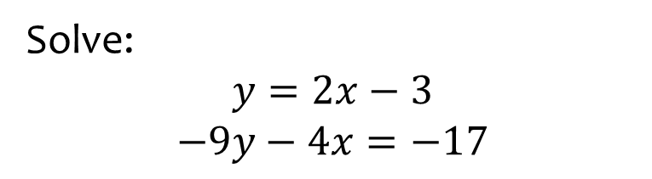
Worked example
Your turn
Solve:
$$y=4x−9$$
$$−5y−3x=−1$$
Solve:
$$y=2x−3$$
$$−9y−4x=−17$$
$$x=2, y=1$$

Slide 8
3.2) Quadratic simultaneous equations
Chapter CONTENTS

Slide 9
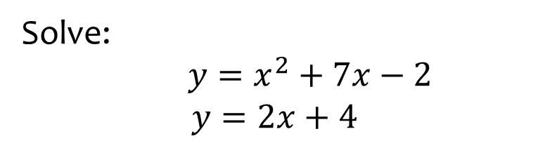
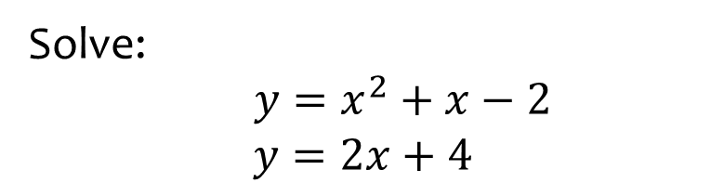

Worked example
Your turn
Solve:
$y=x^{2}+x−2$
$$y=2x+4$$
Solve:
$y=x^{2}+7x−2$
$$y=2x+4$$
$$x=1, y=6$$
$$x=−6, y=−8$$

Slide 10
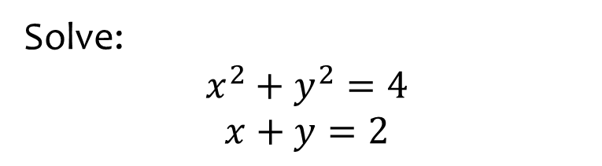
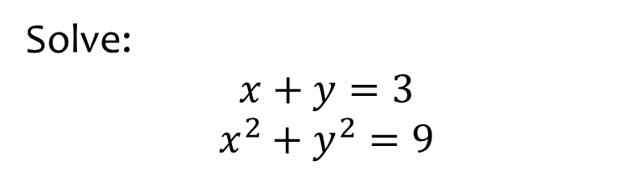

Worked example
Your turn
Solve:
$$x+y=3$$
$$x^{2}+y^{2}=9$$
Solve:
$$x^{2}+y^{2}=4$$
$$x+y=2$$
$$x=0, y=2$$
$$x=2, y=0$$

Slide 11
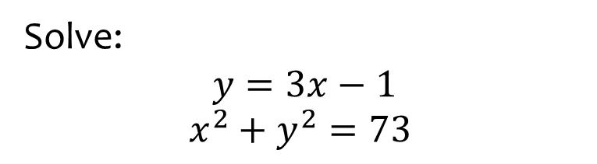
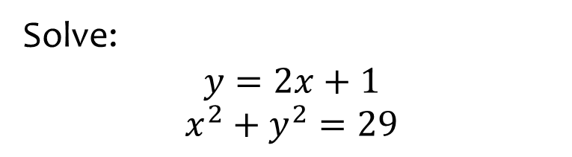
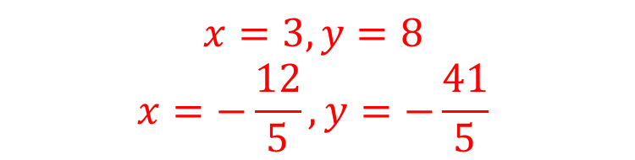
Worked example
Your turn
Solve:
$$y=2x+1$$
$$x^{2}+y^{2}=29$$
Solve:
$$y=3x−1$$
$$x^{2}+y^{2}=73$$
$$x=3, y=8$$
$$x=−\frac{12}{5}, y=−\frac{41}{5}$$

Slide 12
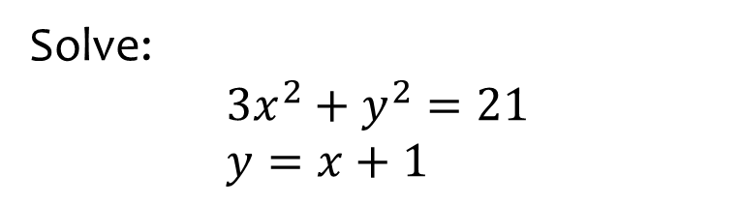
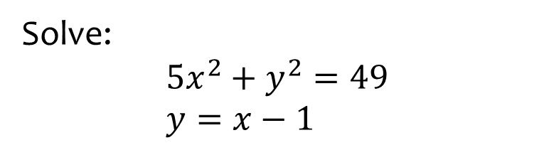

Worked example
Your turn
Solve:
$$5x^{2}+y^{2}=49 \\ y=x−1$$
Solve:
$$3x^{2}+y^{2}=21 \\ y=x+1$$
$$x=−\frac{5}{2}, y=−\frac{3}{2}$$
$$x=2, y=3$$

Slide 13
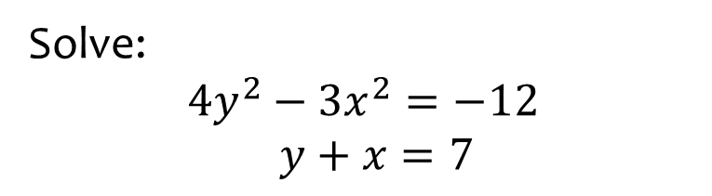
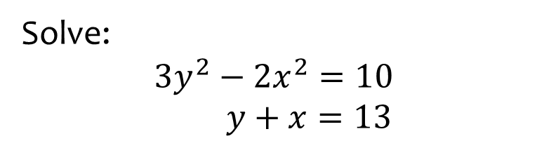

Worked example
Your turn
Solve:
$$3y^{2}−2x^{2}=10$$
$y+x=13$
Solve:
$$4y^{2}−3x^{2}=−12$$
$y+x=7$
$$x=4, y=3$$
$$x=52, y=−45$$

Slide 14
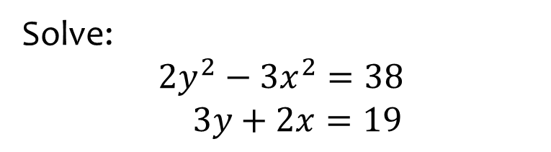
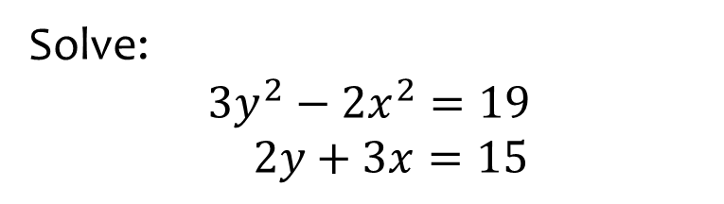

Worked example
Your turn
Solve:
$$3y^{2}−2x^{2}=19$$
$2y+3x=15$
Solve:
$$2y^{2}−3x^{2}=38$$
$3y+2x=19$
$$x=2, y=5$$
$$x=−10, y=13$$

Slide 15
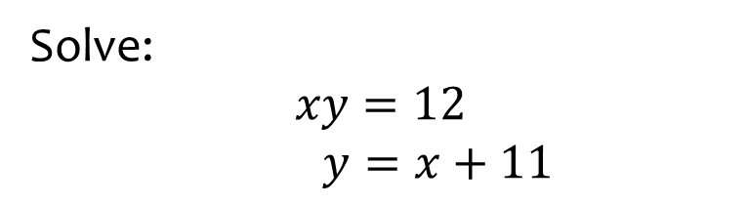


Worked example
Your turn
Solve:
$$xy=12$$
$y=x+4$
$$xy=12$$
$x=y−2$
Solve:
$$xy=12$$
$y=x+11$
$$x=1, y=12$$
$$x=−12, y=−1$$

Slide 16
3.3) Simultaneous equations on graphs
Chapter CONTENTS

Slide 17
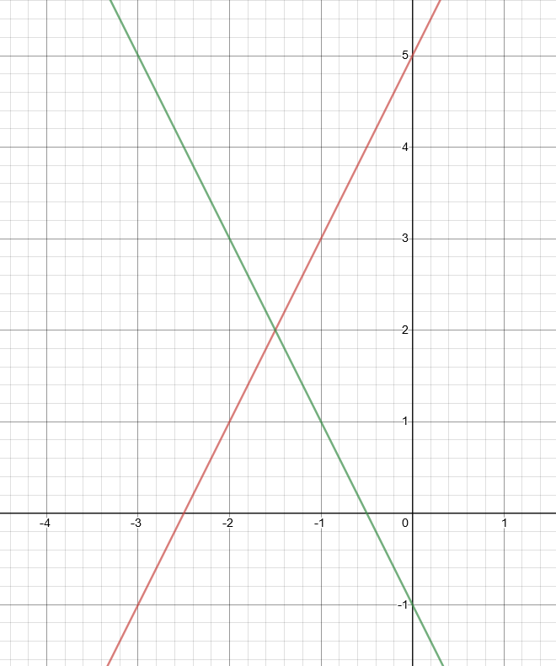
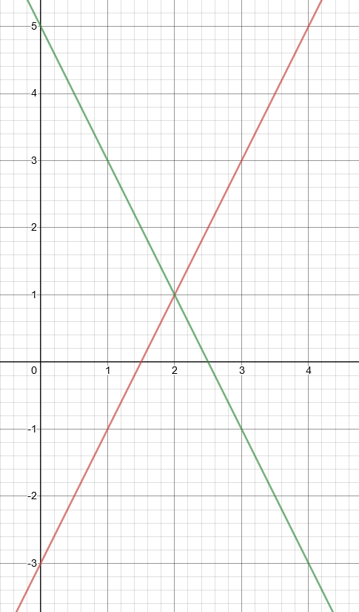
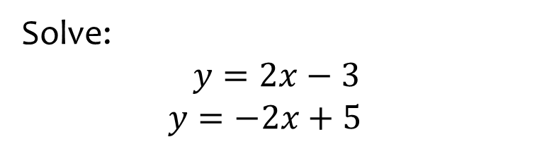
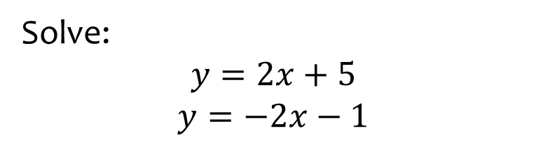

Worked example
Your turn
Solve:
$$y=2x+5$$
$$y=−2x−1$$
Solve:
$$y=2x−3$$
$$y=−2x+5$$
$$x=2, y=1$$

Slide 18
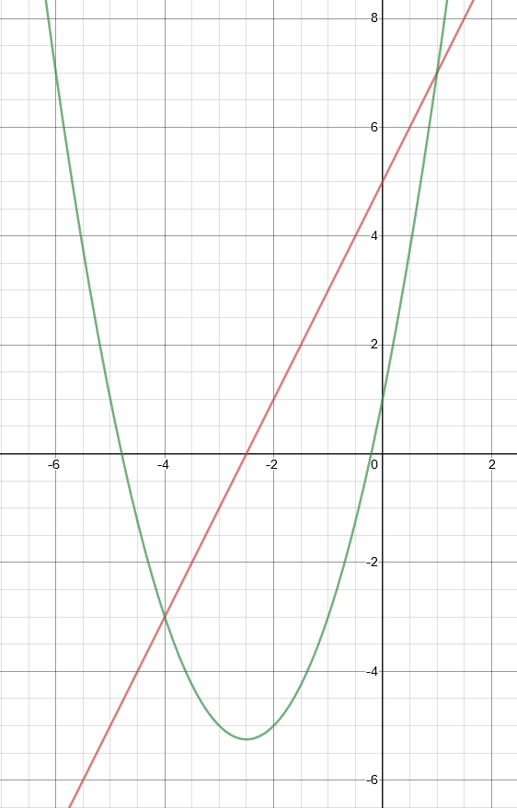
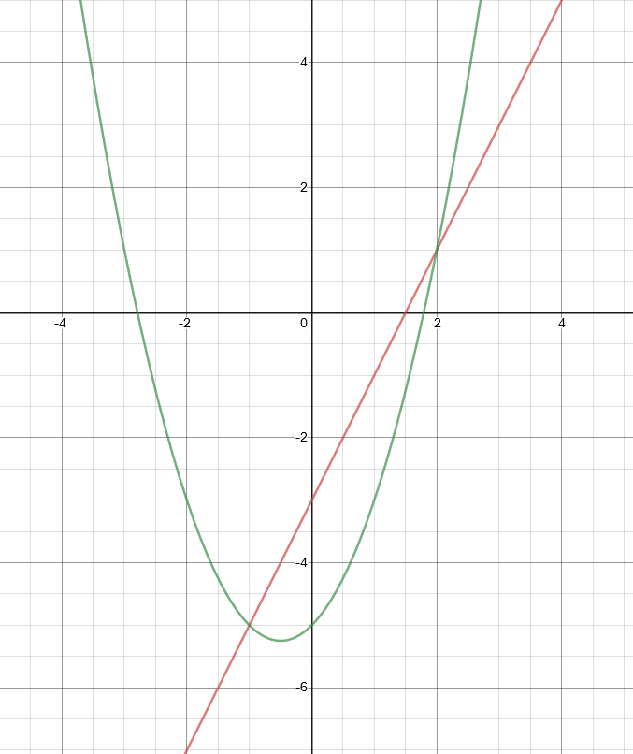
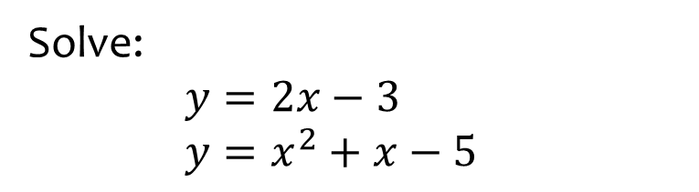
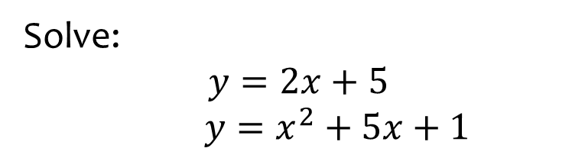

Worked example
Your turn
Solve:
$$y=2x+5$$
$y=x^{2}+5x+1$
Solve:
$y=2x−3$
$y=x^{2}+x−5$
$$x=2, y=1$$
$$x=−1, y=−5$$

Slide 19
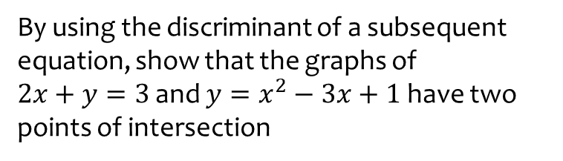
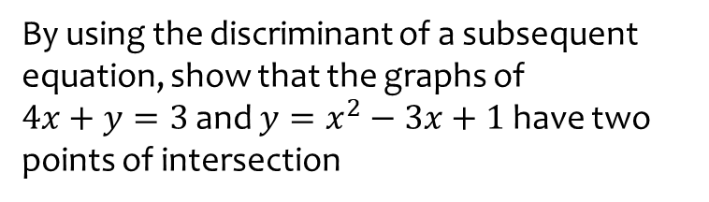

Worked example
Your turn
By using the discriminant of a subsequent equation, show that the graphs of
$4x+y=3$ and $y=x^{2}−3x+1$ have two points of intersection
By using the discriminant of a subsequent equation, show that the graphs of
$2x+y=3$ and $y=x^{2}−3x+1$ have two points of intersection
$$x^{2}−x−2=0$$
Discriminant $=9>0$

Slide 20
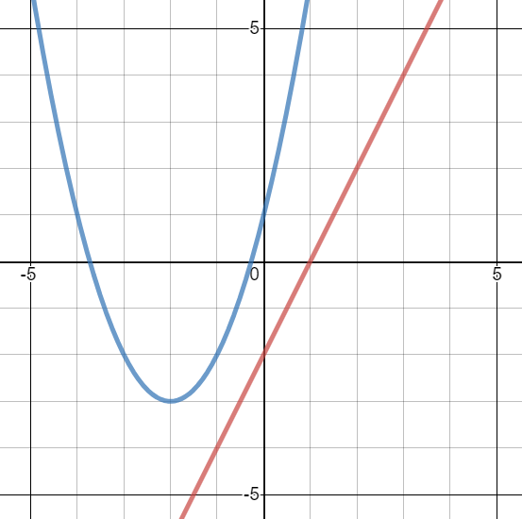
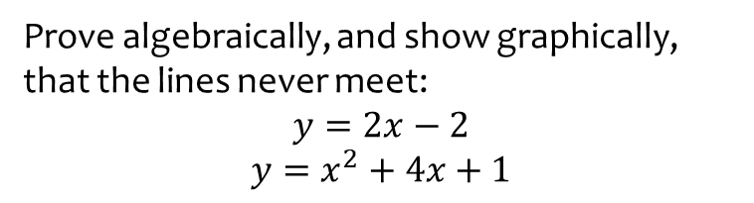
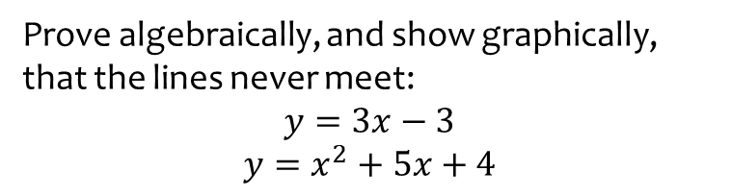

Worked example
Your turn
Prove algebraically, and show graphically, that the lines never meet:
$$y=3x−3$$
$$y=x^{2}+5x+4$$
Prove algebraically, and show graphically, that the lines never meet:
$$y=2x−2$$
$$y=x^{2}+4x+1$$
$$x^{2}+2x+3=0$$
Discriminant $=−8<0$

Slide 21
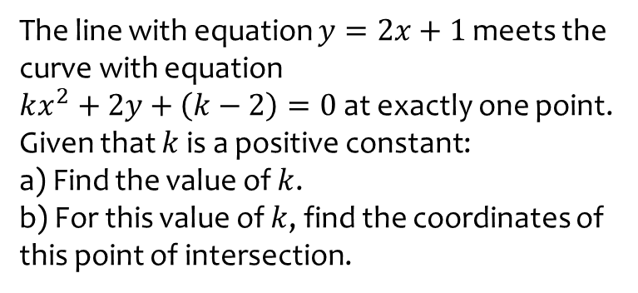
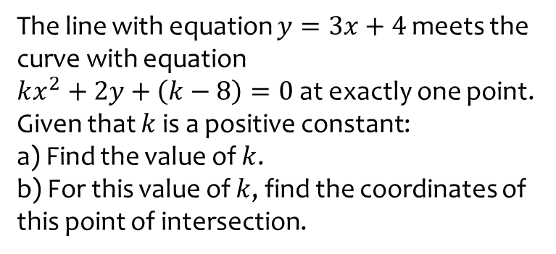
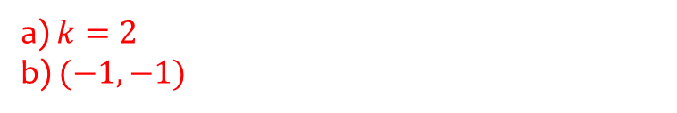
Worked example
Your turn
The line with equation $y=3x+4$ meets the curve with equation
$kx^{2}+2y+\left(k−8\right)=0$ at exactly one point. Given that $k$ is a positive constant:
a) Find the value of $k$.
b) For this value of $k$, find the coordinates of this point of intersection.
The line with equation $y=2x+1$ meets the curve with equation
$kx^{2}+2y+\left(k−2\right)=0$ at exactly one point. Given that $k$ is a positive constant:
a) Find the value of $k$.
b) For this value of $k$, find the coordinates of this point of intersection.
a) $k=2$
b) $(−1, −1)$

Slide 22
3.4) Linear inequalities
Chapter CONTENTS

Slide 23
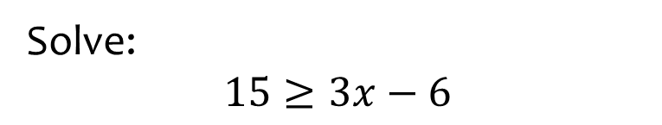


Worked example
Your turn
Solve:
$$3x<12$$
$$4x−1>15$$
$$11≤2x−5$$
Solve:
$$15≥3x−6$$
$$x≤7$$

Slide 24
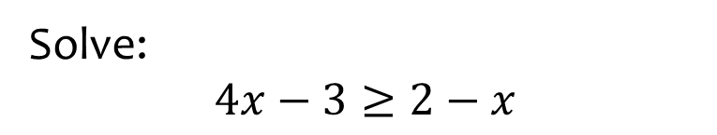


Worked example
Your turn
Solve:
$$5x+2<3x−4$$
$$3x+2≤5x−4$$
$$3x+2>4−5x$$
Solve:
$$4x−3≥2−x$$
$$x≥1$$

Slide 25
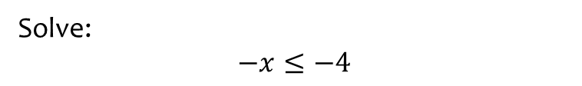

Worked example
Your turn
Solve:
$$−x<2$$
$$−x≥−3$$
Solve:
$$−x≤−4$$
$$x≥4$$

Slide 26
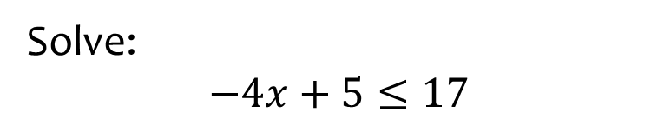


Worked example
Your turn
Solve:
$$−x<12$$
$$12<−2x$$
$$16≥−3x+4$$
Solve:
$$−4x+5≤17$$
$$x≥−3$$

Slide 27
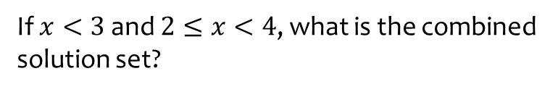
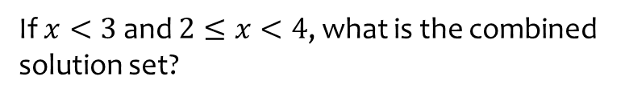
Worked example
Your turn
If $x<3$ and $2≤x<4$, what is the combined solution set?
If $x<3$ and $2≤x<4$, what is the combined solution set?
$$2≤x<3$$

Slide 28
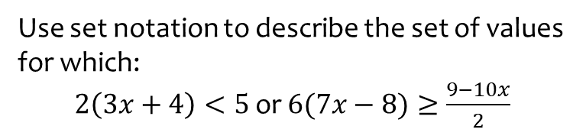


Worked example
Your turn
Use set notation to describe the set of values for which:
$10\left(9x+8\right)<7$ or $6(5x−4)≥\frac{3−2x}{4}$
Use set notation to describe the set of values for which:
$2\left(3x+4\right)<5$ or $6(7x−8)≥\frac{9−10x}{2}$
$$\left\{x:x<−\frac{1}{2}\right\}∪\left\{x:x≥\frac{105}{94}\right\}$$

Slide 29
3.5) Quadratic inequalities
Chapter CONTENTS

Slide 30



Worked example
Your turn
Solve:
$$x^{2}−5x+6=0$$
$$x^{2}−5x+6<0$$
$$x^{2}−5x+6≤0$$
Solve:
$$x^{2}−4x+3<0$$
$$1<x<3$$

Slide 31



Worked example
Your turn
Solve:
$$x^{2}−5x+6=0$$
$$x^{2}−5x+6>0$$
$$x^{2}−5x+6≥0$$
Solve:
$$x^{2}−4x+3>0$$
$$x<1∪x>3$$

Slide 32



Worked example
Your turn
Solve:
$$2x^{2}−7x+3≤0$$
$$2x^{2}−3x−5<0$$
Solve:
$$2x^{2}−7x+6≤0$$
$$\frac{3}{2}≤x≤2$$

Slide 33



Worked example
Your turn
Solve:
$$2x^{2}+x−6≥0$$
$$2x^{2}+x−6>0$$
Solve:
$$3x^{2}+x−2≥0$$
$$x≤−1∪x≥\frac{2}{3}$$

Slide 34



Worked example
Your turn
Find the set of values of $x$ for which:
$$3+5x−2x^{2}<0$$
Find the set of values of $x$ for which:
$$3−5x−2x^{2}<0$$
$x<−3$ or $x>\frac{1}{2}$

Slide 35



Worked example
Your turn
Solve:
$$x^{2}+5x+23≤−3x+8$$
$$x^{2}−14x+57>2x−3$$
Solve:
$$x^{2}+7x+38<−7x−2$$
$$−10<x<−4$$

Slide 36



Worked example
Your turn
Solve:
$$x^{2}<9$$
$${2x}^{2}≤8$$
Solve:
$$x^{2}<16$$
$$−4<x<4$$

Slide 37



Worked example
Your turn
Solve:
$$x^{2}>25$$
$${2x}^{2}≥2$$
Solve:
$$x^{2}>36$$
$$x<−6∪x>6$$

Slide 38



Worked example
Your turn
Find the set of values for which both are true:
$2\left(x−3\right)<7−5x$ and $\left(3x−4\right)\left(5+x\right)<0$
Find the set of values for which both are true:
$3\left(x−2\right)<8−2x$ and $\left(2x−7\right)\left(1+x\right)<0$
$$−1<x<\frac{14}{5}$$

Slide 39


Worked example
Your turn
Find the set of values for which $\frac{10}{x}>5, x≠0$
Find the set of values for which $\frac{6}{x}>2, x≠0$
$$0<x<3$$

Slide 40



Worked example
Your turn
Find the set of values for which $\frac{5}{x−3}<2$
Find the set of values for which $\frac{5}{x−2}<3$
$x<2$ or $x>\frac{11}{3}$

Slide 41


Worked example
Your turn
The equation $kx^{2}−5kx+50=0$, where $k$ is a constant, has no real roots.
Prove that $k$ satisfies the inequality $0≤k<8$
The equation $kx^{2}−3kx+9=0$, where $k$ is a constant, has no real roots.
Prove that $k$ satisfies the inequality $0≤k<4$
Proof

Slide 42
3.6) Inequalities on graphs
Chapter CONTENTS

Slide 43





Worked example
Your turn
$L_{1}$ has equation $y=12−4x$.
$L_{2}$ has equation $y=x^{2}$.
The diagram shows a sketch of $L_{1}$ and $L_{2}$ on the same axes.
Find the coordinates of the points of intersection.
Hence write down the solution to the inequality $12−4x>x^{2}$
$L_{1}$ has equation $y=12+4x$.
$L_{2}$ has equation $y=x^{2}$.
The diagram shows a sketch of $L_{1}$ and $L_{2}$ on the same axes.
Find the coordinates of the points of intersection.
Hence write down the solution to the inequality $12+4x>x^{2}$
a) $(6, 36)$ and $(−2, 4)$
b) $−2<x<6$

Slide 44
3.7) Regions
Chapter CONTENTS

Slide 45



Worked example
Your turn
Shade the region that satisfies the inequalities:
$$4y+x≤12 \\ y>x^{2}−5x−6$$
Shade the region that satisfies the inequalities:
$$2y+x<14 \\ y≥x^{2}−3x−4$$

Slide 46





Worked example
Your turn
Shade the region which satisfies the inequalities. Label it R.
$2≤x≤5$ and $1<y<3$
Shade the region which satisfies the inequalities. Label it R
$1≤x≤4$ and $2<y<6$
$$R$$
Graphs used with permission from DESMOS: https://www.desmos.com/

Slide 47




Worked example
Your turn
Shade the region which satisfies the inequalities. Label it R
$x≤3$, $y>1$ and $y≥x+3$
Shade the region which satisfies the inequalities. Label it R.
$$x<4,y≥3,y≥x+2$$
$$R$$
Graphs used with permission from DESMOS: https://www.desmos.com/

Slide 48




Worked example
Your turn
Shade the region which satisfies the inequalities:
$x≥−2$, $y<1$ and $y<x−1$
Shade the region which satisfies the inequalities. Label it R.
$$x>−3,y≤4 \text{and} y<x−2$$
$$R$$
Graphs used with permission from DESMOS: https://www.desmos.com/

Slide 49




Worked example
Your turn
Shade the region which satisfies the inequalities:
$x≥2,y>−1$ and $x+y≤5$
Shade the region which satisfies the inequalities. Label it R.
$x≥2,y>1$ and $x+y≤6$
$$R$$
Graphs used with permission from DESMOS: https://www.desmos.com/

