Slide 1
3) Elastic strings and springs
3.1) Hooke’s law and equilibrium problems
3.2) Hooke’s law and dynamics problems
3.3) Elastic energy
3.4) Problems involving elastic energy

Slide 2
3.1) Hooke’s law and equilibrium problems
Chapter CONTENTS

Slide 3

Worked example
Your turn
An elastic string of natural length 4m and modulus of elasticity 58.8N has one end fixed. A particle of mass 2kg is attached to the other end and hangs at rest. Find the extension of the string.
An elastic string of natural length 2m and modulus of elasticity 29.4N has one end fixed. A particle of mass 4kg is attached to the other end and hangs at rest. Find the extension of the string.
$2.67 m$ (3 sf)

Slide 4
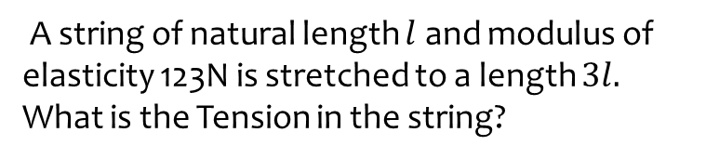
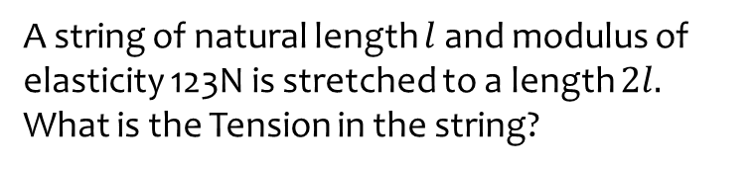
Worked example
Your turn
A string of natural length $l$ and modulus of elasticity 123N is stretched to a length $2l.$
What is the Tension in the string?
A string of natural length $l$ and modulus of elasticity 123N is stretched to a length $3l.$
What is the Tension in the string?
$$246 N$$

Slide 5
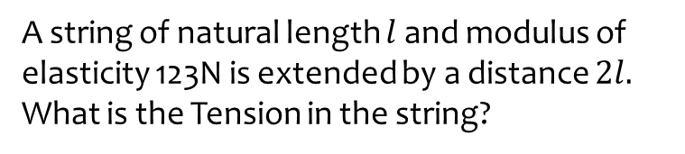
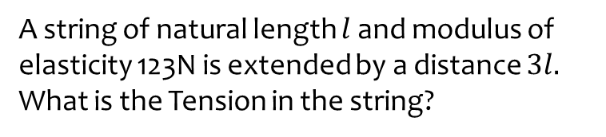
Worked example
Your turn
A string of natural length $l$ and modulus of elasticity 123N is extended by a distance $3l.$
What is the Tension in the string?
A string of natural length $l$ and modulus of elasticity 123N is extended by a distance $2l.$
What is the Tension in the string?
$$246 N$$

Slide 6
Worked example
Your turn
A spring of natural length 3m is stretched to a length of 12m by applying a force to both ends of 99N.
What is the modulus of elasticity of the spring?
A spring of natural length 3m is stretched to a length of 6m by applying a force to both ends of 99N.
What is the modulus of elasticity of the spring?
$$99 N$$

Slide 7

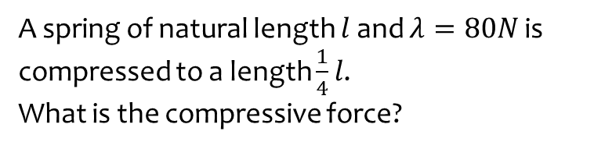

Worked example
Your turn
A spring of natural length $l$and $λ=80N$ is compressed to a length $\frac{1}{4}l$.
What is the compressive force?
A spring of natural length $l$and $λ=40N$ is compressed to a length $\frac{3}{4}l$.
What is the compressive force?
A string of natural length $l$and $λ=40N$ is compressed by a force of 10N. What is $x$?
$$10 N$$
Unknown – strings collapse under compression

Slide 8
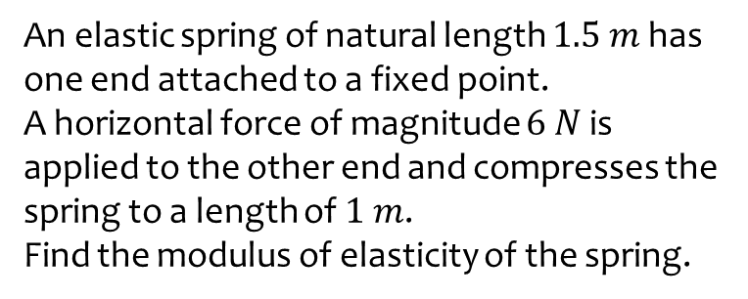
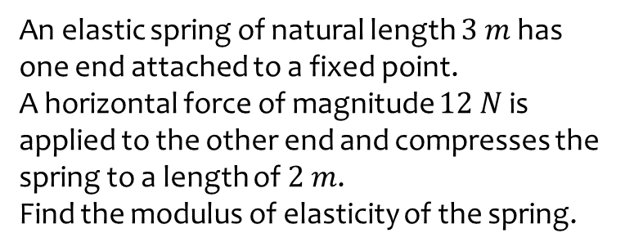
Worked example
Your turn
An elastic spring of natural length $3 m$ has one end attached to a fixed point.
A horizontal force of magnitude $12 N$ is applied to the other end and compresses the spring to a length of $2 m$.
Find the modulus of elasticity of the spring.
An elastic spring of natural length $1.5 m$ has one end attached to a fixed point.
A horizontal force of magnitude $6 N$ is applied to the other end and compresses the spring to a length of $1 m$.
Find the modulus of elasticity of the spring.
$$18 N$$

Slide 9

Worked example
Your turn
The elastic springs PQ and QR are joined together at Q to form one long spring.
The spring PQ has natural length 3.2 m and modulus of elasticity 40 N.
The spring QR has natural length 2.8 m and modulus of elasticity 56 N.
The ends P and R, of the long string are attached to two fixed points which are 8 m apart on the same horizontal plane.
[Assume Q is at rest and in equilibrium].
Find the Tension in the combined spring.
The elastic springs PQ and QR are joined together at Q to form one long spring.
The spring PQ has natural length 1.6 m and modulus of elasticity 20 N.
The spring QR has natural length 1.4 m and modulus of elasticity 28 N.
The ends P and R, of the long string are attached to two fixed points which are 4 m apart on the same horizontal plane.
[Assume Q is at rest and in equilibrium].
Find the Tension in the combined spring.
$7.69 N$ (3 sf)

Slide 10
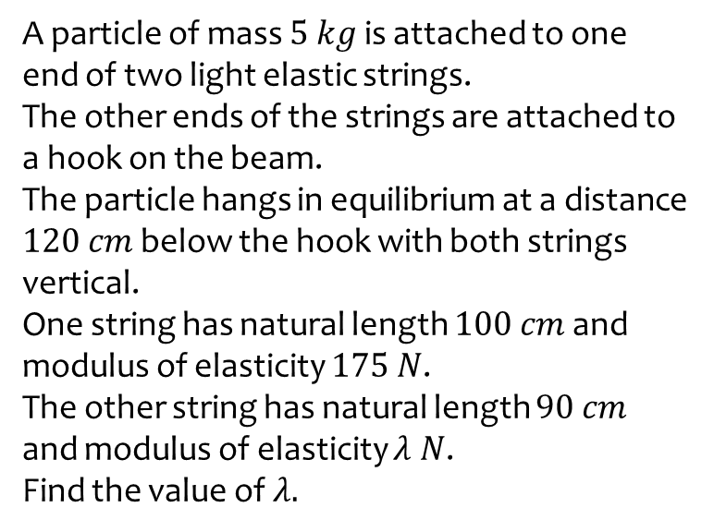
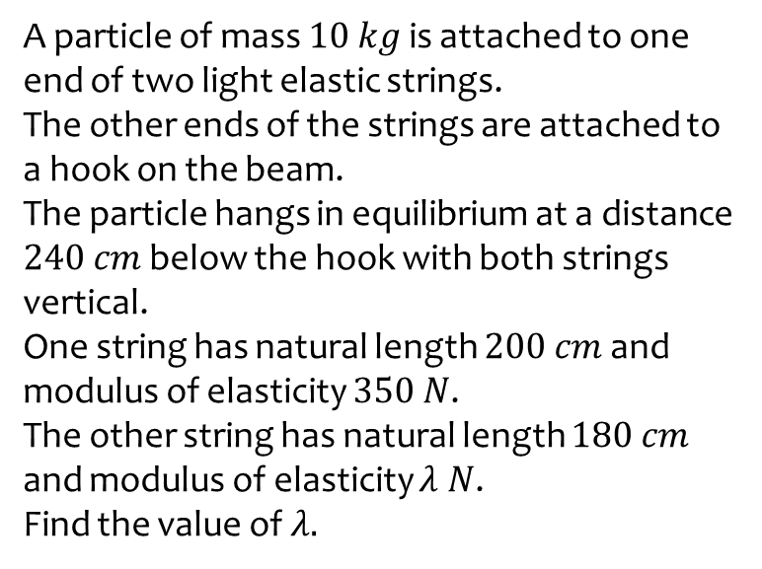
Worked example
Your turn
A particle of mass $10 kg$ is attached to one end of two light elastic strings.
The other ends of the strings are attached to a hook on the beam.
The particle hangs in equilibrium at a distance $240 cm$ below the hook with both strings vertical.
One string has natural length $200 cm$ and modulus of elasticity $350 N$.
The other string has natural length $180 cm$ and modulus of elasticity $λ N$.
Find the value of $λ.$
A particle of mass $5 kg$ is attached to one end of two light elastic strings.
The other ends of the strings are attached to a hook on the beam.
The particle hangs in equilibrium at a distance $120 cm$ below the hook with both strings vertical.
One string has natural length $100 cm$ and modulus of elasticity $175 N$.
The other string has natural length $90 cm$ and modulus of elasticity $λ N$.
Find the value of $λ.$
$$λ=42$$

Slide 11
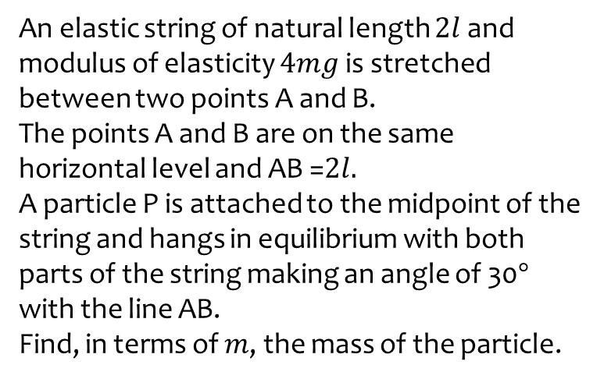
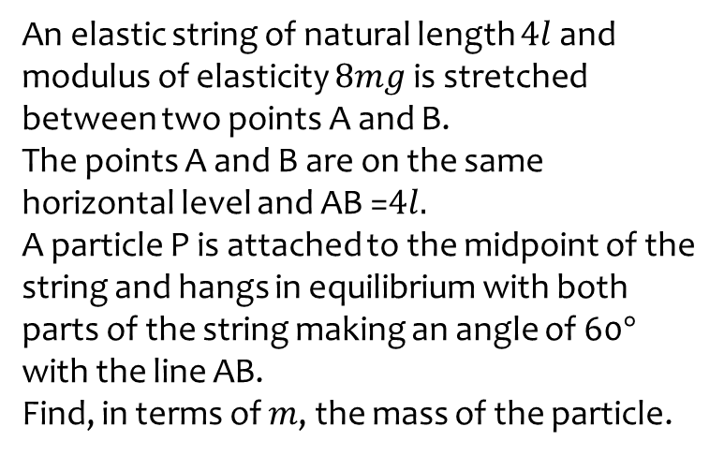

Worked example
Your turn
An elastic string of natural length $4l$ and modulus of elasticity $8mg$ is stretched between two points A and B.
The points A and B are on the same horizontal level and AB =$4l.$
A particle P is attached to the midpoint of the string and hangs in equilibrium with both parts of the string making an angle of 60$°$ with the line AB.
Find, in terms of $m$, the mass of the particle.
An elastic string of natural length $2l$ and modulus of elasticity $4mg$ is stretched between two points A and B.
The points A and B are on the same horizontal level and AB =$2l.$
A particle P is attached to the midpoint of the string and hangs in equilibrium with both parts of the string making an angle of 30$°$ with the line AB.
Find, in terms of $m$, the mass of the particle.
$0.619m$ kg (3 sf)

Slide 12
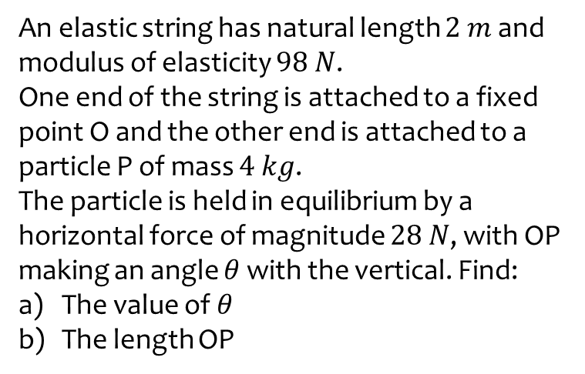
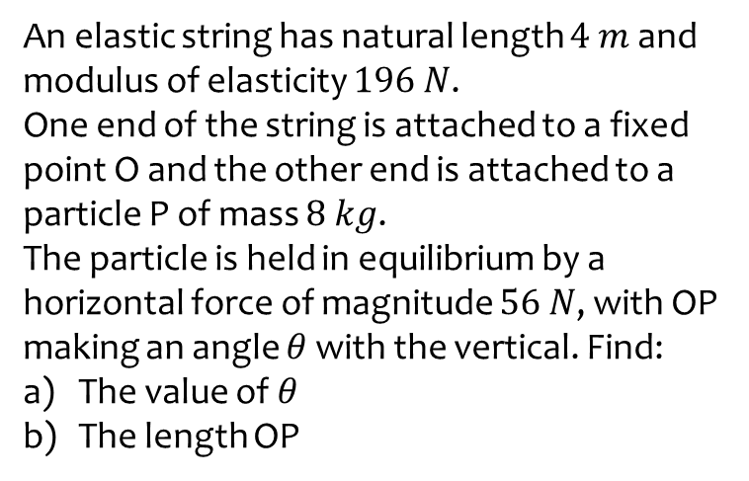
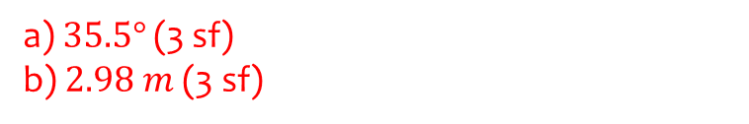
Worked example
Your turn
An elastic string has natural length $4 m$ and modulus of elasticity $196 N$.
One end of the string is attached to a fixed point O and the other end is attached to a particle P of mass $8 kg$.
The particle is held in equilibrium by a horizontal force of magnitude $56 N$, with OP making an angle $θ$ with the vertical. Find:
The value of $θ$
The length OP
An elastic string has natural length $2 m$ and modulus of elasticity $98 N$.
One end of the string is attached to a fixed point O and the other end is attached to a particle P of mass $4 kg$.
The particle is held in equilibrium by a horizontal force of magnitude $28 N$, with OP making an angle $θ$ with the vertical. Find:
The value of $θ$
The length OP
a) $35.5°$ (3 sf)
b) $2.98 m$ (3 sf)

Slide 13
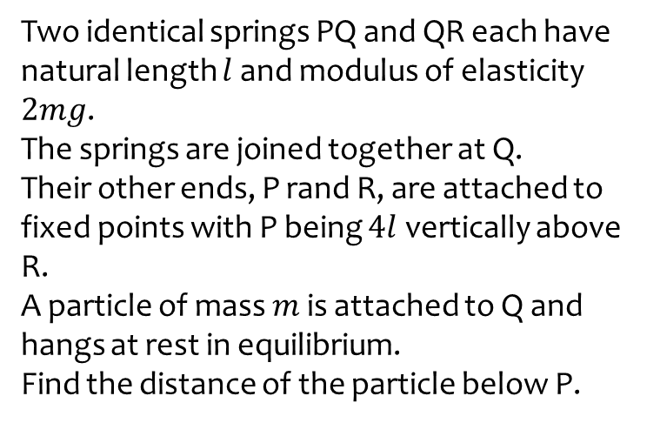
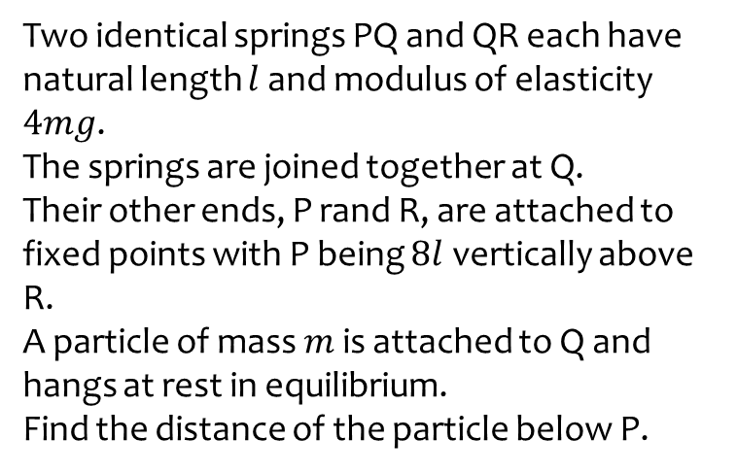

Worked example
Your turn
Two identical springs PQ and QR each have natural length $l$ and modulus of elasticity $4mg$.
The springs are joined together at Q.
Their other ends, P rand R, are attached to fixed points with P being $8l$ vertically above R.
A particle of mass $m$ is attached to Q and hangs at rest in equilibrium.
Find the distance of the particle below P.
Two identical springs PQ and QR each have natural length $l$ and modulus of elasticity $2mg$.
The springs are joined together at Q.
Their other ends, P rand R, are attached to fixed points with P being $4l$ vertically above R.
A particle of mass $m$ is attached to Q and hangs at rest in equilibrium.
Find the distance of the particle below P.
$$\frac{9l}{4}$$

Slide 14
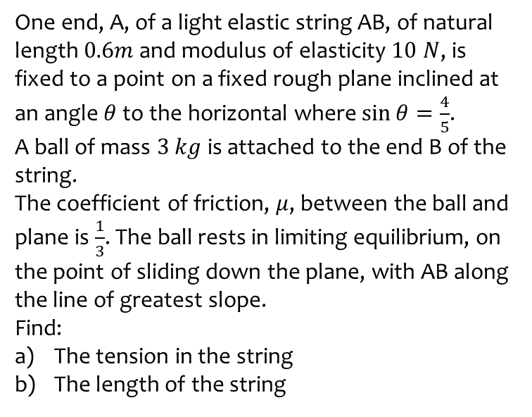
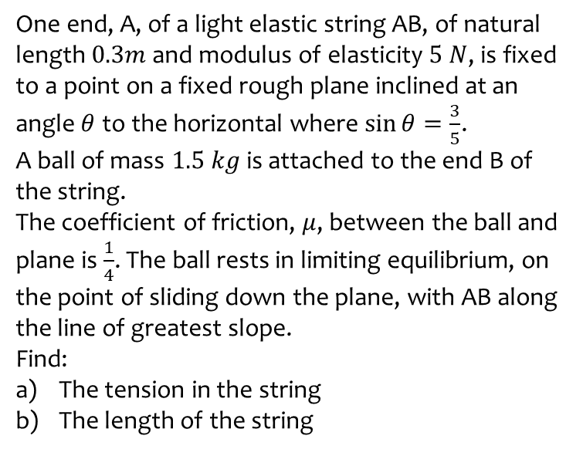
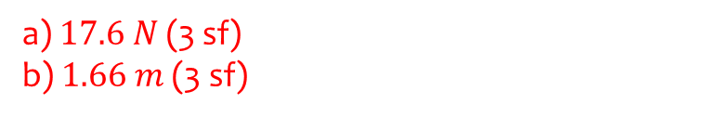
Worked example
Your turn
One end, A, of a light elastic string AB, of natural length $0.3m$ and modulus of elasticity $5 N$, is fixed to a point on a fixed rough plane inclined at an angle $θ$ to the horizontal where $\sin{θ}=\frac{3}{5}$.
A ball of mass $1.5 kg$ is attached to the end B of the string.
The coefficient of friction, $μ$, between the ball and plane is $\frac{1}{4}$. The ball rests in limiting equilibrium, on the point of sliding down the plane, with AB along the line of greatest slope.
Find:
The tension in the string
The length of the string
One end, A, of a light elastic string AB, of natural length $0.6m$ and modulus of elasticity $10 N$, is fixed to a point on a fixed rough plane inclined at an angle $θ$ to the horizontal where $\sin{θ}=\frac{4}{5}$.
A ball of mass $3 kg$ is attached to the end B of the string.
The coefficient of friction, $μ$, between the ball and plane is $\frac{1}{3}$. The ball rests in limiting equilibrium, on the point of sliding down the plane, with AB along the line of greatest slope.
Find:
The tension in the string
The length of the string
a) $17.6 N$ (3 sf)
b) $1.66 m$ (3 sf)

Slide 15
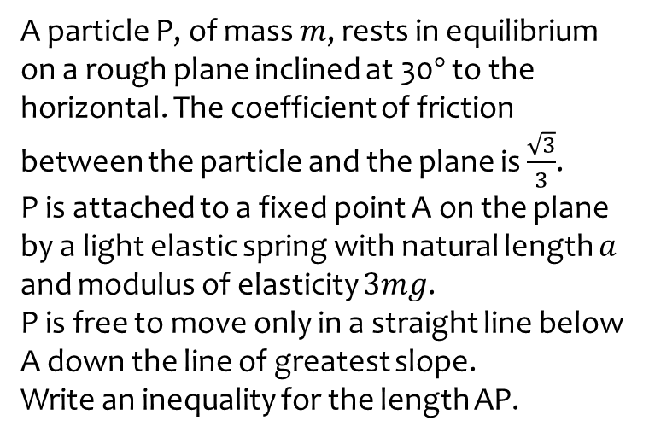
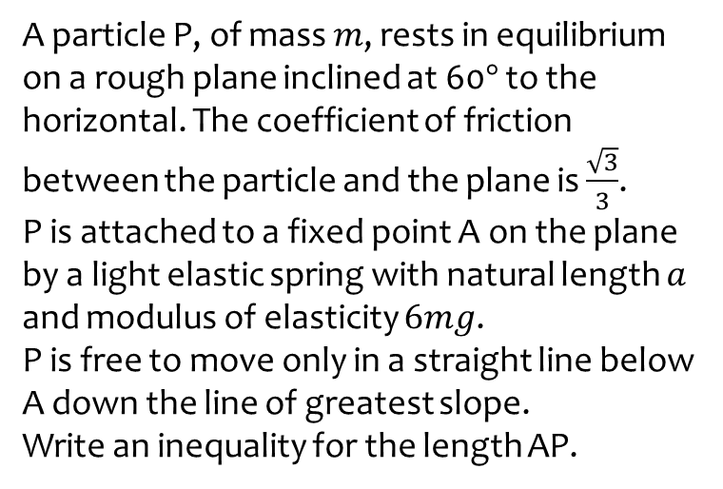

Worked example
Your turn
A particle P, of mass $m$, rests in equilibrium on a rough plane inclined at 60$°$ to the horizontal. The coefficient of friction between the particle and the plane is $\frac{\sqrt{3}}{3}$.
P is attached to a fixed point A on the plane by a light elastic spring with natural length $a$ and modulus of elasticity $6mg$.
P is free to move only in a straight line below A down the line of greatest slope.
Write an inequality for the length AP.
A particle P, of mass $m$, rests in equilibrium on a rough plane inclined at 30$°$ to the horizontal. The coefficient of friction between the particle and the plane is $\frac{\sqrt{3}}{3}$.
P is attached to a fixed point A on the plane by a light elastic spring with natural length $a$ and modulus of elasticity $3mg$.
P is free to move only in a straight line below A down the line of greatest slope.
Write an inequality for the length AP.
$$a≤AP≤\frac{4a}{3}$$

Slide 16
3.2) Hooke’s law and dynamics problems
Chapter CONTENTS

Slide 17
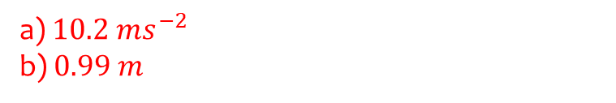
Worked example
Your turn
One end of a light elastic string, of natural length 1m and modulus of elasticity 40N, is attached to a fixed point A.
The other end is attached to a particle of mass 4kg.
The particle is held at a point which is 3m below A and released from rest. Find:
The initial acceleration of the particle
The length of the string when the particle reaches its maximum speed.
One end of a light elastic string, of natural length 0.5m and modulus of elasticity 20N, is attached to a fixed point A.
The other end is attached to a particle of mass 2kg.
The particle is held at a point which is 1.5m below A and released from rest. Find:
The initial acceleration of the particle
The length of the string when the particle reaches its maximum speed.
a) $10.2 ms^{−2}$
b) $0.99 m$

Slide 18
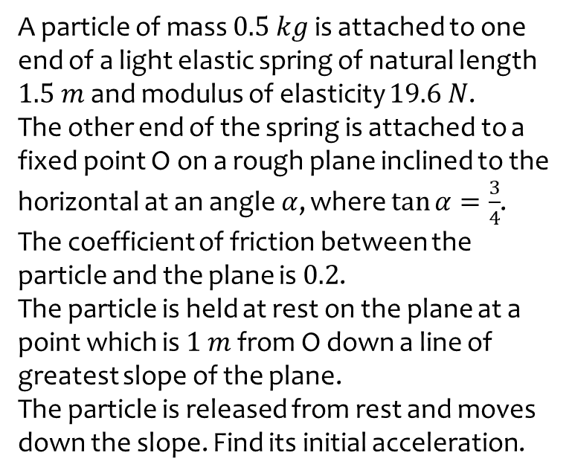
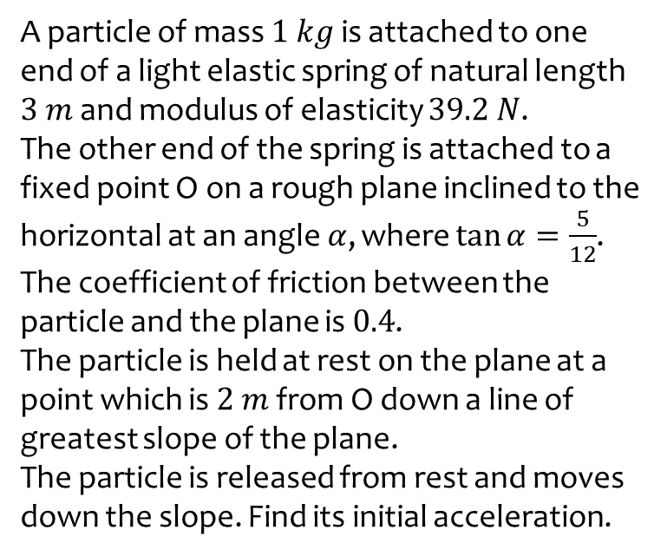

Worked example
Your turn
A particle of mass $1 kg$ is attached to one end of a light elastic spring of natural length $3 m$ and modulus of elasticity $39.2 N$.
The other end of the spring is attached to a fixed point O on a rough plane inclined to the horizontal at an angle $α$, where $\tan{α}=\frac{5}{12}$.
The coefficient of friction between the particle and the plane is $0.4$.
The particle is held at rest on the plane at a point which is $2 m$ from O down a line of greatest slope of the plane.
The particle is released from rest and moves down the slope. Find its initial acceleration.
A particle of mass $0.5 kg$ is attached to one end of a light elastic spring of natural length $1.5 m$ and modulus of elasticity $19.6 N$.
The other end of the spring is attached to a fixed point O on a rough plane inclined to the horizontal at an angle $α$, where $\tan{α}=\frac{3}{4}$.
The coefficient of friction between the particle and the plane is $0.2$.
The particle is held at rest on the plane at a point which is $1 m$ from O down a line of greatest slope of the plane.
The particle is released from rest and moves down the slope. Find its initial acceleration.
$17.4 ms^{−2}$ (3 sf)

Slide 19
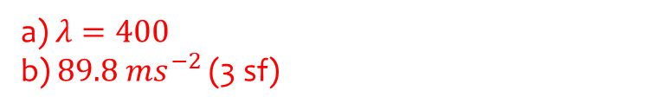
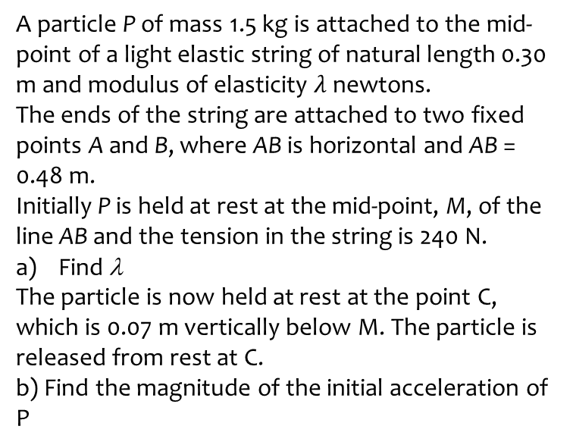
Worked example
Your turn
A particle P of mass 3 kg is attached to the mid-point of a light elastic string of natural length 0.60 m and modulus of elasticity λ newtons.
The ends of the string are attached to two fixed points A and B, where AB is horizontal and AB = 0.96 m.
Initially P is held at rest at the mid-point, M, of the line AB and the tension in the string is 480 N.
Find λ
The particle is now held at rest at the point C, which is 0.14 m vertically below M. The particle is released from rest at C.
b) Find the magnitude of the initial acceleration of P
A particle P of mass 1.5 kg is attached to the mid-point of a light elastic string of natural length 0.30 m and modulus of elasticity $λ$ newtons.
The ends of the string are attached to two fixed points A and B, where AB is horizontal and AB = 0.48 m.
Initially P is held at rest at the mid-point, M, of the line AB and the tension in the string is 240 N.
Find λ
The particle is now held at rest at the point C, which is 0.07 m vertically below M. The particle is released from rest at C.
b) Find the magnitude of the initial acceleration of P
a) $λ=400$
b) $89.8 ms^{−2}$ (3 sf)

Slide 20
3.3) Elastic energy
Chapter CONTENTS

Slide 21

Worked example
Your turn
An elastic string has natural length 1.6m and modulus of elasticity 3N.
Find the energy stored in the string when its length is 1.4m.
An elastic string has natural length 1.4m and modulus of elasticity 6N.
Find the energy stored in the string when its length is 1.6m.
$0.0857 J$ (3 sf)

Slide 22
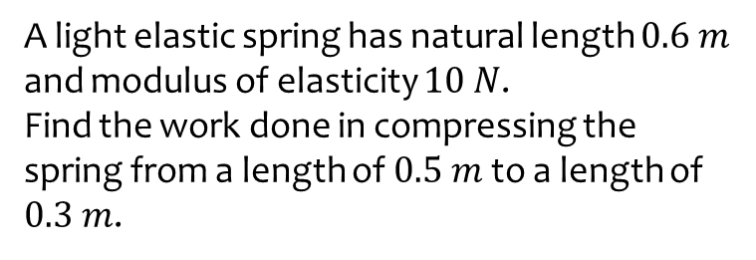
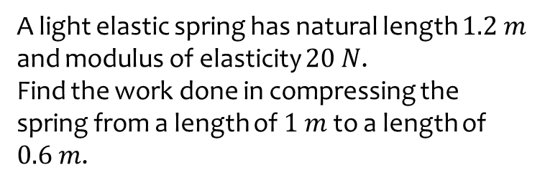

Worked example
Your turn
A light elastic spring has natural length $1.2 m$ and modulus of elasticity $20 N$.
Find the work done in compressing the spring from a length of $1 m$ to a length of $0.6 m$.
A light elastic spring has natural length $0.6 m$ and modulus of elasticity $10 N$.
Find the work done in compressing the spring from a length of $0.5 m$ to a length of $0.3 m$.
$0.667 J$ (3 sf)

Slide 23
3.4) Problems involving elastic energy
Chapter CONTENTS

Slide 24
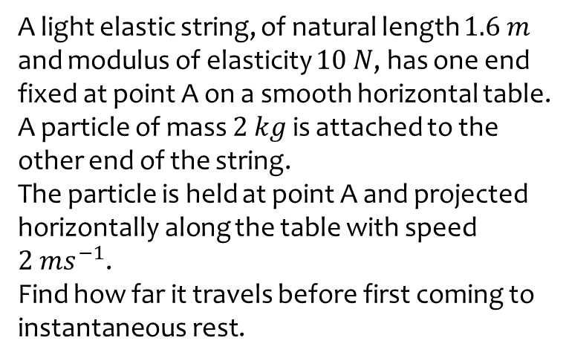
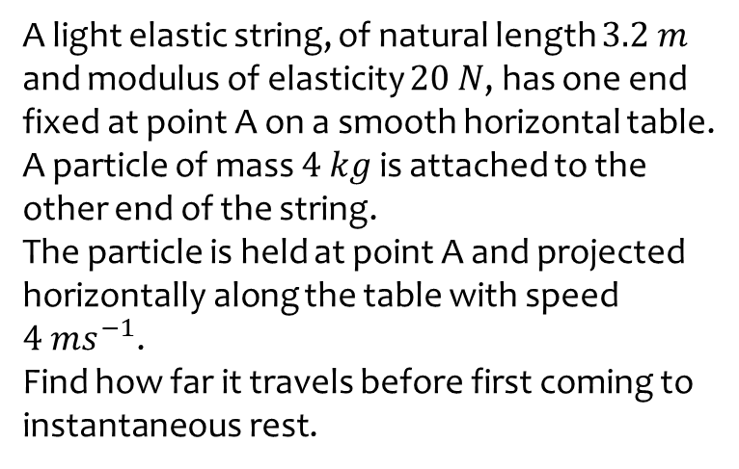

Worked example
Your turn
A light elastic string, of natural length $3.2 m$ and modulus of elasticity $20 N$, has one end fixed at point A on a smooth horizontal table.
A particle of mass $4 kg$ is attached to the other end of the string.
The particle is held at point A and projected horizontally along the table with speed $4 ms^{−1}$.
Find how far it travels before first coming to instantaneous rest.
A light elastic string, of natural length $1.6 m$ and modulus of elasticity $10 N$, has one end fixed at point A on a smooth horizontal table.
A particle of mass $2 kg$ is attached to the other end of the string.
The particle is held at point A and projected horizontally along the table with speed $2 ms^{−1}$.
Find how far it travels before first coming to instantaneous rest.
$2.73 m$ (3 sf)

Slide 25
Worked example
Your turn
A particle of mass 1kg is attached to one end of an elastic string, of natural length 4m and modulus of elasticity 39.2 N.
The other end of the elastic string is attached to a point O.
The particle is released from the point O.
Find the greatest distance it will reach below O.
A particle of mass 0.5kg is attached to one end of an elastic string, of natural length 2m and modulus of elasticity 19.6N.
The other end of the elastic string is attached to a point O.
The particle is released from the point O.
Find the greatest distance it will reach below O.
$$4 m$$

Slide 26
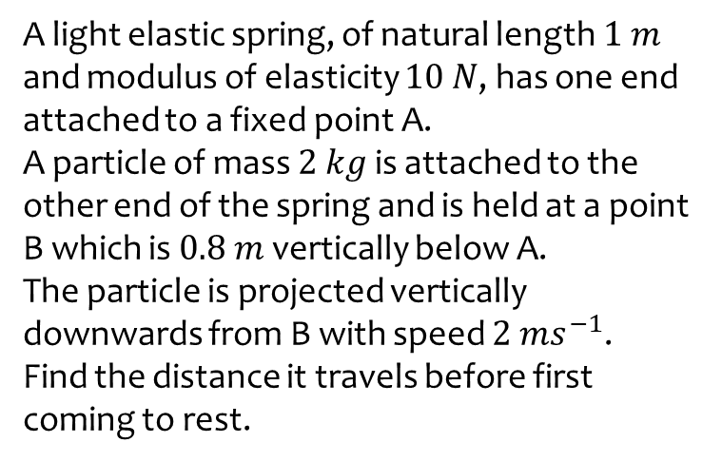
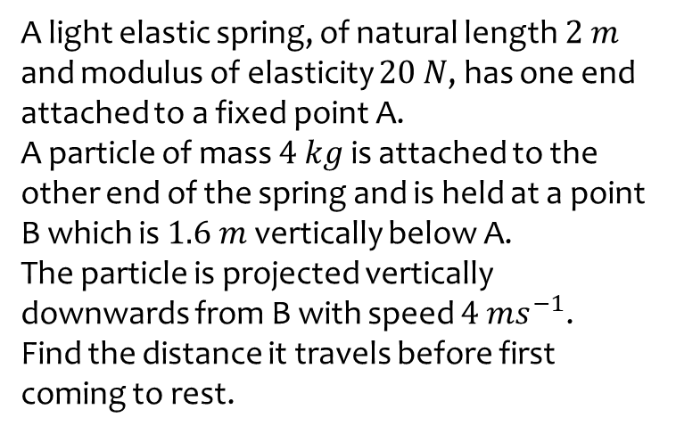

Worked example
Your turn
A light elastic spring, of natural length $2 m$ and modulus of elasticity $20 N$, has one end attached to a fixed point A.
A particle of mass $4 kg$ is attached to the other end of the spring and is held at a point B which is $1.6 m$ vertically below A.
The particle is projected vertically downwards from B with speed $4 ms^{−1}$.
Find the distance it travels before first coming to rest.
A light elastic spring, of natural length $1 m$ and modulus of elasticity $10 N$, has one end attached to a fixed point A.
A particle of mass $2 kg$ is attached to the other end of the spring and is held at a point B which is $0.8 m$ vertically below A.
The particle is projected vertically downwards from B with speed $2 ms^{−1}$.
Find the distance it travels before first coming to rest.
$4.50 m$ (3 sf)

Slide 27
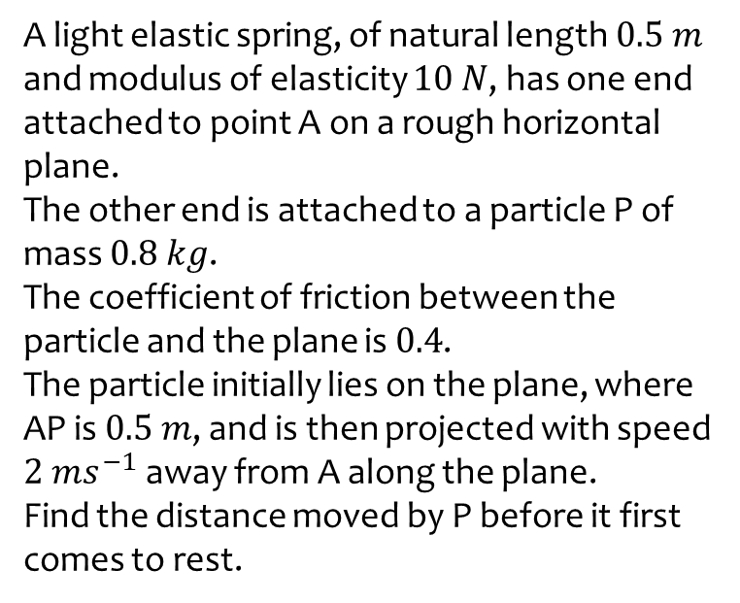
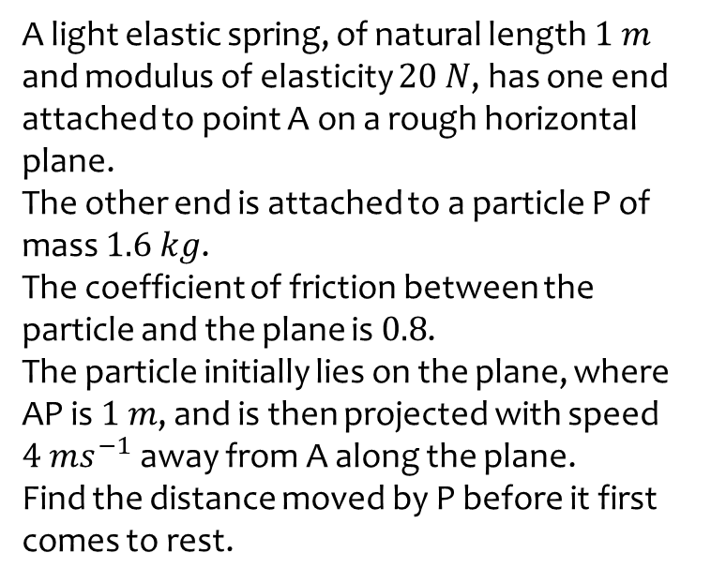

Worked example
Your turn
A light elastic spring, of natural length $1 m$ and modulus of elasticity $20 N$, has one end attached to point A on a rough horizontal plane.
The other end is attached to a particle P of mass $1.6 kg$.
The coefficient of friction between the particle and the plane is $0.8$.
The particle initially lies on the plane, where AP is $1 m$, and is then projected with speed $4 ms^{−1}$ away from A along the plane.
Find the distance moved by P before it first comes to rest.
A light elastic spring, of natural length $0.5 m$ and modulus of elasticity $10 N$, has one end attached to point A on a rough horizontal plane.
The other end is attached to a particle P of mass $0.8 kg$.
The coefficient of friction between the particle and the plane is $0.4$.
The particle initially lies on the plane, where AP is $0.5 m$, and is then projected with speed $2 ms^{−1}$ away from A along the plane.
Find the distance moved by P before it first comes to rest.
$0.273 m$ (3 sf)

Slide 28
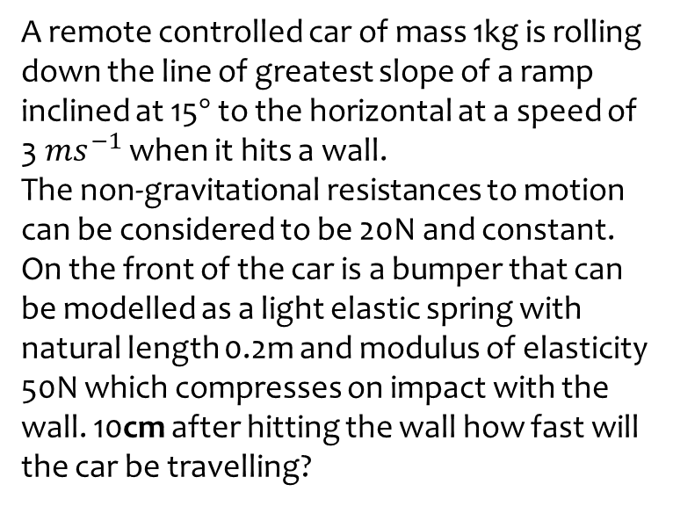
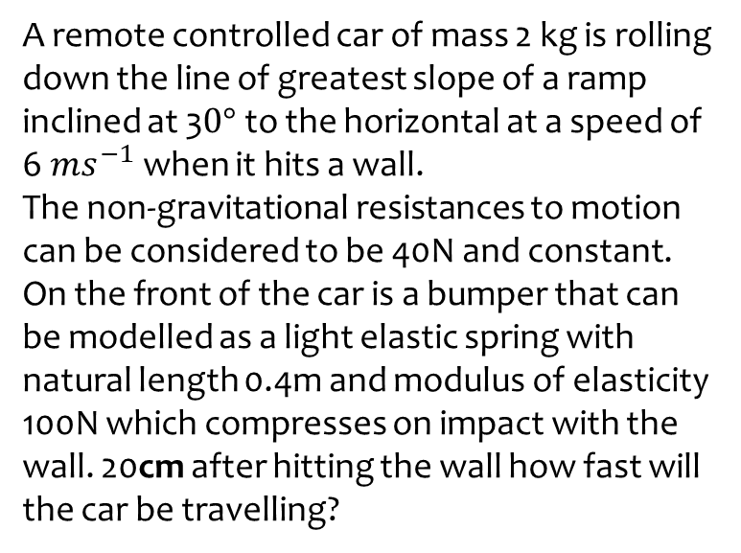

Worked example
Your turn
A remote controlled car of mass 2 kg is rolling down the line of greatest slope of a ramp inclined at 3$0°$ to the horizontal at a speed of 6$ms^{−1}$ when it hits a wall.
The non-gravitational resistances to motion can be considered to be 40N and constant.
On the front of the car is a bumper that can be modelled as a light elastic spring with natural length 0.4m and modulus of elasticity 100N which compresses on impact with the wall. 20cm after hitting the wall how fast will the car be travelling?
A remote controlled car of mass 1kg is rolling down the line of greatest slope of a ramp inclined at 15$°$ to the horizontal at a speed of 3$ms^{−1}$ when it hits a wall.
The non-gravitational resistances to motion can be considered to be 20N and constant.
On the front of the car is a bumper that can be modelled as a light elastic spring with natural length 0.2m and modulus of elasticity 50N which compresses on impact with the wall. 10cm after hitting the wall how fast will the car be travelling?
$1.73 ms^{−1}$ (3 sf)

