Slide 1
2.6) Modelling with quadratics

Slide 2
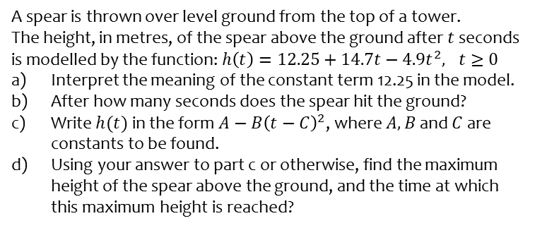
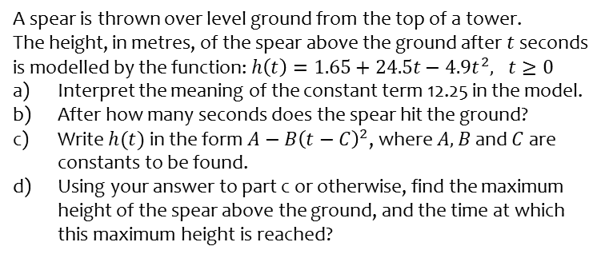
Worked example
Your turn
A spear is thrown over level ground from the top of a tower.
The height, in metres, of the spear above the ground after $t$ seconds is modelled by the function: $h\left(t\right)=1.65+24.5t−4.9t^{2}, t≥0$
Interpret the meaning of the constant term 12.25 in the model.
After how many seconds does the spear hit the ground?
Write $h(t)$ in the form $A−B{\left(t−C\right)}^{2}$, where $A, B$ and $C$ are constants to be found.
Using your answer to part c or otherwise, find the maximum height of the spear above the ground, and the time at which this maximum height is reached?
A spear is thrown over level ground from the top of a tower.
The height, in metres, of the spear above the ground after $t$ seconds is modelled by the function: $h\left(t\right)=12.25+14.7t−4.9t^{2}, t≥0$
Interpret the meaning of the constant term 12.25 in the model.
After how many seconds does the spear hit the ground?
Write $h(t)$ in the form $A−B{\left(t−C\right)}^{2}$, where $A, B$ and $C$ are constants to be found.
Using your answer to part c or otherwise, find the maximum height of the spear above the ground, and the time at which this maximum height is reached?
a) The height of the tower is $12.25 m$
b) $3.68$ seconds (3 sf)
c) $h\left(t\right)=23.275−4.9{\left(t−1.5\right)}^{2}$
d) Maximum height $=23.275 m$ at $t=1.5$ s

