Slide 1
2.5) The discriminant

Slide 2

Worked example
Your turn
How many distinct real solutions do these equations have?
$$x^{2}+6x+8=0$$
$$x^{2}+6x+9=0$$
$$x^{2}+6x+10=0$$
How many distinct real solutions do these equations have?
$$x^{2}+8x+12=0$$
$$x^{2}+8x+16=0$$
$$x^{2}+8x+17=0$$
$$2$$
$1$ (equal roots)
$$0$$

Slide 3
Worked example
Your turn
Find the value of the discriminant:
$$x^{2}+5x+6=0$$
$$x^{2}−5x+6.25=0$$
$$x^{2}−5x+7=0$$
Find the value of the discriminant:
$$x^{2}+3x+2=0$$
$$x^{2}−3x+2.25=0$$
$$x^{2}−3x+4=0$$
$$1$$
$$0$$
$$−7$$

Slide 4
Worked example
Your turn
Find the value of the discriminant:
$$6x^{2}−3x−2=0$$
$$3x^{2}−2x−6=0$$
Find the value of the discriminant:
$$2x^{2}−6x−3=0$$
$$60$$

Slide 5

Worked example
Your turn
Find the value of the discriminant:
$$4+3x−x^{2}$$
$$4−3x−2x^{2}$$
$$4−x^{2}$$
Find the value of the discriminant:
$$9−5x−x^{2}$$
$$9−5x−3x^{2}$$
$$9−x^{2}$$
$$61$$
$$133$$
$$36$$

Slide 6
Worked example
Your turn
Find the range of values of $k$ for which $f\left(x\right)=x^{2}+kx+25$ has equal roots
Find the range of values of $k$ for which $f\left(x\right)=x^{2}+kx+9$ has equal roots
$$k=±6$$

Slide 7
Worked example
Your turn
Find the range of values of $k$ for which $x^{2}+6x+k=0$ has two distinct real solutions
Find the range of values of $k$ for which $x^{2}+4x+k=0$ has two distinct real solutions
$$k<4$$

Slide 8
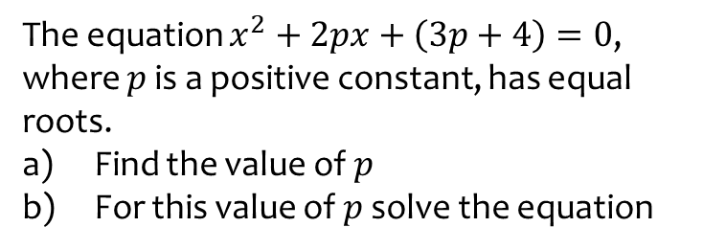
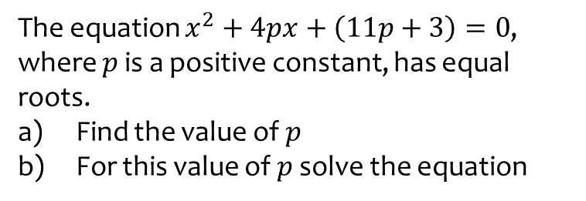
Worked example
Your turn
The equation $x^{2}+4px+\left(11p+3\right)=0$, where $p$ is a positive constant, has equal roots.
Find the value of $p$
For this value of $p$ solve the equation
The equation $x^{2}+2px+\left(3p+4\right)=0$, where $p$ is a positive constant, has equal roots.
Find the value of $p$
For this value of $p$ solve the equation
a) $p=4$
b) $x=−4$

Slide 9
Worked example
Your turn
$$x^{2}+3kx+\left(6k+12\right)=0$$
where $k$ is a negative constant.
Given that this equation has equal roots, determine the value of $k$.
$$x^{2}+5kx+\left(10k+5\right)=0$$
where $k$ is a negative constant.
Given that this equation has equal roots, determine the value of $k$.
$$k=−\frac{2}{5}$$

Slide 10
Worked example
Your turn
Find the range of values of $k$ for which $5x^{2}−3x+k=0$ has no real solutions.
Find the range of values of $k$ for which $3x^{2}−5x+k=0$ has no real solutions.
$$k>\frac{25}{12}$$

Slide 11
Worked example
Your turn
Prove that the function
$$f\left(x\right)=4x^{2}+\left(k+8\right)x−k$$
has two distinct real roots for all values of $k$
Prove that the function
$$f\left(x\right)=3x^{2}+\left(k+6\right)x+k$$
has two distinct real roots for all values of $k$
Proof

