Slide 1
2.7) Solving modulus problems

Slide 2
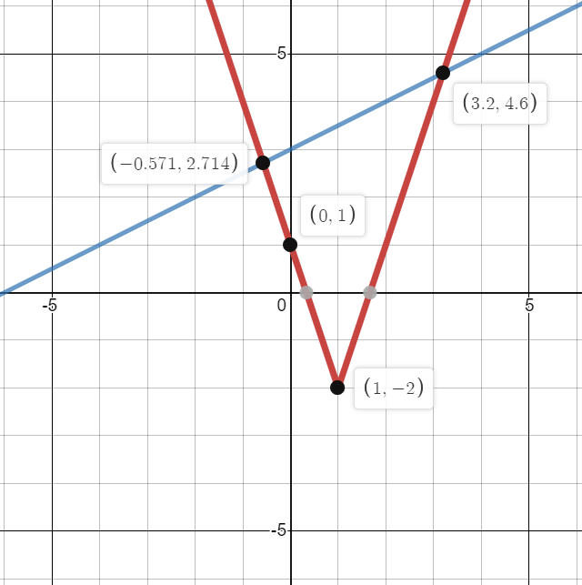
Worked example
Your turn
$$f\left(x\right)=2\left|x+1\right|−3, x∈ℝ$$
Sketch the graph of $y=f\left(x\right)$
State the range of $f$.
Solve the equation $f\left(x\right)=\frac{1}{3}x+2$
$$p\left(x\right)=3\left|x−1\right|−2, x∈ℝ$$
Sketch the graph of $y=p\left(x\right)$
State the range of $p$.
Solve the equation $p\left(x\right)=\frac{1}{2}x+3$
Sketch
$p\left(x\right)≥−2$
$x=−\frac{4}{7}, x=\frac{16}{5}$
Graphs used with permission from DESMOS: https://www.desmos.com/

Slide 3
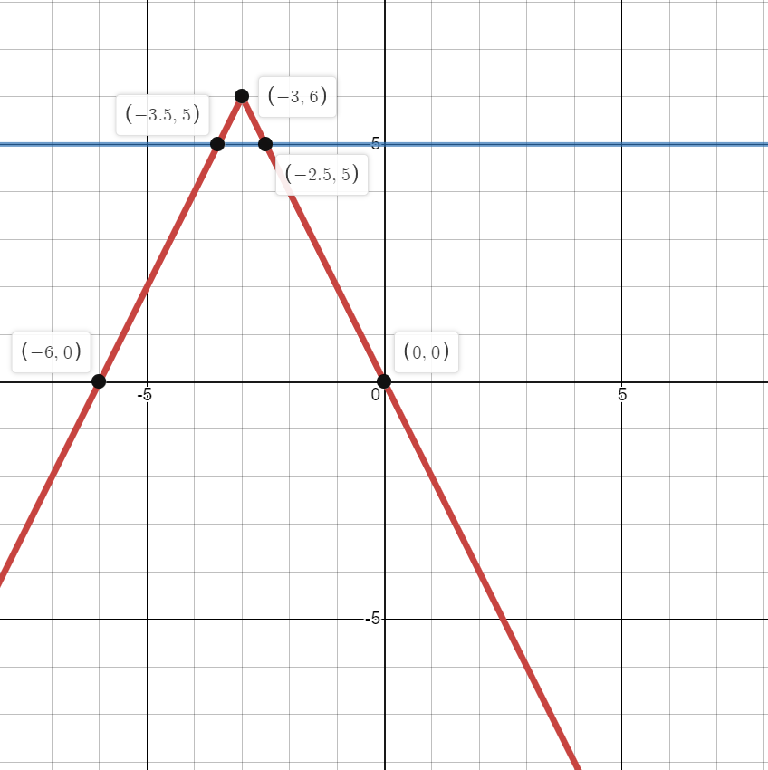
Worked example
Your turn
$$f\left(x\right)=6−2|x+3|, x∈ℝ$$
Sketch the graph of $y=f\left(x\right)$
State the range of $f$.
Solve the inequality $f\left(x\right)>5$
$$p\left(x\right)=6−2|x+3|, x∈ℝ$$
Sketch the graph of $y=p\left(x\right)$
State the range of $p$.
Solve the inequality $p\left(x\right)>5$
Sketch
$p\left(x\right)≤6$
$−\frac{7}{2}<x<−\frac{5}{2}$
Graphs used with permission from DESMOS: https://www.desmos.com/

Slide 4
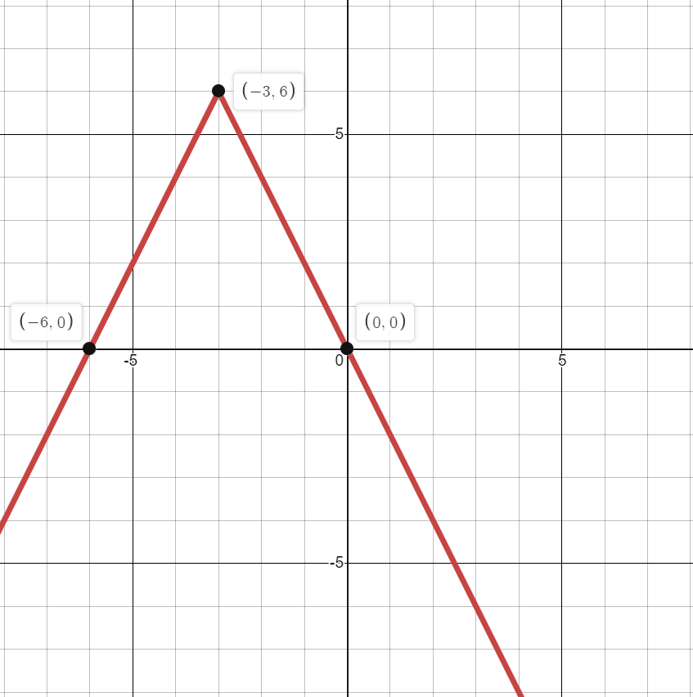
Worked example
Your turn
$$f\left(x\right)=6+3|x−2|, x∈ℝ$$
State the range of values of $k$ for which $f\left(x\right)=k$has:
no solutions
exactly one solution
two distinct solutions
$$h\left(x\right)=6−2|x+3|, x∈ℝ$$
State the range of values of $k$ for which $f\left(x\right)=k$has:
no solutions
exactly one solution
two distinct solutions
a) $k>6$
b) $k=6$
c) $k<6$
Graphs used with permission from DESMOS: https://www.desmos.com/

