Slide 1
2.4) Quadratic graphs

Slide 2
Worked example
Your turn
Write down the line of symmetry of:
$$y=x^{2}+4x−5$$
$$y=x^{2}−6x+10$$
Write down the line of symmetry of:
$$y=x^{2}+8x−17$$
$$x=−4$$

Slide 3
Worked example
Your turn
Write down the line of symmetry of:
$$y=12x−2x^{2}−5$$
$$y=12x−3x^{2}+5$$
Write down the line of symmetry of:
$$y=4x−2x^{2}−3$$
$$x=1$$

Slide 4
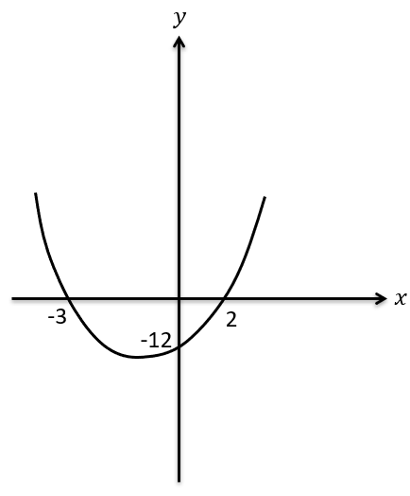
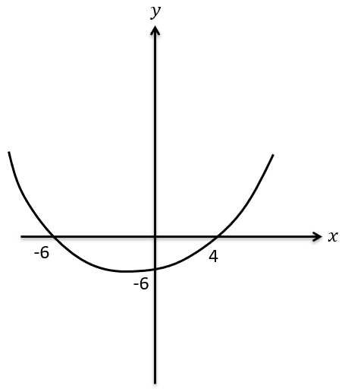
Worked example
Your turn
Determine the equation of this quadratic graph, in the form $y=ax^{2}+bx+c$.
Determine the equation of this quadratic graph, in the form $y=ax^{2}+bx+c$.
$$y=2x^{2}+2x−12$$

Slide 5
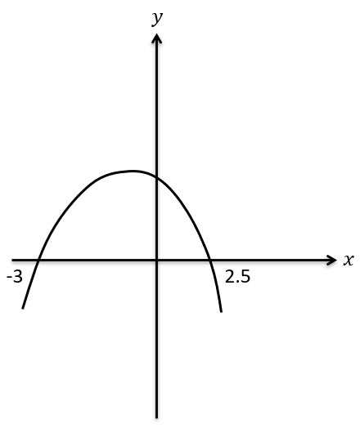
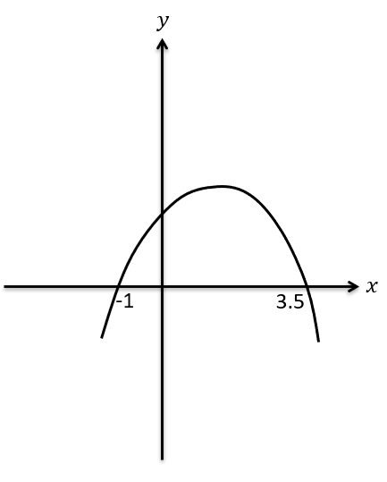
Worked example
Your turn
Determine the equation of this quadratic graph, in the form $y=ax^{2}+bx+c$, where $a,b,c$ are integers.
Determine the equation of this quadratic graph, in the form $y=ax^{2}+bx+c$, where $a,b,c$ are integers.
$$y=−2x^{2}+5x+7$$

Slide 6
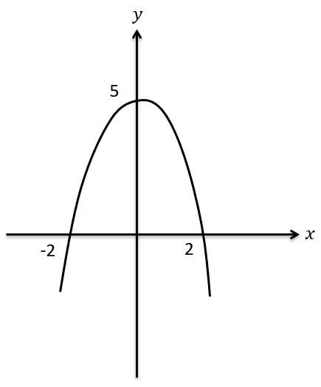
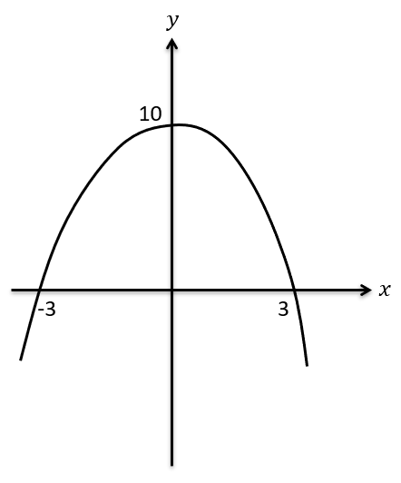
Worked example
Your turn
Determine the equation of this quadratic graph, in the form $y=ax^{2}+bx+c$, where $a,b,c$ are integers.
Determine the equation of this quadratic graph, in the form $y=ax^{2}+bx+c$, where $a,b,c$ are integers.
$$y=\frac{10}{9}(x+3)(3−x)$$

Slide 7
Worked example
Your turn
The graph of $y=ax^{2}+bx+c$ has a minimum at $(3, −5)$ and passes through $(4, 0)$. Find the values of $a, b$ and $c$
The graph of $y=ax^{2}+bx+c$ has a minimum at $(7, −2)$ and passes through $(8, 0)$. Find the values of $a, b$ and $c$
$$a=2, b=−28, c=96$$

Slide 8
Worked example
Your turn
Find the coordinates of the turning point of:
$$y=x^{2}+6x−5$$
$${y=x}^{2}−8x+3$$
Find the coordinates of the turning point of:
$$y=x^{2}+8x−2$$
$$(−4, −18)$$

Slide 9
Worked example
Your turn
Find the coordinates of the turning point of:
$$y={2x}^{2}+6x−5$$
$${y=2x}^{2}−8x+3$$
Find the coordinates of the turning point of:
$$y=2x^{2}+10x−3$$
$$(−\frac{5}{2}, −\frac{31}{2})$$

Slide 10
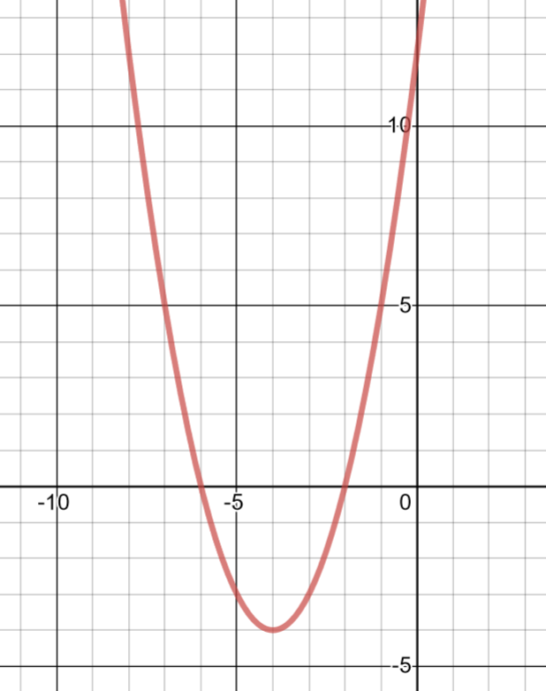
Worked example
Your turn
Sketch $y=x^{2}+6x+8$, labelling the intercepts with the axes and the turning points.
Sketch $y=x^{2}+8x+12$, labelling the intercepts with the axes and the turning points.
$$−6$$
$$−2$$
$$(−4, −4)$$
Graph used with permission from DESMOS: https://www.desmos.com/

Slide 11
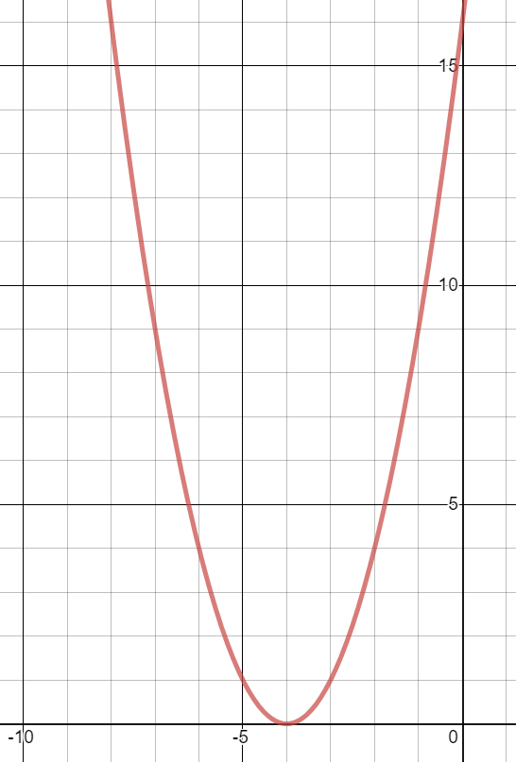
Worked example
Your turn
Sketch $y=x^{2}+6x+9$, labelling the intercepts with the axes and the turning points.
Sketch $y=x^{2}+8x+16$, labelling the intercepts with the axes and the turning points.
Graph used with permission from DESMOS: https://www.desmos.com/

Slide 12
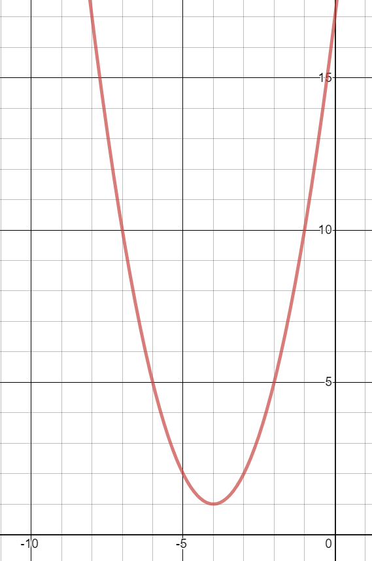
Worked example
Your turn
Sketch $y=x^{2}+6x+10$, labelling the intercepts with the axes and the turning points.
Sketch $y=x^{2}+8x+17$, labelling the intercepts with the axes and the turning points.
Graph used with permission from DESMOS: https://www.desmos.com/

Slide 13
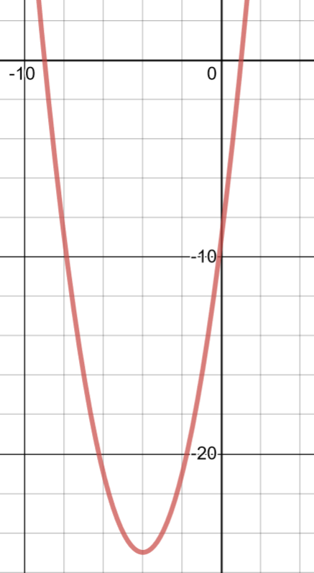
Worked example
Your turn
Sketch $y=x^{2}+6x−7$, labelling the intercepts with the axes and the turning points.
Sketch $y=x^{2}+8x−9$, labelling the intercepts with the axes and the turning points.
$$−9$$
$$1$$
$$(−4, −25)$$
Graph used with permission from DESMOS: https://www.desmos.com/

Slide 14
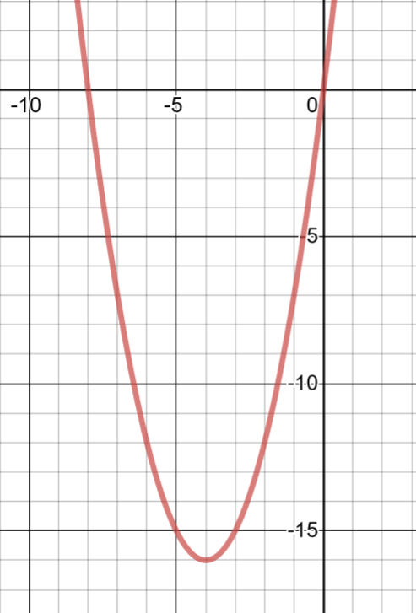
Worked example
Your turn
Sketch $y=x^{2}+6x$, labelling the intercepts with the axes and the turning points.
Sketch $y=x^{2}+8x$, labelling the intercepts with the axes and the turning points.
$$−8$$
$$(−4, −16)$$
Graph used with permission from DESMOS: https://www.desmos.com/

Slide 15
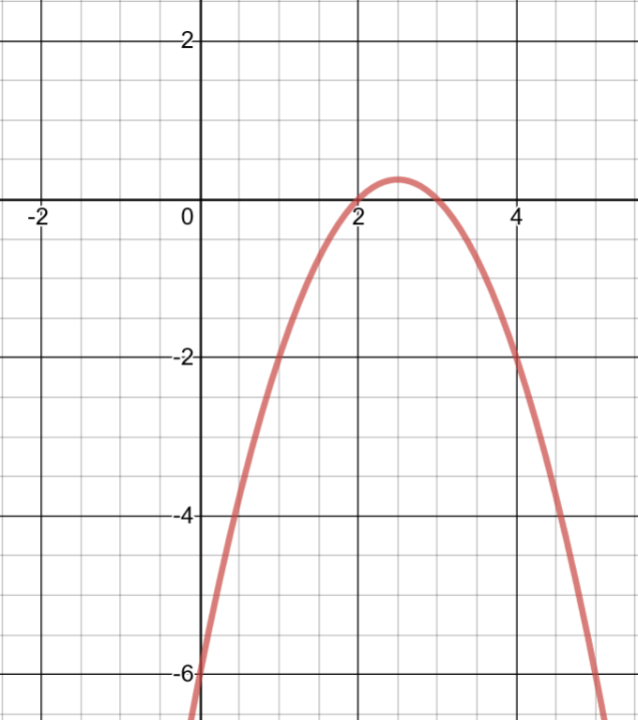
Worked example
Your turn
Sketch $y=−x^{2}+3x−2$, labelling the intercepts with the axes and the turning points.
Sketch $y=−x^{2}+5x−6$, labelling the intercepts with the axes and the turning points.
$$(\frac{5}{2},\frac{1}{4})$$
$$3$$
Graph used with permission from DESMOS: https://www.desmos.com/

Slide 16
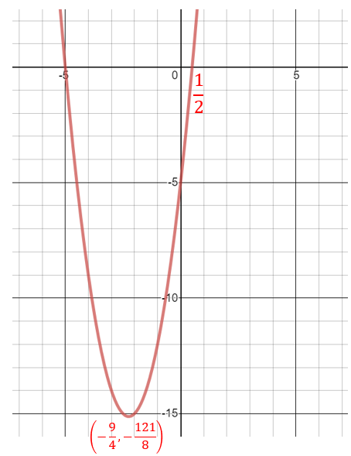
Worked example
Your turn
Sketch $y={2x}^{2}+5x−3$, labelling the intercepts with the axes and the turning points.
Sketch$y={2x}^{2}+9x−5$, labelling the intercepts with the axes and the turning points.
Graph used with permission from DESMOS: https://www.desmos.com/

