Slide 1
2.6) Combining transformations

Slide 2
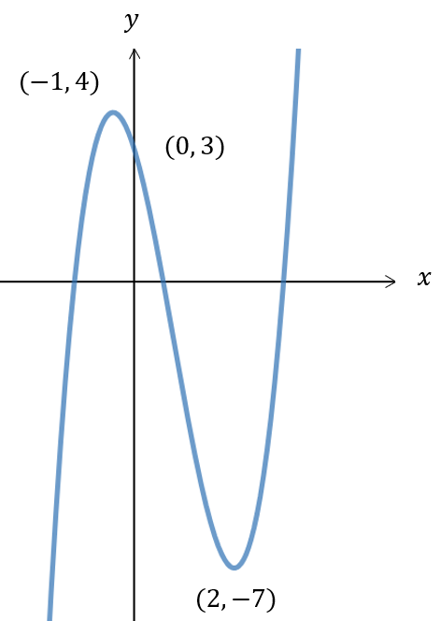
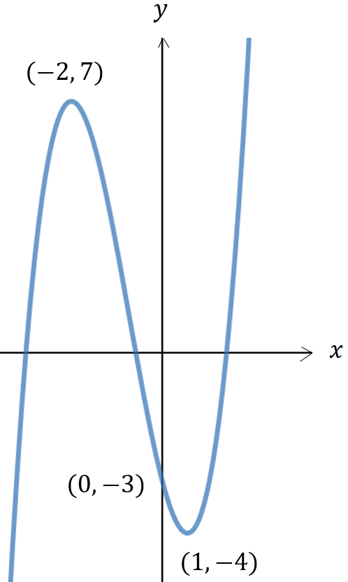
Worked example
Your turn
A sketch of the graph $y=f(x)$ is shown:
Sketch the graph of $y=f\left(x\right)−2$
A sketch of the graph $y=f(x)$ is shown:
Sketch the graph of $y=f\left(x\right)+3$
Correct sketch
New $y$-intercept: $(0, 0)$
New turning points: $(−2, 10)$ and $(1, −1)$

Slide 3

Worked example
Your turn
A sketch of the graph $y=f(x)$ is shown:
Sketch the graph of $y=f\left(x−2\right)$
A sketch of the graph $y=f(x)$ is shown:
Sketch the graph of $y=f\left(x+3\right)$
Correct sketch
New turning points: $(−5, 7)$ and $(−2, −4)$

Slide 4
Worked example
Your turn
A sketch of the graph $y=f(x)$ is shown:
Sketch the graph of $y=3f\left(x\right)$
A sketch of the graph $y=f(x)$ is shown:
Sketch the graph of $y=2f\left(x\right)$
Correct sketch
New $y$-intercept: $(0, −6)$
New turning points: $(−2, 14)$ and $(1, −8)$

Slide 5
Worked example
Your turn
A sketch of the graph $y=f(x)$ is shown:
Sketch the graph of $y=f\left(2x\right)$
A sketch of the graph $y=f(x)$ is shown:
Sketch the graph of $y=f\left(3x\right)$
Correct sketch
New $y$-intercept: $(0, −3)$
New turning points: $(−\frac{2}{3}, 14)$ and $(\frac{1}{3}, −8)$

Slide 6
Worked example
Your turn
A sketch of the graph $y=f(x)$ is shown:
Sketch the graph of $y=−f\left(x\right)$
A sketch of the graph $y=f(x)$ is shown:
Sketch the graph of $y=−f\left(x\right)$
Correct sketch
New $y$-intercept: $(0, 3)$
New turning points: $(−2, −7)$ and $(1, 4)$

Slide 7
Worked example
Your turn
A sketch of the graph $y=f(x)$ is shown:
Sketch the graph of $y=f\left(−x\right)$
A sketch of the graph $y=f(x)$ is shown:
Sketch the graph of $y=f\left(−x\right)$
Correct sketch
New $y$-intercept: $(0, −3)$
New turning points: $(2, −7)$ and $(−1, 4)$

Slide 8


Worked example
Your turn
A sketch of the graph $y=f(x)$ is shown:
Sketch the graph of $y=f\left(x+2\right)+3$
A sketch of the graph $y=f(x)$ is shown:
Sketch the graph of $y=f\left(x−3\right)−2$
Correct sketch
New turning points: $(1, 5)$ and $(4, −6)$

Slide 9


Worked example
Your turn
A sketch of the graph $y=f(x)$ is shown:
Sketch the graph of $y=−f\left(x\right)+3$
A sketch of the graph $y=f(x)$ is shown:
Sketch the graph of $y=−f\left(x\right)−2$
Correct sketch
New $y$-intercept: $(0, 1)$
New turning points: $(−2, −9)$ and $(1, 2)$

Slide 10

Worked example
Your turn
A sketch of the graph $y=f(x)$ is shown:
Sketch the graph of $y=f\left(−x\right)−3$
A sketch of the graph $y=f(x)$ is shown:
Sketch the graph of $y=f\left(−x\right)+2$
Correct sketch
New $y$-intercept: $(0, −1)$
New turning points: $(2, −5)$ and $(−1, 6)$

Slide 11

Worked example
Your turn
A sketch of the graph $y=f(x)$ is shown:
Sketch the graph of $y=3f\left(x\right)+2$
A sketch of the graph $y=f(x)$ is shown:
Sketch the graph of $y=2f\left(x\right)+3$
Correct sketch
New $y$-intercept: $(0, −3)$
New turning points: $(−2, 17)$ and $(1, −5)$

Slide 12

Worked example
Your turn
A sketch of the graph $y=f(x)$ is shown:
Sketch the graph of $y=f\left(2x\right)−3$
A sketch of the graph $y=f(x)$ is shown:
Sketch the graph of $y=f\left(3x\right)−2$
Correct sketch
New $y$-intercept: $(0, −5)$
New turning points: $(−\frac{2}{3}, 5)$ and $(\frac{1}{3}, −6)$

Slide 13

Worked example
Your turn
A sketch of the graph $y=f(x)$ is shown:
Sketch the graph of $y=−f\left(3x\right)+2$
A sketch of the graph $y=f(x)$ is shown:
Sketch the graph of $y=−f\left(2x\right)−3$
Correct sketch
New $y$-intercept: $(0, 0)$
New turning points: $(−1, −10)$ and $(\frac{1}{2}, 1)$

Slide 14

Worked example
Your turn
A sketch of the graph $y=f(x)$ is shown:
Sketch the graph of $y=5f\left(x−2\right)−3$
A sketch of the graph $y=f(x)$ is shown:
Sketch the graph of $y=7f\left(x+3\right)+2$
Correct sketch
New turning points: $(−5, 51)$ and $(−2, −26)$

Slide 15
Worked example
Your turn
A sketch of the graph $y=f(x)$ is shown:
Sketch the graph of $y=−5f\left(x+2\right)+3$
A sketch of the graph $y=f(x)$ is shown:
Sketch the graph of $y=−7f\left(x−3\right)−2$
Correct sketch
New turning points: $(1, −51)$ and $(4, 26)$

Slide 16
Worked example
Your turn
A sketch of the graph $y=f(x)$ is shown:
Sketch the graph of $y=|f\left(x\right)|$
A sketch of the graph $y=f(x)$ is shown:
Sketch the graph of $y=|f\left(x\right)|$
Correct sketch
New $y$-intercept: $(0, 3)$
New turning points: $(−2, 7)$ and $(1, 4)$

Slide 17

Worked example
Your turn
A sketch of the graph $y=f(x)$ is shown:
Sketch the graph of $y=|f\left(−x\right)|$
A sketch of the graph $y=f(x)$ is shown:
Sketch the graph of $y=|f\left(−x\right)|$
Correct sketch
New $y$-intercept: $(0, 3)$
New turning points: $(−1, 4)$ and $(2, 7)$

Slide 18
Worked example
Your turn
A sketch of the graph $y=f(x)$ is shown:
Sketch the graph of $y=f\left(|x|\right)$
A sketch of the graph $y=f(x)$ is shown:
Sketch the graph of $y=f\left(|x|\right)$
Correct sketch
New $y$-intercept: $(0, −3)$
New turning points: $(−1, −4)$ and $(1, −4)$

Slide 19
Worked example
Your turn
A sketch of the graph $y=f(x)$ is shown:
Sketch the graph of $y=−f\left(|x|\right)$
A sketch of the graph $y=f(x)$ is shown:
Sketch the graph of $y=−f\left(|x|\right)$
Correct sketch
New $y$-intercept: $(0, 3)$
New turning points: $\left(−1, 4\right)$and $(1, 4)$

