Slide 1
2.5) Coding

Slide 2
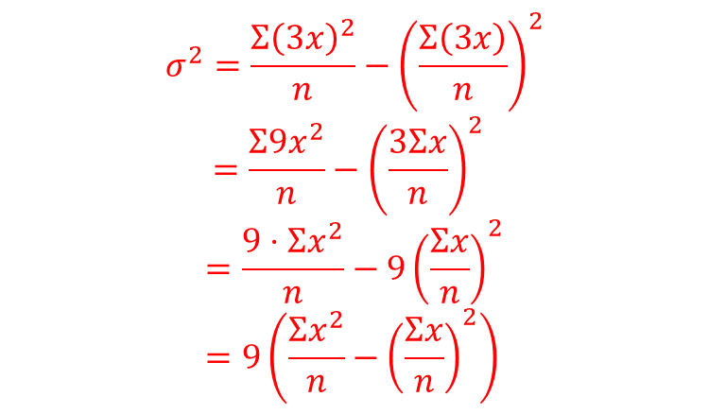
Worked example
Your turn
Prove that if all values of $x$ are multiplied by $5$, the variance increases by a scale factor of $25$
Prove that if all values of $x$ are multiplied by $3$, the variance increases by a scale factor of $9$
$$σ^{2}=\frac{Σ{\left(3x\right)}^{2}}{n}−{\left(\frac{Σ\left(3x\right)}{n}\right)}^{2} \\ =\frac{Σ9x^{2}}{n}−{\left(\frac{3Σx}{n}\right)}^{2}$$
$$=\frac{9⋅Σx^{2}}{n}−9{\left(\frac{Σx}{n}\right)}^{2} \\ =9\left(\frac{Σx^{2}}{n}−{\left(\frac{Σx}{n}\right)}^{2}\right)$$

Slide 3
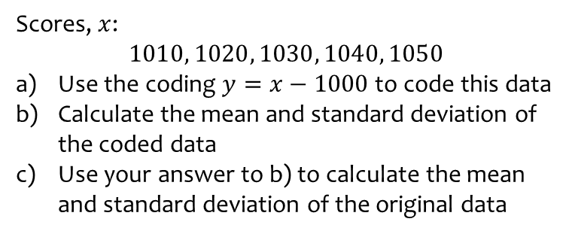
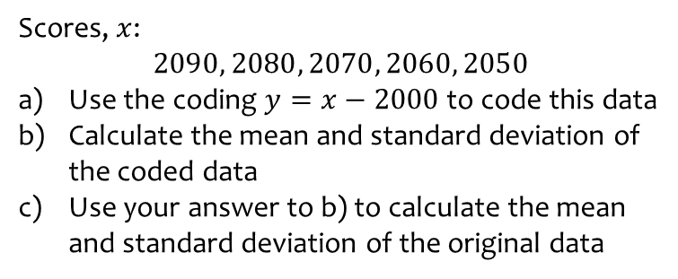
Worked example
Your turn
Scores, $x$:
$$2090, 2080, 2070, 2060, 2050$$
Use the coding $y=x−2000$ to code this data
Calculate the mean and standard deviation of the coded data
Use your answer to b) to calculate the mean and standard deviation of the original data
Scores, $x$:
$$1010, 1020, 1030, 1040, 1050$$
Use the coding $y=x−1000$ to code this data
Calculate the mean and standard deviation of the coded data
Use your answer to b) to calculate the mean and standard deviation of the original data
a) $y:10, 20, 30, 40, 50$
b) $\overline{y}=30$ , $σ_{y}=14.1$ (3 sf)
c) $\overline{x}=1030$ , $σ_{x}=14.1$ (3 sf)

Slide 4
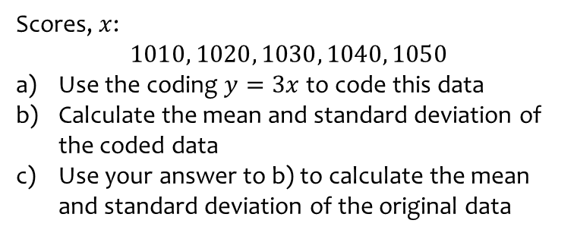
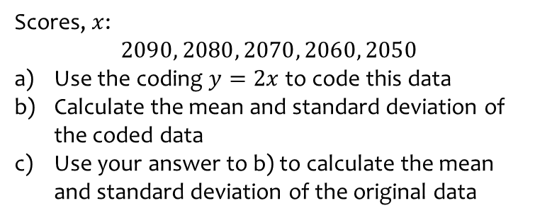
Worked example
Your turn
Scores, $x$:
$$2090, 2080, 2070, 2060, 2050$$
Use the coding $y=2x$ to code this data
Calculate the mean and standard deviation of the coded data
Use your answer to b) to calculate the mean and standard deviation of the original data
Scores, $x$:
$$1010, 1020, 1030, 1040, 1050$$
Use the coding $y=3x$ to code this data
Calculate the mean and standard deviation of the coded data
Use your answer to b) to calculate the mean and standard deviation of the original data
a) $y:3030, 3060, 3090, 3120, 3150$
b) $\overline{y}=3090$ , $σ_{y}=42.4$ (3 sf)
c) $\overline{x}=1030$ , $σ_{x}=14.1$ (3 sf)

Slide 5
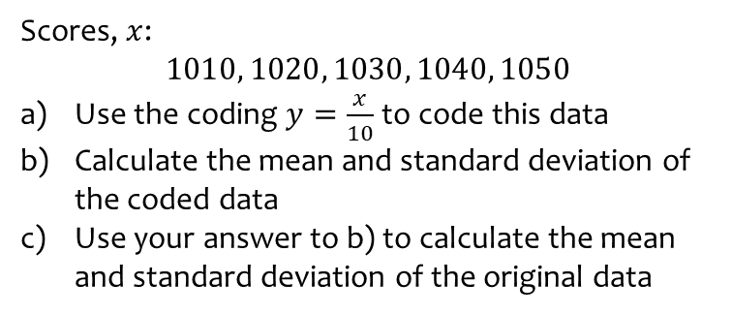
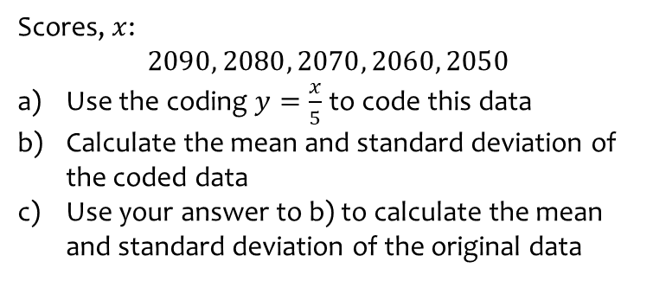
Worked example
Your turn
Scores, $x$:
$$2090, 2080, 2070, 2060, 2050$$
Use the coding $y=\frac{x}{5}$ to code this data
Calculate the mean and standard deviation of the coded data
Use your answer to b) to calculate the mean and standard deviation of the original data
Scores, $x$:
$$1010, 1020, 1030, 1040, 1050$$
Use the coding $y=\frac{x}{10}$ to code this data
Calculate the mean and standard deviation of the coded data
Use your answer to b) to calculate the mean and standard deviation of the original data
a) $y:101, 102, 103, 104, 105$
b) $\overline{y}=103$ , $σ_{y}=1.41$ (3 sf)
c) $\overline{x}=1030$ , $σ_{x}=14.1$ (3 sf)

Slide 6
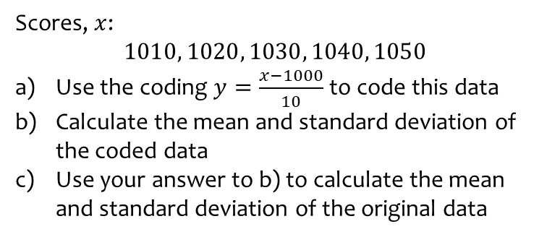
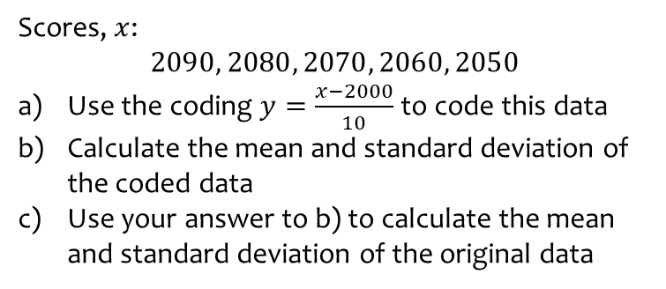
Worked example
Your turn
Scores, $x$:
$$2090, 2080, 2070, 2060, 2050$$
Use the coding $y=\frac{x−2000}{10}$ to code this data
Calculate the mean and standard deviation of the coded data
Use your answer to b) to calculate the mean and standard deviation of the original data
Scores, $x$:
$$1010, 1020, 1030, 1040, 1050$$
Use the coding $y=\frac{x−1000}{10}$ to code this data
Calculate the mean and standard deviation of the coded data
Use your answer to b) to calculate the mean and standard deviation of the original data
a) $y:1, 2, 3, 4, 5$
b) $\overline{y}=3$ , $σ_{y}=1.41$ (3 sf)
c) $\overline{x}=1030$ , $σ_{x}=14.1$ (3 sf)

Slide 7
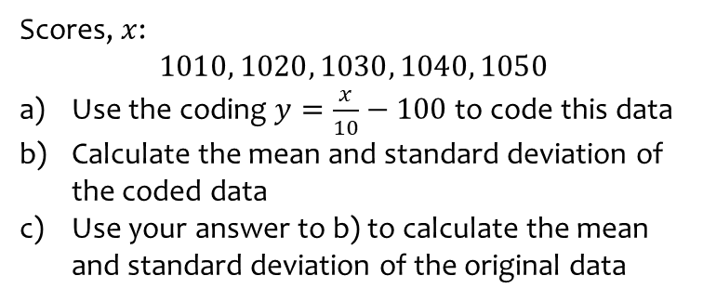
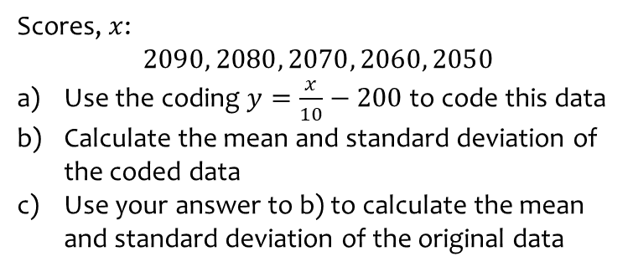
Worked example
Your turn
Scores, $x$:
$$2090, 2080, 2070, 2060, 2050$$
Use the coding $y=\frac{x}{10}−200$ to code this data
Calculate the mean and standard deviation of the coded data
Use your answer to b) to calculate the mean and standard deviation of the original data
Scores, $x$:
$$1010, 1020, 1030, 1040, 1050$$
Use the coding $y=\frac{x}{10}−100$ to code this data
Calculate the mean and standard deviation of the coded data
Use your answer to b) to calculate the mean and standard deviation of the original data
a) $y:1, 2, 3, 4, 5$
b) $\overline{y}=3$ , $σ_{y}=1.41$ (3 sf)
c) $\overline{x}=1030$ , $σ_{x}=14.1$ (3 sf)

Slide 8
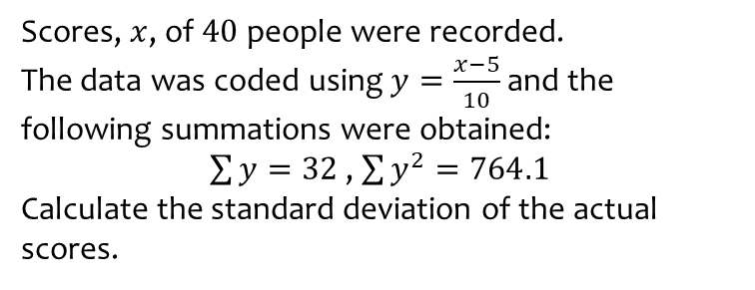
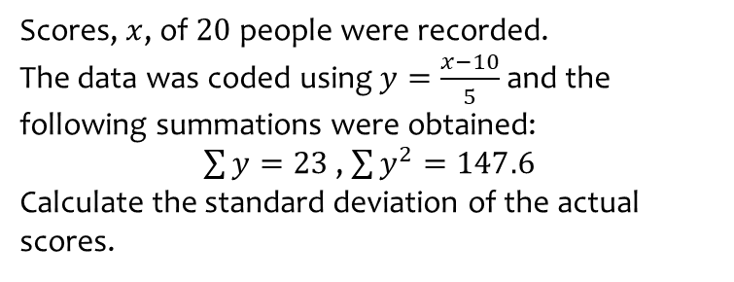
Worked example
Your turn
Scores, $x$, of $20$ people were recorded.
The data was coded using $y=\frac{x−10}{5}$and the following summations were obtained:
$\sum{y}=23$ , $\sum{y^{2}}=147.6$
Calculate the standard deviation of the actual scores.
Scores, $x$, of $40$ people were recorded.
The data was coded using $y=\frac{x−5}{10}$and the following summations were obtained:
$\sum{y}=32$ , $\sum{y^{2}}=764.1$
Calculate the standard deviation of the actual scores.
$σ_{x}=42.97$ (2 dp)

Slide 9
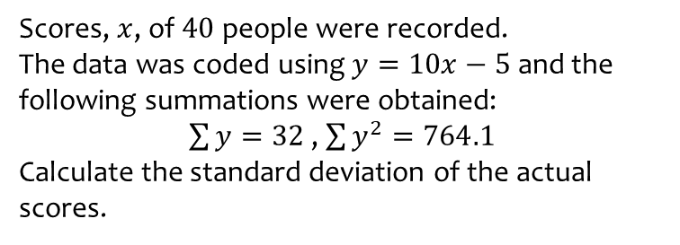
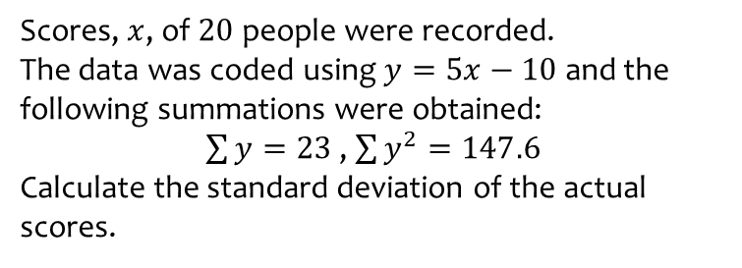
Worked example
Your turn
Scores, $x$, of $20$ people were recorded.
The data was coded using $y=5x−10$ and the following summations were obtained:
$\sum{y}=23$ , $\sum{y^{2}}=147.6$
Calculate the standard deviation of the actual scores.
Scores, $x$, of $40$ people were recorded.
The data was coded using $y=10x−5$ and the following summations were obtained:
$\sum{y}=32$ , $\sum{y^{2}}=764.1$
Calculate the standard deviation of the actual scores.
$σ_{x}=0.4297$ (4 dp)

Slide 10
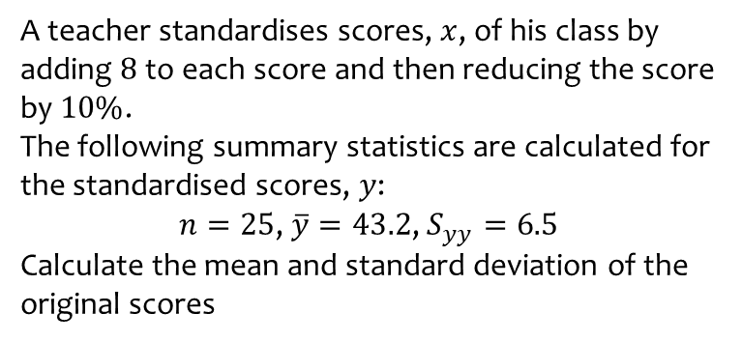
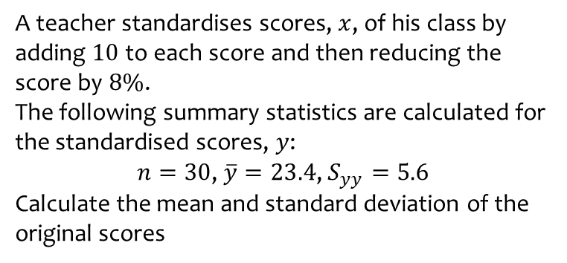
Worked example
Your turn
A teacher standardises scores, $x$, of his class by adding $10$ to each score and then reducing the score by $8\%$.
The following summary statistics are calculated for the standardised scores, $y$:
$n=30$, $\overline{y}=23.4$, $S_{yy}=5.6$
Calculate the mean and standard deviation of the original scores
A teacher standardises scores, $x$, of his class by adding $8$ to each score and then reducing the score by $10\%$.
The following summary statistics are calculated for the standardised scores, $y$:
$n=25$, $\overline{y}=43.2$, $S_{yy}=6.5$
Calculate the mean and standard deviation of the original scores
Mean $=\overline{x}=40$
Standard deviation $=σ_{x}=0.567$ (3 sf)

Slide 11
Worked example
Your turn
A person was recording times, $x$, in a race.
They then realised the stopwatch was slow and all times were actually 3 minutes more than the recorded times.
Explain the effect on:
The mean
The standard deviation
The median
The range
The lower quartile
The interquartile range
A person was recording times, $x$, in a race.
They then realised the stopwatch was slow and all times were actually 5 minutes less than the recorded times.
Explain the effect on:
The mean
The standard deviation
The median
The range
The lower quartile
The interquartile range
Decreases by 5
No effect
Decreases by 5
No effect
Decreases by 5
No effect

