Slide 1
2.4) Variance and standard deviation

Slide 2
Worked example
Your turn
Calculate the variance and standard deviation:
$$2, 3, 4, 5, 6$$
Calculate the variance and standard deviation:
$$2, 3, 4, 5, 7$$
Variance $=σ^{2}=2.96$
Standard deviation $=σ=1.72$ (3 sf)

Slide 3
Worked example
Your turn
Calculate the variance and standard deviation:
$$2, 3, 4, 5, 6$$
Calculate the variance and standard deviation:
$$4, 6, 8, 10, 12$$
Variance $=σ^{2}=8$
Standard deviation $=σ=2.83$ (3 sf)

Slide 4
Worked example
Your turn
Calculate the variance and standard deviation:
$$2, 4, 6, 8, 10$$
Calculate the variance and standard deviation:
$$1, 2, 3, 4, 5$$
Variance $=σ^{2}=2$
Standard deviation $=σ=1.41$ (3 sf)

Slide 5
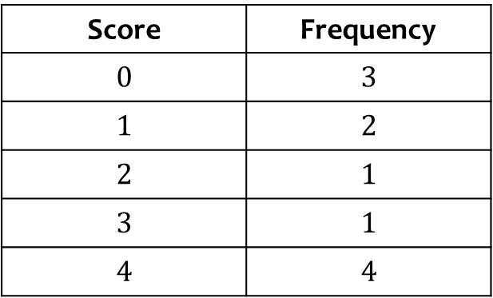
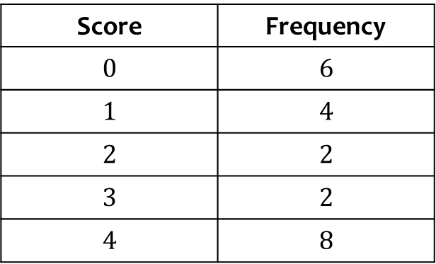
Worked example
Your turn
Calculate the variance and standard deviation:
Calculate the variance and standard deviation:
Score | Frequency
$$0$$ | $$3$$
$$1$$ | $$2$$
$$2$$ | $$1$$
$$3$$ | $$1$$
$$4$$ | $$4$$
Score | Frequency
$$0$$ | $$6$$
$$1$$ | $$4$$
$$2$$ | $$2$$
$$3$$ | $$2$$
$$4$$ | $$8$$
$\text{Variance} =σ^{2}=2.81$ (3 sf)
$$\text{Standard} \text{deviation} =σ=1.68\text{ (3 }\text{sf}\text{)}$$

Slide 6
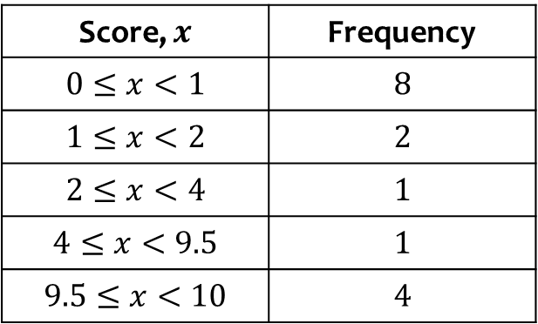
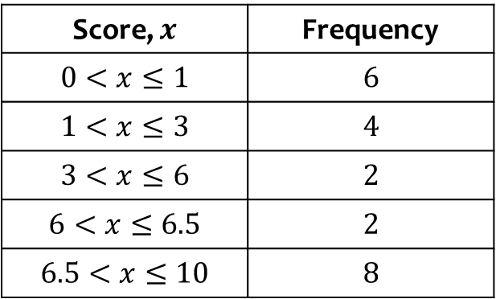
Worked example
Your turn
Estimate the variance and standard deviation:
Estimate the variance and standard deviation:
Score, $x$ | Frequency
$$0≤x<1$$ | $$8$$
$$1≤x<2$$ | $$2$$
$$2≤x<4$$ | $$1$$
$$4≤x<9.5$$ | $$1$$
$$9.5≤x<10$$ | $$4$$
Score, $x$ | Frequency
$$0<x≤1$$ | $$6$$
$$1<x≤3$$ | $$4$$
$$3<x≤6$$ | $$2$$
$$6<x≤6.5$$ | $$2$$
$$6.5<x≤10$$ | $$8$$
$$\text{Variance} =σ_{x}^{2}≈10\text{.9}\text{ (3 }\text{sf}\text{)}$$
$$\text{Standard} \text{deviation} =σ_{x}≈3.30\text{ (3 }\text{sf}\text{)}$$

Slide 7
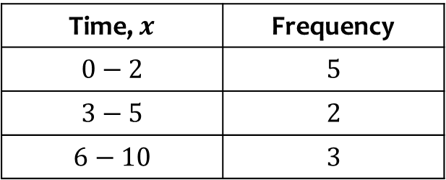
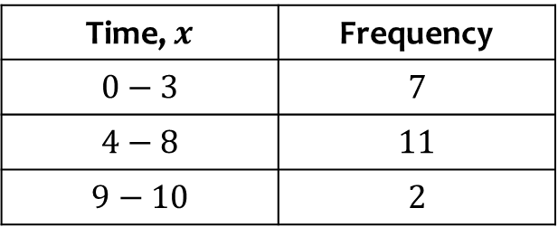
Worked example
Your turn
Times, $x$, have been rounded to the nearest minute. Estimate the variance and standard deviation:
Times, $x$, have been rounded to the nearest minute. Estimate the variance and standard deviation:
Time, $x$ | Frequency
$$0−2$$ | $$5$$
$$3−5$$ | $$2$$
$$6−10$$ | $$3$$
Time, $x$ | Frequency
$$0−3$$ | $$7$$
$$4−8$$ | $$11$$
$$9−10$$ | $$2$$
$$\text{Variance} =σ_{x}^{2}≈5.81\text{ (3 }\text{sf}\text{)}$$
$$\text{Standard} \text{deviation} =σ_{x}≈2.41\text{ (3 }\text{sf}\text{)}$$

Slide 8
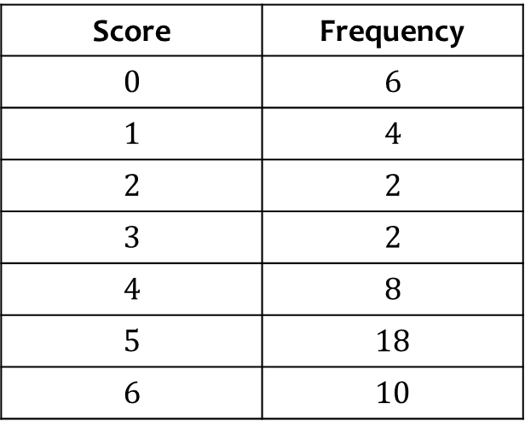
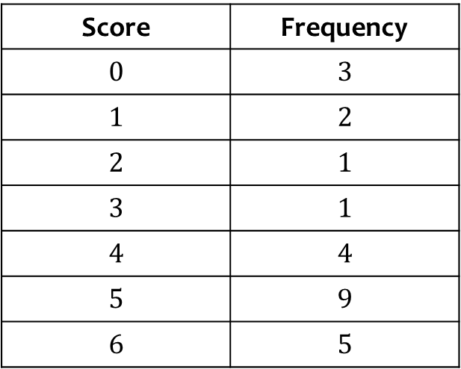
Worked example
Your turn
Work out how many people had a score more than one standard deviation below the mean
Work out how many people had a score more than one standard deviation above the mean
Score | Frequency
$$0$$ | $$3$$
$$1$$ | $$2$$
$$2$$ | $$1$$
$$3$$ | $$1$$
$$4$$ | $$4$$
$$5$$ | $$9$$
$$6$$ | $$5$$
Score | Frequency
$$0$$ | $$6$$
$$1$$ | $$4$$
$$2$$ | $$2$$
$$3$$ | $$2$$
$$4$$ | $$8$$
$$5$$ | $$18$$
$$6$$ | $$10$$
$$10$$

Slide 9
Worked example
Your turn
The scores, $x$, were recorded for 20 people.
The summary data is:
$$S_{xx}=235$$
Calculate the standard deviation
The scores, $x$, were recorded for 40 people.
The summary data is:
$$S_{xx}=532$$
Calculate the standard deviation
$σ_{x}=3.65$ (3 sf)

Slide 10
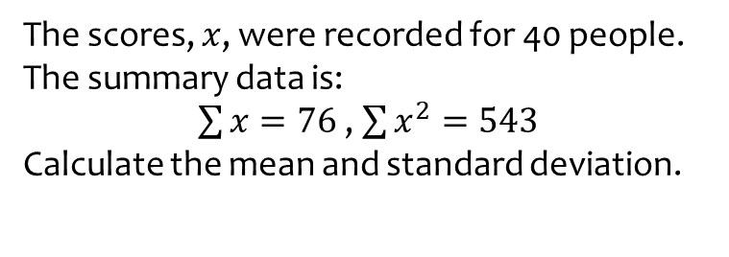
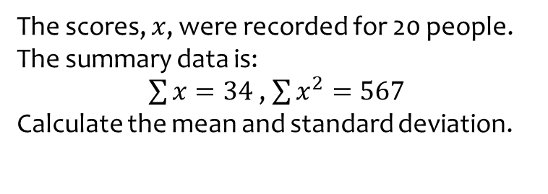
Worked example
Your turn
The scores, $x$, were recorded for 20 people.
The summary data is:
$\sum{x}=34$ , $\sum{x^{2}}=567$
Calculate the mean and standard deviation.
The scores, $x$, were recorded for 40 people.
The summary data is:
$\sum{x}=76$ , $\sum{x^{2}}=543$
Calculate the mean and standard deviation.
Mean $=\overline{x}=1.9$
Standard deviation $=σ_{x}=3.16$ (3 sf)

Slide 11
Worked example
Your turn
The scores, $x$, were recorded for 20 people.
The summary data is:
$\sum{x}=34$ , $\sum{x^{2}}=567$
The highest score was $8.5$.
The lowest score was $0.2$.
Estimate the number of scores which were greater than one standard deviation above the mean.
The scores, $x$, were recorded for 40 people.
The summary data is:
$\sum{x}=76$ , $\sum{x^{2}}=543$
The highest score was $5.8$.
The lowest score was $0.3$.
Estimate the number of scores which were greater than one standard deviation above the mean.
$$5$$

