Slide 1
2.3) Functions

Slide 2


Worked example
Your turn
If $f\left(x\right)=x^{2}+3$, evaluate:
$f\left(4\right)$ $f\left(−2\right)$
If $g\left(x\right)=x^{3}−5$, evaluate:
$g\left(4\right)$ $g\left(−2\right)$
If $h\left(x\right)=x^{2}+4$, evaluate:
$$h\left(5\right)$$
$$h\left(−2\right)$$
$$29$$
$$8$$

Slide 3
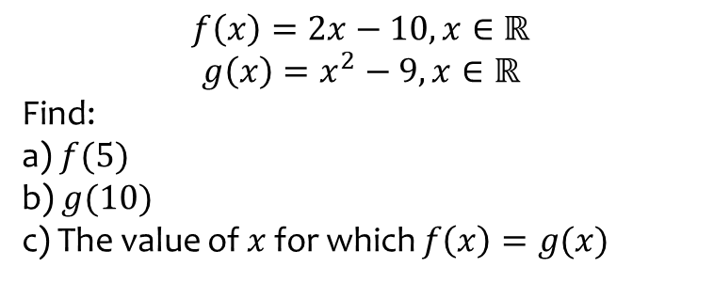
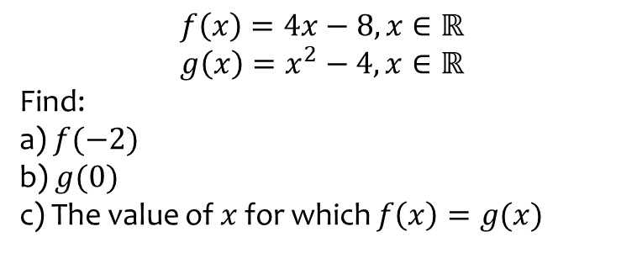
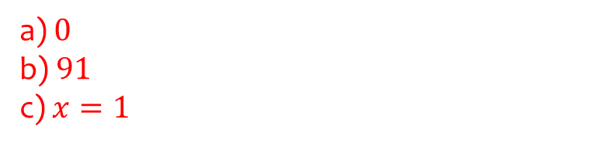
Worked example
Your turn
$$f\left(x\right)=4x−8, x∈ℝ$$
$$g\left(x\right)=x^{2}−4, x∈ℝ$$
Find:
a) $f(−2)$
b) $g(0)$
c) The value of $x$ for which $f\left(x\right)=g(x)$
$$f\left(x\right)=2x−10, x∈ℝ$$
$$g\left(x\right)=x^{2}−9, x∈ℝ$$
Find:
a) $f(5)$
b) $g(10)$
c) The value of $x$ for which $f\left(x\right)=g(x)$
a) $0$
b) $91$
c) $x=1$

Slide 4
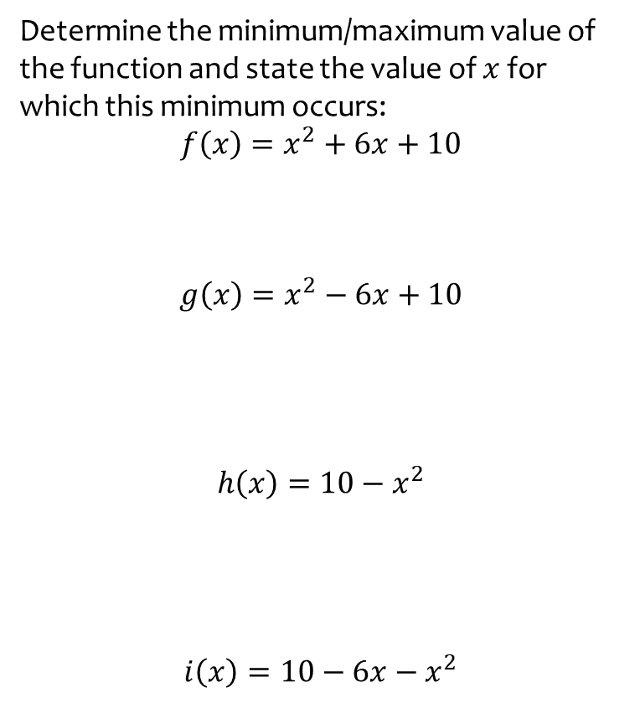
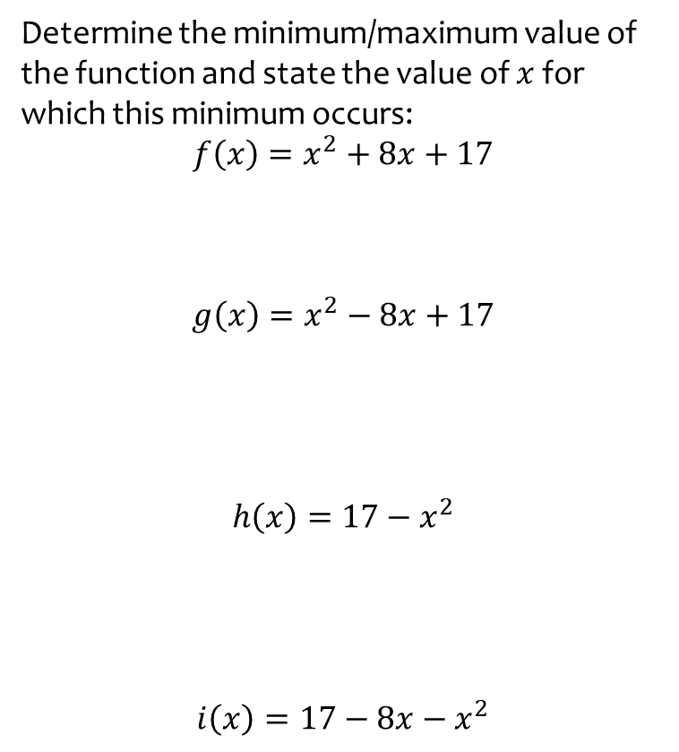

Worked example
Your turn
Determine the minimum/maximum value of the function and state the value of $x$ for which this minimum occurs:
$$f\left(x\right)=x^{2}+8x+17$$
$$g\left(x\right)=x^{2}−8x+17$$
$$h\left(x\right)=17−x^{2}$$
$$i\left(x\right)=17−8x−x^{2}$$
Determine the minimum/maximum value of the function and state the value of $x$ for which this minimum occurs:
$$f\left(x\right)=x^{2}+6x+10$$
$$g\left(x\right)=x^{2}−6x+10$$
$$h\left(x\right)=10−x^{2}$$
$$i\left(x\right)=10−6x−x^{2}$$
Minimum of $19$ when $x=−3$
Minimum of $1$ when $x=3$
Maximum of $10$ when $x=0$
Maximum of $19$ when $x=−3$

Slide 5
Worked example
Your turn
$$f\left(x\right)=4x−8, x∈ℝ$$
$$g\left(x\right)=x^{2}−4, x∈ℝ$$
Find:
a) $f(−2)$
b) $g(0)$
c) The value of $x$ for which $f\left(x\right)=g(x)$
$$f\left(x\right)=2x−10, x∈ℝ$$
$$g\left(x\right)=x^{2}−9, x∈ℝ$$
Find:
a) $f(5)$
b) $g(10)$
c) The value of $x$ for which $f\left(x\right)=g(x)$
a) $0$
b) $91$
c) $x=1$

Slide 6
Worked example
Your turn
$$f\left(x\right)=5x+4$$
Find:
$f\left(x+3\right)$ $f(x−4)$
$f\left(5x\right)$ $f(\frac{1}{6}x)$
$$g\left(x\right)=3x+2$$
Find:
$g\left(x+2\right)$ $g(x−2)$
$g\left(2x\right)$ $g(\frac{1}{2}x)$
$$3x+8$$
$$3x+4$$
$$6x+2$$
$$\frac{3}{2}x+2$$

Slide 7


Worked example
Your turn
$$f\left(x\right)=3x^{2}−2$$
$f\left(x+2\right)$ $f(x−2)$
$f\left(2x\right)$ $f(\frac{1}{2}x)$
$$g\left(x\right)=5x^{2}+3$$
$g\left(x+4\right)$ $f(x−4)$
$g\left(3x\right)$ $g(\frac{1}{3}x)$
$$5{\left(x+4\right)}^{2}+3$$
$$=5x^{2}+40x+83$$
$$5{\left(x−4\right)}^{2}+3$$
$$=5x^{2}−40x+83$$
$$5{(3x)}^{2}+3$$
$$=45x^{2}+3$$
$$5{\left(\frac{1}{3}x\right)}^{2}+3$$
$$=\frac{5}{9}x^{2}+3$$

Slide 8


Worked example
Your turn
$$f\left(x\right)=3x^{2}−5x−2$$
$f\left(x+2\right)$ $f(x−2)$
$f\left(2x\right)$ $f(\frac{1}{2}x)$
$$g\left(x\right)=5x^{2}−2x+3$$
$g\left(x+4\right)$ $f(x−4)$
$g\left(3x\right)$ $g(\frac{1}{3}x)$
$$5{\left(x+4\right)}^{2}−2\left(x+4\right)+3$$
$$=5x^{2}+38x+75$$
$$5{\left(x−4\right)}^{2}−2\left(x−4\right)+3$$
$$=5x^{2}−42x+91$$
$$5{\left(3x\right)}^{2}−2\left(3x\right)+3$$
$$=45x^{2}−6x+3$$
$$5{\left(\frac{1}{3}x\right)}^{2}−2\left(\frac{1}{3}x\right)+3$$
$$=\frac{5}{9}x^{2}−\frac{2}{3}x+3$$

