Slide 1
2.5) $y=|f\left(x\right)|$ and $y=f(\left|x\right|)$

Slide 2
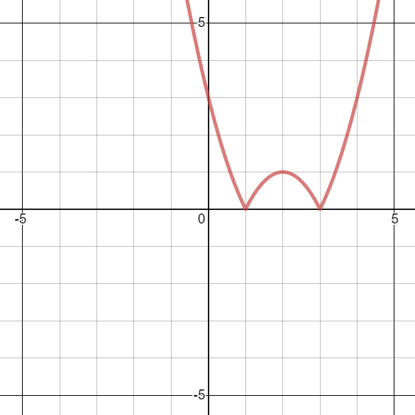
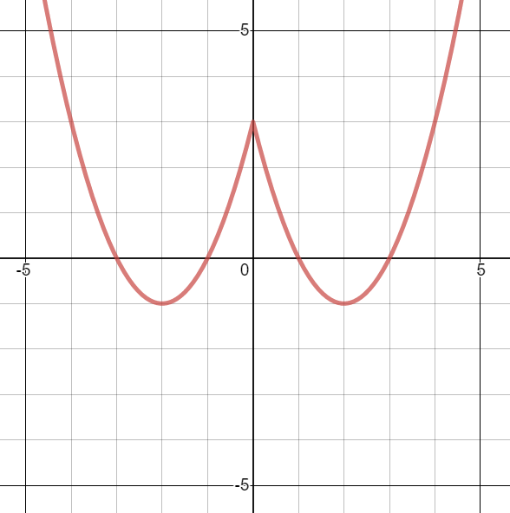


Worked example
Your turn
$$f\left(x\right)=x^{2}+4x+3$$
Sketch:
$y=|f\left(x\right)|$
$y=f(\left|x\right|)$
$f\left(x\right)=x^{2}−4x+$3
Sketch:
$y=|f\left(x\right)|$
$y=f(\left|x\right|)$
Graphs used with permission from DESMOS: https://www.desmos.com/

Slide 3
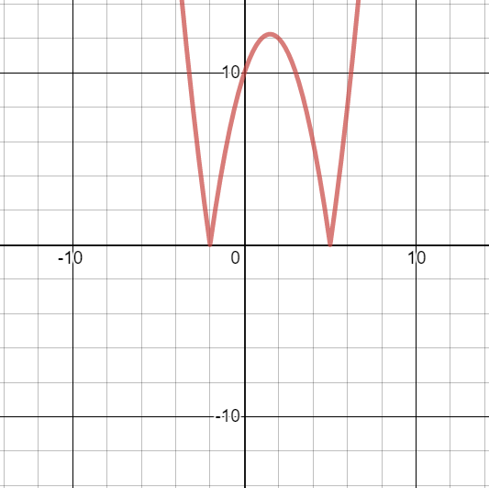
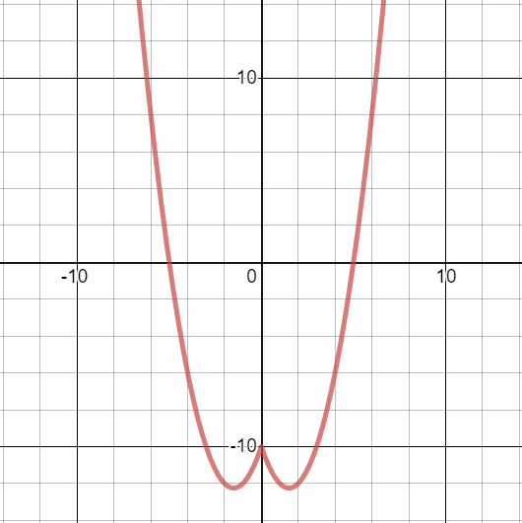


Worked example
Your turn
$$f\left(x\right)=x^{2}+3x−10$$
Sketch:
$y=|f\left(x\right)|$
$y=f(\left|x\right|)$
$$f\left(x\right)=x^{2}−3x−10$$
Sketch:
$y=|f\left(x\right)|$
$y=f(\left|x\right|)$
Graphs used with permission from DESMOS: https://www.desmos.com/

Slide 4
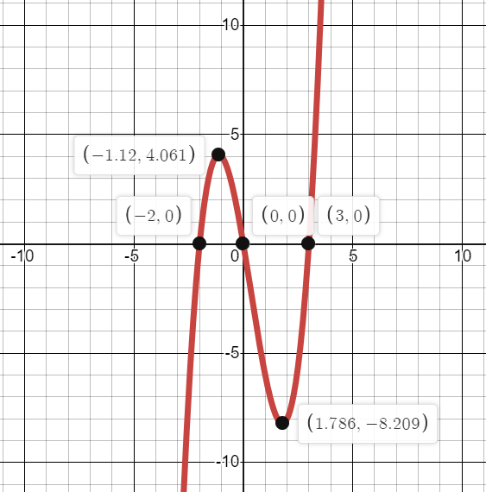
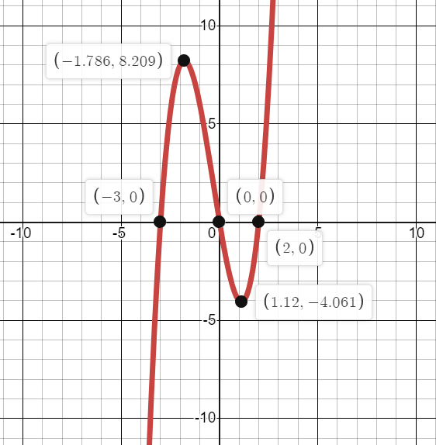
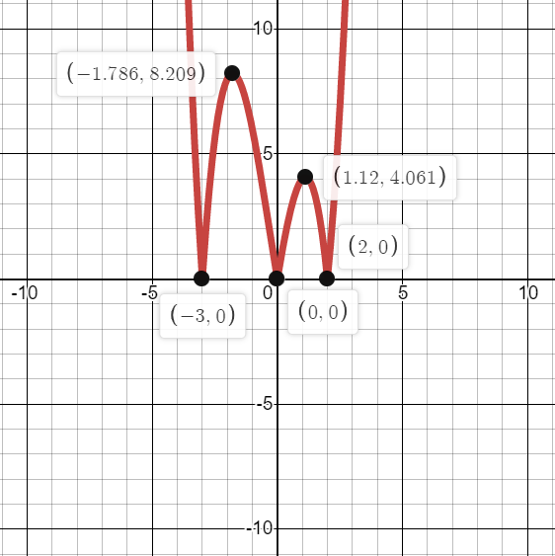
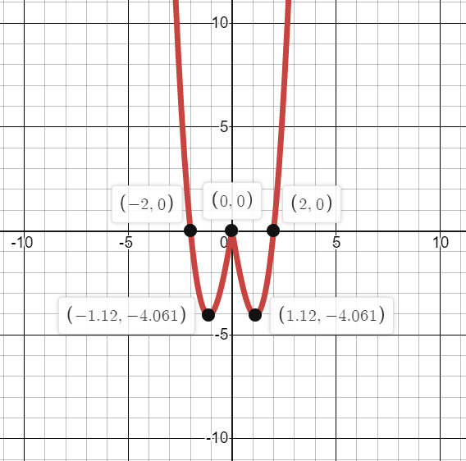

Worked example
Your turn
A sketch of $y=f(x)$ is shown.
Sketch $y=|f\left(x\right)|$ and $y=f(\left|x\right|)$ on separate axes.
A sketch of $y=f(x)$ is shown.
Sketch $y=|f\left(x\right)|$ and $y=f(\left|x\right|)$ on separate axes.
Graphs used with permission from DESMOS: https://www.desmos.com/

Slide 5
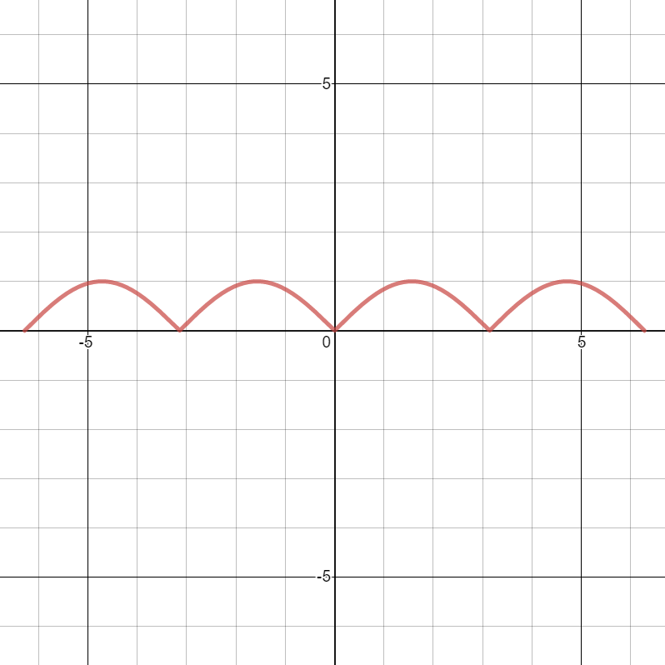
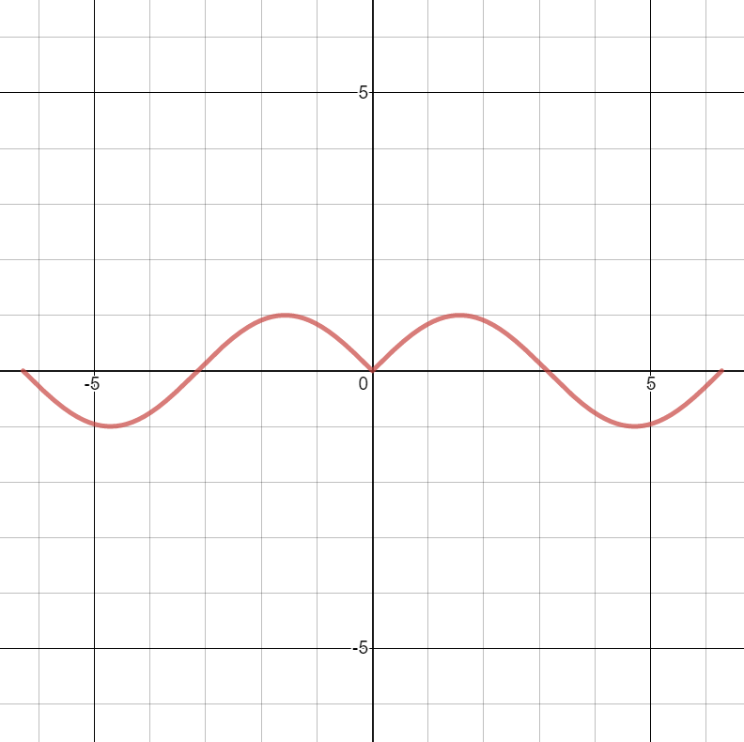


Worked example
Your turn
$$y=\cos{x}, −2π≤x≤2π$$
Sketch:
$y=|\cos{x}|$
$y=\cos{|x|}$
$$y=\sin{x}, −2π≤x≤2π$$
Sketch:
$y=|\sin{x}|$
$y=\sin{|x|}$
Graphs used with permission from DESMOS: https://www.desmos.com/

