Slide 1
2.4) Probability formulae

Slide 2
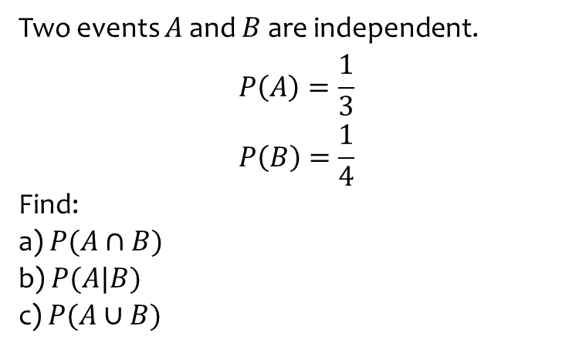
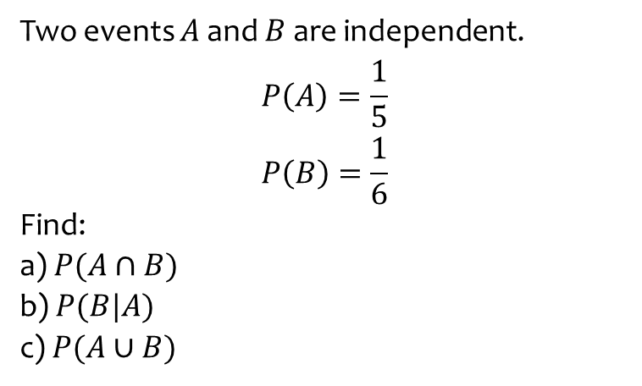
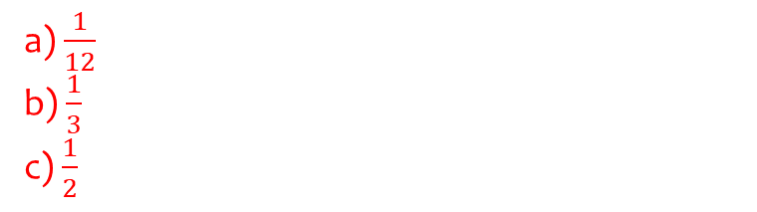
Worked example
Your turn
Two events $A$ and $B$ are independent.
$$P\left(A\right)=\frac{1}{5}$$
$$P\left(B\right)=\frac{1}{6}$$
Find:
a) $P(A∩B)$
b) $P(B|A)$
c) $P(A∪B)$
Two events $A$ and $B$ are independent.
$$P\left(A\right)=\frac{1}{3}$$
$$P\left(B\right)=\frac{1}{4}$$
Find:
a) $P(A∩B)$
b) $P(A|B)$
c) $P(A∪B)$
a) $\frac{1}{12}$
b) $\frac{1}{3}$
c) $\frac{1}{2}$

Slide 3
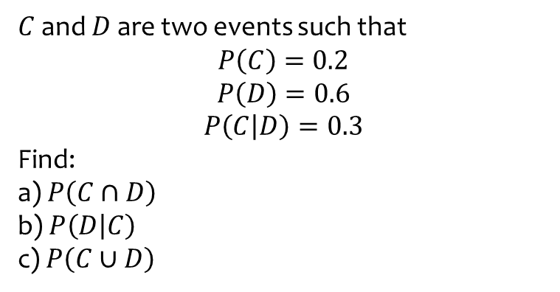
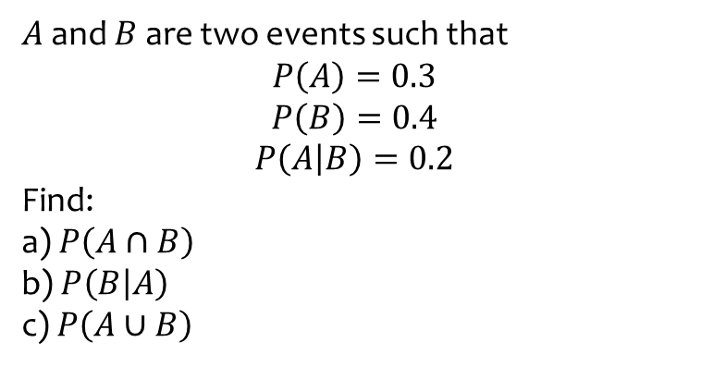
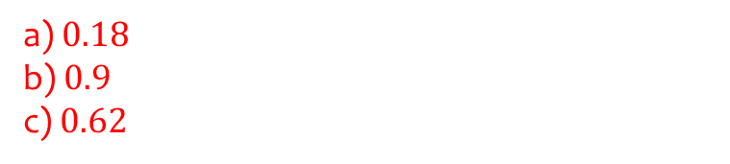
Worked example
Your turn
$A$ and $B$ are two events such that
$$P\left(A\right)=0.3$$
$$P\left(B\right)=0.4$$
$$P\left(A | B\right)=0.2$$
Find:
a) $P\left(A∩B\right)$
b)$P\left(B | A\right)$
c) $P\left(A∪B\right)$
$C$ and $D$ are two events such that
$$P\left(C\right)=0.2$$
$$P\left(D\right)=0.6$$
$$P\left(C | D\right)=0.3$$
Find:
a) $P\left(C∩D\right)$
b)$P\left(D | C\right)$
c) $P\left(C∪D\right)$
a) $0.18$
b) $0.9$
c) $0.62$

Slide 4
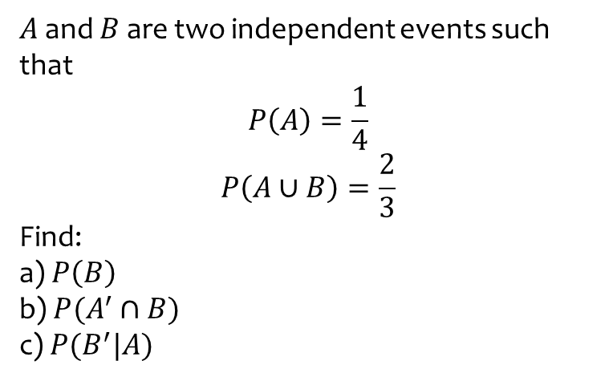
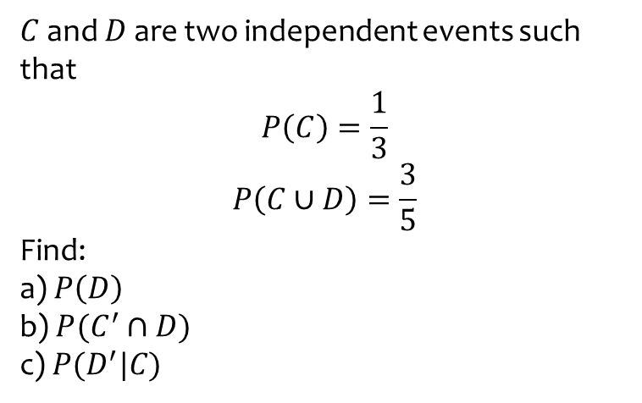
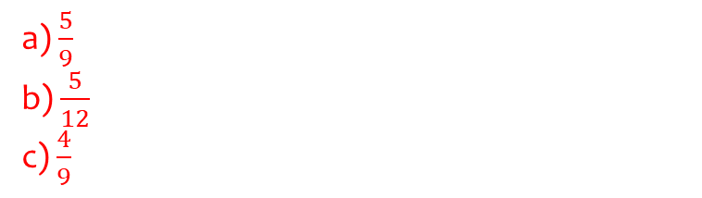
Worked example
Your turn
$C$ and $D$ are two independent events such that
$$P\left(C\right)=\frac{1}{3}$$
$$P\left(C∪D\right)=\frac{3}{5}$$
Find:
a) $P\left(D\right)$
b)$P(C^{′}∩D)$
c) $P(D^{′}|C)$
$A$ and $B$ are two independent events such that
$$P\left(A\right)=\frac{1}{4}$$
$$P\left(A∪B\right)=\frac{2}{3}$$
Find:
a) $P\left(B\right)$
b)$P(A^{′}∩B)$
c) $P(B^{′}|A)$
a) $\frac{5}{9}$
b) $\frac{5}{12}$
c) $\frac{4}{9}$

Slide 5
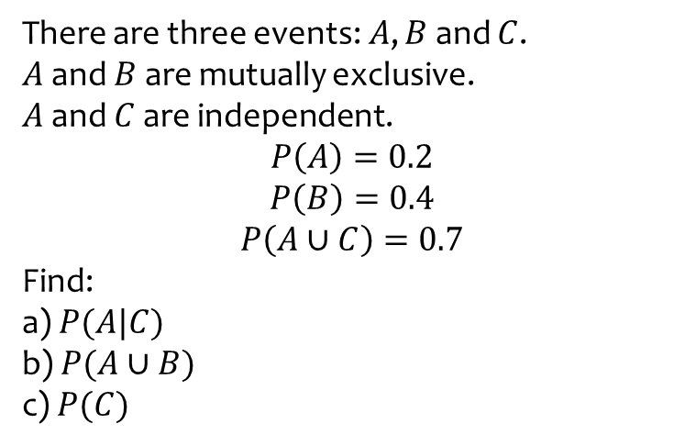
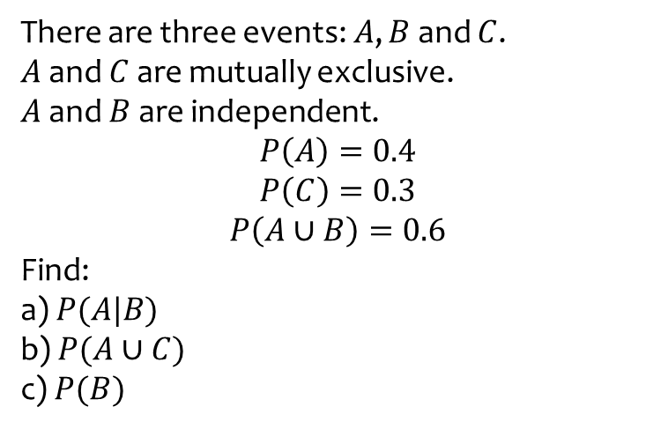
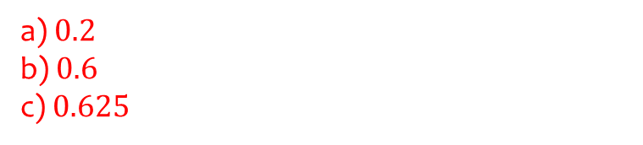
Worked example
Your turn
There are three events: $A$, $B$ and $C$.
$A$ and $C$ are mutually exclusive.
$A$ and $B$ are independent.
$$P\left(A\right)=0.4$$
$$P\left(C\right)=0.3$$
$$P\left(A∪B\right)=0.6$$
Find:
a) $P(A|B)$
b) $P(A∪C)$
c) $P(B)$
There are three events: $A$, $B$ and $C$.
$A$ and $B$ are mutually exclusive.
$A$ and $C$ are independent.
$$P\left(A\right)=0.2$$
$$P\left(B\right)=0.4$$
$$P\left(A∪C\right)=0.7$$
Find:
a) $P(A|C)$
b) $P(A∪B)$
c) $P(C)$
a) $0.2$
b) $0.6$
c) $0.625$

Slide 6

Worked example
Your turn
Write out the law for conditional probability:
“Given John runs to school, find the probability that he’s not late…”
“Given an even number is rolled on a die, find the probability that the number is prime…”
Write out the law for conditional probability:
“Given Bob walks to school, find the probability that he’s not late…”
$$P\left(L^{′} | W\right)=\frac{P\left(L^{′}∩W\right)}{P\left(W\right)}=…$$

Slide 7

Worked example
Your turn
Write out the relevant probability laws:
C and D are independent events.
C and D are mutually exclusive events.
Write out the law for independent events:
A and B are independent events.
C and D are mutually exclusive events.
$$P\left(A∩B\right)=P\left(A\right)P\left(B\right) \\ P\left(A | B\right)=P(A)$$
$$P\left(C∩D\right)=0$$
$$P\left(C∪D\right)=P\left(C\right)+P(D)$$

