Slide 1
2.4) Power

Slide 2
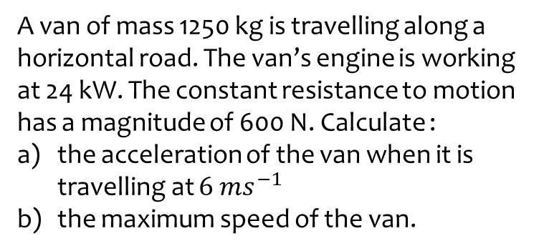
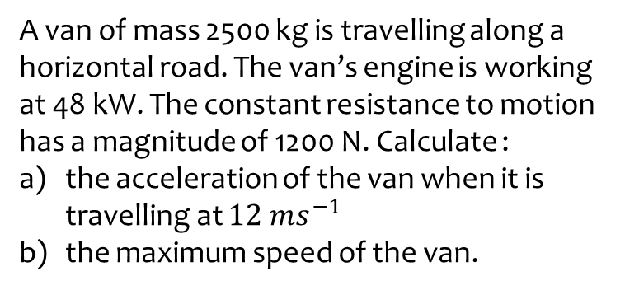
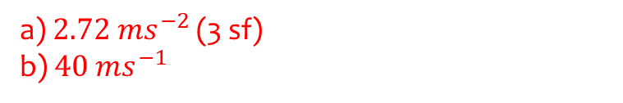
Worked example
Your turn
A van of mass 2500 kg is travelling along a horizontal road. The van’s engine is working at 48 kW. The constant resistance to motion has a magnitude of 1200 N. Calculate :
the acceleration of the van when it is travelling at $12 ms^{−1}$
the maximum speed of the van.
A van of mass 1250 kg is travelling along a horizontal road. The van’s engine is working at 24 kW. The constant resistance to motion has a magnitude of 600 N. Calculate :
the acceleration of the van when it is travelling at $6 ms^{−1}$
the maximum speed of the van.
a) $2.72 ms^{−2}$ (3 sf)
b) $40 ms^{−1}$

Slide 3
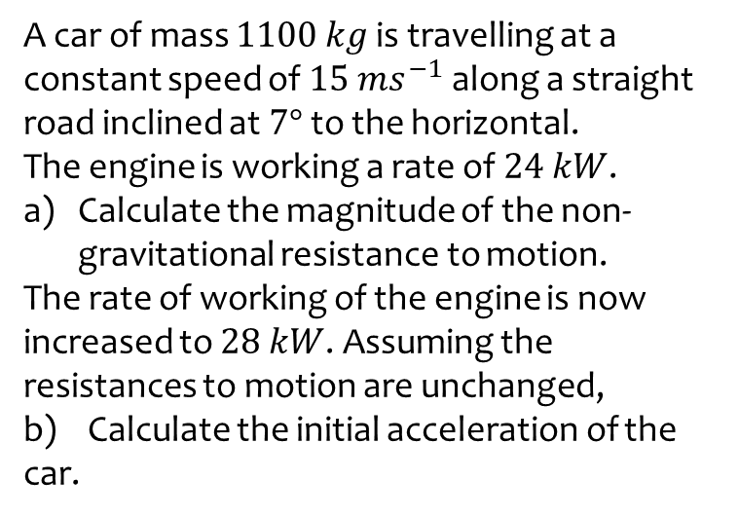
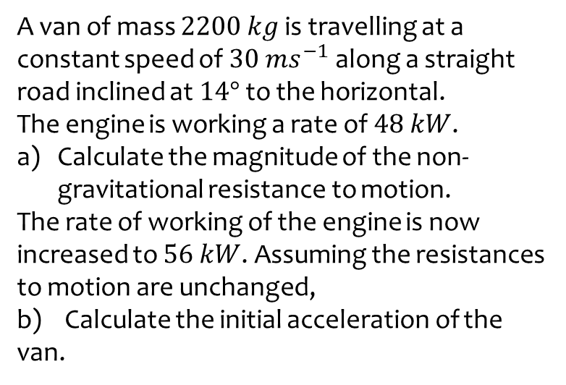
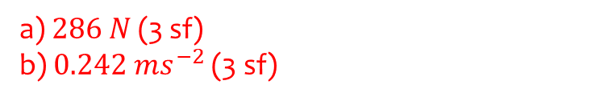
Worked example
Your turn
A van of mass $2200 kg$ is travelling at a constant speed of $30 ms^{−1}$ along a straight road inclined at $14°$ to the horizontal.
The engine is working a rate of $48 kW$.
Calculate the magnitude of the non-gravitational resistance to motion.
The rate of working of the engine is now increased to $56 kW$. Assuming the resistances to motion are unchanged,
b) Calculate the initial acceleration of the van.
A car of mass $1100 kg$ is travelling at a constant speed of $15 ms^{−1}$ along a straight road inclined at $7°$ to the horizontal.
The engine is working a rate of $24 kW$.
Calculate the magnitude of the non-gravitational resistance to motion.
The rate of working of the engine is now increased to $28 kW$. Assuming the resistances to motion are unchanged,
b) Calculate the initial acceleration of the car.
a) $286 N$ (3 sf)
b) $0.242 ms^{−2}$ (3 sf)

Slide 4
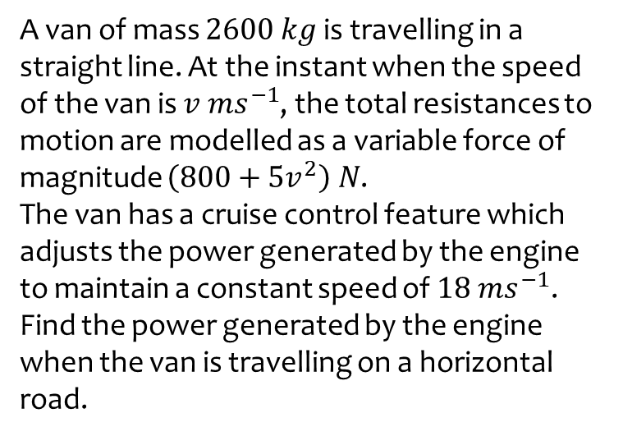
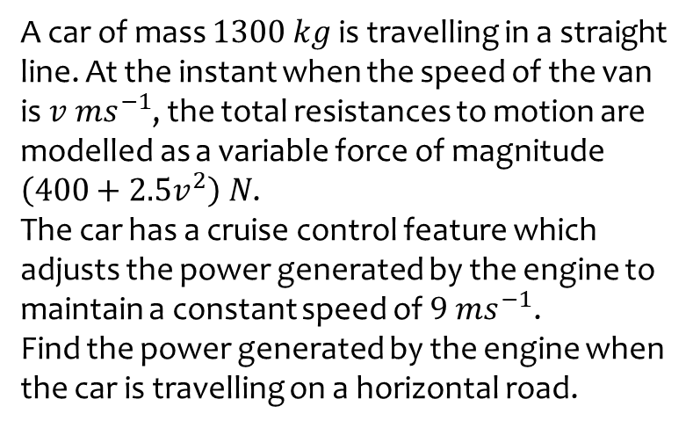

Worked example
Your turn
A car of mass $1300 kg$ is travelling in a straight line. At the instant when the speed of the van is $v ms^{−1}$, the total resistances to motion are modelled as a variable force of magnitude $\left(400+2.5v^{2}\right) N$.
The car has a cruise control feature which adjusts the power generated by the engine to maintain a constant speed of $9 ms^{−1}$.
Find the power generated by the engine when the car is travelling on a horizontal road.
A van of mass $2600 kg$ is travelling in a straight line. At the instant when the speed of the van is $v ms^{−1}$, the total resistances to motion are modelled as a variable force of magnitude $\left(800+5v^{2}\right) N$.
The van has a cruise control feature which adjusts the power generated by the engine to maintain a constant speed of $18 ms^{−1}$.
Find the power generated by the engine when the van is travelling on a horizontal road.
$43600 W$ (3 sf)

Slide 5
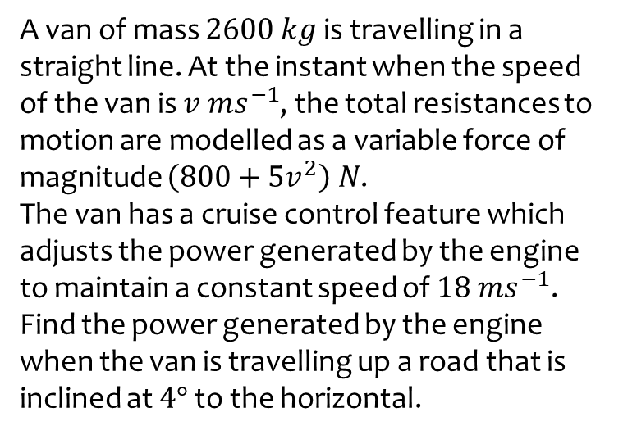
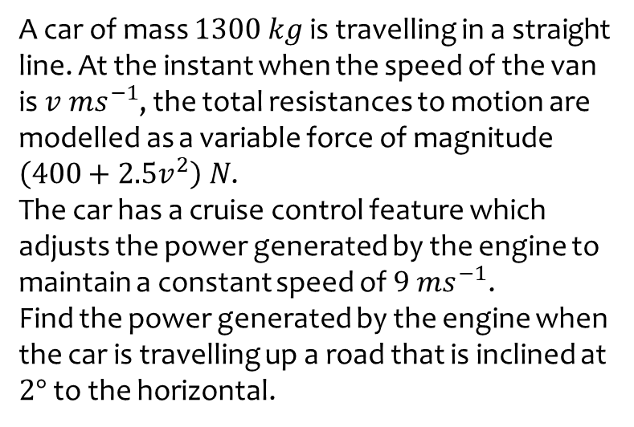

Worked example
Your turn
A car of mass $1300 kg$ is travelling in a straight line. At the instant when the speed of the van is $v ms^{−1}$, the total resistances to motion are modelled as a variable force of magnitude $\left(400+2.5v^{2}\right) N$.
The car has a cruise control feature which adjusts the power generated by the engine to maintain a constant speed of $9 ms^{−1}$.
Find the power generated by the engine when the car is travelling up a road that is inclined at $2°$ to the horizontal.
A van of mass $2600 kg$ is travelling in a straight line. At the instant when the speed of the van is $v ms^{−1}$, the total resistances to motion are modelled as a variable force of magnitude $\left(800+5v^{2}\right) N$.
The van has a cruise control feature which adjusts the power generated by the engine to maintain a constant speed of $18 ms^{−1}$.
Find the power generated by the engine when the van is travelling up a road that is inclined at $4°$ to the horizontal.
$75600 W$ (3 sf)

Slide 6
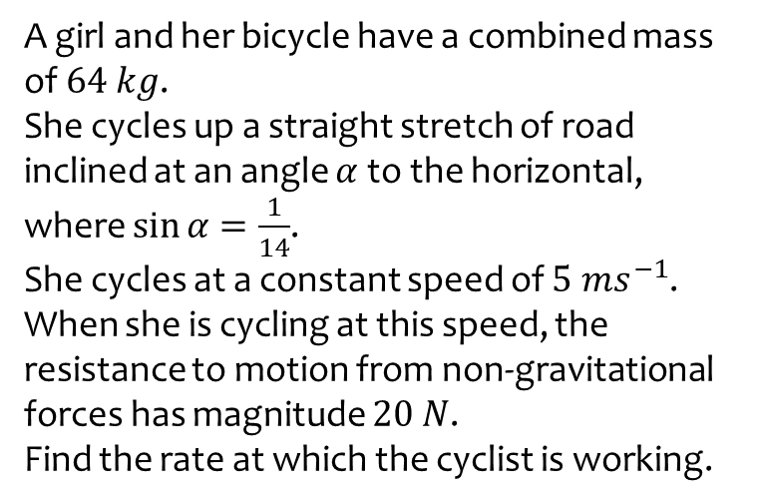
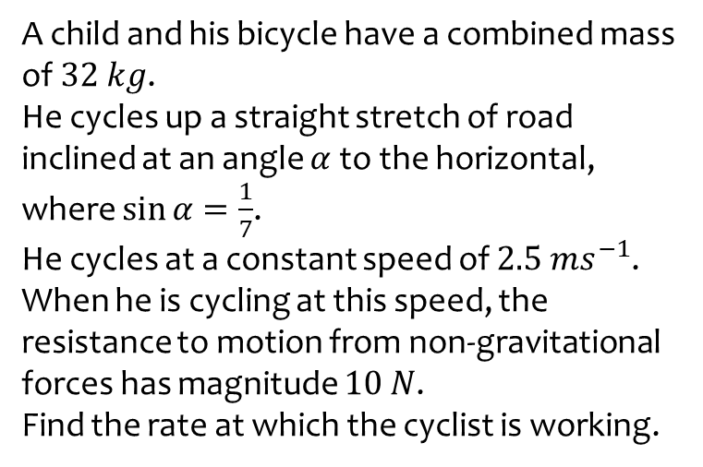
Worked example
Your turn
A child and his bicycle have a combined mass of $32 kg$.
He cycles up a straight stretch of road inclined at an angle $α$ to the horizontal, where $\sin{α}=\frac{1}{7}$.
He cycles at a constant speed of $2.5 ms^{−1}$.
When he is cycling at this speed, the resistance to motion from non-gravitational forces has magnitude $10 N$.
Find the rate at which the cyclist is working.
A girl and her bicycle have a combined mass of $64 kg$.
She cycles up a straight stretch of road inclined at an angle $α$ to the horizontal, where $\sin{α}=\frac{1}{14}$.
She cycles at a constant speed of $5 ms^{−1}$.
When she is cycling at this speed, the resistance to motion from non-gravitational forces has magnitude $20 N$.
Find the rate at which the cyclist is working.
$$324 W$$

