Slide 1
2.4) Inverse functions

Slide 2
Worked example
Your turn
Find the inverse functions:
$$f\left(x\right)=4x+3, x∈ℝ$$
$$g\left(x\right)=4−3x, x∈ℝ$$
Find the inverse function:
$$h\left(x\right)=3−4x, x∈ℝ$$
$$h^{−1}\left(x\right)=\frac{3−x}{4}, x∈ℝ$$

Slide 3

Worked example
Your turn
Find the inverse functions:
$$f\left(x\right)=\frac{x−2}{2x+1}\text{, } x≠\frac{1}{2}$$
$$g\left(x\right)=\frac{2x+3}{4x−5}, x≠\frac{5}{4}$$
Find the inverse function:
$$h\left(x\right)=\frac{x+2}{2x−1}\text{, } x≠\frac{1}{2}$$
$$h^{−1}\left(x\right)=\frac{x+2}{2x−1}, x≠\frac{1}{2}$$

Slide 4

Worked example
Your turn
Find the inverse functions:
$$f\left(x\right)=3x^{2}−5, x≥0$$
$$g\left(x\right)=4x^{2}+6, x≥0$$
Find the inverse function:
$$h\left(x\right)=2x^{2}−7, x≥0$$
$$h^{−1}\left(x\right)=\sqrt{\frac{x+7}{2}}, x≥−7$$

Slide 5

Worked example
Your turn
Find the inverse functions:
$$f\left(x\right)=x^{2}+4x+3, x≥−2$$
$$g\left(x\right)=x^{2}−8x−5, x≥5$$
Find the inverse function:
$$h\left(x\right)=x^{2}−6x−5, x≥3$$
$$h^{−1}\left(x\right)=3+\sqrt{x+14}, x≥−14$$

Slide 6
Worked example
Your turn
Find the inverse functions:
$$f\left(x\right)=\frac{2}{x−5}, x∈ℝ, x≠5$$
$$g\left(x\right)=\frac{7}{x+2}, x∈ℝ, x≠−2$$
Find the inverse function:
$$h\left(x\right)=\frac{3}{x−1}, x∈ℝ, x≠1$$
$$h^{−1}\left(x\right)=\frac{3+x}{x}, x≠0$$

Slide 7

Worked example
Your turn
Find the inverse functions:
$$f\left(x\right)=e^{x}−3, x∈ℝ$$
$$g\left(x\right)=e^{x}+4, x∈ℝ$$
Find the inverse function:
$$h\left(x\right)=e^{x}−5, x∈ℝ$$
$$h^{−1}\left(x\right)=\ln\left(x+5\right), x>−5$$

Slide 8

Worked example
Your turn
Find the inverse functions:
$$f\left(x\right)=\ln{x}−3, x>0$$
$$g\left(x\right)=\ln{(x−4)}, x>4$$
Find the inverse function:
$$h\left(x\right)=\ln{(x−5)}, x>5$$
$$h^{−1}\left(x\right)=e^{x}+5, x∈ℝ$$

Slide 9
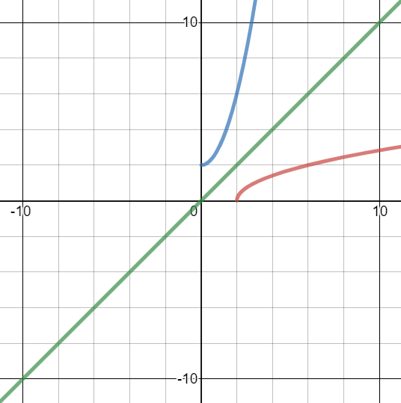
Worked example
Your turn
$$f\left(x\right)=\sqrt{x−3} \left\{x∈ℝ,x≥3\right\}$$
State the range of $f(x)$
Find the function $f^{−1}(x)$ and state its domain and range
Sketch $y=f\left(x\right)$, $y=f^{−1}(x)$ and $y=x$
$$p\left(x\right)=\sqrt{x−2} \left\{x∈ℝ,x≥2\right\}$$
State the range of $p(x)$
Find the function $p^{−1}(x)$ and state its domain and range
Sketch $y=p\left(x\right)$, $y=p^{−1}(x)$ and $y=x$
a) $p\left(x\right)≥0$
b) $p^{−1}\left(x\right)=x^{2}+2$
Domain: $x∈ℝ, x≥0$
Range: $p^{−1}\left(x\right)≥2$
c) Sketch
Graphs used with permission from DESMOS: https://www.desmos.com/

Slide 10
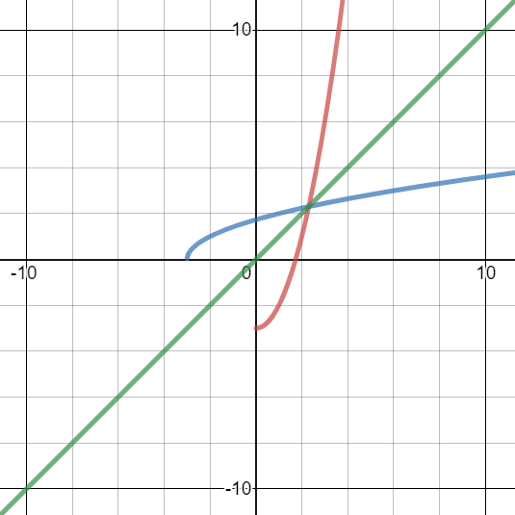
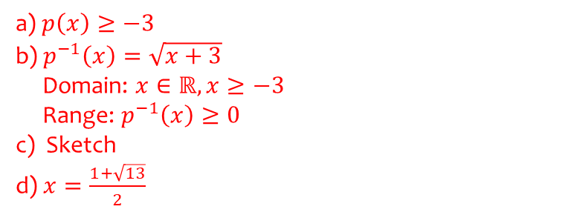
Worked example
Your turn
$f\left(x\right)=x^{2}−5$, $x∈ℝ$, $x≥0$.
State the range of $f(x)$
Find the function $f^{−1}(x)$ and state its domain and range
Sketch $y=f\left(x\right)$, $y=f^{−1}(x)$ and $y=x$
Solve the equation $f\left(x\right)=f^{−1}\left(x\right)$.
$p\left(x\right)=x^{2}−3$, $x∈ℝ$, $x≥0$.
State the range of $p(x)$
Find the function $p^{−1}(x)$ and state its domain and range
Sketch $y=p\left(x\right)$, $y=p^{−1}(x)$ and $y=x$
Solve the equation $p\left(x\right)=p^{−1}\left(x\right)$.
a) $p\left(x\right)≥−3$
b) $p^{−1}\left(x\right)=\sqrt{x+3}$
Domain: $x∈ℝ, x≥−3$
Range: $p^{−1}\left(x\right)≥0$
c) Sketch
d) $x=\frac{1+\sqrt{13}}{2}$
Graphs used with permission from DESMOS: https://www.desmos.com/

