Slide 1
2.3) Measures of spread

Slide 2
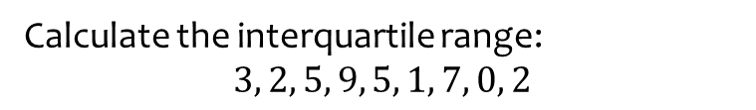
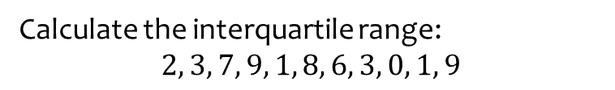
Worked example
Your turn
Calculate the interquartile range:
$$2, 3, 7, 9, 1, 8, 6, 3, 0, 1, 9$$
Calculate the interquartile range:
$$3, 2, 5, 9, 5, 1, 7, 0, 2$$
$$3$$

Slide 3
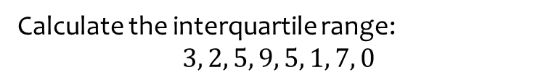
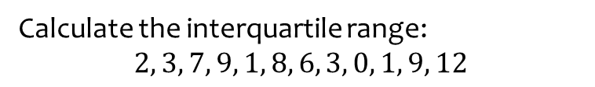
Worked example
Your turn
Calculate the interquartile range:
$$2, 3, 7, 9, 1, 8, 6, 3, 0, 1, 9, 12$$
Calculate the interquartile range:
$$3, 2, 5, 9, 5, 1, 7, 0$$
$$4.5$$

Slide 4
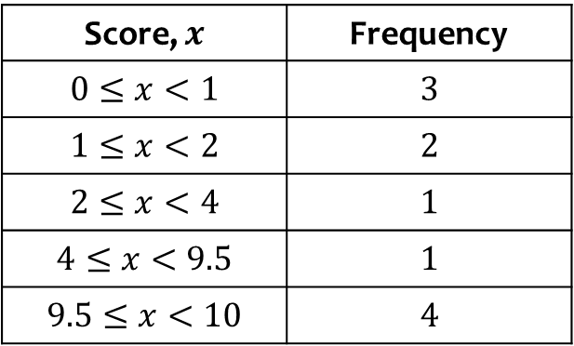

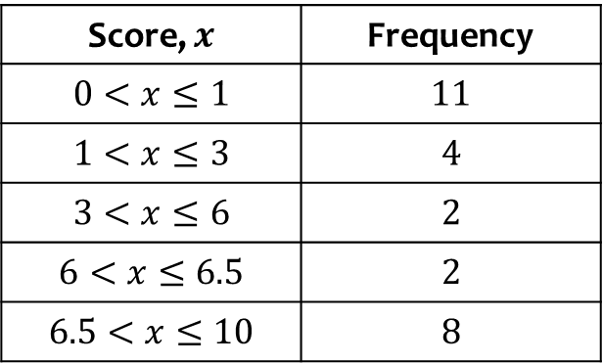
Worked example
Your turn
Estimate the interquartile range:
Estimate the interquartile range:
Score, $x$ | Frequency
$$0≤x<1$$ | $$3$$
$$1≤x<2$$ | $$2$$
$$2≤x<4$$ | $$1$$
$$4≤x<9.5$$ | $$1$$
$$9.5≤x<10$$ | $$4$$
Score, $x$ | Frequency
$$0<x≤1$$ | $$11$$
$$1<x≤3$$ | $$4$$
$$3<x≤6$$ | $$2$$
$$6<x≤6.5$$ | $$2$$
$$6.5<x≤10$$ | $$8$$
$6.43$ (3 sf)

Slide 5
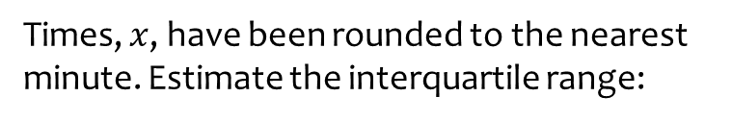
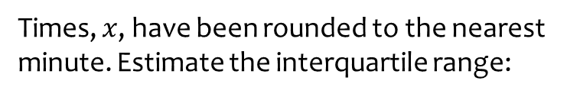
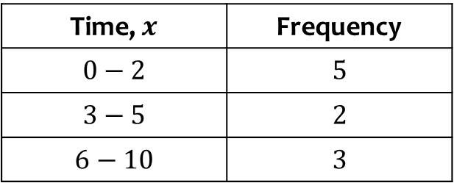
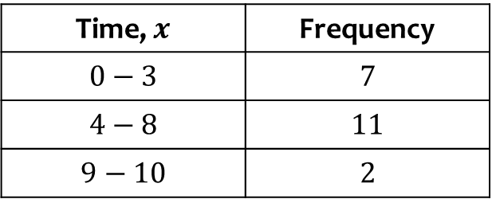

Worked example
Your turn
Times, $x$, have been rounded to the nearest minute. Estimate the interquartile range:
Times, $x$, have been rounded to the nearest minute. Estimate the interquartile range:
Time, $x$ | Frequency
$$0−2$$ | $$5$$
$$3−5$$ | $$2$$
$$6−10$$ | $$3$$
Time, $x$ | Frequency
$$0−3$$ | $$7$$
$$4−8$$ | $$11$$
$$9−10$$ | $$2$$
$3.22$ (3 sf)

Slide 6

Worked example
Your turn
Estimate the 20th – 80th interpercentile range:
Estimate the 10th – 90th interpercentile range:
Score, $x$ | Frequency
$$0≤x<1$$ | $$3$$
$$1≤x<2$$ | $$2$$
$$2≤x<4$$ | $$1$$
$$4≤x<9.5$$ | $$1$$
$$9.5≤x<10$$ | $$4$$
Score, $x$ | Frequency
$$0<x≤1$$ | $$11$$
$$1<x≤3$$ | $$4$$
$$3<x≤6$$ | $$2$$
$$6<x≤6.5$$ | $$2$$
$$6.5<x≤10$$ | $$8$$
$8.57$ (3 sf)

Slide 7
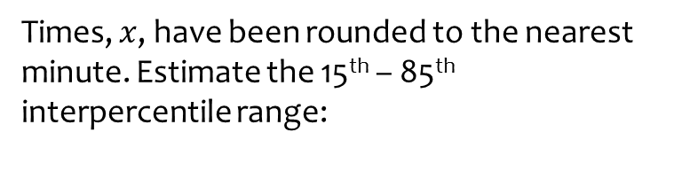
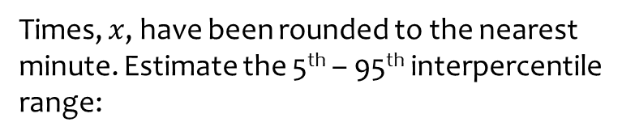

Worked example
Your turn
Times, $x$, have been rounded to the nearest minute. Estimate the 5th – 95th interpercentile range:
Times, $x$, have been rounded to the nearest minute. Estimate the 15th – 85th interpercentile range:
Time, $x$ | Frequency
$$0−2$$ | $$5$$
$$3−5$$ | $$2$$
$$6−10$$ | $$3$$
Time, $x$ | Frequency
$$0−3$$ | $$7$$
$$4−8$$ | $$11$$
$$9−10$$ | $$2$$
$6.55$ (3 sf)

