Slide 1
2.2) Completing the square

Slide 2
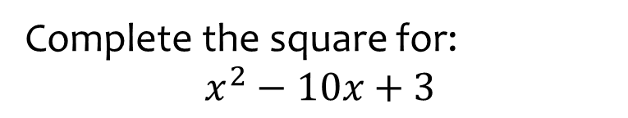


Worked example
Your turn
Complete the square for:
$$x^{2}+4x$$
$$x^{2}−6x$$
$$x^{2}+8x−7$$
Complete the square for:
$$x^{2}−10x+3$$
$${\left(x−5\right)}^{2}−22$$

Slide 3
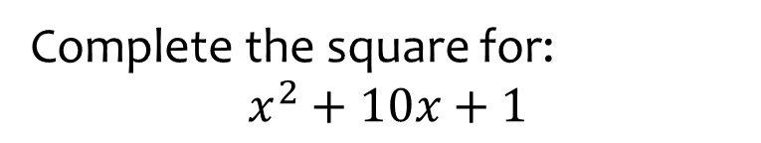


Worked example
Your turn
Complete the square for:
$$x^{2}+6x+5$$
$$x^{2}+8x+3$$
Complete the square for:
$$x^{2}+10x+1$$
$${\left(x+5\right)}^{2}−24$$

Slide 4
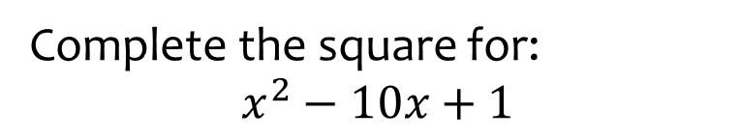


Worked example
Your turn
Complete the square for:
$$x^{2}−6x+5$$
$$x^{2}−8x−3$$
Complete the square for:
$$x^{2}−10x+1$$
$${\left(x−5\right)}^{2}−24$$

Slide 5
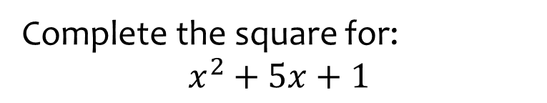


Worked example
Your turn
Complete the square for:
$$x^{2}+9x+5$$
$$x^{2}+7x+3$$
Complete the square for:
$$x^{2}+5x+1$$
$${\left(x+\frac{5}{2}\right)}^{2}−\frac{21}{4}$$

Slide 6
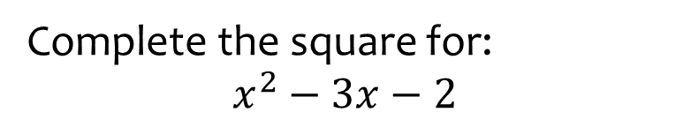


Worked example
Your turn
Complete the square for:
$$x^{2}−5x−3$$
$$x^{2}−x+2$$
Complete the square for:
$$x^{2}−3x−2$$
$${\left(x−\frac{3}{2}\right)}^{2}−\frac{17}{4}$$

Slide 7
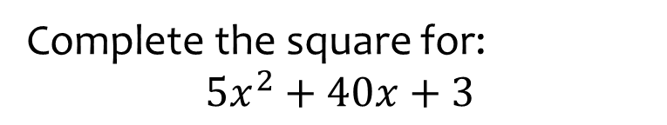


Worked example
Your turn
Complete the square for:
$${2x}^{2}+12x+1$$
$$3x^{2}+12x+2$$
Complete the square for:
$$5x^{2}+40x+3$$
$$5{\left(x+4\right)}^{2}−77$$

Slide 8
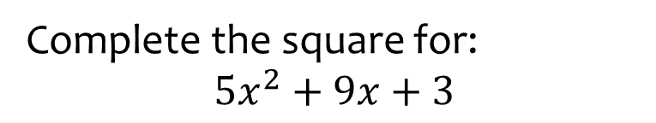


Worked example
Your turn
Complete the square for:
$${2x}^{2}+5x+1$$
$$3x^{2}+7x+2$$
Complete the square for:
$$5x^{2}+9x+3$$
$$5{\left(x+\frac{9}{10}\right)}^{2}−\frac{21}{20}$$

Slide 9
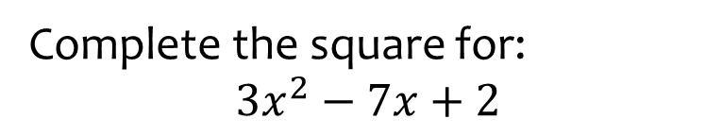


Worked example
Your turn
Complete the square for:
$${2x}^{2}−5x+3$$
$$5x^{2}−3x+1$$
Complete the square for:
$$3x^{2}−7x+2$$
$$3{\left(x−\frac{7}{6}\right)}^{2}−\frac{25}{12}$$

Slide 10
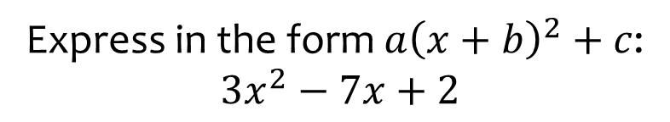

Worked example
Your turn
Express in the form $a{\left(x+b\right)}^{2}+c$:
$${2x}^{2}−5x+3$$
Express in the form $a{\left(x+b\right)}^{2}+c$:
$$3x^{2}−7x+2$$
$$3{\left(x−\frac{7}{6}\right)}^{2}−\frac{25}{12}$$

Slide 11
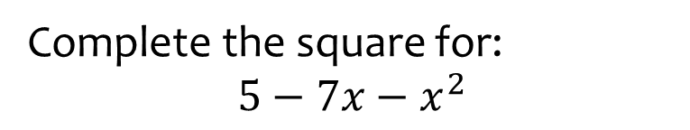


Worked example
Your turn
Complete the square for:
$$3+5x−x^{2}$$
$$2−3x−x^{2}$$
Complete the square for:
$$5−7x−x^{2}$$
$$−{\left(x+\frac{7}{2}\right)}^{2}+\frac{69}{4}$$

Slide 12
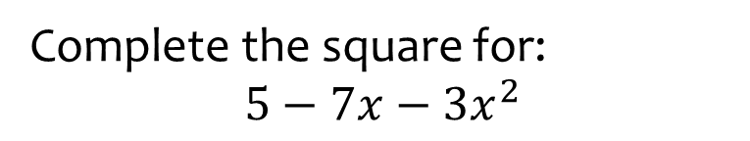


Worked example
Your turn
Complete the square for:
$$3+5x−{2x}^{2}$$
$$2−3x−{5x}^{2}$$
Complete the square for:
$$5−7x−{3x}^{2}$$
$$−3{\left(x+\frac{7}{6}\right)}^{2}+\frac{109}{12}$$

Slide 13
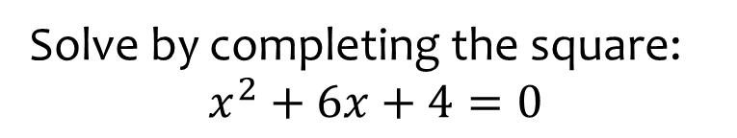


Worked example
Your turn
Solve by completing the square:
$$x^{2}+8x+3=0$$
$$x^{2}+10x−4=0$$
Solve by completing the square:
$$x^{2}+6x+4=0$$
$$x=−3+\sqrt{5}, x=−3−\sqrt{5}$$

Slide 14
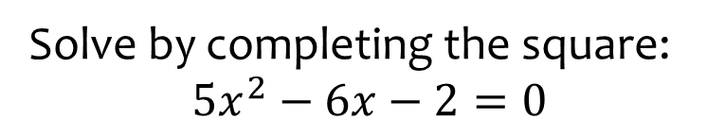


Worked example
Your turn
Solve by completing the square:
$$2x^{2}−8x+3=0$$
$${3x}^{2}−10x−4=0$$
Solve by completing the square:
$${5x}^{2}−6x−2=0$$
$$x=\frac{3+\sqrt{19}}{5}, x=\frac{3−\sqrt{19}}{5}$$

Slide 15
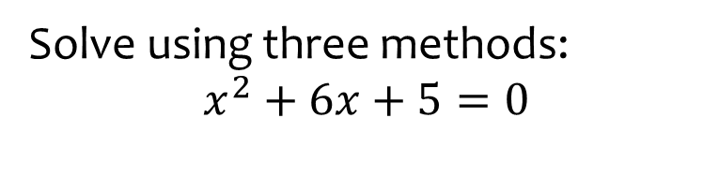


Worked example
Your turn
Solve using three methods:
$$x^{2}+6x+8=0$$
$$x^{2}+6x+8=0$$
$$x^{2}+6x+8=0$$
Solve using three methods:
$$x^{2}+6x+5=0$$
$$x=−5, x=−1$$

Slide 16
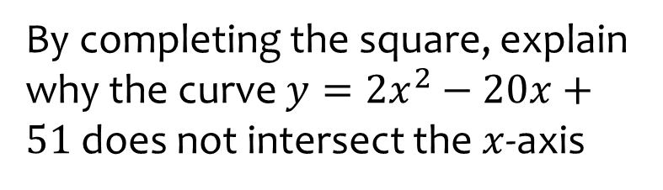
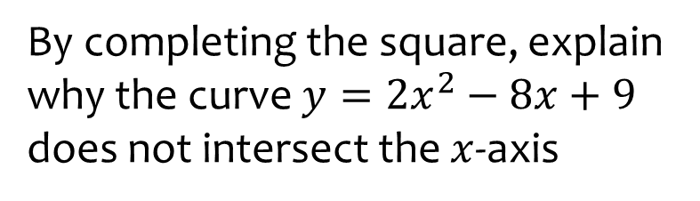
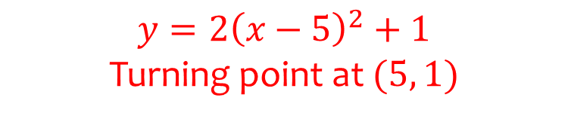
Worked example
Your turn
By completing the square, explain why the curve $y=2x^{2}−8x+9$ does not intersect the $x$-axis
By completing the square, explain why the curve $y=2x^{2}−20x+51$ does not intersect the $x$-axis
$$y=2{\left(x−5\right)}^{2}+1$$
Turning point at $(5, 1)$

Slide 17
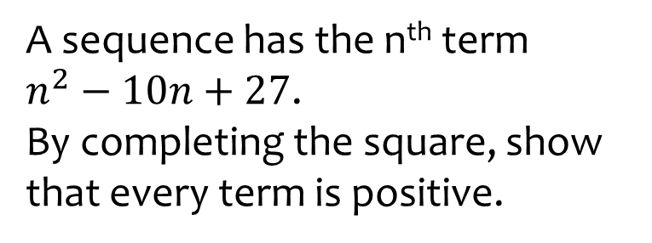
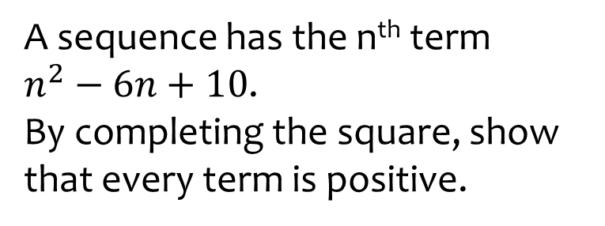
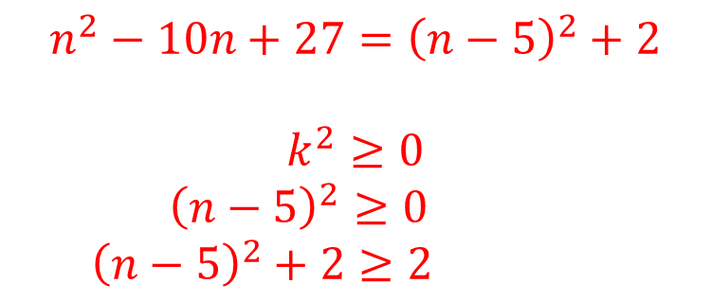
Worked example
Your turn
A sequence has the n^{th} term
$n^{2}−6n+10$.
By completing the square, show that every term is positive.
A sequence has the n^{th} term
$n^{2}−10n+27$.
By completing the square, show that every term is positive.
$$n^{2}−10n+27={\left(n−5\right)}^{2}+2$$
$$k^{2}≥0$$
$${\left(n−5\right)}^{2}≥0$$
$${\left(n−5\right)}^{2}+2≥2$$

