Slide 1
2.3) Conservation of mechanical energy and the work-energy principle

Slide 2
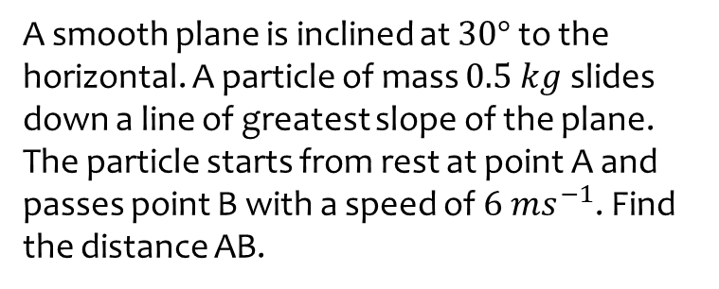
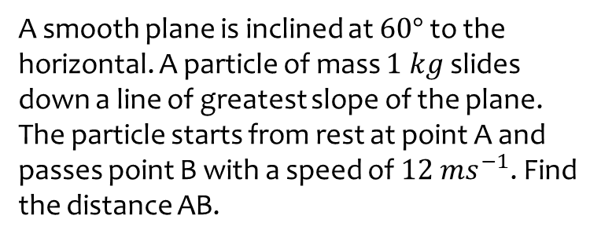

Worked example
Your turn
A smooth plane is inclined at $60°$ to the horizontal. A particle of mass $1 kg$ slides down a line of greatest slope of the plane. The particle starts from rest at point A and passes point B with a speed of $12 ms^{−1}$. Find the distance AB.
A smooth plane is inclined at $30°$ to the horizontal. A particle of mass $0.5 kg$ slides down a line of greatest slope of the plane. The particle starts from rest at point A and passes point B with a speed of $6 ms^{−1}$. Find the distance AB.
$3.67 m$ (3 sf)

Slide 3
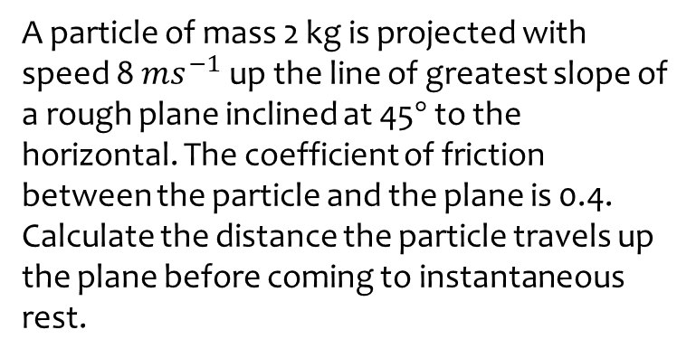
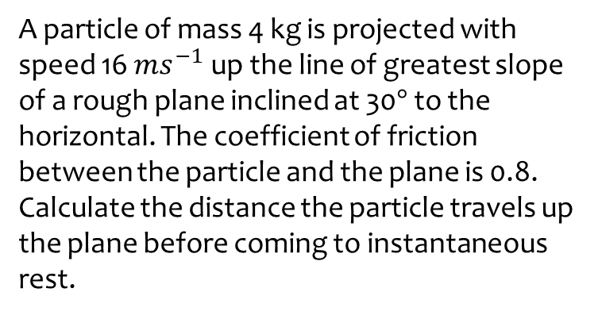

Worked example
Your turn
A particle of mass 4 kg is projected with speed 16 $ms^{−1}$ up the line of greatest slope of a rough plane inclined at 30$°$ to the horizontal. The coefficient of friction between the particle and the plane is 0.8. Calculate the distance the particle travels up the plane before coming to instantaneous rest.
A particle of mass 2 kg is projected with speed 8 $ms^{−1}$ up the line of greatest slope of a rough plane inclined at 45$°$ to the horizontal. The coefficient of friction between the particle and the plane is 0.4. Calculate the distance the particle travels up the plane before coming to instantaneous rest.
$3.30 m$ (3 sf)

Slide 4
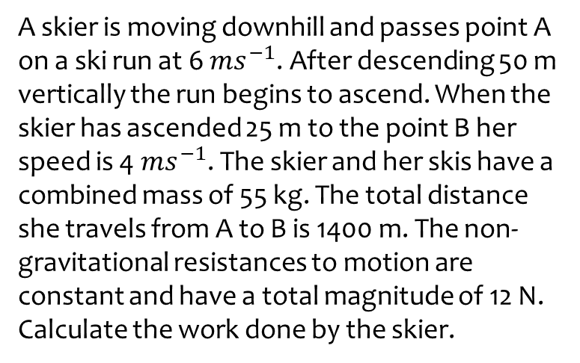
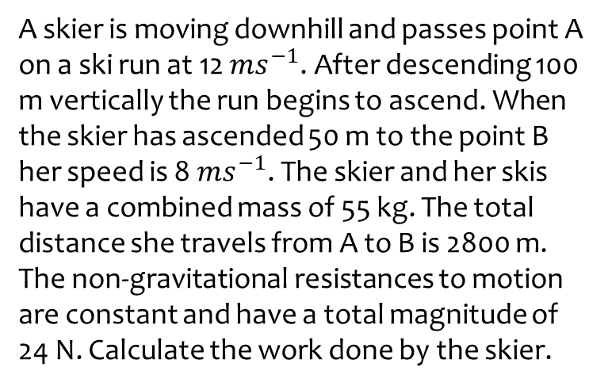

Worked example
Your turn
A skier is moving downhill and passes point A on a ski run at 12 $ms^{−1}$. After descending 100 m vertically the run begins to ascend. When the skier has ascended 50 m to the point B her speed is 8 $ms^{−1}$. The skier and her skis have a combined mass of 55 kg. The total distance she travels from A to B is 2800 m. The non-gravitational resistances to motion are constant and have a total magnitude of 24 N. Calculate the work done by the skier.
A skier is moving downhill and passes point A on a ski run at 6 $ms^{−1}$. After descending 50 m vertically the run begins to ascend. When the skier has ascended 25 m to the point B her speed is 4 $ms^{−1}$. The skier and her skis have a combined mass of 55 kg. The total distance she travels from A to B is 1400 m. The non-gravitational resistances to motion are constant and have a total magnitude of 12 N. Calculate the work done by the skier.
$2780 J$ (3 sf)

Slide 5
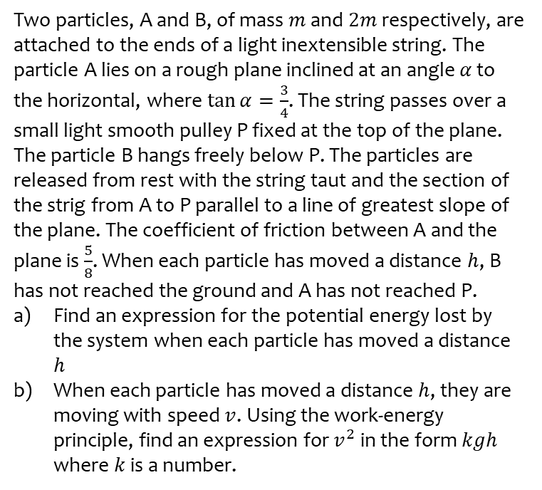
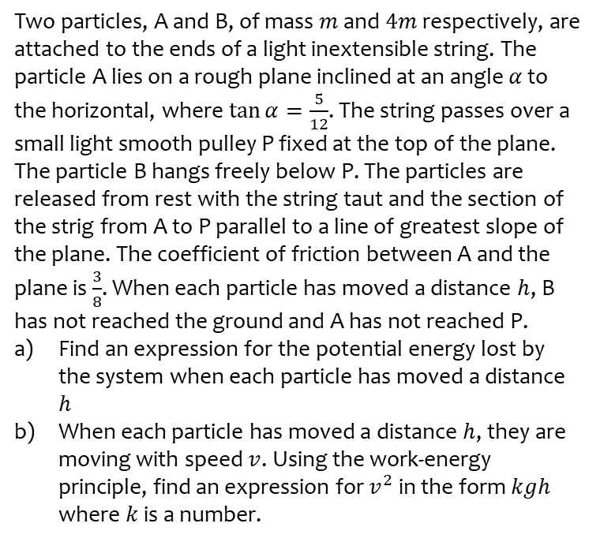
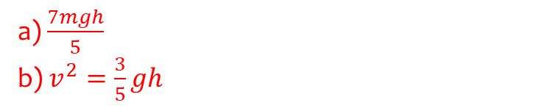
Worked example
Your turn
Two particles, A and B, of mass $m$ and $4m$ respectively, are attached to the ends of a light inextensible string. The particle A lies on a rough plane inclined at an angle $α$ to the horizontal, where $\tan{α}=\frac{5}{12}$. The string passes over a small light smooth pulley P fixed at the top of the plane. The particle B hangs freely below P. The particles are released from rest with the string taut and the section of the strig from A to P parallel to a line of greatest slope of the plane. The coefficient of friction between A and the plane is $\frac{3}{8}$. When each particle has moved a distance $h$, B has not reached the ground and A has not reached P.
Find an expression for the potential energy lost by the system when each particle has moved a distance $h$
When each particle has moved a distance $h$, they are moving with speed $v$. Using the work-energy principle, find an expression for $v^{2}$ in the form $kgh$ where $k$ is a number.
Two particles, A and B, of mass $m$ and $2m$ respectively, are attached to the ends of a light inextensible string. The particle A lies on a rough plane inclined at an angle $α$ to the horizontal, where $\tan{α}=\frac{3}{4}$. The string passes over a small light smooth pulley P fixed at the top of the plane. The particle B hangs freely below P. The particles are released from rest with the string taut and the section of the strig from A to P parallel to a line of greatest slope of the plane. The coefficient of friction between A and the plane is $\frac{5}{8}$. When each particle has moved a distance $h$, B has not reached the ground and A has not reached P.
Find an expression for the potential energy lost by the system when each particle has moved a distance $h$
When each particle has moved a distance $h$, they are moving with speed $v$. Using the work-energy principle, find an expression for $v^{2}$ in the form $kgh$ where $k$ is a number.
a) $\frac{7mgh}{5}$
b) $v^{2}=\frac{3}{5}gh$

