Slide 1
2.2) Other measures of location

Slide 2
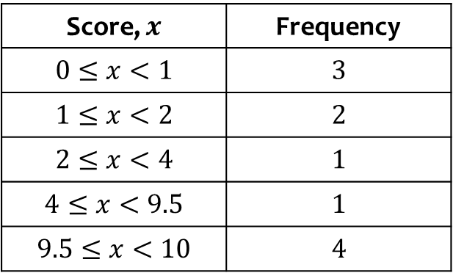
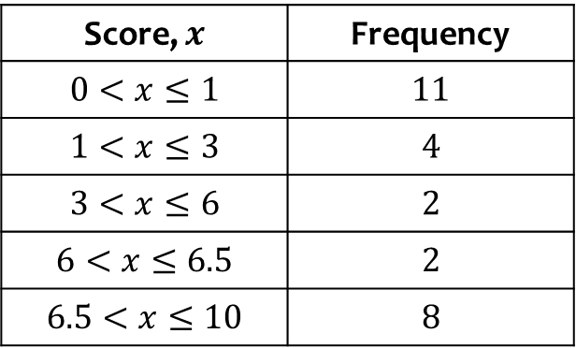
Worked example
Your turn
Estimate the median:
Estimate the median:
Score, $x$ | Frequency
$$0≤x<1$$ | $$3$$
$$1≤x<2$$ | $$2$$
$$2≤x<4$$ | $$1$$
$$4≤x<9.5$$ | $$1$$
$$9.5≤x<10$$ | $$4$$
Score, $x$ | Frequency
$$0<x≤1$$ | $$11$$
$$1<x≤3$$ | $$4$$
$$3<x≤6$$ | $$2$$
$$6<x≤6.5$$ | $$2$$
$$6.5<x≤10$$ | $$8$$
$$2.25$$

Slide 3
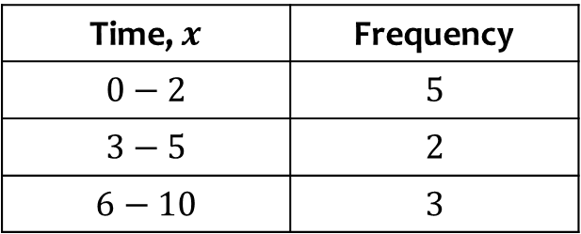
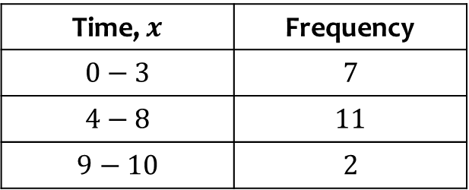
Worked example
Your turn
Times, $x$, have been rounded to the nearest minute. Estimate the median:
Times, $x$, have been rounded to the nearest minute. Estimate the median:
Time, $x$ | Frequency
$$0−2$$ | $$5$$
$$3−5$$ | $$2$$
$$6−10$$ | $$3$$
Time, $x$ | Frequency
$$0−3$$ | $$7$$
$$4−8$$ | $$11$$
$$9−10$$ | $$2$$
$4.86$ (3 sf)

Slide 4
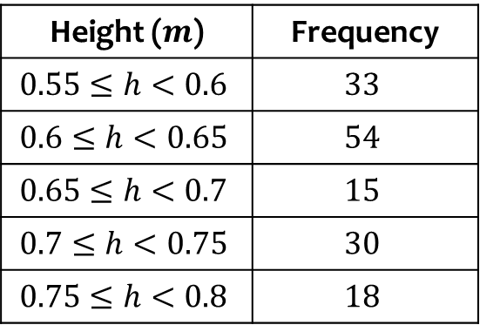
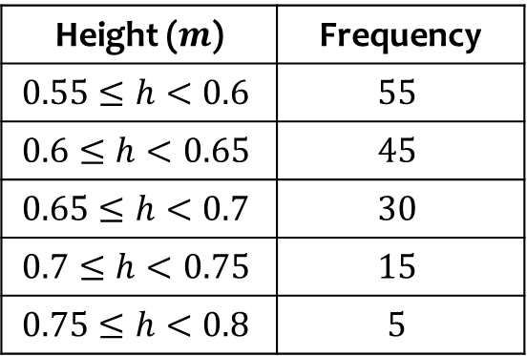
Worked example
Your turn
Estimate the median:
Estimate the median:
Height ($m$) | Frequency
$$0.55≤h<0.6$$ | $$33$$
$$0.6≤h<0.65$$ | $$54$$
$$0.65≤h<0.7$$ | $$15$$
$$0.7≤h<0.75$$ | $$30$$
$$0.75≤h<0.8$$ | $$18$$
Height ($m$) | Frequency
$$0.55≤h<0.6$$ | $$55$$
$$0.6≤h<0.65$$ | $$45$$
$$0.65≤h<0.7$$ | $$30$$
$$0.7≤h<0.75$$ | $$15$$
$$0.75≤h<0.8$$ | $$5$$
$0.62 m$ (2 dp)

Slide 5
Worked example
Your turn
Find the lower quartile:
$$2, 3, 7, 9, 1, 8, 6, 3, 0, 1, 9$$
Find the lower quartile:
$$3, 2, 5, 9, 5, 1, 7, 0, 2$$
$$2$$

Slide 6
Worked example
Your turn
Find the upper quartile:
$$2, 3, 7, 9, 1, 8, 6, 3, 0, 1, 9$$
Find the upper quartile:
$$3, 2, 5, 9, 5, 1, 7, 0, 2$$
$$5$$

Slide 7
Worked example
Your turn
Find the lower quartile:
$$2, 3, 7, 9, 1, 8, 6, 3, 0, 1, 9, 12$$
Find the lower quartile:
$$3, 2, 5, 9, 5, 1, 7, 0$$
$$1.5$$

Slide 8
Worked example
Your turn
Find the upper quartile:
$$2, 3, 7, 9, 1, 8, 6, 3, 0, 1, 9, 12$$
Find the upper quartile:
$$3, 2, 5, 9, 5, 1, 7, 0$$
$$6$$

Slide 9
Worked example
Your turn
Estimate the lower quartile:
Estimate the lower quartile:
Score, $x$ | Frequency
$$0≤x<1$$ | $$3$$
$$1≤x<2$$ | $$2$$
$$2≤x<4$$ | $$1$$
$$4≤x<9.5$$ | $$1$$
$$9.5≤x<10$$ | $$4$$
Score, $x$ | Frequency
$$0<x≤1$$ | $$11$$
$$1<x≤3$$ | $$4$$
$$3<x≤6$$ | $$2$$
$$6<x≤6.5$$ | $$2$$
$$6.5<x≤10$$ | $$8$$
$0.61$ (2 sf)

Slide 10
Worked example
Your turn
Estimate the upper quartile:
Estimate the upper quartile:
Score, $x$ | Frequency
$$0≤x<1$$ | $$3$$
$$1≤x<2$$ | $$2$$
$$2≤x<4$$ | $$1$$
$$4≤x<9.5$$ | $$1$$
$$9.5≤x<10$$ | $$4$$
Score, $x$ | Frequency
$$0<x≤1$$ | $$11$$
$$1<x≤3$$ | $$4$$
$$3<x≤6$$ | $$2$$
$$6<x≤6.5$$ | $$2$$
$$6.5<x≤10$$ | $$8$$
$7.05$ (2 sf)

Slide 11
Worked example
Your turn
Times, $x$, have been rounded to the nearest minute. Estimate the lower quartile:
Times, $x$, have been rounded to the nearest minute. Estimate the lower quartile:
Time, $x$ | Frequency
$$0−2$$ | $$5$$
$$3−5$$ | $$2$$
$$6−10$$ | $$3$$
Time, $x$ | Frequency
$$0−3$$ | $$7$$
$$4−8$$ | $$11$$
$$9−10$$ | $$2$$
$$2.5$$

Slide 12
Worked example
Your turn
Times, $x$, have been rounded to the nearest minute. Estimate the upper quartile:
Times, $x$, have been rounded to the nearest minute. Estimate the upper quartile:
Time, $x$ | Frequency
$$0−2$$ | $$5$$
$$3−5$$ | $$2$$
$$6−10$$ | $$3$$
Time, $x$ | Frequency
$$0−3$$ | $$7$$
$$4−8$$ | $$11$$
$$9−10$$ | $$2$$
$5.72$ (3 sf)

Slide 13
Worked example
Your turn
Estimate the 27th percentile:
Estimate the 72nd percentile:
Score, $x$ | Frequency
$$0≤x<1$$ | $$3$$
$$1≤x<2$$ | $$2$$
$$2≤x<4$$ | $$1$$
$$4≤x<9.5$$ | $$1$$
$$9.5≤x<10$$ | $$4$$
Score, $x$ | Frequency
$$0<x≤1$$ | $$11$$
$$1<x≤3$$ | $$4$$
$$3<x≤6$$ | $$2$$
$$6<x≤6.5$$ | $$2$$
$$6.5<x≤10$$ | $$8$$
$$6.6925$$

Slide 14
Worked example
Your turn
Times, $x$, have been rounded to the nearest minute. Estimate the 63rd percentile:
Times, $x$, have been rounded to the nearest minute. Estimate the 36th percentile:
Time, $x$ | Frequency
$$0−2$$ | $$5$$
$$3−5$$ | $$2$$
$$6−10$$ | $$3$$
Time, $x$ | Frequency
$$0−3$$ | $$7$$
$$4−8$$ | $$11$$
$$9−10$$ | $$2$$
$$3.59$$

