Slide 1
2.3) Conditional probabilities in Venn diagrams

Slide 2
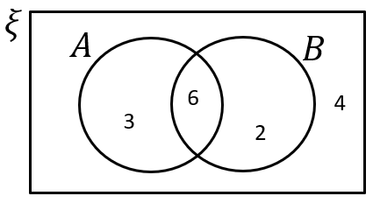
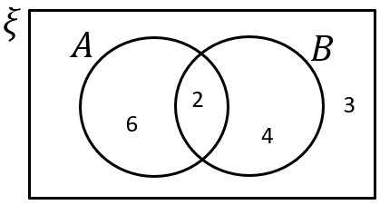


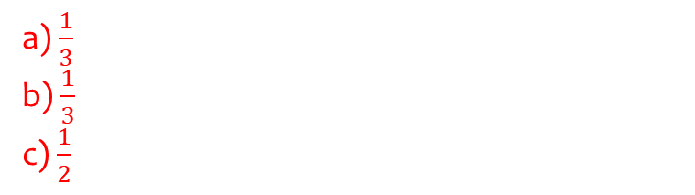
Worked example
Your turn
Using the Venn diagram, determine:
a) $P\left(A | B\right)$
b) $P\left(A′ | B′\right)$
c) $P\left(A | A∪B\right)$
Using the Venn diagram, determine:
a) $P\left(A | B\right)$
b) $P\left(A′ | B′\right)$
c) $P\left(B | A∪B\right)$
a) $\frac{1}{3}$
b) $\frac{1}{3}$
c) $\frac{1}{2}$

Slide 3
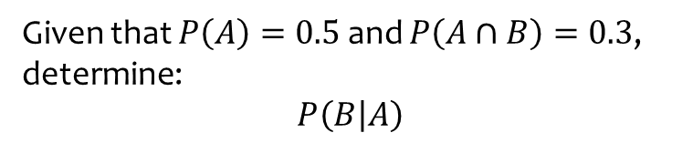
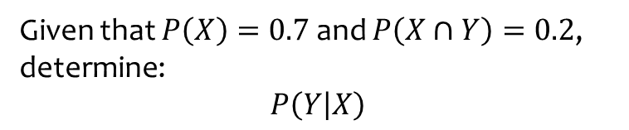
Worked example
Your turn
Given that $P\left(X\right)=0.7$ and $P\left(X∩Y\right)=0.2$, determine:
$$P\left(Y | X\right)$$
Given that $P\left(A\right)=0.5$ and $P\left(A∩B\right)=0.3$, determine:
$$P\left(B | A\right)$$
$$0.6$$

Slide 4
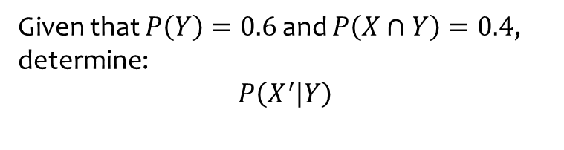
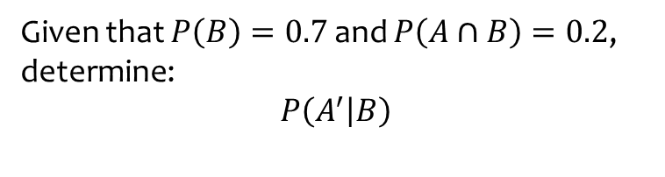

Worked example
Your turn
Given that $P\left(B\right)=0.7$ and $P\left(A∩B\right)=0.2$,
determine:
$P\left(A^{′} | B\right)$
Given that $P\left(Y\right)=0.6$ and $P\left(X∩Y\right)=0.4$,
determine:
$P\left(X^{′} | Y\right)$
$$\frac{1}{3}$$

Slide 5

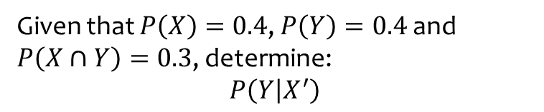
Worked example
Your turn
Given that $P\left(X\right)=0.4$, $P\left(Y\right)=0.4$ and $P\left(X∩Y\right)=0.3$, determine:
$P\left(Y | X^{′}\right)$
Given that $P\left(A\right)=0.5$, $P\left(B\right)=0.5$ and $P\left(A∩B\right)=0.4$, determine:
$P\left(B | A^{′}\right)$
$$0.2$$

Slide 6
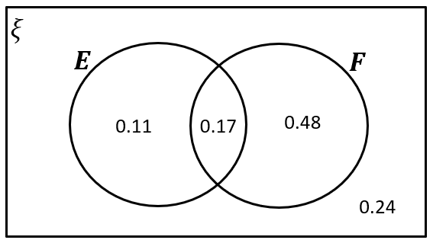
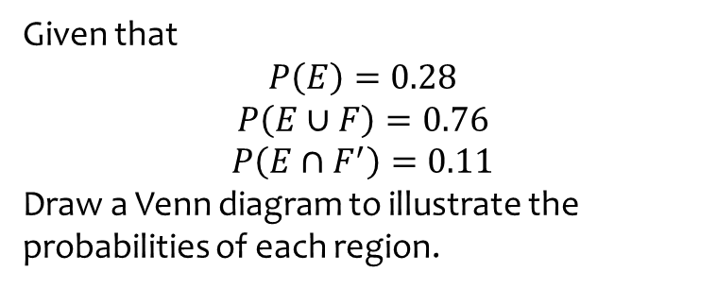
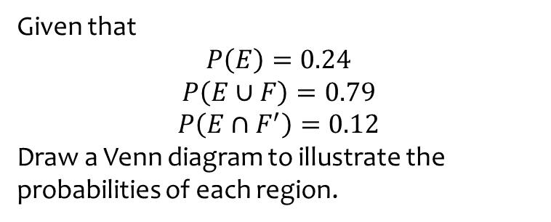
Worked example
Your turn
Given that
$$P\left(E\right)=0.24$$
$$P\left(E∪F\right)=0.79$$
$$P\left(E∩F^{′}\right)=0.12$$
Draw a Venn diagram to illustrate the probabilities of each region.
Given that
$$P\left(E\right)=0.28$$
$$P\left(E∪F\right)=0.76$$
$$P\left(E∩F^{′}\right)=0.11$$
Draw a Venn diagram to illustrate the probabilities of each region.

Slide 7
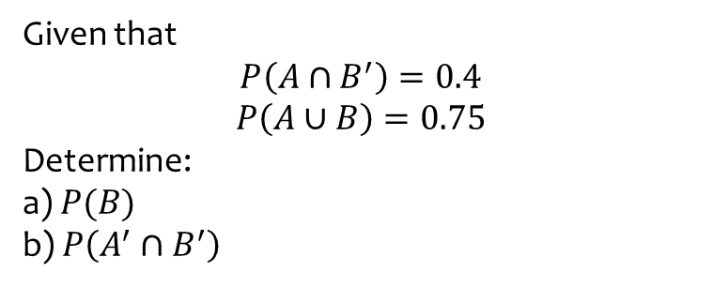
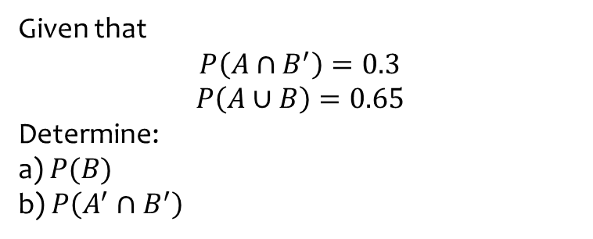
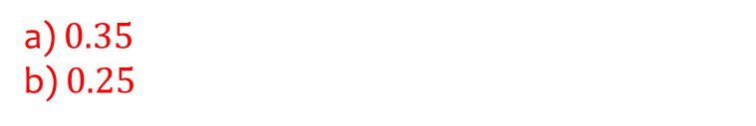
Worked example
Your turn
Given that
$$P\left(A∩B^{′}\right)=0.3$$
$$P\left(A∪B\right)=0.65$$
Determine:
a) $P(B)$
b) $P\left(A^{′}∩B^{′}\right)$
Given that
$$P\left(A∩B^{′}\right)=0.4$$
$$P\left(A∪B\right)=0.75$$
Determine:
a) $P(B)$
b) $P\left(A^{′}∩B^{′}\right)$
a) $0.35$
b) $0.25$

Slide 8
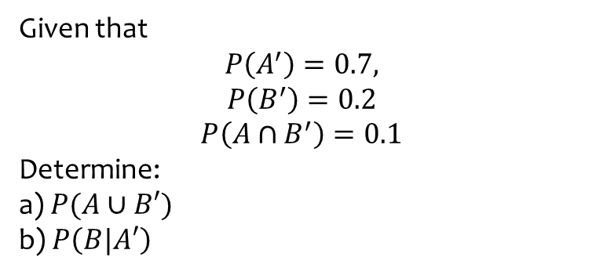
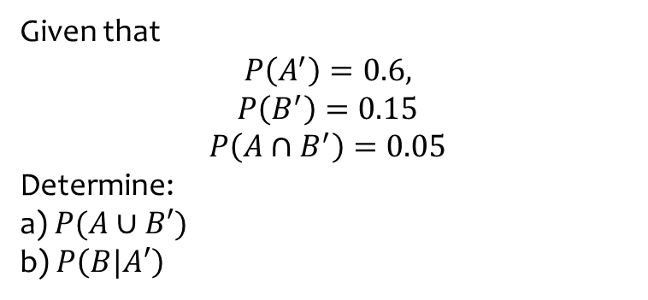
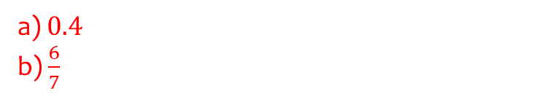
Worked example
Your turn
Given that
$$P\left(A^{′}\right)=0.6,$$
$$P\left(B^{′}\right)=0.15$$
$$P\left(A∩B^{′}\right)=0.05$$
Determine:
a) $P(A∪B′)$
b) $P\left(B|A′\right)$
Given that
$$P\left(A^{′}\right)=0.7,$$
$$P\left(B^{′}\right)=0.2$$
$$P\left(A∩B^{′}\right)=0.1$$
Determine:
a) $P(A∪B′)$
b) $P\left(B|A′\right)$
a) $0.4$
b) $\frac{6}{7}$

Slide 9
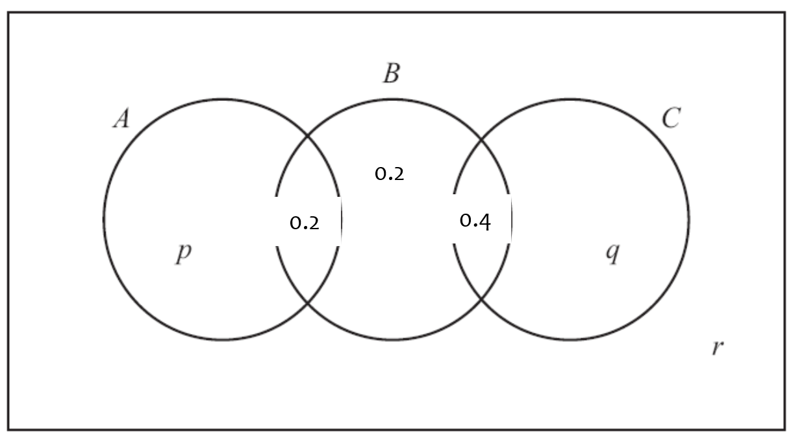
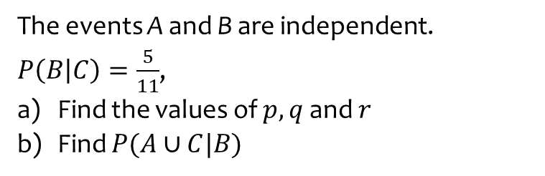
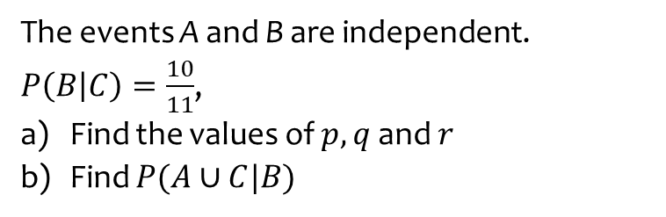
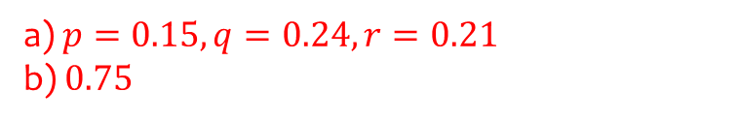
Worked example
Your turn
The events A and B are independent.
$P\left(B | C\right)=\frac{10}{11}$,
Find the values of $p, q$ and $r$
Find $P(A∪C|B)$
The events A and B are independent.
$P\left(B | C\right)=\frac{5}{11}$,
Find the values of $p, q$ and $r$
Find $P(A∪C|B)$
a) $p=0.15, q=0.24, r=0.21$
b) $0.75$

