Slide 1
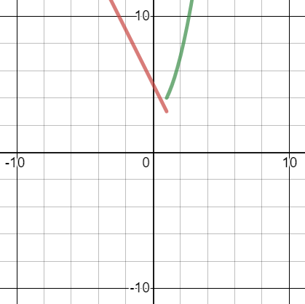
Worked example
Your turn
The function $f(x)$ is defined by
$$f:x→\left\{\begin{aligned}2−5x, x<1 \\ x^{2}−3, x≥1\end{aligned}\right.$$
Sketch $y=f\left(x\right)$, and state the range of $f\left(x\right)$.
Solve $f\left(x\right)=22$
The function $f(x)$ is defined by
$$f:x→\left\{\begin{aligned}5−2x, x<1 \\ x^{2}+3, x≥1\end{aligned}\right.$$
Sketch $y=f\left(x\right)$, and state the range of $f\left(x\right)$.
Solve $f\left(x\right)=19$
Sketch ; $f\left(x\right)>3$
$x=4, x=−7$
Graphs used with permission from DESMOS: https://www.desmos.com/

