Slide 1
2.2) Kinetic and potential energy

Slide 2
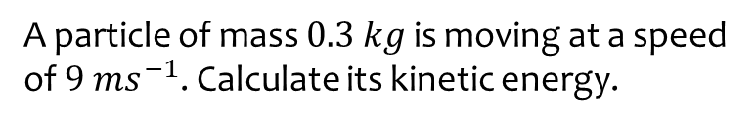
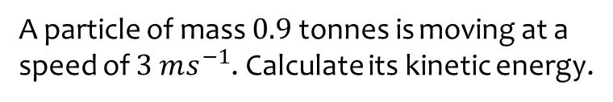

Worked example
Your turn
A particle of mass $0.9$tonnes is moving at a speed of $3 ms^{−1}$. Calculate its kinetic energy.
A particle of mass $0.3 kg$ is moving at a speed of $9 ms^{−1}$. Calculate its kinetic energy.
$12.2 J$ (3 sf)

Slide 3
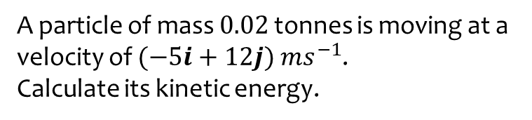
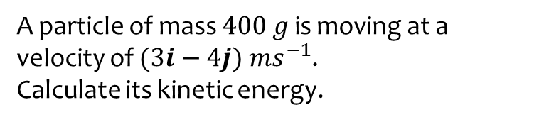
Worked example
Your turn
A particle of mass $400 g$ is moving at a velocity of $(3i−4j) ms^{−1}$.
Calculate its kinetic energy.
A particle of mass $0.02$ tonnes is moving at a velocity of $(−5i+12j) ms^{−1}$.
Calculate its kinetic energy.
$$1690 J$$

Slide 4
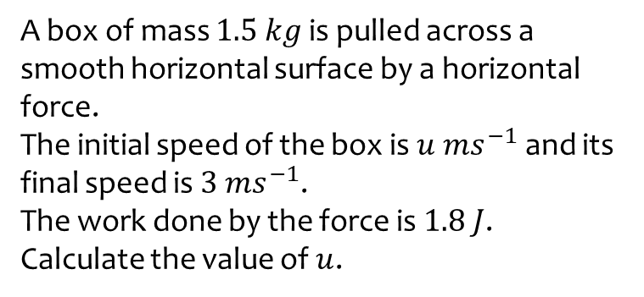
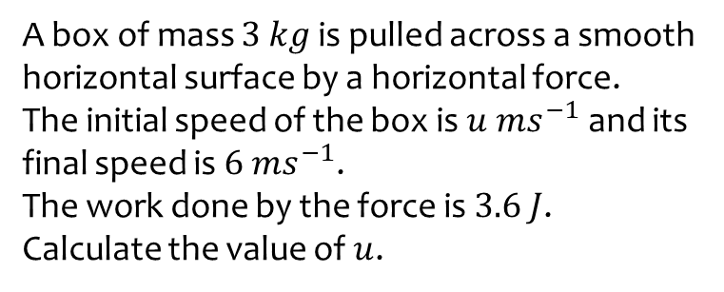

Worked example
Your turn
A box of mass $3 kg$ is pulled across a smooth horizontal surface by a horizontal force.
The initial speed of the box is $u ms^{−1}$ and its final speed is $6 ms^{−1}$.
The work done by the force is $3.6 J$.
Calculate the value of $u$.
A box of mass $1.5 kg$ is pulled across a smooth horizontal surface by a horizontal force.
The initial speed of the box is $u ms^{−1}$ and its final speed is $3 ms^{−1}$.
The work done by the force is $1.8 J$.
Calculate the value of $u$.
$u=2.57$ (3 sf)

Slide 5
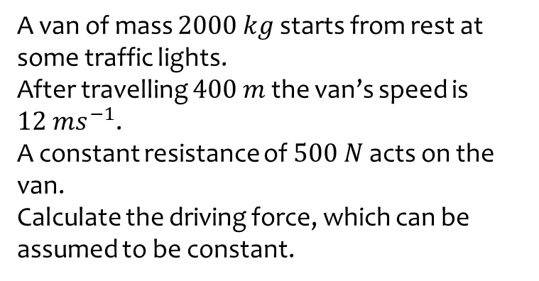
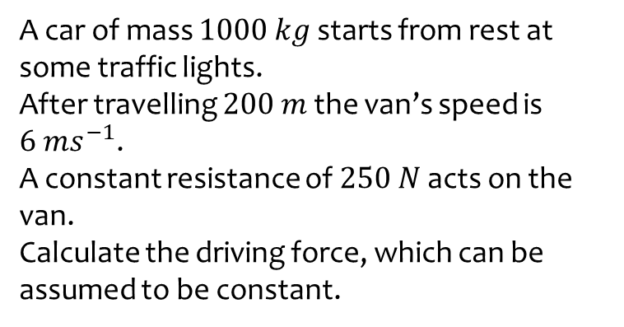
Worked example
Your turn
A car of mass $1000 kg$ starts from rest at some traffic lights.
After travelling $200 m$ the van’s speed is $6 ms^{−1}$.
A constant resistance of $250 N$ acts on the van.
Calculate the driving force, which can be assumed to be constant.
A van of mass $2000 kg$ starts from rest at some traffic lights.
After travelling $400 m$ the van’s speed is $12 ms^{−1}$.
A constant resistance of $500 N$ acts on the van.
Calculate the driving force, which can be assumed to be constant.
$$860 N$$

Slide 6
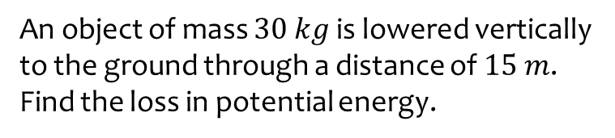
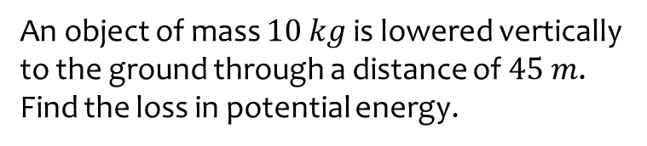
Worked example
Your turn
An object of mass $10 kg$ is lowered vertically to the ground through a distance of $45 m$.
Find the loss in potential energy.
An object of mass $30 kg$ is lowered vertically to the ground through a distance of $15 m$.
Find the loss in potential energy.
$$4410 J$$

Slide 7
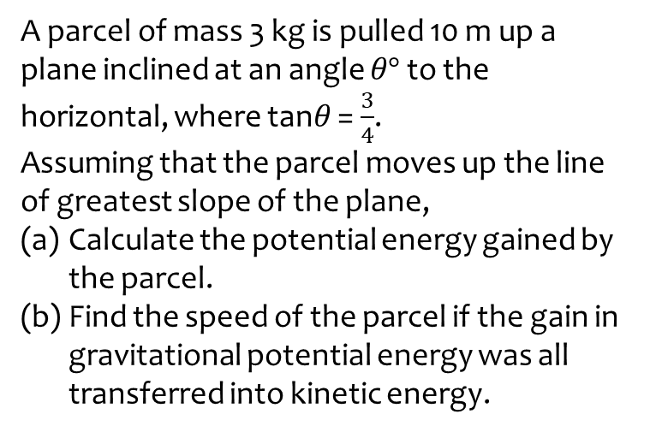
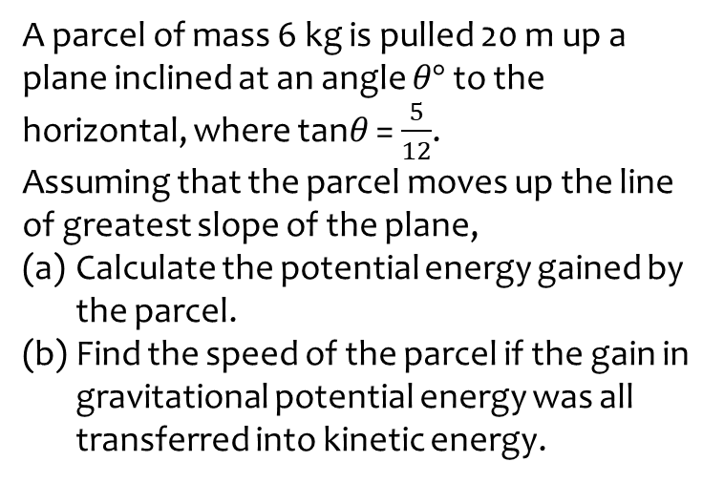
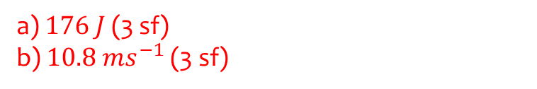
Worked example
Your turn
A parcel of mass 6 kg is pulled 20 m up a plane inclined at an angle $θ°$ to the horizontal, where tan$θ$ = $\frac{5}{12}$.
Assuming that the parcel moves up the line of greatest slope of the plane,
Calculate the potential energy gained by the parcel.
Find the speed of the parcel if the gain in gravitational potential energy was all transferred into kinetic energy.
A parcel of mass 3 kg is pulled 10 m up a plane inclined at an angle $θ°$ to the horizontal, where tan$θ$ = $\frac{3}{4}$.
Assuming that the parcel moves up the line of greatest slope of the plane,
Calculate the potential energy gained by the parcel.
Find the speed of the parcel if the gain in gravitational potential energy was all transferred into kinetic energy.
a) $176 J$ (3 sf)
b) $10.8 ms^{−1}$ (3 sf)

Slide 8
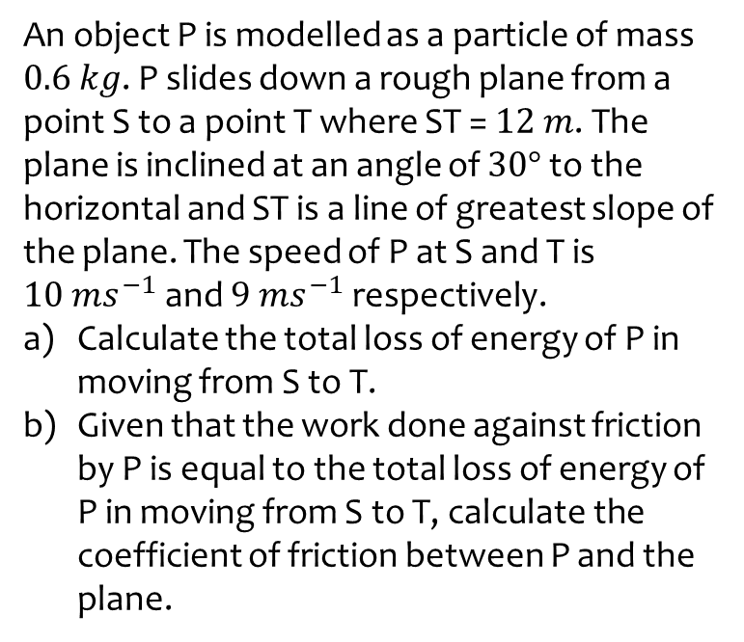
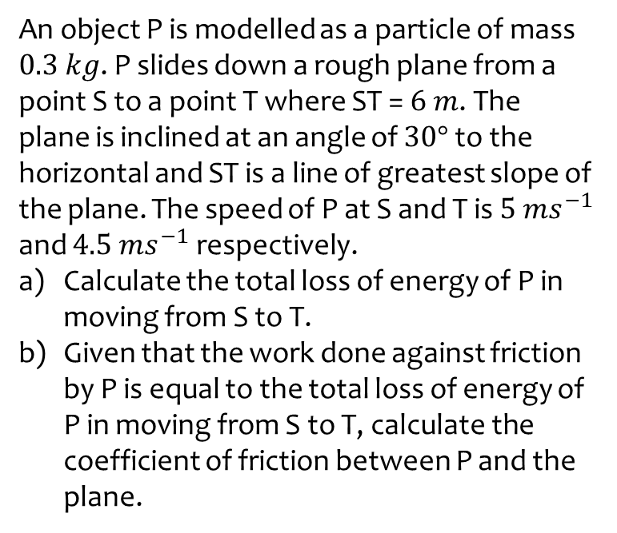
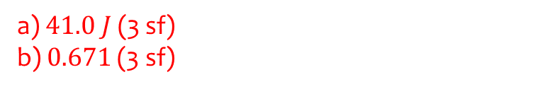
Worked example
Your turn
An object P is modelled as a particle of mass $0.3 kg$. P slides down a rough plane from a point S to a point T where ST = $6 m$. The plane is inclined at an angle of $30°$ to the horizontal and ST is a line of greatest slope of the plane. The speed of P at S and T is $5 ms^{−1}$ and $4.5 ms^{−1}$ respectively.
Calculate the total loss of energy of P in moving from S to T.
Given that the work done against friction by P is equal to the total loss of energy of P in moving from S to T, calculate the coefficient of friction between P and the plane.
An object P is modelled as a particle of mass $0.6 kg$. P slides down a rough plane from a point S to a point T where ST = $12 m$. The plane is inclined at an angle of $30°$ to the horizontal and ST is a line of greatest slope of the plane. The speed of P at S and T is $10 ms^{−1}$ and $9 ms^{−1}$ respectively.
Calculate the total loss of energy of P in moving from S to T.
Given that the work done against friction by P is equal to the total loss of energy of P in moving from S to T, calculate the coefficient of friction between P and the plane.
a) $41.0 J$ (3 sf)
b) $0.671$ (3 sf)

