Slide 1
2.2) Conditional probability

Slide 2
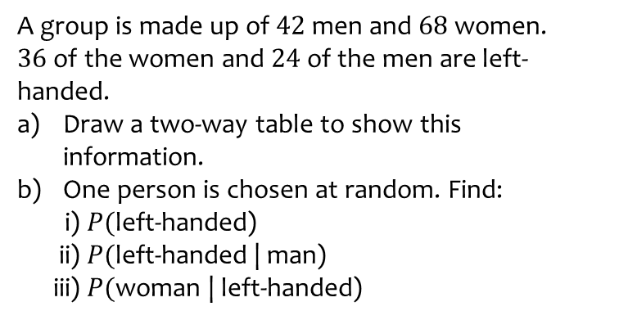
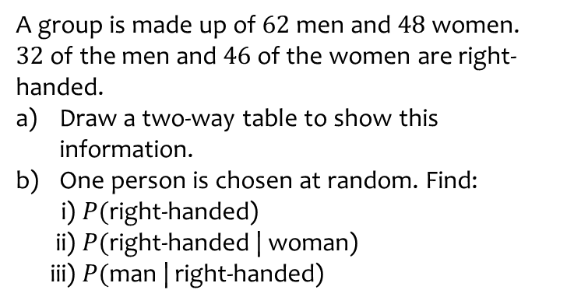
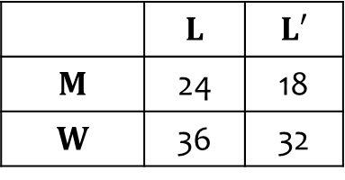

Worked example
Your turn
A group is made up of $62$ men and $48$ women.
$32$ of the men and $46$ of the women are right-handed.
Draw a two-way table to show this information.
One person is chosen at random. Find:
i) $P($right-handed)
ii) $P($right-handed | woman)
iii) $P($man | right-handed)
A group is made up of $42$ men and $68$ women.
$36$ of the women and $24$ of the men are left-handed.
Draw a two-way table to show this information.
One person is chosen at random. Find:
i) $P($left-handed)
ii) $P($left-handed | man)
iii) $P($woman | left-handed)
a)
b)
i) $\frac{60}{110}=\frac{6}{11}$
ii) $\frac{24}{42}=\frac{4}{7}$
iii) $\frac{36}{60}=\frac{3}{5}$
 | $$L$$ | $$L′$$
$$M$$ | 24 | 18
$$W$$ | 36 | 32

Slide 3
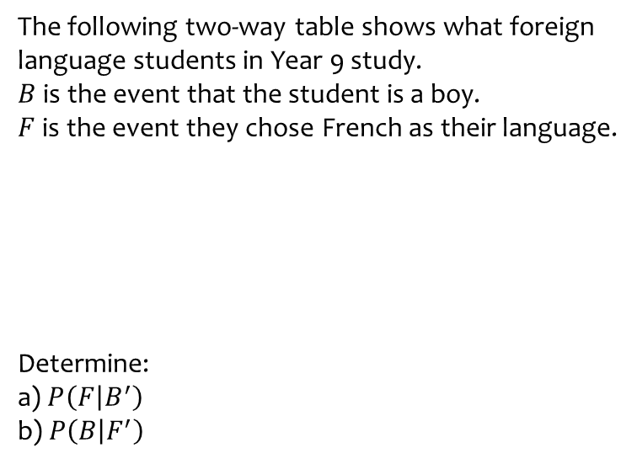
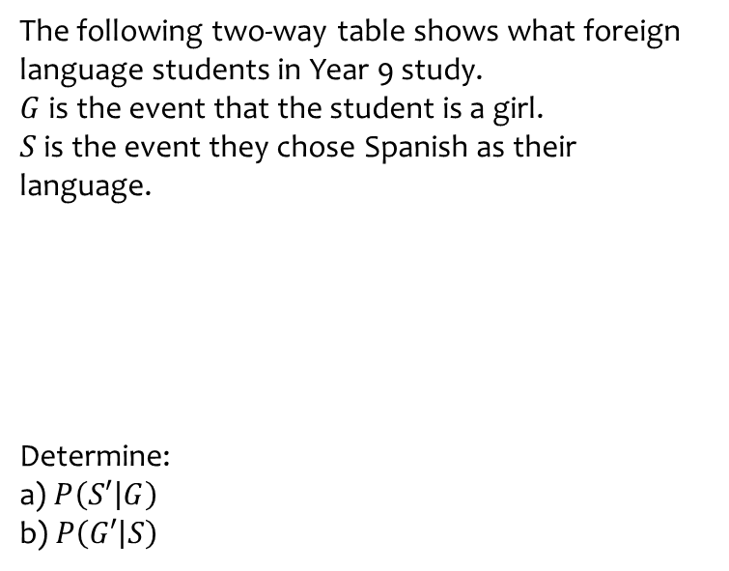
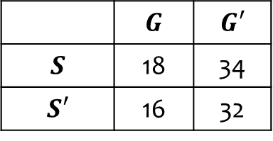
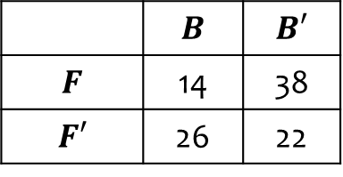
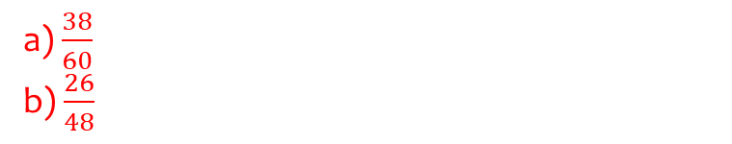
Worked example
Your turn
The following two-way table shows what foreign language students in Year 9 study.
$G$ is the event that the student is a girl.
$S$ is the event they chose Spanish as their language.
Determine:
a) $P\left(S′ | G\right)$
b) $P\left(G′ | S\right)$
The following two-way table shows what foreign language students in Year 9 study.
$B$ is the event that the student is a boy.
$F$ is the event they chose French as their language.
Determine:
a) $P\left(F | B^{′}\right)$
b) $P\left(B | F^{′}\right)$
 | $$G$$ | $$G′$$
$$S$$ | 18 | 34
$$S′$$ | 16 | 32
 | $$B$$ | $$B′$$
$$F$$ | 14 | 38
$$F′$$ | 26 | 22
a) $\frac{38}{60}$
b) $\frac{26}{48}$

