Slide 1
2.1) Solving quadratic equations

Slide 2
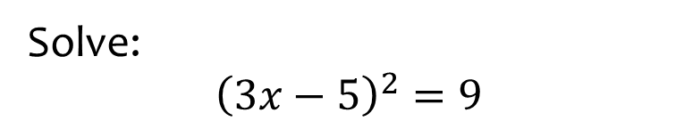
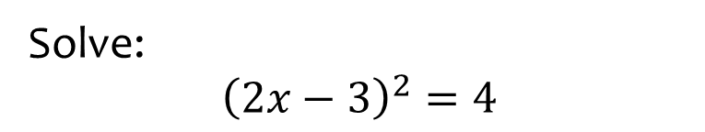

Worked example
Your turn
Solve:
$${\left(2x−3\right)}^{2}=4$$
Solve:
$${\left(3x−5\right)}^{2}=9$$
$$x=\frac{2}{3},x=\frac{8}{3}$$

Slide 3
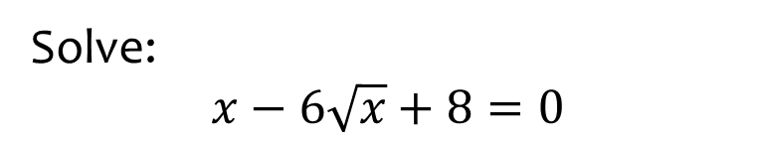
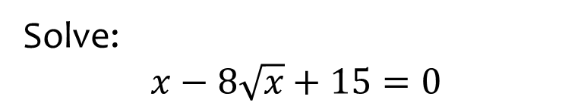

Worked example
Your turn
Solve:
$$x−8\sqrt{x}+15=0$$
Solve:
$$x−6\sqrt{x}+8=0$$
$$x=4, x=16$$

Slide 4
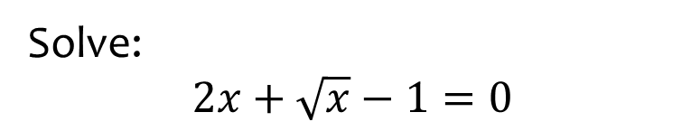
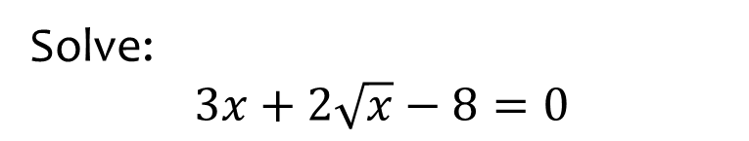

Worked example
Your turn
Solve:
$$3x+2\sqrt{x}−8=0$$
Solve:
$$2x+\sqrt{x}−1=0$$
$$x=\frac{1}{4}$$

Slide 5
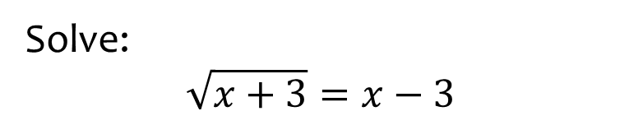
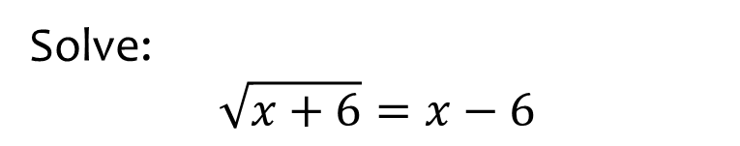

Worked example
Your turn
Solve:
$$\sqrt{x+6}=x−6$$
Solve:
$$\sqrt{x+3}=x−3$$
$x=6$ only

Slide 6
Worked example
Your turn
Solve:
$${\left(2x−3\right)}^{2}=4$$
Solve:
$${\left(3x−5\right)}^{2}=9$$
$$x=\frac{2}{3},x=\frac{8}{3}$$

Slide 7
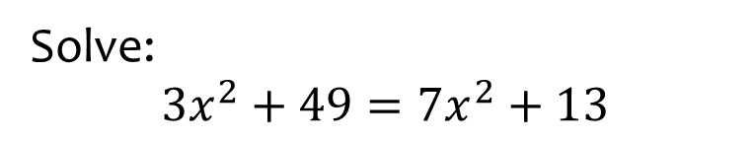


Worked example
Your turn
Solve:
$${2x}^{2}−1=17$$
$$45+2x^{2}=5x^{2}−3$$
$$1−x^{2}=−6x^{2}+6$$
Solve:
$${3x}^{2}+49=7x^{2}+13$$
$$x=±3$$

Slide 8




Worked example
Your turn
Solve:
$$2x^{2}=18$$
$${\left(2x\right)}^{2}=4$$
Solve:
$$3x^{2}=48$$
$${\left(3x\right)}^{2}=36$$
$$x=±4$$
$$x=±2$$

Slide 9
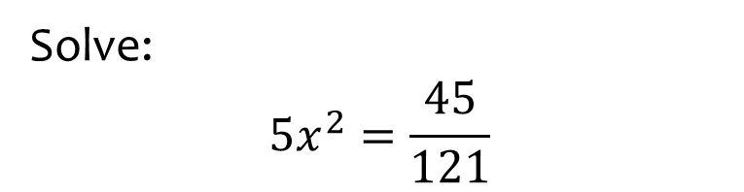


Worked example
Your turn
Solve:
$$2x^{2}=\frac{32}{25}$$
$$3x^{2}=\frac{27}{49}$$
Solve:
$$5x^{2}=\frac{45}{121}$$
$$x=±\frac{3}{11}$$

Slide 10
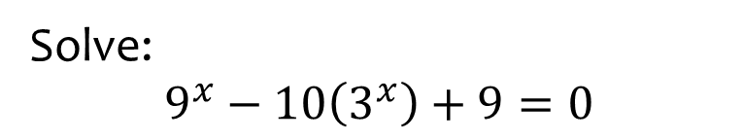


Worked example
Your turn
Solve:
$$4^{x}−12\left(2^{x}\right)+32=0$$
$${16}^{x}−5\left(4^{x}\right)+4=0$$
Solve:
$$9^{x}−10\left(3^{x}\right)+9=0$$
$$x=2, x=0$$

Slide 11
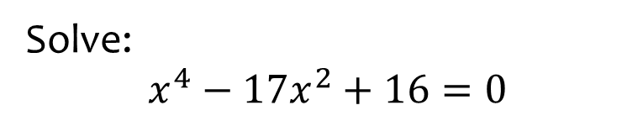


Worked example
Your turn
Solve:
$x^{4}−5x^{2}+4=0$
$$x^{4}−13x^{2}+36=0$$
Solve:
$$x^{4}−17x^{2}+16=0$$
$$x=±4, x=±1$$

Slide 12
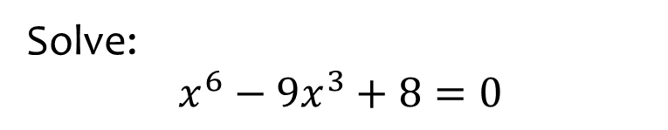
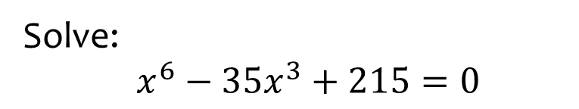

Worked example
Your turn
Solve:
$x^{6}−35x^{3}+215=0$
Solve:
$$x^{6}−9x^{3}+8=0$$
$$x=2, x=1$$

Slide 13
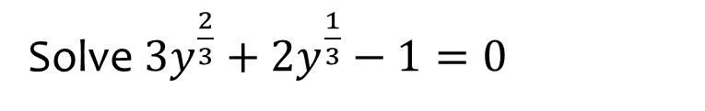
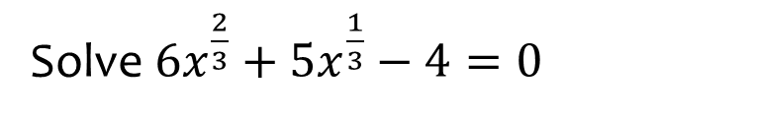

Worked example
Your turn
Solve $6x^{\frac{2}{3}}+5x^{\frac{1}{3}}−4=0$
Solve ${3y}^{\frac{2}{3}}+2y^{\frac{1}{3}}−1=0$
$$y=\frac{1}{27}, y=−1$$

Slide 14
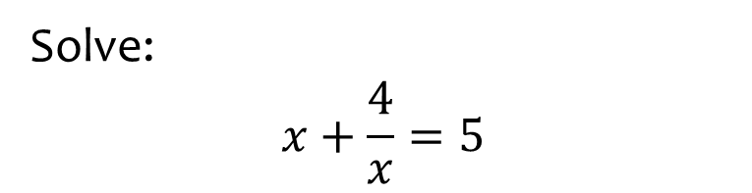


Worked example
Your turn
Solve:
$$x+\frac{2}{x}=3$$
$$x−\frac{3}{x}=5$$
Solve:
$$x+\frac{4}{x}=5$$
$$x=4, x=1$$

Slide 15
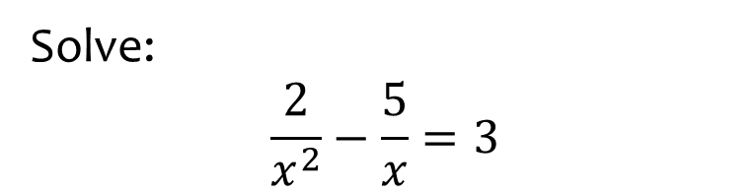


Worked example
Your turn
Solve:
$$\frac{3}{x^{2}}+\frac{2}{x}=1$$
$$\frac{2}{x^{2}}−\frac{7}{x}=3$$
Solve:
$$\frac{2}{x^{2}}−\frac{5}{x}=3$$
$$x=\frac{1}{3}, x=−2$$

Slide 16

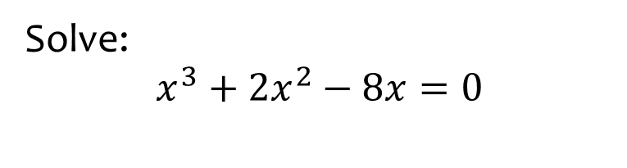

Worked example
Your turn
Solve:
$$x^{3}+2x^{2}−8x=0$$
Solve:
$$x^{3}−3x^{2}−10x=0$$
$$x=0, x=5, x=−2$$

Slide 17
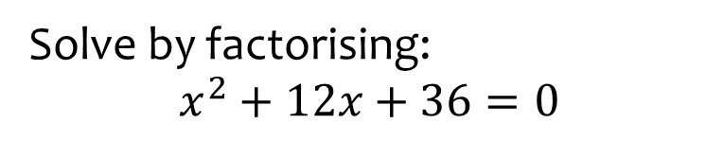


Worked example
Your turn
Solve by factorising:
$$x^{2}+6x+9=0$$
$$x^{2}+8x+16=0$$
$$x^{2}+10x+25=0$$
$$x^{2}+2x+1=0$$
Solve by factorising:
$$x^{2}+12x+36=0$$
$$x=−6$$

Slide 18
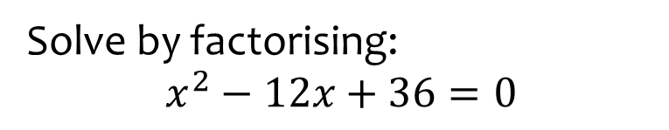


Worked example
Your turn
Solve by factorising:
$$x^{2}−6x+9=0$$
$$x^{2}−8x+16=0$$
$$x^{2}−10x+25=0$$
$$x^{2}−2x+1=0$$
Solve by factorising:
$$x^{2}−12x+36=0$$
$$x=6$$

Slide 19



Worked example
Your turn
Solve by factorising:
$$x^{2}+17x+16=0$$
$$x^{2}+10x+16=0$$
$$x^{2}+8x+16=0$$
$$x^{2}−8x+16=0$$
Solve by factorising:
$$x^{2}+37x+36=0$$
$$x^{2}+20x+36=0$$
$$x^{2}+15x+36=0$$
$$x^{2}+13x+36=0$$
$$x^{2}+12x+36=0$$
$$x=−36, x=−1$$
$$x=−18, x=−2$$
$$x=−12, x=−3$$
$$x=−9, x=−4$$
$$x=−6$$

Slide 20



Worked example
Your turn
Solve by factorising:
$$x^{2}+10x+9=0$$
$$x^{2}+10x+16=0$$
$$x^{2}+10x+25=0$$
$$x^{2}+10x=0$$
Solve by factorising:
$$x^{2}+12x+11=0$$
$$x^{2}+12x+27=0$$
$$x^{2}+12x+36=0$$
$$x^{2}+12x=0$$
$$x=−11, x=−1$$
$$x=−9, x=−3$$
$$x=−6$$
$$x=0, x=−12$$

Slide 21



Worked example
Your turn
Solve by factorising:
$$3x^{2}+10x+3=0$$
$$3x^{2}+10x+8=0$$
$$3x^{2}+14x+8=0$$
Solve by factorising:
$$5x^{2}+8x+3=0$$
$$5x^{2}+16x+12=0$$
$$5x^{2}+32x+12=0$$
$$x=−\frac{3}{5}, x=−1$$
$$x=−\frac{6}{5}, x=−2$$
$$x=−\frac{2}{5}, x=−6$$

Slide 22
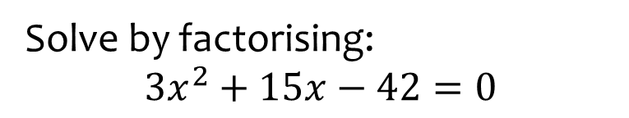


Worked example
Your turn
Solve by factorising:
$$2x^{2}+8x+6=0$$
$$3x^{2}+21x+30=0$$
$$5x^{2}+5x−30=0$$
Solve by factorising:
$$3x^{2}+15x−42=0$$
$$x=−7, x=2$$

Slide 23
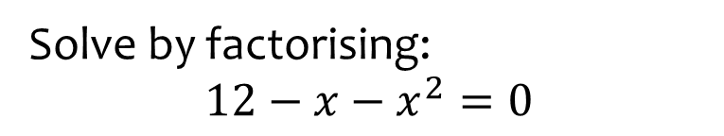


Worked example
Your turn
Solve by factorising:
$$6+5x−x^{2}=0$$
$$3−2x−x^{2}=0$$
Solve by factorising:
$$12−x−x^{2}=0$$
$$x=3, x=−4$$

Slide 24


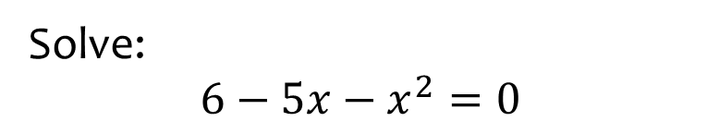
Worked example
Your turn
Solve:
$$6+5x−x^{2}=0$$
$$−6+5x−x^{2}=0$$
Solve:
$$6−5x−x^{2}=0$$
$$x=−6, x=1$$

Slide 25
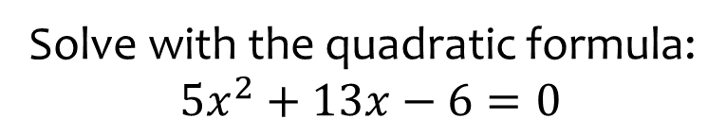


Worked example
Your turn
Solve with the quadratic formula:
$${2x}^{2}+x−3=0$$
$$3x^{2}+x−10=0$$
Solve with the quadratic formula:
$$5x^{2}+13x−6=0$$
$$x=\frac{2}{5}, x=−3$$

Slide 26
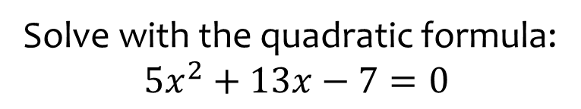


Worked example
Your turn
Solve with the quadratic formula:
$${2x}^{2}+x−4=0$$
$$3x^{2}+x−11=0$$
Solve with the quadratic formula:
$$5x^{2}+13x−7=0$$
$$x=\frac{−13+\sqrt{309}}{10}, x=\frac{−13−\sqrt{309}}{10}$$

Slide 27



Worked example
Your turn
Solve with the quadratic formula:
$$x^{2}+x−11=0$$
$$−{2x}^{2}+x+3=0$$
Solve with the quadratic formula:
$$−x^{2}+13x−7=0$$
$$x=\frac{13+\sqrt{141}}{2}, x=\frac{13−\sqrt{141}}{2}$$

Slide 28


Worked example
Your turn
The solutions to a quadratic equation are $x=\frac{5±\sqrt{25+24}}{6}$
What is the quadratic equation?
The solutions to a quadratic equation are $x=\frac{6±\sqrt{36+8}}{2}$
What is the quadratic equation?
$$x^{2}−6x−2=0$$

Slide 29



Worked example
Your turn
How many real roots are there to:
$$x^{2}+6x+8=0$$
$$x^{2}+6x+9=0$$
$$x^{2}+6x+10=0$$
How many real roots are there to:
$$x^{2}+8x+12=0$$
$$x^{2}+8x+16=0$$
$$x^{2}+8x+17=0$$
Two: $x=−6, x=−2$
One: $x=−4$
No real roots

Slide 30
Worked example
Your turn
Solve:
$$x+\frac{2}{x}=3$$
$$x−\frac{3}{x}=5$$
Solve:
$$x+\frac{4}{x}=5$$
$$x=4, x=1$$

Slide 31
Worked example
Your turn
Solve:
$$\frac{3}{x^{2}}+\frac{2}{x}=1$$
$$\frac{2}{x^{2}}−\frac{7}{x}=3$$
Solve:
$$\frac{2}{x^{2}}−\frac{5}{x}=3$$
$$x=\frac{1}{3}, x=−2$$

Slide 32



Worked example
Your turn
Solve by completing the square:
$$x^{2}+8x+3=0$$
$$x^{2}+10x−4=0$$
Solve by completing the square:
$$x^{2}+6x+4=0$$
$$x=−3+\sqrt{5}, x=−3−\sqrt{5}$$

Slide 33



Worked example
Your turn
Solve by completing the square:
$$2x^{2}−8x+3=0$$
$${3x}^{2}−10x−4=0$$
Solve by completing the square:
$${5x}^{2}−6x−2=0$$
$$x=\frac{3+\sqrt{19}}{5}, x=\frac{3−\sqrt{19}}{5}$$

Slide 34



Worked example
Your turn
Solve using three methods:
$$x^{2}+6x+8=0$$
$$x^{2}+6x+8=0$$
$$x^{2}+6x+8=0$$
Solve using three methods:
$$x^{2}+6x+5=0$$
$$x=−5, x=−1$$

Slide 35







Worked example
Your turn
The area of the rectangle is equal to $32$ square units. Find $x$
The area of the rectangle is equal to $28$square units. Find $x$
$$x−3$$
$$x−7$$
$$x−5$$
$$x−2$$
$$x=9$$

Slide 36









Worked example
Your turn
The area of the triangle is equal to $16$square units. Find $x$
The area of the triangle is equal to $24$square units. Find $x$
$$4\sqrt{5}$$
$$10$$
$$2x−8$$
$$x−1$$
$$x+2$$
$$2x−6$$
$$x=7$$

Slide 37



Worked example
Your turn
Two numbers have a difference of $3$ and a product of $88$. Find the two numbers.
Two numbers have a difference of $5$ and a product of $14$. Find the two numbers.
Two numbers have a difference of $4$ and a product of $12$. Find the two numbers.
$$x=6, y=2$$
$$x=−2, y=−6$$

