Slide 1
2.1) Measures of central tendency

Slide 2
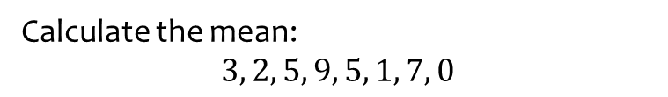
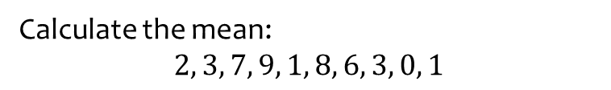
Worked example
Your turn
Calculate the mean:
$$2, 3, 7, 9, 1, 8, 6, 3, 0, 1$$
Calculate the mean:
$$3, 2, 5, 9, 5, 1, 7, 0$$
$$4$$

Slide 3
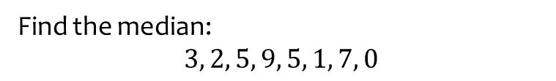
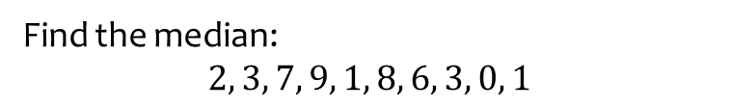
Worked example
Your turn
Find the median:
$$2, 3, 7, 9, 1, 8, 6, 3, 0, 1$$
Find the median:
$$3, 2, 5, 9, 5, 1, 7, 0$$
$$4$$

Slide 4
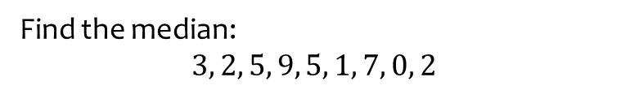
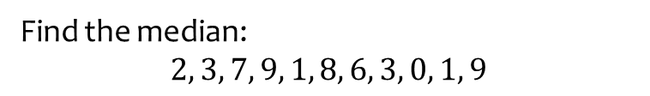
Worked example
Your turn
Find the median:
$$2, 3, 7, 9, 1, 8, 6, 3, 0, 1, 9$$
Find the median:
$$3, 2, 5, 9, 5, 1, 7, 0, 2$$
$$3$$

Slide 5
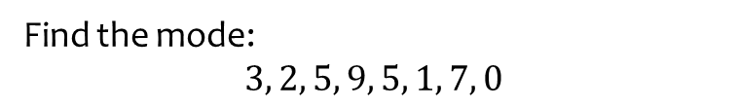
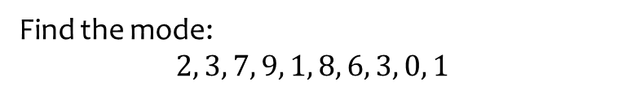
Worked example
Your turn
Find the mode:
$$2, 3, 7, 9, 1, 8, 6, 3, 0, 1$$
Find the mode:
$$3, 2, 5, 9, 5, 1, 7, 0$$
$$5$$

Slide 6
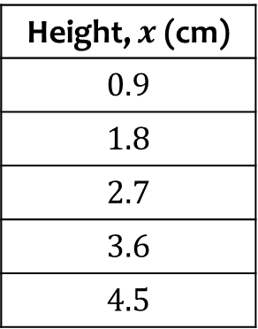
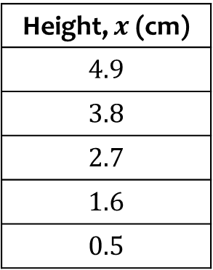
Worked example
Your turn
Calculate the mean height:
Calculate the mean height:
Height, $x$ (cm)
$$0.9$$
$$1.8$$
$$2.7$$
$$3.6$$
$$4.5$$
Height, $x$ (cm)
$$4.9$$
$$3.8$$
$$2.7$$
$$1.6$$
$$0.5$$
$$\overline{x}=2.7$$

Slide 7
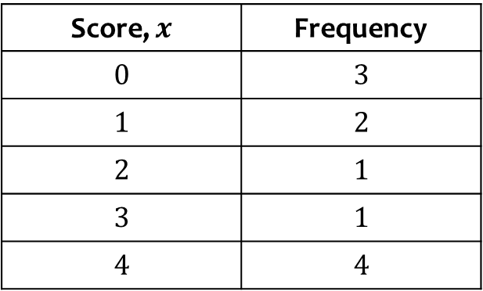

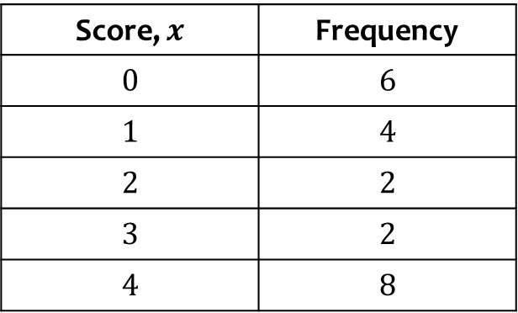
Worked example
Your turn
Calculate the mean score:
Calculate the mean score:
Score, $x$ | Frequency
$$0$$ | $$3$$
$$1$$ | $$2$$
$$2$$ | $$1$$
$$3$$ | $$1$$
$$4$$ | $$4$$
Score, $x$ | Frequency
$$0$$ | $$6$$
$$1$$ | $$4$$
$$2$$ | $$2$$
$$3$$ | $$2$$
$$4$$ | $$8$$
$\overline{x}=2.09$(3 sf)

Slide 8
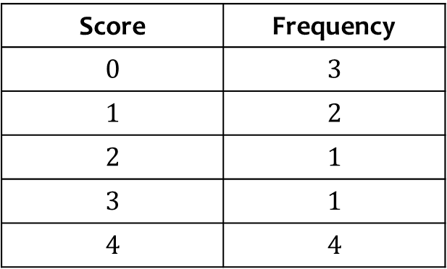
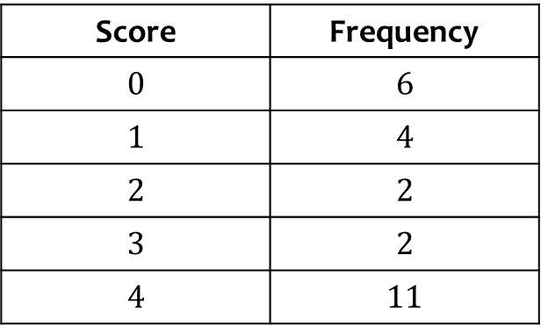
Worked example
Your turn
Find the median score:
Find the median score:
Score | Frequency
$$0$$ | $$3$$
$$1$$ | $$2$$
$$2$$ | $$1$$
$$3$$ | $$1$$
$$4$$ | $$4$$
Score | Frequency
$$0$$ | $$6$$
$$1$$ | $$4$$
$$2$$ | $$2$$
$$3$$ | $$2$$
$$4$$ | $$11$$
$$3$$

Slide 9
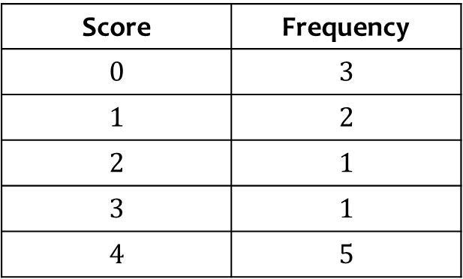
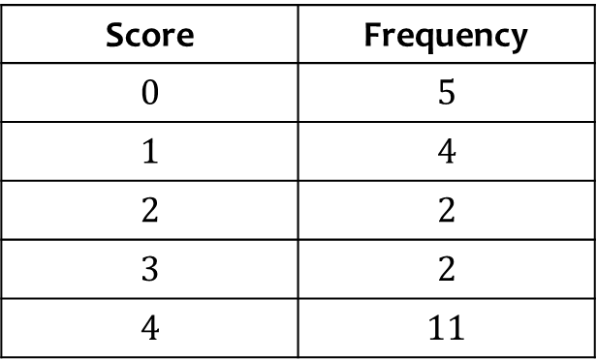
Worked example
Your turn
Find the median score:
Find the median score:
Score | Frequency
$$0$$ | $$3$$
$$1$$ | $$2$$
$$2$$ | $$1$$
$$3$$ | $$1$$
$$4$$ | $$5$$
Score | Frequency
$$0$$ | $$5$$
$$1$$ | $$4$$
$$2$$ | $$2$$
$$3$$ | $$2$$
$$4$$ | $$11$$
$$3$$

Slide 10
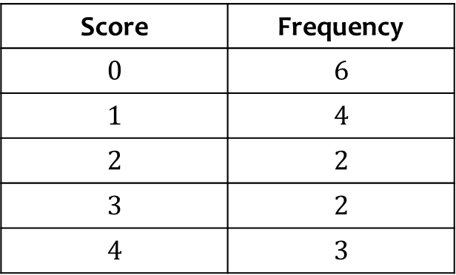
Worked example
Your turn
Find the mode of the scores:
Find the mode of the scores:
Score | Frequency
$$0$$ | $$3$$
$$1$$ | $$2$$
$$2$$ | $$1$$
$$3$$ | $$1$$
$$4$$ | $$4$$
Score | Frequency
$$0$$ | $$6$$
$$1$$ | $$4$$
$$2$$ | $$2$$
$$3$$ | $$2$$
$$4$$ | $$3$$
$$0$$

Slide 11
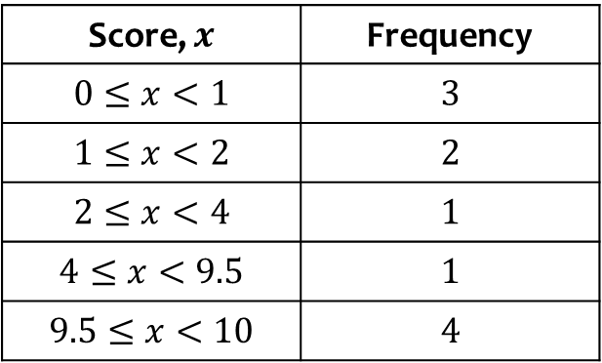

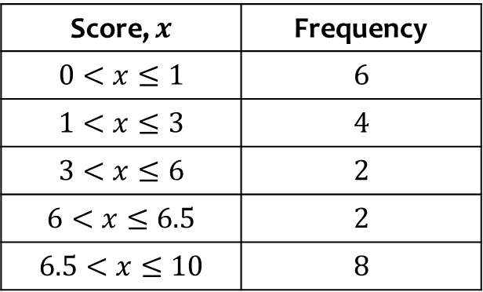
Worked example
Your turn
Calculate an estimate for the mean score:
Calculate an estimate for the mean score:
Score, $x$ | Frequency
$$0≤x<1$$ | $$3$$
$$1≤x<2$$ | $$2$$
$$2≤x<4$$ | $$1$$
$$4≤x<9.5$$ | $$1$$
$$9.5≤x<10$$ | $$4$$
Score, $x$ | Frequency
$$0<x≤1$$ | $$6$$
$$1<x≤3$$ | $$4$$
$$3<x≤6$$ | $$2$$
$$6<x≤6.5$$ | $$2$$
$$6.5<x≤10$$ | $$8$$
$\overline{x}=4.48$(3 sf)

Slide 12
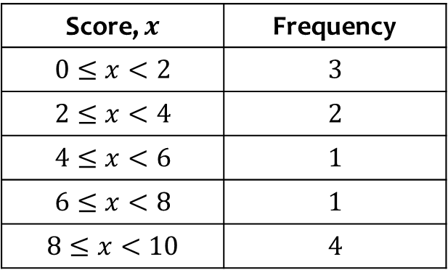

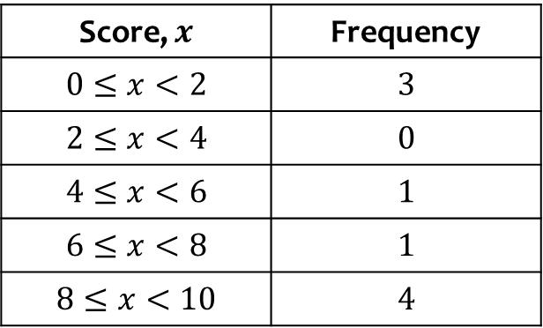
Worked example
Your turn
Calculate an estimate for the mean score:
Calculate an estimate for the mean score:
Score, $x$ | Frequency
$$0≤x<2$$ | $$3$$
$$2≤x<4$$ | $$2$$
$$4≤x<6$$ | $$1$$
$$6≤x<8$$ | $$1$$
$$8≤x<10$$ | $$4$$
Score, $x$ | Frequency
$$0≤x<2$$ | $$3$$
$$2≤x<4$$ | $$0$$
$$4≤x<6$$ | $$1$$
$$6≤x<8$$ | $$1$$
$$8≤x<10$$ | $$4$$
$\overline{x}=5.67$(3 sf)

Slide 13
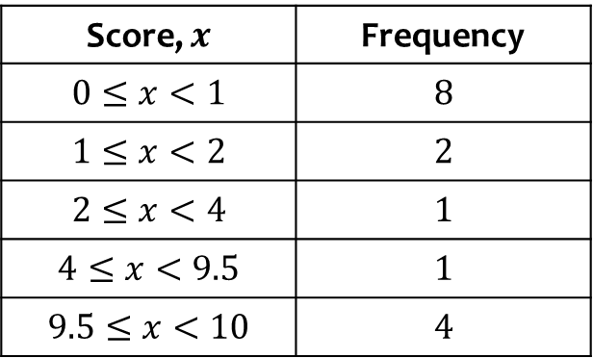
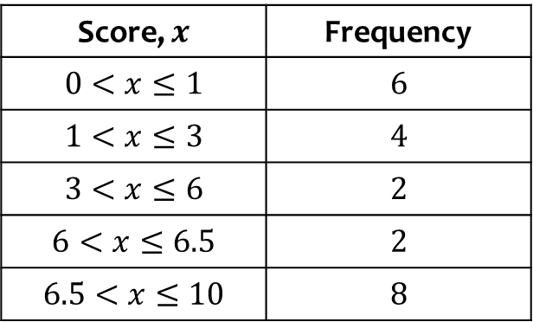
Worked example
Your turn
Write down the interval containing the median
Write down the interval containing the median
Score, $x$ | Frequency
$$0≤x<1$$ | $$8$$
$$1≤x<2$$ | $$2$$
$$2≤x<4$$ | $$1$$
$$4≤x<9.5$$ | $$1$$
$$9.5≤x<10$$ | $$4$$
Score, $x$ | Frequency
$$0<x≤1$$ | $$6$$
$$1<x≤3$$ | $$4$$
$$3<x≤6$$ | $$2$$
$$6<x≤6.5$$ | $$2$$
$$6.5<x≤10$$ | $$8$$
$$3<x≤6$$

Slide 14
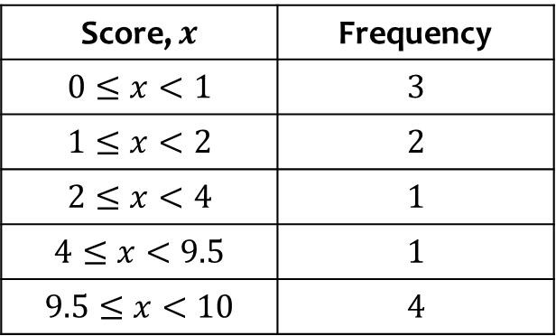
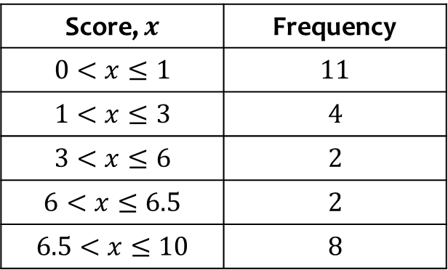
Worked example
Your turn
Write down the interval containing the median
Write down the interval containing the median
Score, $x$ | Frequency
$$0≤x<1$$ | $$3$$
$$1≤x<2$$ | $$2$$
$$2≤x<4$$ | $$1$$
$$4≤x<9.5$$ | $$1$$
$$9.5≤x<10$$ | $$4$$
Score, $x$ | Frequency
$$0<x≤1$$ | $$11$$
$$1<x≤3$$ | $$4$$
$$3<x≤6$$ | $$2$$
$$6<x≤6.5$$ | $$2$$
$$6.5<x≤10$$ | $$8$$
$$1<x≤3$$

Slide 15
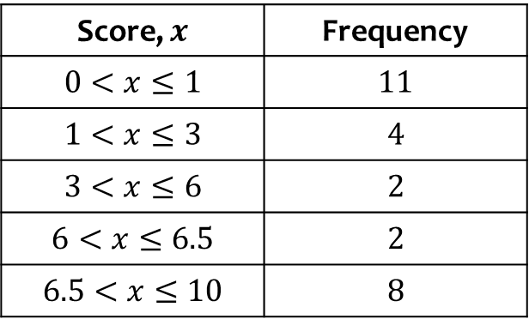
Worked example
Your turn
Write down the modal class
Write down the modal class
Score, $x$ | Frequency
$$0≤x<1$$ | $$3$$
$$1≤x<2$$ | $$2$$
$$2≤x<4$$ | $$1$$
$$4≤x<9.5$$ | $$1$$
$$9.5≤x<10$$ | $$4$$
Score, $x$ | Frequency
$$0<x≤1$$ | $$11$$
$$1<x≤3$$ | $$4$$
$$3<x≤6$$ | $$2$$
$$6<x≤6.5$$ | $$2$$
$$6.5<x≤10$$ | $$8$$
$$0<x≤1$$

Slide 16
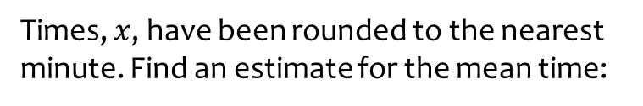
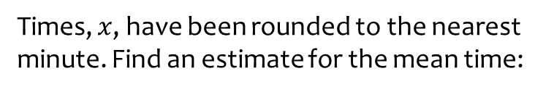
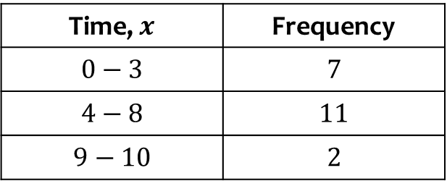
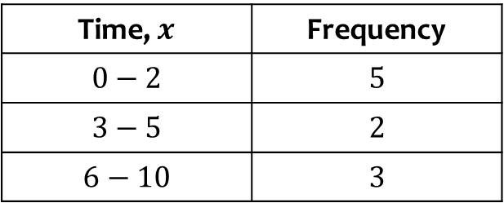
Worked example
Your turn
Times, $x$, have been rounded to the nearest minute. Find an estimate for the mean time:
Times, $x$, have been rounded to the nearest minute. Find an estimate for the mean time:
Time, $x$ | Frequency
$$0−2$$ | $$5$$
$$3−5$$ | $$2$$
$$6−10$$ | $$3$$
Time, $x$ | Frequency
$$0−3$$ | $$7$$
$$4−8$$ | $$11$$
$$9−10$$ | $$2$$
$$\overline{x}=4.8125$$

Slide 17
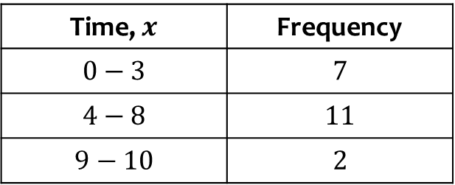
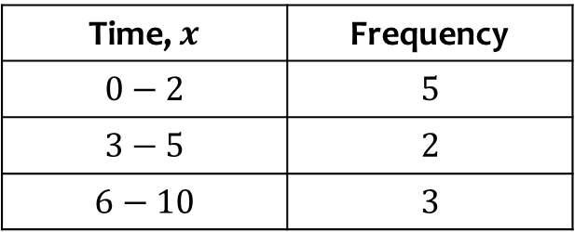
Worked example
Your turn
Write down the class containing the median
Write down the class containing the median
Time, $x$ | Frequency
$$0−2$$ | $$5$$
$$3−5$$ | $$2$$
$$6−10$$ | $$3$$
Time, $x$ | Frequency
$$0−3$$ | $$7$$
$$4−8$$ | $$11$$
$$9−10$$ | $$2$$
$$4−8$$

Slide 18
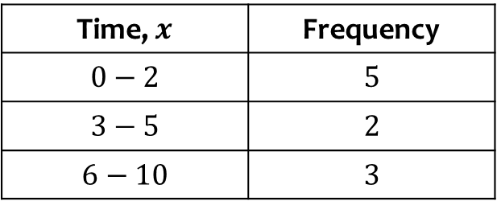
Worked example
Your turn
Write down the modal class
Write down the modal class
Time, $x$ | Frequency
$$0−2$$ | $$5$$
$$3−5$$ | $$2$$
$$6−10$$ | $$3$$
Time, $x$ | Frequency
$$0−3$$ | $$7$$
$$4−8$$ | $$11$$
$$9−10$$ | $$2$$
$$4−8$$

Slide 19

Worked example
Your turn
The table shows the length of time for different people to complete a task:
Calculate the mean.
The table shows the length of time for different people to complete a task:
Calculate the mean.
Person | A | B | C | D | E | F
Time (minutes) | 1 | 3 | 8 | 2 | 1 | 9
Person | A | B | C | D | E | F
Time (minutes) | 7 | 3 | 8 | 2 | 1 | 3
$4$ minutes

Slide 20

Worked example
Your turn
The table shows the length of time for different people to complete a task:
Find the median:
The table shows the length of time for different people to complete a task:
Find the median:
Person | A | B | C | D | E | F
Time (minutes) | 1 | 3 | 8 | 2 | 1 | 9
Person | A | B | C | D | E | F
Time (minutes) | 7 | 3 | 8 | 2 | 1 | 3
$3$ minutes

Slide 21
Worked example
Your turn
The table shows the length of time for different people to complete a task:
Write down the mode.
The table shows the length of time for different people to complete a task:
Write down the mode.
Person | A | B | C | D | E | F
Time (minutes) | 1 | 3 | 8 | 2 | 1 | 9
Person | A | B | C | D | E | F
Time (minutes) | 7 | 3 | 8 | 2 | 1 | 3
$3$ minutes

Slide 22
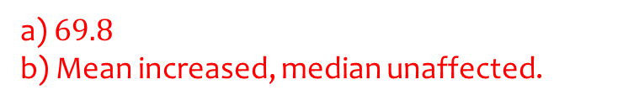
Worked example
Your turn
The mean maths score of 10 pupils in class A is 26.
The mean maths score of 40 pupils in class B is 57.
Find the overall mean of all the pupils’ marks.
The teacher realises they mismarked one student’s paper; he should have received 90 instead of 95. Explain the effect on the mean and median.
The mean maths score of 20 pupils in class A is 62.
The mean maths score of 30 pupils in class B is 75.
Find the overall mean of all the pupils’ marks.
The teacher realises they mismarked one student’s paper; he should have received 100 instead of 95. Explain the effect on the mean and median.
a) $69.8$
b) Mean increased, median unaffected.

