Slide 1
2.1) Work done

Slide 2
Worked example
Your turn
A horizontal force of 16 N moves a box 2.5 m across a horizontal floor. Calculate the work done by the force.
A horizontal force of 8 N moves a box 5 m across a horizontal floor. Calculate the work done by the force.
$$40 J$$

Slide 3
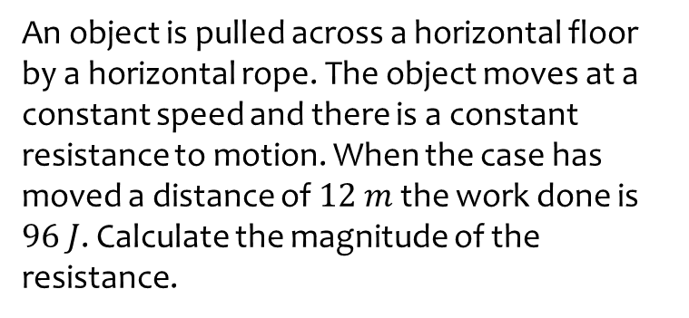
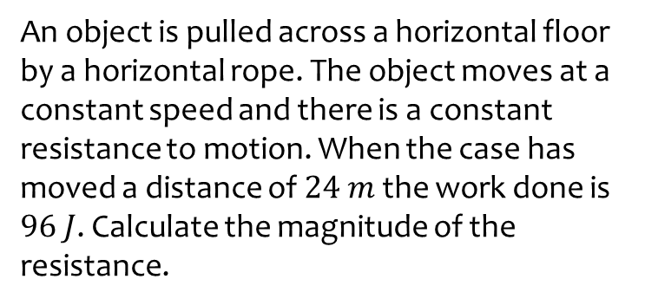
Worked example
Your turn
An object is pulled across a horizontal floor by a horizontal rope. The object moves at a constant speed and there is a constant resistance to motion. When the case has moved a distance of $24 m$ the work done is $96 J$. Calculate the magnitude of the resistance.
An object is pulled across a horizontal floor by a horizontal rope. The object moves at a constant speed and there is a constant resistance to motion. When the case has moved a distance of $12 m$ the work done is $96 J$. Calculate the magnitude of the resistance.
$$8 N$$

Slide 4
Worked example
Your turn
An object of mass $15 kg$ is raised vertically at a constant speed by means of a vertical cable. Calculate the work done when the object is raised a distance of $14 m$.
An object of mass $30 kg$ is raised vertically at a constant speed by means of a vertical cable. Calculate the work done when the object is raised a distance of $7 m$.
$2100 J$ (2 sf)

Slide 5
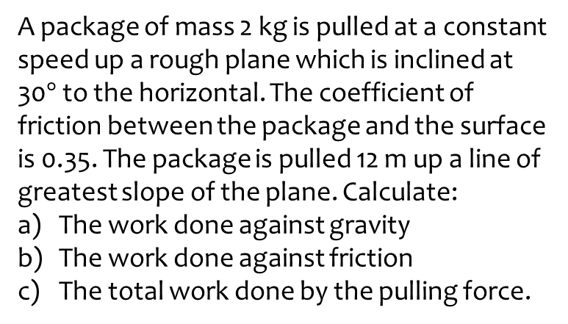
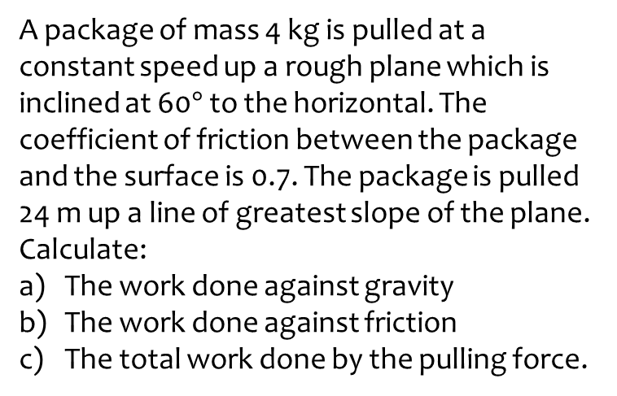
Worked example
Your turn
A package of mass 4 kg is pulled at a constant speed up a rough plane which is inclined at 60$°$ to the horizontal. The coefficient of friction between the package and the surface is 0.7. The package is pulled 24 m up a line of greatest slope of the plane. Calculate:
The work done against gravity
The work done against friction
The total work done by the pulling force.
A package of mass 2 kg is pulled at a constant speed up a rough plane which is inclined at 30$°$ to the horizontal. The coefficient of friction between the package and the surface is 0.35. The package is pulled 12 m up a line of greatest slope of the plane. Calculate:
The work done against gravity
The work done against friction
The total work done by the pulling force.
a) $118 J$ (3 sf)
b) $71.3 J$ (3 sf)
c) $189 J$ (3 sf)

Slide 6
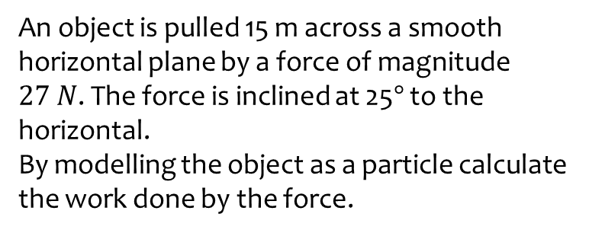
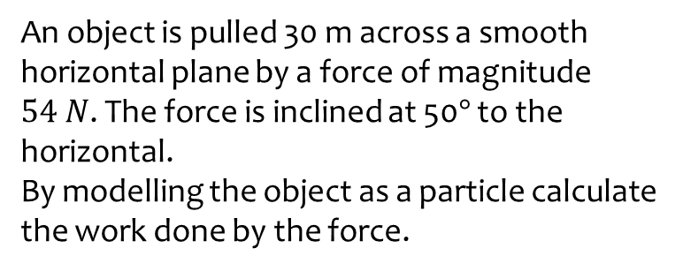
Worked example
Your turn
An object is pulled 30 m across a smooth horizontal plane by a force of magnitude $54 N$. The force is inclined at 50$°$ to the horizontal.
By modelling the object as a particle calculate the work done by the force.
An object is pulled 15 m across a smooth horizontal plane by a force of magnitude $27 N$. The force is inclined at 25$°$ to the horizontal.
By modelling the object as a particle calculate the work done by the force.
$367 J$(3 sf)

