Slide 1
2.1) The modulus function

Slide 2
Worked example
Your turn
If $f\left(x\right)=\left|4x+5\right|−6$, find:
$f(5)$
$f(−2)$
$f(1)$
If $f\left(x\right)=\left|2x−3\right|+1$, find:
$f(5)$
$f(−2)$
$f(1)$
$$8$$
$$−6$$
$$2$$

Slide 3
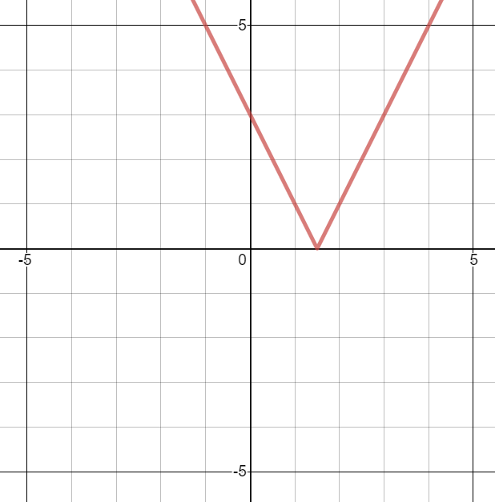
Worked example
Your turn
Sketch:
$$y=|3x−2|$$
$$y=|2−3x|$$
Sketch:
$$y=|2x−3|$$
Graphs used with permission from DESMOS: https://www.desmos.com/

Slide 4
Worked example
Your turn
Solve:
$$\left|3x−2\right|=7$$
$$\left|2−3x\right|=6$$
Solve:
$$\left|2x−3\right|=5$$
$$x=−1, x=4$$

Slide 5
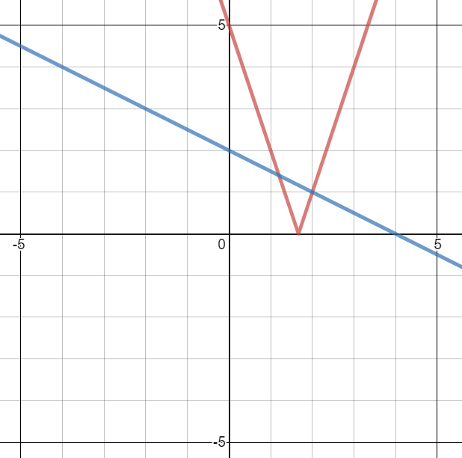
Worked example
Your turn
Solve:
$$\left|5x−2\right|=3−\frac{1}{3}x$$
$$\left|5−3x\right|=\frac{1}{2}x+2$$
Solve:
$$\left|3x−5\right|=2−\frac{1}{2}x$$
$$x=\frac{6}{5}, x=2$$
Graphs used with permission from DESMOS: https://www.desmos.com/

Slide 6
Worked example
Your turn
Solve:
$$\left|5x−2\right|<3−\frac{1}{3}x$$
$$\left|5−3x\right|≤\frac{1}{2}x+2$$
Solve:
$$\left|3x−5\right|<2−\frac{1}{2}x$$
$$\frac{6}{5}<x<2$$
Graphs used with permission from DESMOS: https://www.desmos.com/

Slide 7
Worked example
Your turn
Solve:
$$\left|5x−2\right|>3−\frac{1}{3}x$$
$$\left|5−3x\right|≥\frac{1}{2}x+2$$
Solve:
$$\left|3x−5\right|>2−\frac{1}{2}x$$
$$x<\frac{6}{5}∪x>2$$
Graphs used with permission from DESMOS: https://www.desmos.com/

Slide 8
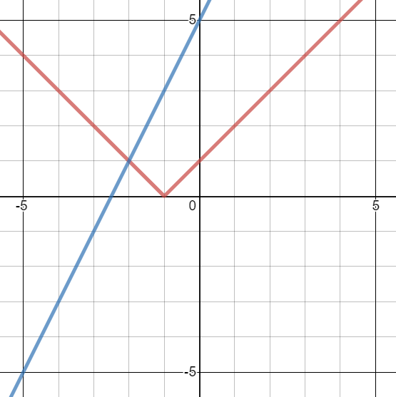
Worked example
Your turn
Solve:
$$\left|x+3\right|=5x+2$$
$$\left|x+3\right|=x+2$$
Solve:
$$\left|x+1\right|=2x+5$$
$$x=−2$$
Graphs used with permission from DESMOS: https://www.desmos.com/

