Slide 1
2.1) Set notation

Slide 2
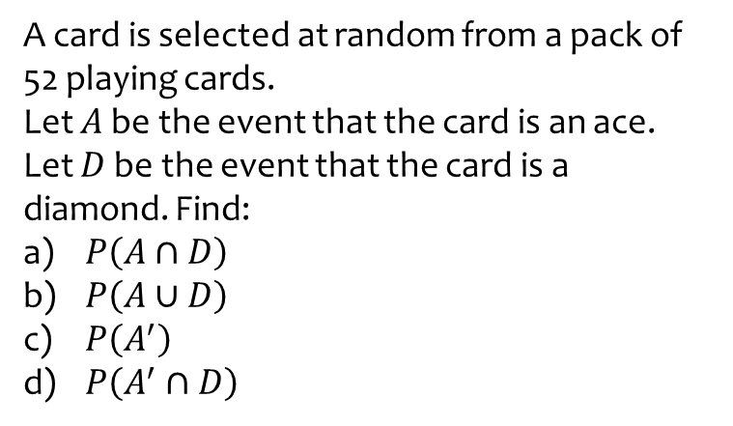
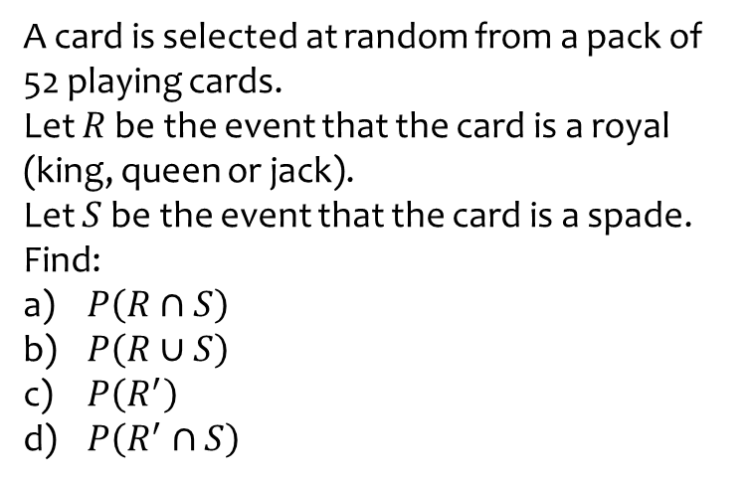

Worked example
Your turn
A card is selected at random from a pack of 52 playing cards.
Let $R$ be the event that the card is a royal (king, queen or jack).
Let $S$ be the event that the card is a spade. Find:
$P\left(R∩S\right)$
$P\left(R∪S\right)$
$P\left(R^{′}\right)$
$P\left(R^{′}∩S\right)$
A card is selected at random from a pack of 52 playing cards.
Let $A$ be the event that the card is an ace.
Let $D$ be the event that the card is a diamond. Find:
$P\left(A∩D\right)$
$P\left(A∪D\right)$
$P\left(A^{′}\right)$
$P\left(A^{′}∩D\right)$
a) $\frac{1}{52}$
b) $\frac{16}{52}$
c) $\frac{48}{52}$
d) $\frac{12}{52}$

Slide 3
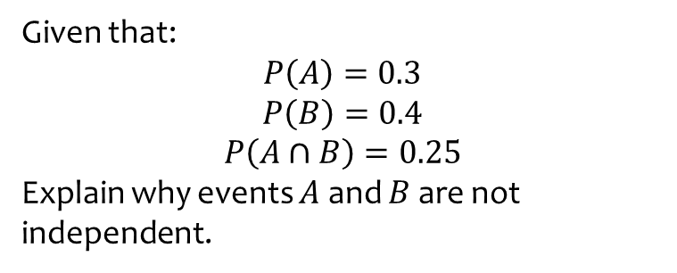
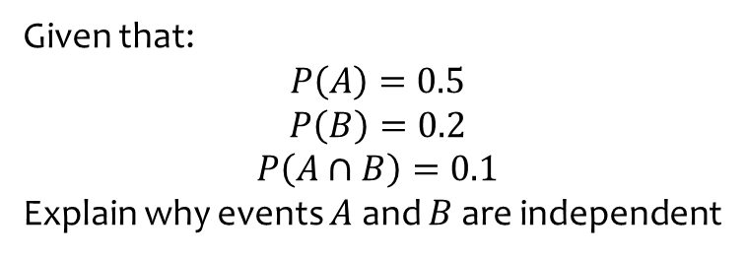
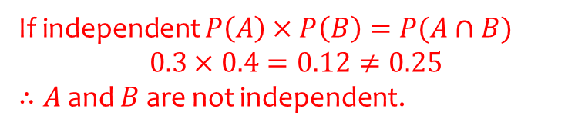
Worked example
Your turn
Given that:
$$P\left(A\right)=0.5$$
$$P\left(B\right)=0.2$$
$$P\left(A∩B\right)=0.1$$
Explain why events $A$ and $B$ are independent
Given that:
$$P\left(A\right)=0.3$$
$$P\left(B\right)=0.4$$
$$P\left(A∩B\right)=0.25$$
Explain why events $A$ and $B$ are not independent.
If independent $P\left(A\right)×P\left(B\right)=P(A∩B)$
$0.3×0.4=0.12≠0.25$
$∴A$ and $B$ are not independent.

Slide 4
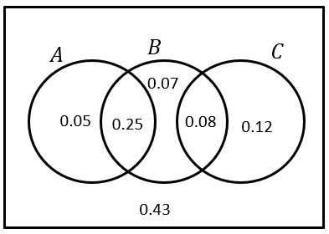
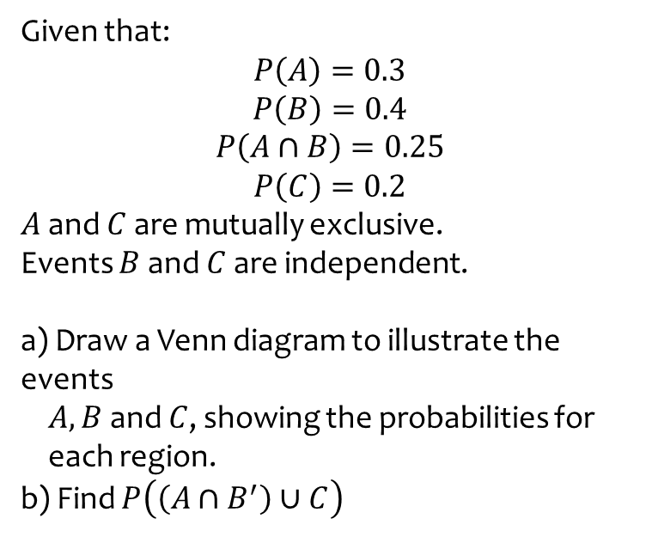
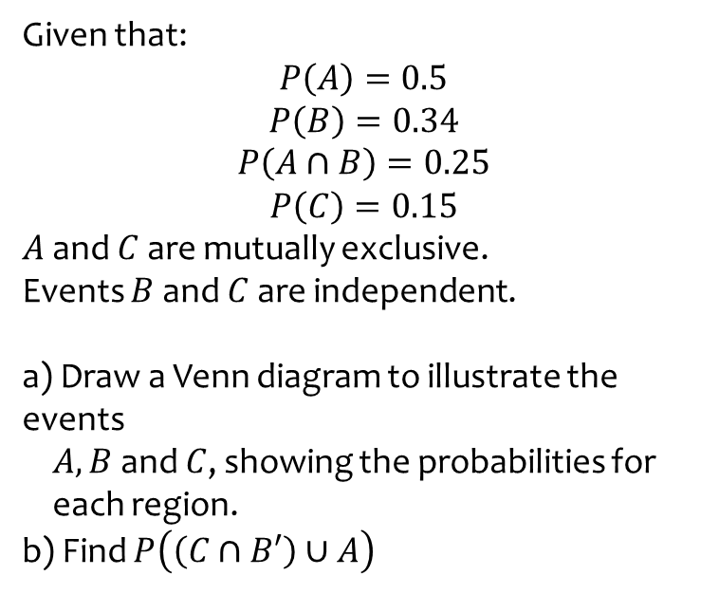

Worked example
Your turn
Given that:
$$P\left(A\right)=0.5$$
$$P\left(B\right)=0.34$$
$$P\left(A∩B\right)=0.25$$
$$P\left(C\right)=0.15$$
$A$ and $C$ are mutually exclusive.
Events $B$ and $C$ are independent.
a) Draw a Venn diagram to illustrate the events
$A, B$ and $C$, showing the probabilities for
each region.
b) Find $P\left(\left(C∩B′\right)∪A\right)$
Given that:
$$P\left(A\right)=0.3$$
$$P\left(B\right)=0.4$$
$$P\left(A∩B\right)=0.25$$
$$P\left(C\right)=0.2$$
$A$ and $C$ are mutually exclusive.
Events $B$ and $C$ are independent.
a) Draw a Venn diagram to illustrate the events
$A, B$ and $C$, showing the probabilities for
each region.
b) Find $P\left(\left(A∩B^{′}\right)∪C\right)$
a)
b) $0.25$
Diagrams/Graphs used with permission from DrFrostMaths: https://www.drfrostmaths.com/

Slide 5
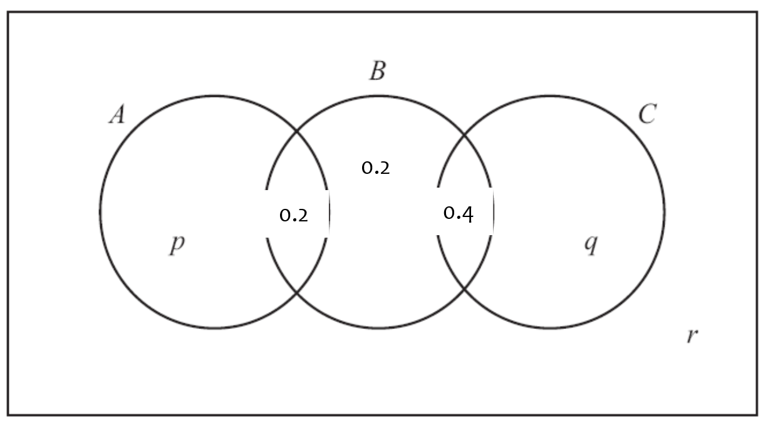
Worked example
Your turn
The events A and B are independent.
Find the value of p.
The events A and B are independent.
Find the value of p.
$$p=0.15$$

Slide 6
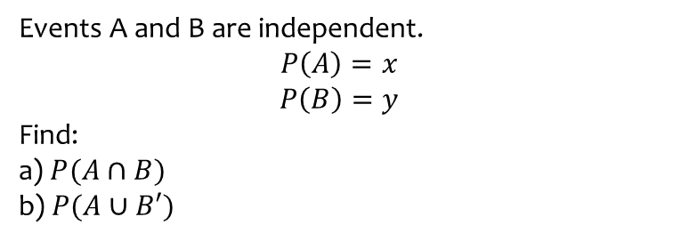
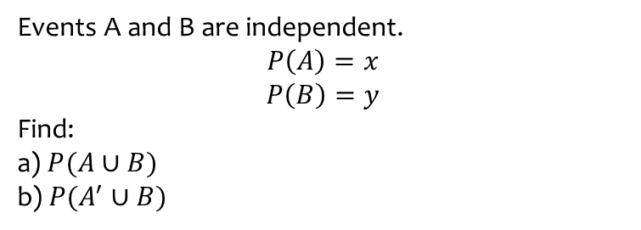
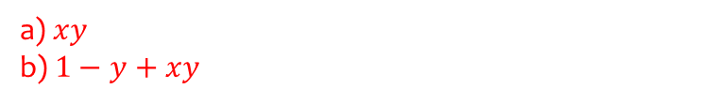
Worked example
Your turn
Events A and B are independent.
$$P\left(A\right)=x$$
$$P\left(B\right)=y$$
Find:
a) $P(A∪B)$
b) $P(A^{′}∪B)$
Events A and B are independent.
$$P\left(A\right)=x$$
$$P\left(B\right)=y$$
Find:
a) $P(A∩B)$
b) $P(A∪B′)$
a) $xy$
b) $1−y+xy$

Slide 7
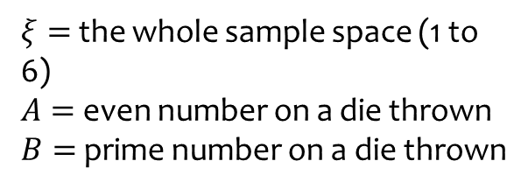


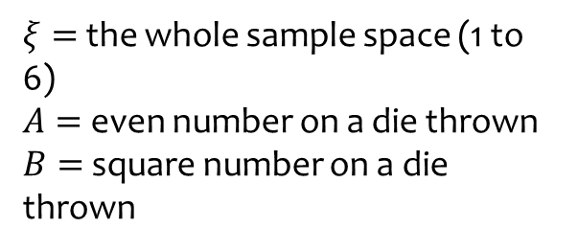





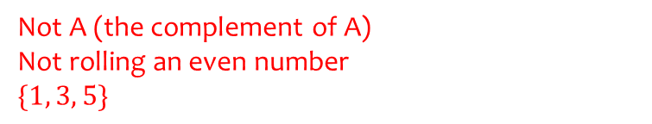

Worked example
Your turn
State what it means in this context, and the resulting set of outcomes:
$$A′$$
State what it means in this context, and the resulting set of outcomes:
$$A′$$
$$ξ$$
$$ξ$$
$$A$$
$$B$$
$$A$$
$$B$$
2
1
4
3
4
3
2
1
6
6
5
5
$ξ=$ the whole sample space (1 to 6)
$A=$ even number on a die thrown
$B=$ square number on a die thrown
$ξ=$ the whole sample space (1 to 6)
$A=$ even number on a die thrown
$B=$ prime number on a die thrown
Not A (the complement of A)
Not rolling an even number
$$\{1, 3, 5\}$$
Diagrams/Graphs used with permission from DrFrostMaths: https://www.drfrostmaths.com/

Slide 8



Worked example
Your turn
State what it means in this context, and the resulting set of outcomes:
$$B′$$
State what it means in this context, and the resulting set of outcomes:
$$B′$$
$$ξ$$
$$ξ$$
$$A$$
$$B$$
$$A$$
$$B$$
2
1
4
3
4
3
2
1
6
6
5
5
$ξ=$ the whole sample space (1 to 6)
$A=$ even number on a die thrown
$B=$ square number on a die thrown
$ξ=$ the whole sample space (1 to 6)
$A=$ even number on a die thrown
$B=$ prime number on a die thrown
Not B (the complement of B)
Not rolling a prime number
$$\{1, 4, 6\}$$
Diagrams/Graphs used with permission from DrFrostMaths: https://www.drfrostmaths.com/

Slide 9


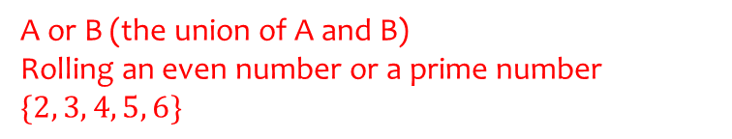
Worked example
Your turn
State what it means in this context, and the resulting set of outcomes:
$$A∪B$$
State what it means in this context, and the resulting set of outcomes:
$$A∪B$$
$$ξ$$
$$ξ$$
$$A$$
$$B$$
$$A$$
$$B$$
2
1
4
3
4
3
2
1
6
6
5
5
$ξ=$ the whole sample space (1 to 6)
$A=$ even number on a die thrown
$B=$ square number on a die thrown
$ξ=$ the whole sample space (1 to 6)
$A=$ even number on a die thrown
$B=$ prime number on a die thrown
A or B (the union of A and B)
Rolling an even number or a prime number
$$\{2, 3, 4, 5, 6\}$$
Diagrams/Graphs used with permission from DrFrostMaths: https://www.drfrostmaths.com/

Slide 10


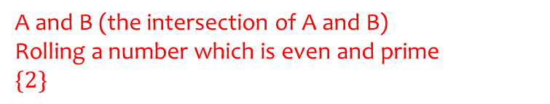
Worked example
Your turn
State what it means in this context, and the resulting set of outcomes:
$$A∩B$$
State what it means in this context, and the resulting set of outcomes:
$$A∩B$$
$$ξ$$
$$ξ$$
$$A$$
$$B$$
$$A$$
$$B$$
2
1
4
3
4
3
2
1
6
6
5
5
$ξ=$ the whole sample space (1 to 6)
$A=$ even number on a die thrown
$B=$ square number on a die thrown
$ξ=$ the whole sample space (1 to 6)
$A=$ even number on a die thrown
$B=$ prime number on a die thrown
A and B (the intersection of A and B)
Rolling a number which is even and prime
$$\{2\}$$
Diagrams/Graphs used with permission from DrFrostMaths: https://www.drfrostmaths.com/

Slide 11


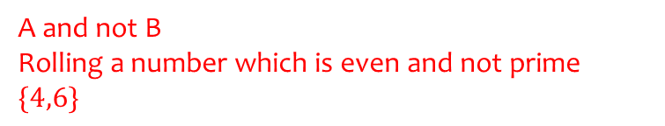
Worked example
Your turn
State what it means in this context, and the resulting set of outcomes:
$$A∩B′$$
State what it means in this context, and the resulting set of outcomes:
$$A∩B′$$
$$ξ$$
$$ξ$$
$$A$$
$$B$$
$$A$$
$$B$$
2
1
4
3
4
3
2
1
6
6
5
5
$ξ=$ the whole sample space (1 to 6)
$A=$ even number on a die thrown
$B=$ square number on a die thrown
$ξ=$ the whole sample space (1 to 6)
$A=$ even number on a die thrown
$B=$ prime number on a die thrown
A and not B
Rolling a number which is even and not prime
$$\{4,6\}$$
Diagrams/Graphs used with permission from DrFrostMaths: https://www.drfrostmaths.com/

Slide 12


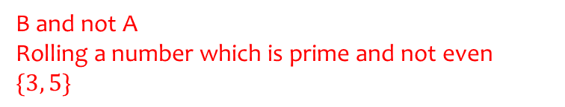
Worked example
Your turn
State what it means in this context, and the resulting set of outcomes:
$$A′∩B$$
State what it means in this context, and the resulting set of outcomes:
$$A′∩B$$
$$ξ$$
$$ξ$$
$$A$$
$$B$$
$$A$$
$$B$$
2
1
4
3
4
3
2
1
6
6
5
5
$ξ=$ the whole sample space (1 to 6)
$A=$ even number on a die thrown
$B=$ square number on a die thrown
$ξ=$ the whole sample space (1 to 6)
$A=$ even number on a die thrown
$B=$ prime number on a die thrown
B and not A
Rolling a number which is prime and not even
$$\{3, 5\}$$
Diagrams/Graphs used with permission from DrFrostMaths: https://www.drfrostmaths.com/

Slide 13


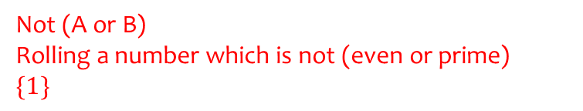
Worked example
Your turn
State what it means in this context, and the resulting set of outcomes:
$$(A∪B)′$$
State what it means in this context, and the resulting set of outcomes:
$$(A∪B)′$$
$$ξ$$
$$ξ$$
$$A$$
$$B$$
$$A$$
$$B$$
2
1
4
3
4
3
2
1
6
6
5
5
$ξ=$ the whole sample space (1 to 6)
$A=$ even number on a die thrown
$B=$ square number on a die thrown
$ξ=$ the whole sample space (1 to 6)
$A=$ even number on a die thrown
$B=$ prime number on a die thrown
Not (A or B)
Rolling a number which is not (even or prime)
$$\{1\}$$
Diagrams/Graphs used with permission from DrFrostMaths: https://www.drfrostmaths.com/

Slide 14


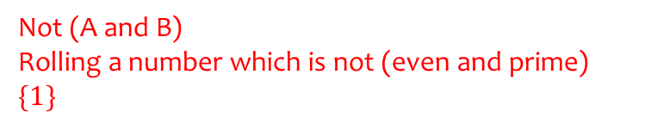
Worked example
Your turn
State what it means in this context, and the resulting set of outcomes:
$${\left(A∩B\right)}^{′}$$
State what it means in this context, and the resulting set of outcomes:
$${\left(A∩B\right)}^{′}$$
$$ξ$$
$$ξ$$
$$A$$
$$B$$
$$A$$
$$B$$
2
1
4
3
4
3
2
1
6
6
5
5
$ξ=$ the whole sample space (1 to 6)
$A=$ even number on a die thrown
$B=$ square number on a die thrown
$ξ=$ the whole sample space (1 to 6)
$A=$ even number on a die thrown
$B=$ prime number on a die thrown
Not (A and B)
Rolling a number which is not (even and prime)
$$\{1\}$$
Diagrams/Graphs used with permission from DrFrostMaths: https://www.drfrostmaths.com/

Slide 15
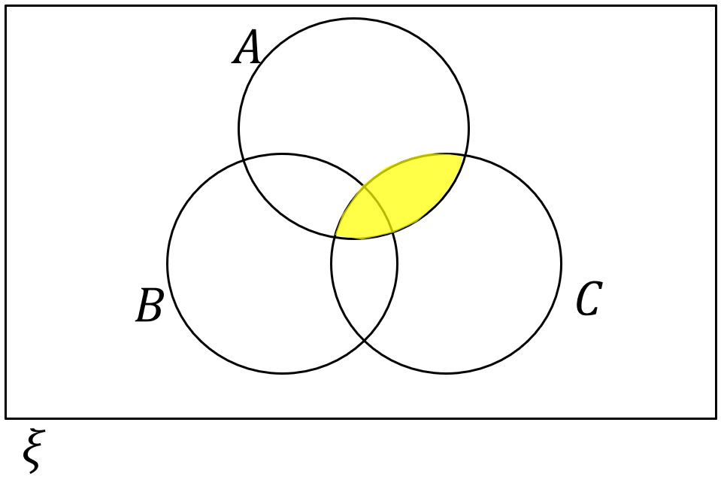
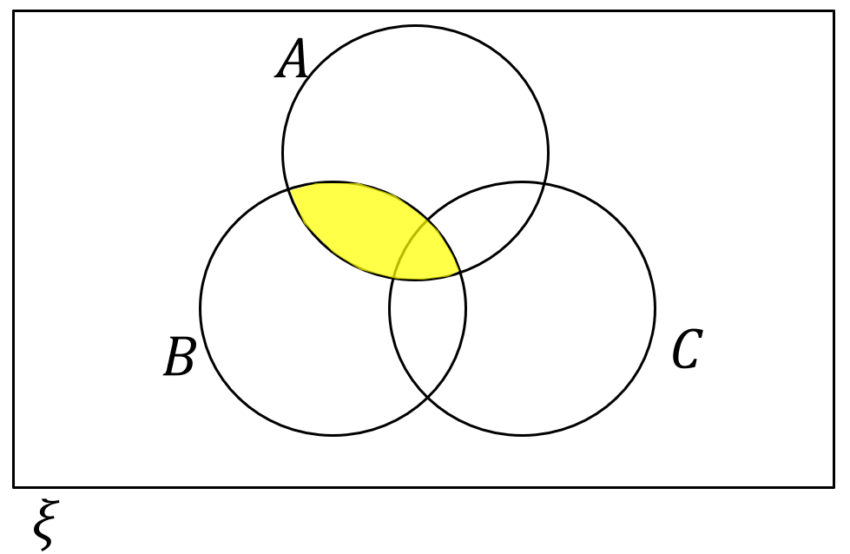
Worked example
Your turn
Describe the area indicated using set notation:
Describe the area indicated using set notation:
$$A∩B$$
Diagrams/Graphs used with permission from DrFrostMaths: https://www.drfrostmaths.com/

Slide 16
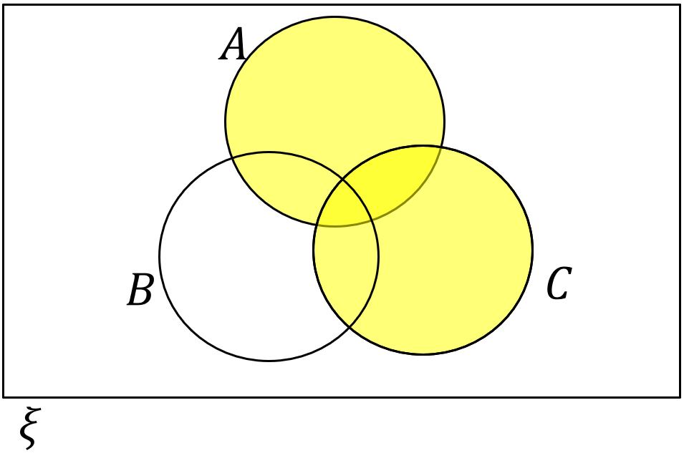
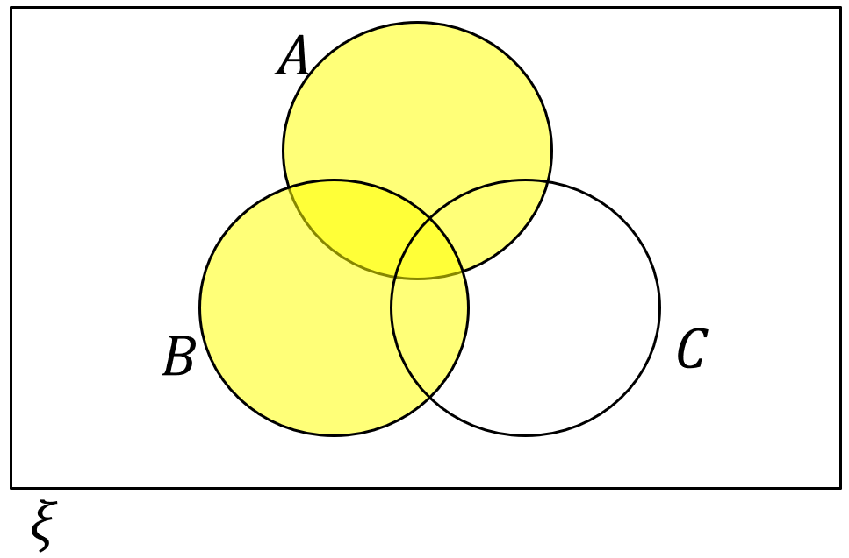
Worked example
Your turn
Describe the area indicated using set notation:
Describe the area indicated using set notation:
$$A∪B$$
Diagrams/Graphs used with permission from DrFrostMaths: https://www.drfrostmaths.com/

Slide 17
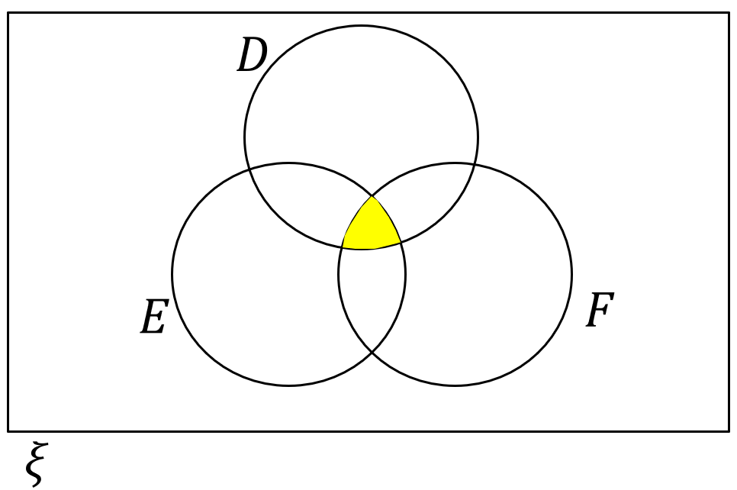
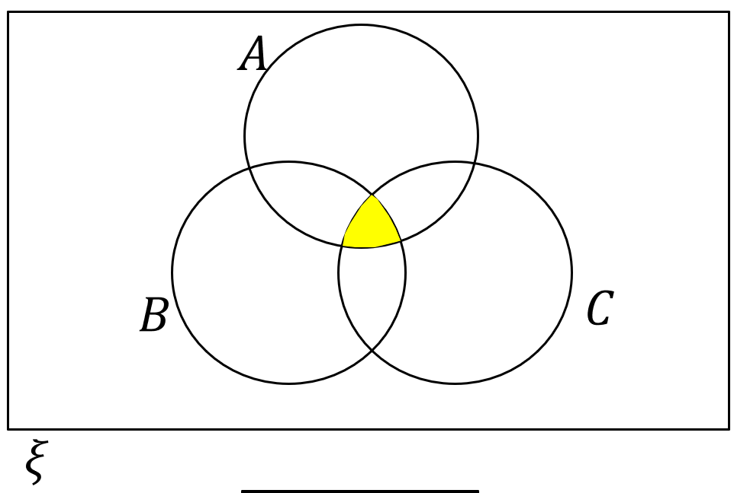
Worked example
Your turn
Describe the area indicated using set notation:
Describe the area indicated using set notation:
$$A∩B∩C$$
Diagrams/Graphs used with permission from DrFrostMaths: https://www.drfrostmaths.com/

Slide 18
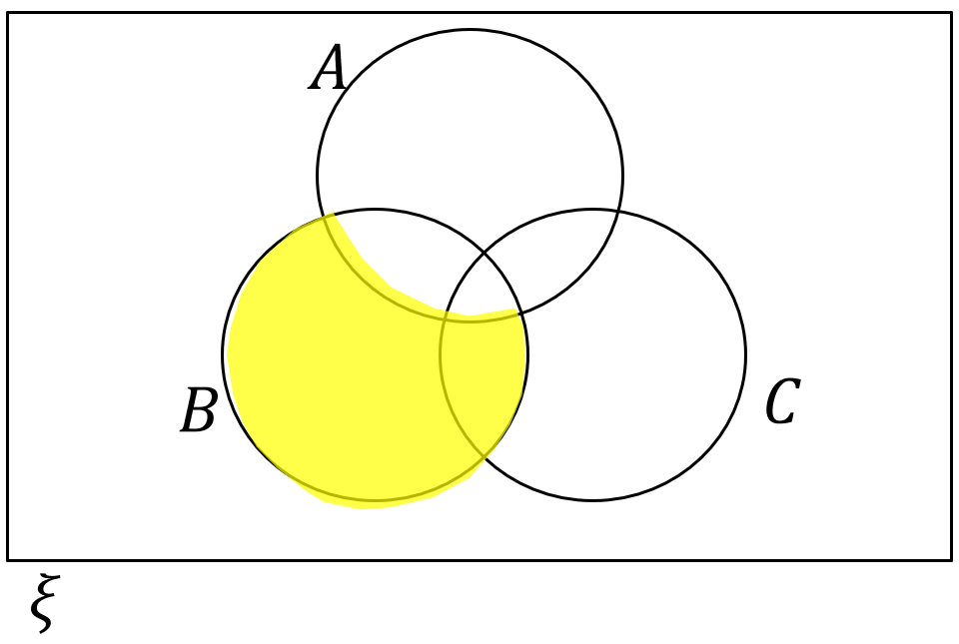
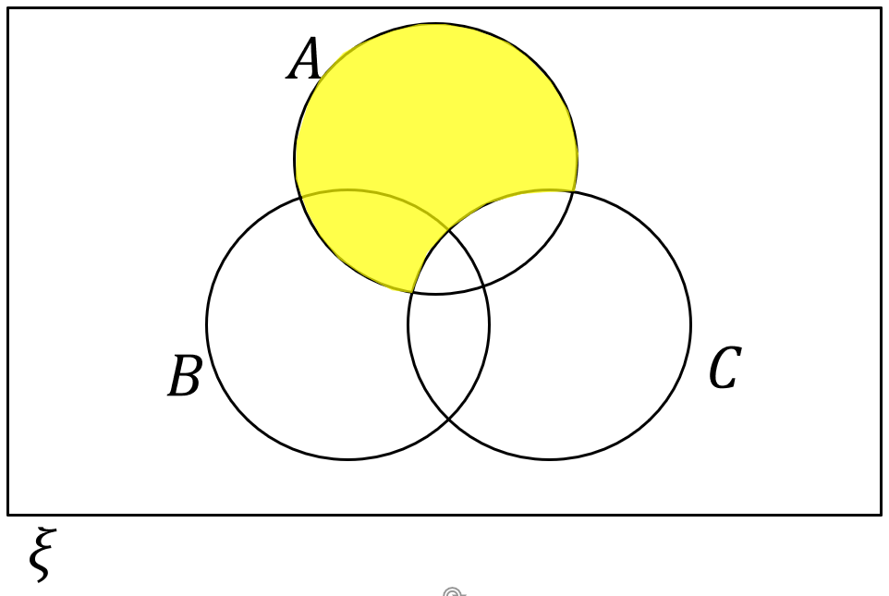
Worked example
Your turn
Describe the area indicated using set notation:
Describe the area indicated using set notation:
$$A∩C^{′}$$
Diagrams/Graphs used with permission from DrFrostMaths: https://www.drfrostmaths.com/

Slide 19
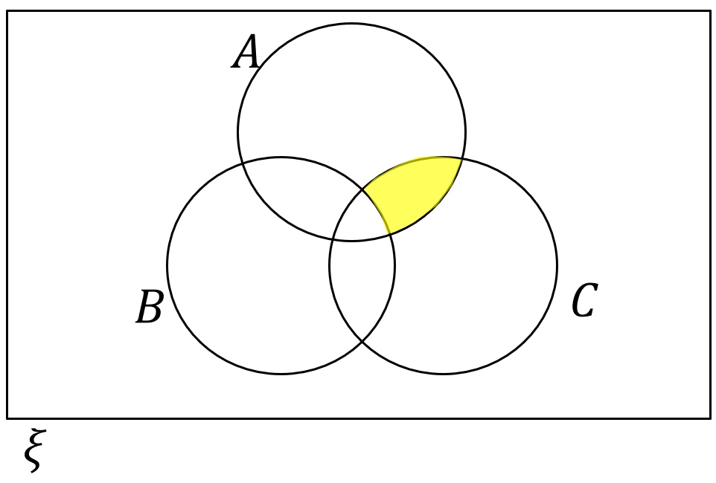
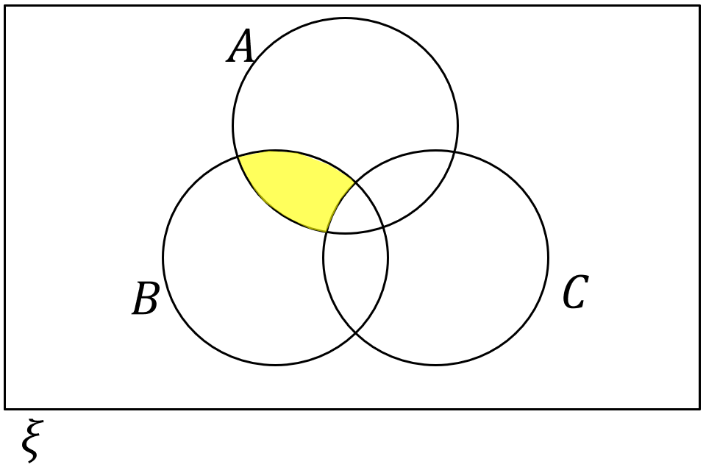
Worked example
Your turn
Describe the area indicated using set notation:
Describe the area indicated using set notation:
$$A∩B∩C^{′}$$
Diagrams/Graphs used with permission from DrFrostMaths: https://www.drfrostmaths.com/

Slide 20
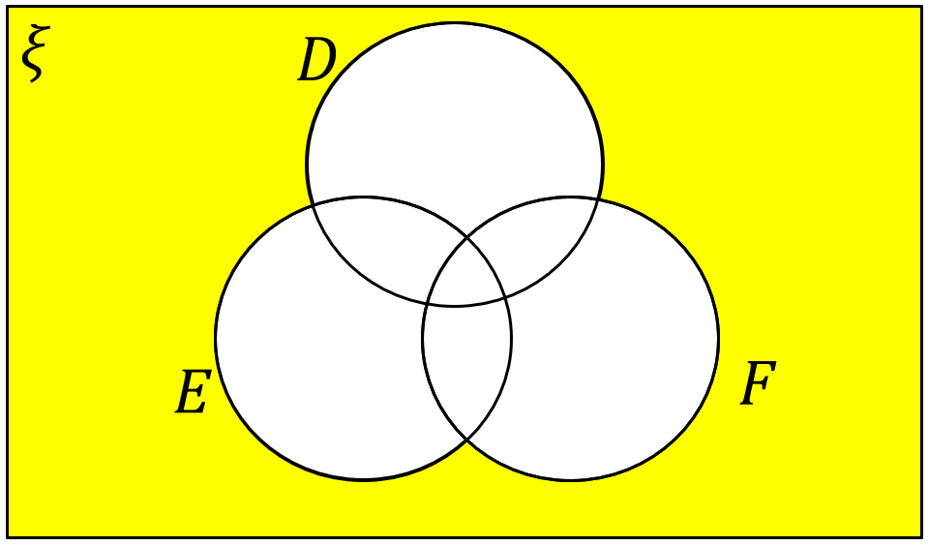

Worked example
Your turn
Describe the area indicated using set notation:
Describe the area indicated using set notation:
$A^{′}∩B^{′}∩C^{′}$ or ${\left(A∪B∪C\right)}^{′}$
Diagrams/Graphs used with permission from DrFrostMaths: https://www.drfrostmaths.com/

Slide 21


Worked example
Your turn
Describe the area indicated using set notation:
Describe the area indicated using set notation:
$$A′$$
Diagrams/Graphs used with permission from DrFrostMaths: https://www.drfrostmaths.com/

Slide 22


Worked example
Your turn
Describe the area indicated using set notation:
Describe the area indicated using set notation:
$$A∩{\left(B∩C\right)}^{′}$$
Diagrams/Graphs used with permission from DrFrostMaths: https://www.drfrostmaths.com/

Slide 23


Worked example
Your turn
Describe the area indicated using set notation:
Describe the area indicated using set notation:
$$A∩B^{′}∩C′$$
Diagrams/Graphs used with permission from DrFrostMaths: https://www.drfrostmaths.com/

Slide 24


















Worked example
Your turn
$ξ$ = $\left\{Days of the week\right\}$
$$A\text{ = }\left\{Tuesday, Thursday\right\}$$
B = $\left\{Days starting with S or T\right\}$
Draw a Venn diagram to represent this information.
$ξ$ = $\left\{Months of the year\right\}$
$$A\text{ = }\left\{Months starting with A\right\}$$
B = $\left\{Months with six letters\right\}$
Draw a Venn diagram to represent this information.
$$ξ$$
$$ξ$$
$$January$$
$$February$$
$$March$$
$$May$$
$$June$$
$$A$$
$$B$$
$$A$$
$$B$$
$$April$$
$$August$$
$$July$$
$$September$$
$$October$$
$$November$$
$$December$$

Slide 25






Worked example
Your turn
On the Venn diagram, shade the region representing:
$$C∩D$$
On the Venn diagram, shade the region representing:
$$A∩B$$
$$ξ$$
$$C$$
$$D$$
$$A$$
$$B$$

Slide 26

Worked example
Your turn
On the Venn diagram, shade the region representing:
$$C∪D$$
On the Venn diagram, shade the region representing:
$$A∪B$$
$$ξ$$
$$C$$
$$D$$
$$A$$
$$B$$

Slide 27

Worked example
Your turn
On the Venn diagram, shade the region representing:
$$D′$$
On the Venn diagram, shade the region representing:
$$A′$$
$$ξ$$
$$C$$
$$D$$
$$A$$
$$B$$

Slide 28

Worked example
Your turn
On the Venn diagram, shade the region representing:
$$C∩D′$$
On the Venn diagram, shade the region representing:
$$A′∩B$$
$$ξ$$
$$C$$
$$D$$
$$A$$
$$B$$

Slide 29

Worked example
Your turn
On the Venn diagram, shade the region representing:
$(C∪D)′$ or $C′∩D′$
On the Venn diagram, shade the region representing:
$(A∪B)′$ or $A′∩B′$
$$ξ$$
$$C$$
$$D$$
$$A$$
$$B$$

Slide 30







Worked example
Your turn
On the Venn diagram, shade the region representing:
$$D∩E∩F$$
On the Venn diagram, shade the region representing:
$$A∩B∩C$$
$$ξ$$
$$D$$
$$E$$
$$A$$
$$B$$
$$F$$
$$C$$

Slide 31

Worked example
Your turn
On the Venn diagram, shade the region representing:
$$D∪E∪F$$
On the Venn diagram, shade the region representing:
$$A∪B∪C$$
$$ξ$$
$$D$$
$$E$$
$$A$$
$$B$$
$$F$$
$$C$$

Slide 32

Worked example
Your turn
On the Venn diagram, shade the region representing:
$$D∩E′∩F$$
On the Venn diagram, shade the region representing:
$$A′∩B∩C$$
$$ξ$$
$$D$$
$$E$$
$$A$$
$$B$$
$$F$$
$$C$$

Slide 33

Worked example
Your turn
On the Venn diagram, shade the region representing:
$$(D∪E∪F)′$$
On the Venn diagram, shade the region representing:
$$(A∪B∪C)′$$
$$ξ$$
$$D$$
$$E$$
$$A$$
$$B$$
$$F$$
$$C$$

Slide 34

Worked example
Your turn
On the Venn diagram, shade the region representing:
$$(D∪E)∩F′$$
On the Venn diagram, shade the region representing:
$$(A∪B)∩C′$$
$$ξ$$
$$D$$
$$E$$
$$A$$
$$B$$
$$F$$
$$C$$

Slide 35

Worked example
Your turn
On the Venn diagram, shade the region representing:
$$(D∩F)∪(E∩F^{′})$$
On the Venn diagram, shade the region representing:
$$(B∩C)∪(A^{′}∩C)$$
$$ξ$$
$$D$$
$$E$$
$$A$$
$$B$$
$$F$$
$$C$$

Slide 36

Worked example
Your turn
On the Venn diagram, shade the region representing:
$$(D′∪F)∩(D∪E′)$$
On the Venn diagram, shade the region representing:
$$(A′∪B)∩(B^{′}∪C)$$
$$ξ$$
$$D$$
$$E$$
$$A$$
$$B$$
$$F$$
$$C$$

Slide 37


Worked example
Your turn
Represent as a Venn diagram:
$ξ=$Positive integers between $1$ and $10$ inclusive
$A=\{$Multiples of $2\}$
$B=\{$Multiples of $4\}$
Represent as a Venn diagram:
$ξ=$Positive integers between $10$ and $20$ inclusive
$A=\{$Multiples of $3\}$
$B=\{$Multiples of $6\}$
$$ξ$$
$$A$$
$$10$$
$$11$$
$$13$$
$$14$$
$$15$$
$$16$$
$$17$$
$$19$$
$$20$$
$$B$$
$$12$$
$$18$$

Slide 38
Worked example
Your turn
In a group of 28 scientists:
20 have degrees in Physics.
18 have degrees in Chemistry.
Some have degrees in both
4 scientists have degrees which are neither Physics nor Chemistry.
Find the number of scientists who have degrees in both Physics and Chemistry.
In a group of 30 mathematicians:
15 have studied Calculus.
22 have studied Topology.
Some have studied both.
3 mathematicians have not yet studied either Calculus or topology
Find the number of mathematicians who have studied both Calculus and Topology.
$$10$$

