Slide 1
2) Measures of location and spread
2.1) Measures of central tendency
2.2) Other measures of location
2.3) Measures of spread
2.4) Variance and standard deviation
2.5) Coding

Slide 2
2.1) Measures of central tendency
Chapter CONTENTS

Slide 3
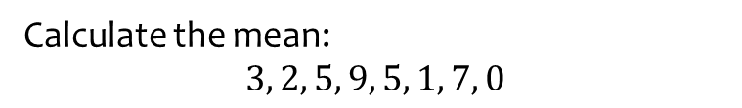
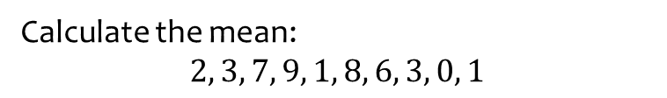
Worked example
Your turn
Calculate the mean:
$$2, 3, 7, 9, 1, 8, 6, 3, 0, 1$$
Calculate the mean:
$$3, 2, 5, 9, 5, 1, 7, 0$$
$$4$$

Slide 4
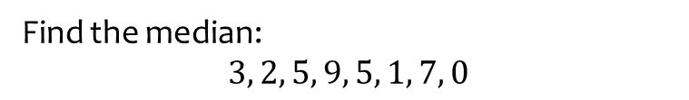
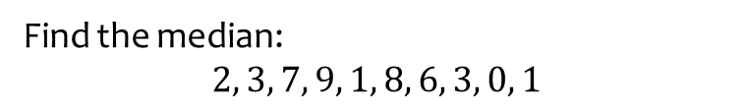
Worked example
Your turn
Find the median:
$$2, 3, 7, 9, 1, 8, 6, 3, 0, 1$$
Find the median:
$$3, 2, 5, 9, 5, 1, 7, 0$$
$$4$$

Slide 5
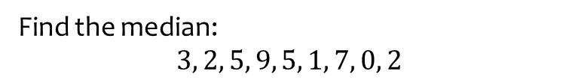
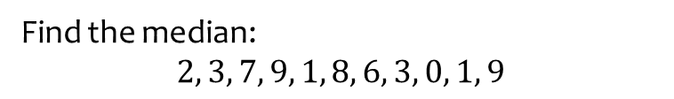
Worked example
Your turn
Find the median:
$$2, 3, 7, 9, 1, 8, 6, 3, 0, 1, 9$$
Find the median:
$$3, 2, 5, 9, 5, 1, 7, 0, 2$$
$$3$$

Slide 6
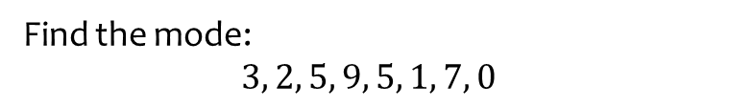
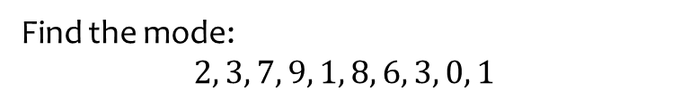
Worked example
Your turn
Find the mode:
$$2, 3, 7, 9, 1, 8, 6, 3, 0, 1$$
Find the mode:
$$3, 2, 5, 9, 5, 1, 7, 0$$
$$5$$

Slide 7
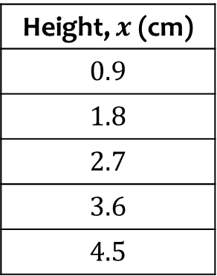
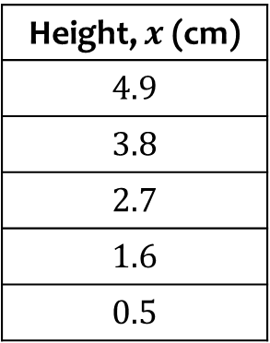
Worked example
Your turn
Calculate the mean height:
Calculate the mean height:
Height, $x$ (cm)
$$0.9$$
$$1.8$$
$$2.7$$
$$3.6$$
$$4.5$$
Height, $x$ (cm)
$$4.9$$
$$3.8$$
$$2.7$$
$$1.6$$
$$0.5$$
$$\overline{x}=2.7$$

Slide 8
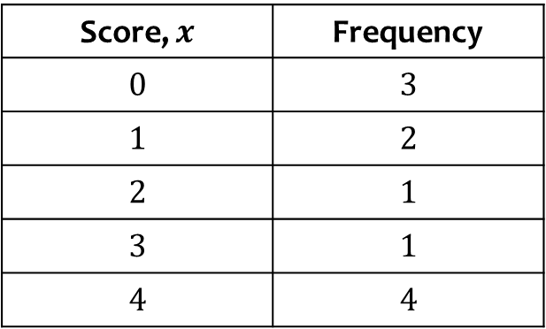

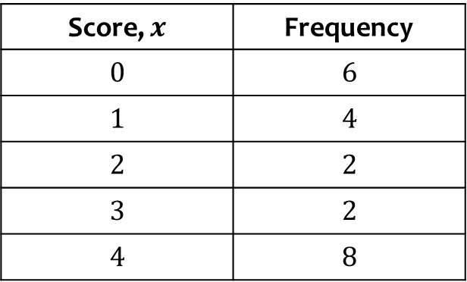
Worked example
Your turn
Calculate the mean score:
Calculate the mean score:
Score, $x$ | Frequency
$$0$$ | $$3$$
$$1$$ | $$2$$
$$2$$ | $$1$$
$$3$$ | $$1$$
$$4$$ | $$4$$
Score, $x$ | Frequency
$$0$$ | $$6$$
$$1$$ | $$4$$
$$2$$ | $$2$$
$$3$$ | $$2$$
$$4$$ | $$8$$
$\overline{x}=2.09$(3 sf)

Slide 9
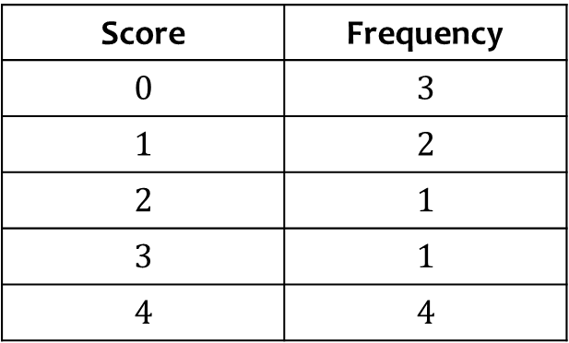
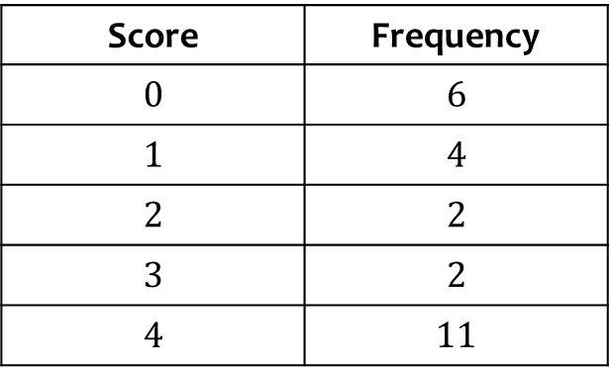
Worked example
Your turn
Find the median score:
Find the median score:
Score | Frequency
$$0$$ | $$3$$
$$1$$ | $$2$$
$$2$$ | $$1$$
$$3$$ | $$1$$
$$4$$ | $$4$$
Score | Frequency
$$0$$ | $$6$$
$$1$$ | $$4$$
$$2$$ | $$2$$
$$3$$ | $$2$$
$$4$$ | $$11$$
$$3$$

Slide 10
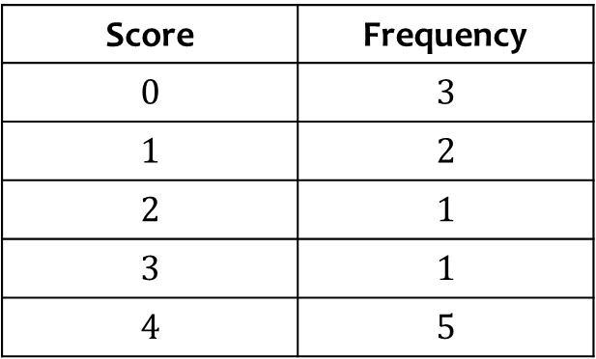
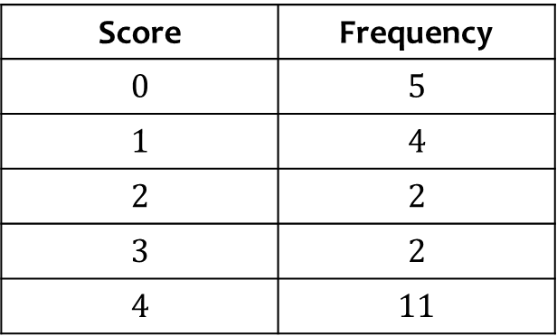
Worked example
Your turn
Find the median score:
Find the median score:
Score | Frequency
$$0$$ | $$3$$
$$1$$ | $$2$$
$$2$$ | $$1$$
$$3$$ | $$1$$
$$4$$ | $$5$$
Score | Frequency
$$0$$ | $$5$$
$$1$$ | $$4$$
$$2$$ | $$2$$
$$3$$ | $$2$$
$$4$$ | $$11$$
$$3$$

Slide 11
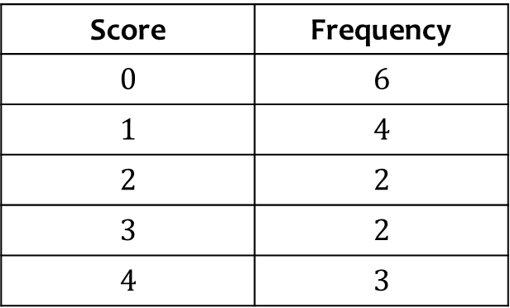
Worked example
Your turn
Find the mode of the scores:
Find the mode of the scores:
Score | Frequency
$$0$$ | $$3$$
$$1$$ | $$2$$
$$2$$ | $$1$$
$$3$$ | $$1$$
$$4$$ | $$4$$
Score | Frequency
$$0$$ | $$6$$
$$1$$ | $$4$$
$$2$$ | $$2$$
$$3$$ | $$2$$
$$4$$ | $$3$$
$$0$$

Slide 12
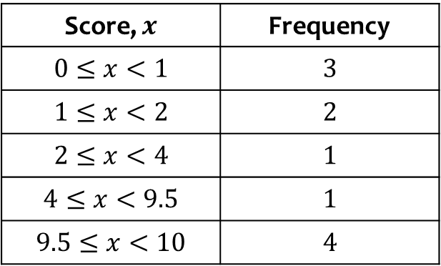

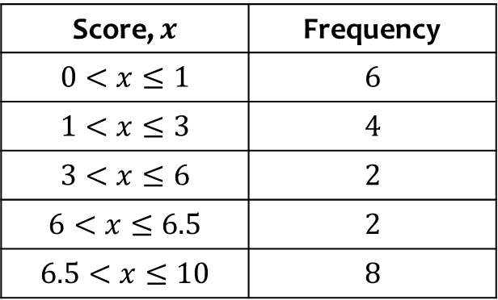
Worked example
Your turn
Calculate an estimate for the mean score:
Calculate an estimate for the mean score:
Score, $x$ | Frequency
$$0≤x<1$$ | $$3$$
$$1≤x<2$$ | $$2$$
$$2≤x<4$$ | $$1$$
$$4≤x<9.5$$ | $$1$$
$$9.5≤x<10$$ | $$4$$
Score, $x$ | Frequency
$$0<x≤1$$ | $$6$$
$$1<x≤3$$ | $$4$$
$$3<x≤6$$ | $$2$$
$$6<x≤6.5$$ | $$2$$
$$6.5<x≤10$$ | $$8$$
$\overline{x}=4.48$(3 sf)

Slide 13
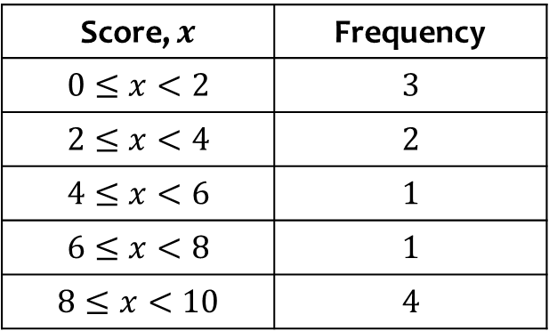

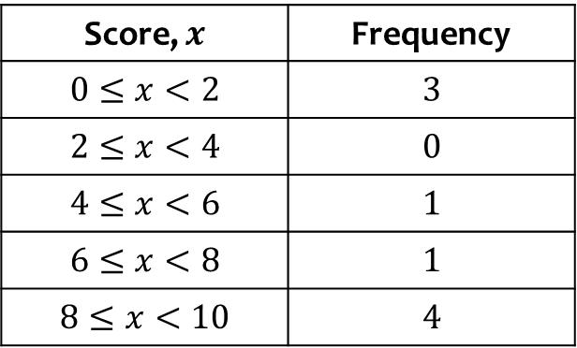
Worked example
Your turn
Calculate an estimate for the mean score:
Calculate an estimate for the mean score:
Score, $x$ | Frequency
$$0≤x<2$$ | $$3$$
$$2≤x<4$$ | $$2$$
$$4≤x<6$$ | $$1$$
$$6≤x<8$$ | $$1$$
$$8≤x<10$$ | $$4$$
Score, $x$ | Frequency
$$0≤x<2$$ | $$3$$
$$2≤x<4$$ | $$0$$
$$4≤x<6$$ | $$1$$
$$6≤x<8$$ | $$1$$
$$8≤x<10$$ | $$4$$
$\overline{x}=5.67$(3 sf)

Slide 14
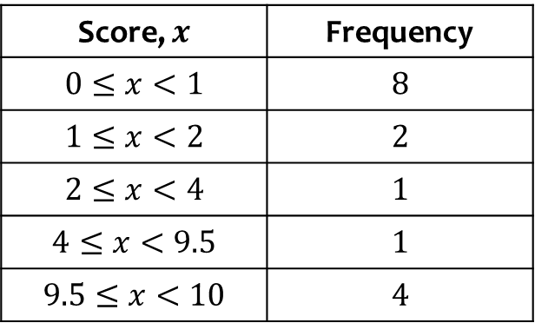
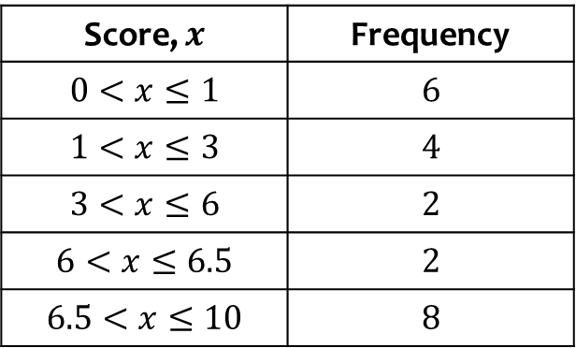
Worked example
Your turn
Write down the interval containing the median
Write down the interval containing the median
Score, $x$ | Frequency
$$0≤x<1$$ | $$8$$
$$1≤x<2$$ | $$2$$
$$2≤x<4$$ | $$1$$
$$4≤x<9.5$$ | $$1$$
$$9.5≤x<10$$ | $$4$$
Score, $x$ | Frequency
$$0<x≤1$$ | $$6$$
$$1<x≤3$$ | $$4$$
$$3<x≤6$$ | $$2$$
$$6<x≤6.5$$ | $$2$$
$$6.5<x≤10$$ | $$8$$
$$3<x≤6$$

Slide 15
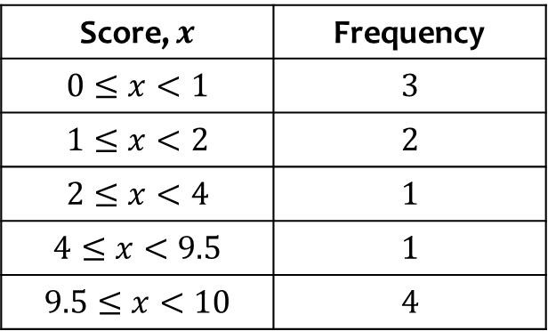
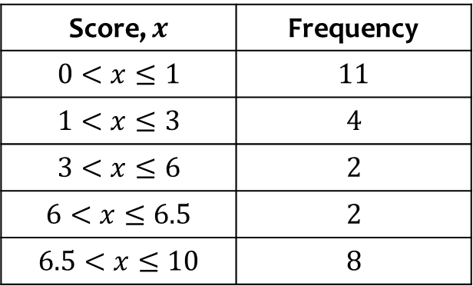
Worked example
Your turn
Write down the interval containing the median
Write down the interval containing the median
Score, $x$ | Frequency
$$0≤x<1$$ | $$3$$
$$1≤x<2$$ | $$2$$
$$2≤x<4$$ | $$1$$
$$4≤x<9.5$$ | $$1$$
$$9.5≤x<10$$ | $$4$$
Score, $x$ | Frequency
$$0<x≤1$$ | $$11$$
$$1<x≤3$$ | $$4$$
$$3<x≤6$$ | $$2$$
$$6<x≤6.5$$ | $$2$$
$$6.5<x≤10$$ | $$8$$
$$1<x≤3$$

Slide 16
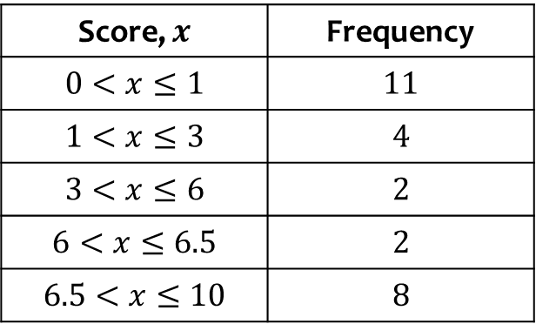
Worked example
Your turn
Write down the modal class
Write down the modal class
Score, $x$ | Frequency
$$0≤x<1$$ | $$3$$
$$1≤x<2$$ | $$2$$
$$2≤x<4$$ | $$1$$
$$4≤x<9.5$$ | $$1$$
$$9.5≤x<10$$ | $$4$$
Score, $x$ | Frequency
$$0<x≤1$$ | $$11$$
$$1<x≤3$$ | $$4$$
$$3<x≤6$$ | $$2$$
$$6<x≤6.5$$ | $$2$$
$$6.5<x≤10$$ | $$8$$
$$0<x≤1$$

Slide 17
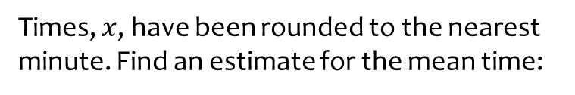
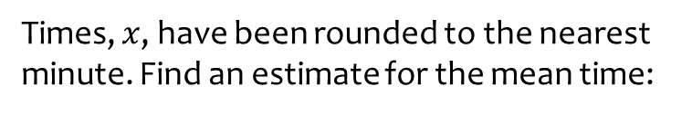
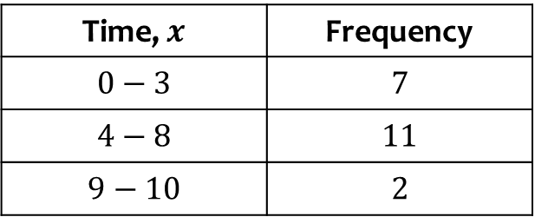
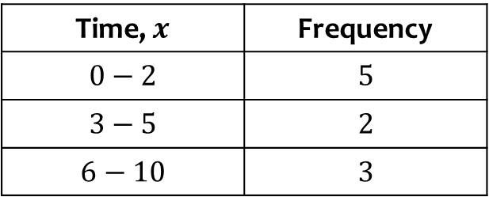
Worked example
Your turn
Times, $x$, have been rounded to the nearest minute. Find an estimate for the mean time:
Times, $x$, have been rounded to the nearest minute. Find an estimate for the mean time:
Time, $x$ | Frequency
$$0−2$$ | $$5$$
$$3−5$$ | $$2$$
$$6−10$$ | $$3$$
Time, $x$ | Frequency
$$0−3$$ | $$7$$
$$4−8$$ | $$11$$
$$9−10$$ | $$2$$
$$\overline{x}=4.8125$$

Slide 18
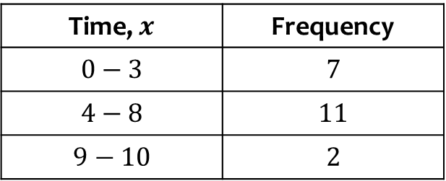
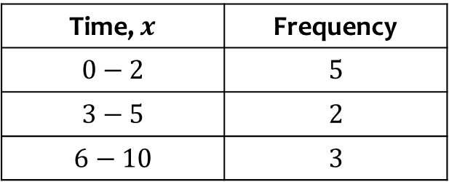
Worked example
Your turn
Write down the class containing the median
Write down the class containing the median
Time, $x$ | Frequency
$$0−2$$ | $$5$$
$$3−5$$ | $$2$$
$$6−10$$ | $$3$$
Time, $x$ | Frequency
$$0−3$$ | $$7$$
$$4−8$$ | $$11$$
$$9−10$$ | $$2$$
$$4−8$$

Slide 19
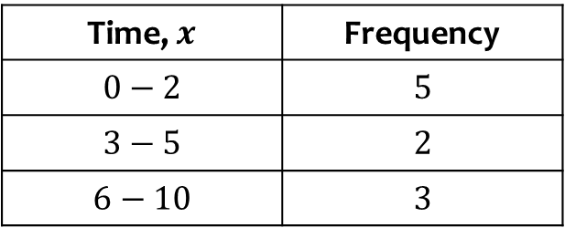
Worked example
Your turn
Write down the modal class
Write down the modal class
Time, $x$ | Frequency
$$0−2$$ | $$5$$
$$3−5$$ | $$2$$
$$6−10$$ | $$3$$
Time, $x$ | Frequency
$$0−3$$ | $$7$$
$$4−8$$ | $$11$$
$$9−10$$ | $$2$$
$$4−8$$

Slide 20

Worked example
Your turn
The table shows the length of time for different people to complete a task:
Calculate the mean.
The table shows the length of time for different people to complete a task:
Calculate the mean.
Person | A | B | C | D | E | F
Time (minutes) | 1 | 3 | 8 | 2 | 1 | 9
Person | A | B | C | D | E | F
Time (minutes) | 7 | 3 | 8 | 2 | 1 | 3
$4$ minutes

Slide 21

Worked example
Your turn
The table shows the length of time for different people to complete a task:
Find the median:
The table shows the length of time for different people to complete a task:
Find the median:
Person | A | B | C | D | E | F
Time (minutes) | 1 | 3 | 8 | 2 | 1 | 9
Person | A | B | C | D | E | F
Time (minutes) | 7 | 3 | 8 | 2 | 1 | 3
$3$ minutes

Slide 22
Worked example
Your turn
The table shows the length of time for different people to complete a task:
Write down the mode.
The table shows the length of time for different people to complete a task:
Write down the mode.
Person | A | B | C | D | E | F
Time (minutes) | 1 | 3 | 8 | 2 | 1 | 9
Person | A | B | C | D | E | F
Time (minutes) | 7 | 3 | 8 | 2 | 1 | 3
$3$ minutes

Slide 23
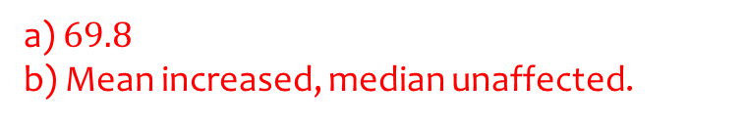
Worked example
Your turn
The mean maths score of 10 pupils in class A is 26.
The mean maths score of 40 pupils in class B is 57.
Find the overall mean of all the pupils’ marks.
The teacher realises they mismarked one student’s paper; he should have received 90 instead of 95. Explain the effect on the mean and median.
The mean maths score of 20 pupils in class A is 62.
The mean maths score of 30 pupils in class B is 75.
Find the overall mean of all the pupils’ marks.
The teacher realises they mismarked one student’s paper; he should have received 100 instead of 95. Explain the effect on the mean and median.
a) $69.8$
b) Mean increased, median unaffected.

Slide 24
2.2) Other measures of location
Chapter CONTENTS

Slide 25
Worked example
Your turn
Estimate the median:
Estimate the median:
Score, $x$ | Frequency
$$0≤x<1$$ | $$3$$
$$1≤x<2$$ | $$2$$
$$2≤x<4$$ | $$1$$
$$4≤x<9.5$$ | $$1$$
$$9.5≤x<10$$ | $$4$$
Score, $x$ | Frequency
$$0<x≤1$$ | $$11$$
$$1<x≤3$$ | $$4$$
$$3<x≤6$$ | $$2$$
$$6<x≤6.5$$ | $$2$$
$$6.5<x≤10$$ | $$8$$
$$2.25$$

Slide 26
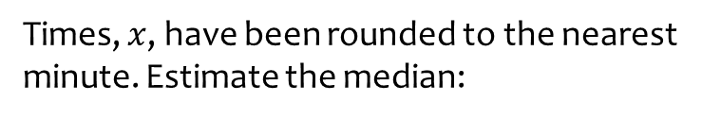
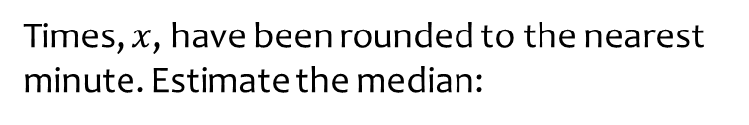

Worked example
Your turn
Times, $x$, have been rounded to the nearest minute. Estimate the median:
Times, $x$, have been rounded to the nearest minute. Estimate the median:
Time, $x$ | Frequency
$$0−2$$ | $$5$$
$$3−5$$ | $$2$$
$$6−10$$ | $$3$$
Time, $x$ | Frequency
$$0−3$$ | $$7$$
$$4−8$$ | $$11$$
$$9−10$$ | $$2$$
$4.86$ (3 sf)

Slide 27
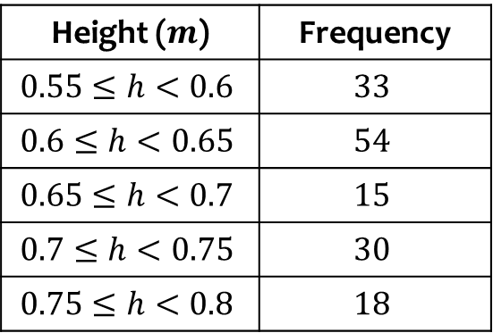

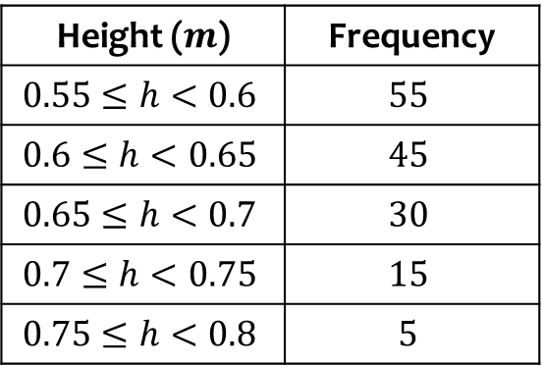
Worked example
Your turn
Estimate the median:
Estimate the median:
Height ($m$) | Frequency
$$0.55≤h<0.6$$ | $$33$$
$$0.6≤h<0.65$$ | $$54$$
$$0.65≤h<0.7$$ | $$15$$
$$0.7≤h<0.75$$ | $$30$$
$$0.75≤h<0.8$$ | $$18$$
Height ($m$) | Frequency
$$0.55≤h<0.6$$ | $$55$$
$$0.6≤h<0.65$$ | $$45$$
$$0.65≤h<0.7$$ | $$30$$
$$0.7≤h<0.75$$ | $$15$$
$$0.75≤h<0.8$$ | $$5$$
$0.62 m$ (2 dp)

Slide 28
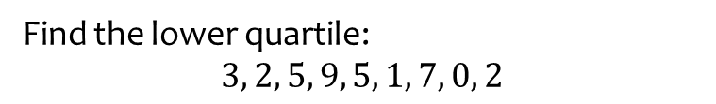
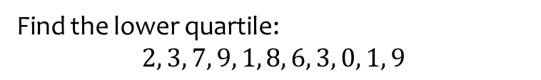
Worked example
Your turn
Find the lower quartile:
$$2, 3, 7, 9, 1, 8, 6, 3, 0, 1, 9$$
Find the lower quartile:
$$3, 2, 5, 9, 5, 1, 7, 0, 2$$
$$2$$

Slide 29
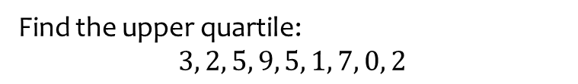
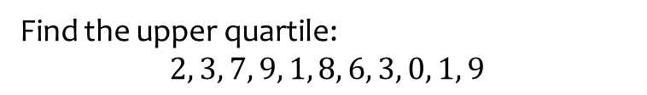
Worked example
Your turn
Find the upper quartile:
$$2, 3, 7, 9, 1, 8, 6, 3, 0, 1, 9$$
Find the upper quartile:
$$3, 2, 5, 9, 5, 1, 7, 0, 2$$
$$5$$

Slide 30
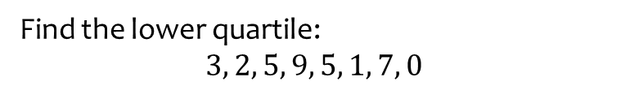
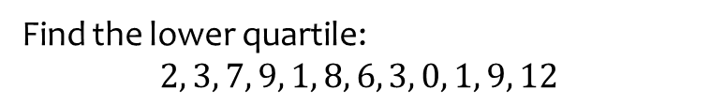
Worked example
Your turn
Find the lower quartile:
$$2, 3, 7, 9, 1, 8, 6, 3, 0, 1, 9, 12$$
Find the lower quartile:
$$3, 2, 5, 9, 5, 1, 7, 0$$
$$1.5$$

Slide 31
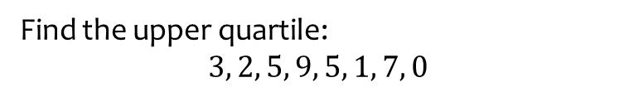
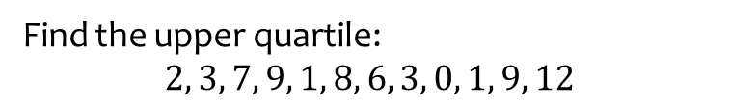
Worked example
Your turn
Find the upper quartile:
$$2, 3, 7, 9, 1, 8, 6, 3, 0, 1, 9, 12$$
Find the upper quartile:
$$3, 2, 5, 9, 5, 1, 7, 0$$
$$6$$

Slide 32

Worked example
Your turn
Estimate the lower quartile:
Estimate the lower quartile:
Score, $x$ | Frequency
$$0≤x<1$$ | $$3$$
$$1≤x<2$$ | $$2$$
$$2≤x<4$$ | $$1$$
$$4≤x<9.5$$ | $$1$$
$$9.5≤x<10$$ | $$4$$
Score, $x$ | Frequency
$$0<x≤1$$ | $$11$$
$$1<x≤3$$ | $$4$$
$$3<x≤6$$ | $$2$$
$$6<x≤6.5$$ | $$2$$
$$6.5<x≤10$$ | $$8$$
$0.61$ (2 sf)

Slide 33

Worked example
Your turn
Estimate the upper quartile:
Estimate the upper quartile:
Score, $x$ | Frequency
$$0≤x<1$$ | $$3$$
$$1≤x<2$$ | $$2$$
$$2≤x<4$$ | $$1$$
$$4≤x<9.5$$ | $$1$$
$$9.5≤x<10$$ | $$4$$
Score, $x$ | Frequency
$$0<x≤1$$ | $$11$$
$$1<x≤3$$ | $$4$$
$$3<x≤6$$ | $$2$$
$$6<x≤6.5$$ | $$2$$
$$6.5<x≤10$$ | $$8$$
$7.05$ (2 sf)

Slide 34
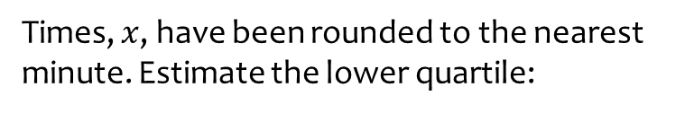
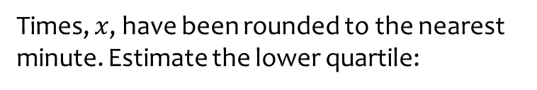
Worked example
Your turn
Times, $x$, have been rounded to the nearest minute. Estimate the lower quartile:
Times, $x$, have been rounded to the nearest minute. Estimate the lower quartile:
Time, $x$ | Frequency
$$0−2$$ | $$5$$
$$3−5$$ | $$2$$
$$6−10$$ | $$3$$
Time, $x$ | Frequency
$$0−3$$ | $$7$$
$$4−8$$ | $$11$$
$$9−10$$ | $$2$$
$$2.5$$

Slide 35
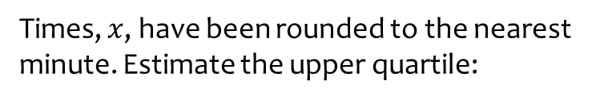
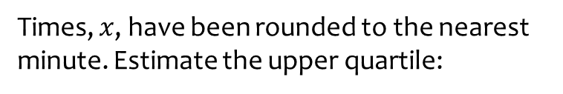

Worked example
Your turn
Times, $x$, have been rounded to the nearest minute. Estimate the upper quartile:
Times, $x$, have been rounded to the nearest minute. Estimate the upper quartile:
Time, $x$ | Frequency
$$0−2$$ | $$5$$
$$3−5$$ | $$2$$
$$6−10$$ | $$3$$
Time, $x$ | Frequency
$$0−3$$ | $$7$$
$$4−8$$ | $$11$$
$$9−10$$ | $$2$$
$5.72$ (3 sf)

Slide 36
Worked example
Your turn
Estimate the 27th percentile:
Estimate the 72nd percentile:
Score, $x$ | Frequency
$$0≤x<1$$ | $$3$$
$$1≤x<2$$ | $$2$$
$$2≤x<4$$ | $$1$$
$$4≤x<9.5$$ | $$1$$
$$9.5≤x<10$$ | $$4$$
Score, $x$ | Frequency
$$0<x≤1$$ | $$11$$
$$1<x≤3$$ | $$4$$
$$3<x≤6$$ | $$2$$
$$6<x≤6.5$$ | $$2$$
$$6.5<x≤10$$ | $$8$$
$$6.6925$$

Slide 37


Worked example
Your turn
Times, $x$, have been rounded to the nearest minute. Estimate the 63rd percentile:
Times, $x$, have been rounded to the nearest minute. Estimate the 36th percentile:
Time, $x$ | Frequency
$$0−2$$ | $$5$$
$$3−5$$ | $$2$$
$$6−10$$ | $$3$$
Time, $x$ | Frequency
$$0−3$$ | $$7$$
$$4−8$$ | $$11$$
$$9−10$$ | $$2$$
$$3.59$$

Slide 38
2.3) Measures of spread
Chapter CONTENTS

Slide 39


Worked example
Your turn
Calculate the interquartile range:
$$2, 3, 7, 9, 1, 8, 6, 3, 0, 1, 9$$
Calculate the interquartile range:
$$3, 2, 5, 9, 5, 1, 7, 0, 2$$
$$3$$

Slide 40


Worked example
Your turn
Calculate the interquartile range:
$$2, 3, 7, 9, 1, 8, 6, 3, 0, 1, 9, 12$$
Calculate the interquartile range:
$$3, 2, 5, 9, 5, 1, 7, 0$$
$$4.5$$

Slide 41

Worked example
Your turn
Estimate the interquartile range:
Estimate the interquartile range:
Score, $x$ | Frequency
$$0≤x<1$$ | $$3$$
$$1≤x<2$$ | $$2$$
$$2≤x<4$$ | $$1$$
$$4≤x<9.5$$ | $$1$$
$$9.5≤x<10$$ | $$4$$
Score, $x$ | Frequency
$$0<x≤1$$ | $$11$$
$$1<x≤3$$ | $$4$$
$$3<x≤6$$ | $$2$$
$$6<x≤6.5$$ | $$2$$
$$6.5<x≤10$$ | $$8$$
$6.43$ (3 sf)

Slide 42



Worked example
Your turn
Times, $x$, have been rounded to the nearest minute. Estimate the interquartile range:
Times, $x$, have been rounded to the nearest minute. Estimate the interquartile range:
Time, $x$ | Frequency
$$0−2$$ | $$5$$
$$3−5$$ | $$2$$
$$6−10$$ | $$3$$
Time, $x$ | Frequency
$$0−3$$ | $$7$$
$$4−8$$ | $$11$$
$$9−10$$ | $$2$$
$3.22$ (3 sf)

Slide 43

Worked example
Your turn
Estimate the 20th – 80th interpercentile range:
Estimate the 10th – 90th interpercentile range:
Score, $x$ | Frequency
$$0≤x<1$$ | $$3$$
$$1≤x<2$$ | $$2$$
$$2≤x<4$$ | $$1$$
$$4≤x<9.5$$ | $$1$$
$$9.5≤x<10$$ | $$4$$
Score, $x$ | Frequency
$$0<x≤1$$ | $$11$$
$$1<x≤3$$ | $$4$$
$$3<x≤6$$ | $$2$$
$$6<x≤6.5$$ | $$2$$
$$6.5<x≤10$$ | $$8$$
$8.57$ (3 sf)

Slide 44



Worked example
Your turn
Times, $x$, have been rounded to the nearest minute. Estimate the 5th – 95th interpercentile range:
Times, $x$, have been rounded to the nearest minute. Estimate the 15th – 85th interpercentile range:
Time, $x$ | Frequency
$$0−2$$ | $$5$$
$$3−5$$ | $$2$$
$$6−10$$ | $$3$$
Time, $x$ | Frequency
$$0−3$$ | $$7$$
$$4−8$$ | $$11$$
$$9−10$$ | $$2$$
$6.55$ (3 sf)

Slide 45
2.4) Variance and standard deviation
Chapter CONTENTS

Slide 46



Worked example
Your turn
Calculate the variance and standard deviation:
$$2, 3, 4, 5, 6$$
Calculate the variance and standard deviation:
$$2, 3, 4, 5, 7$$
Variance $=σ^{2}=2.96$
Standard deviation $=σ=1.72$ (3 sf)

Slide 47


Worked example
Your turn
Calculate the variance and standard deviation:
$$2, 3, 4, 5, 6$$
Calculate the variance and standard deviation:
$$4, 6, 8, 10, 12$$
Variance $=σ^{2}=8$
Standard deviation $=σ=2.83$ (3 sf)

Slide 48



Worked example
Your turn
Calculate the variance and standard deviation:
$$2, 4, 6, 8, 10$$
Calculate the variance and standard deviation:
$$1, 2, 3, 4, 5$$
Variance $=σ^{2}=2$
Standard deviation $=σ=1.41$ (3 sf)

Slide 49



Worked example
Your turn
Calculate the variance and standard deviation:
Calculate the variance and standard deviation:
Score | Frequency
$$0$$ | $$3$$
$$1$$ | $$2$$
$$2$$ | $$1$$
$$3$$ | $$1$$
$$4$$ | $$4$$
Score | Frequency
$$0$$ | $$6$$
$$1$$ | $$4$$
$$2$$ | $$2$$
$$3$$ | $$2$$
$$4$$ | $$8$$
$\text{Variance} =σ^{2}=2.81$ (3 sf)
$$\text{Standard} \text{deviation} =σ=1.68\text{ (3 }\text{sf}\text{)}$$

Slide 50



Worked example
Your turn
Estimate the variance and standard deviation:
Estimate the variance and standard deviation:
Score, $x$ | Frequency
$$0≤x<1$$ | $$8$$
$$1≤x<2$$ | $$2$$
$$2≤x<4$$ | $$1$$
$$4≤x<9.5$$ | $$1$$
$$9.5≤x<10$$ | $$4$$
Score, $x$ | Frequency
$$0<x≤1$$ | $$6$$
$$1<x≤3$$ | $$4$$
$$3<x≤6$$ | $$2$$
$$6<x≤6.5$$ | $$2$$
$$6.5<x≤10$$ | $$8$$
$$\text{Variance} =σ_{x}^{2}≈10\text{.9}\text{ (3 }\text{sf}\text{)}$$
$$\text{Standard} \text{deviation} =σ_{x}≈3.30\text{ (3 }\text{sf}\text{)}$$

Slide 51




Worked example
Your turn
Times, $x$, have been rounded to the nearest minute. Estimate the variance and standard deviation:
Times, $x$, have been rounded to the nearest minute. Estimate the variance and standard deviation:
Time, $x$ | Frequency
$$0−2$$ | $$5$$
$$3−5$$ | $$2$$
$$6−10$$ | $$3$$
Time, $x$ | Frequency
$$0−3$$ | $$7$$
$$4−8$$ | $$11$$
$$9−10$$ | $$2$$
$$\text{Variance} =σ_{x}^{2}≈5.81\text{ (3 }\text{sf}\text{)}$$
$$\text{Standard} \text{deviation} =σ_{x}≈2.41\text{ (3 }\text{sf}\text{)}$$

Slide 52


Worked example
Your turn
Work out how many people had a score more than one standard deviation below the mean
Work out how many people had a score more than one standard deviation above the mean
Score | Frequency
$$0$$ | $$3$$
$$1$$ | $$2$$
$$2$$ | $$1$$
$$3$$ | $$1$$
$$4$$ | $$4$$
$$5$$ | $$9$$
$$6$$ | $$5$$
Score | Frequency
$$0$$ | $$6$$
$$1$$ | $$4$$
$$2$$ | $$2$$
$$3$$ | $$2$$
$$4$$ | $$8$$
$$5$$ | $$18$$
$$6$$ | $$10$$
$$10$$

Slide 53



Worked example
Your turn
The scores, $x$, were recorded for 20 people.
The summary data is:
$$S_{xx}=235$$
Calculate the standard deviation
The scores, $x$, were recorded for 40 people.
The summary data is:
$$S_{xx}=532$$
Calculate the standard deviation
$σ_{x}=3.65$ (3 sf)

Slide 54



Worked example
Your turn
The scores, $x$, were recorded for 20 people.
The summary data is:
$\sum{x}=34$ , $\sum{x^{2}}=567$
Calculate the mean and standard deviation.
The scores, $x$, were recorded for 40 people.
The summary data is:
$\sum{x}=76$ , $\sum{x^{2}}=543$
Calculate the mean and standard deviation.
Mean $=\overline{x}=1.9$
Standard deviation $=σ_{x}=3.16$ (3 sf)

Slide 55


Worked example
Your turn
The scores, $x$, were recorded for 20 people.
The summary data is:
$\sum{x}=34$ , $\sum{x^{2}}=567$
The highest score was $8.5$.
The lowest score was $0.2$.
Estimate the number of scores which were greater than one standard deviation above the mean.
The scores, $x$, were recorded for 40 people.
The summary data is:
$\sum{x}=76$ , $\sum{x^{2}}=543$
The highest score was $5.8$.
The lowest score was $0.3$.
Estimate the number of scores which were greater than one standard deviation above the mean.
$$5$$

Slide 56
2.5) Coding
Chapter CONTENTS

Slide 57



Worked example
Your turn
Prove that if all values of $x$ are multiplied by $5$, the variance increases by a scale factor of $25$
Prove that if all values of $x$ are multiplied by $3$, the variance increases by a scale factor of $9$
$$σ^{2}=\frac{Σ{\left(3x\right)}^{2}}{n}−{\left(\frac{Σ\left(3x\right)}{n}\right)}^{2} \\ =\frac{Σ9x^{2}}{n}−{\left(\frac{3Σx}{n}\right)}^{2}$$
$$=\frac{9⋅Σx^{2}}{n}−9{\left(\frac{Σx}{n}\right)}^{2} \\ =9\left(\frac{Σx^{2}}{n}−{\left(\frac{Σx}{n}\right)}^{2}\right)$$

Slide 58



Worked example
Your turn
Scores, $x$:
$$2090, 2080, 2070, 2060, 2050$$
Use the coding $y=x−2000$ to code this data
Calculate the mean and standard deviation of the coded data
Use your answer to b) to calculate the mean and standard deviation of the original data
Scores, $x$:
$$1010, 1020, 1030, 1040, 1050$$
Use the coding $y=x−1000$ to code this data
Calculate the mean and standard deviation of the coded data
Use your answer to b) to calculate the mean and standard deviation of the original data
a) $y:10, 20, 30, 40, 50$
b) $\overline{y}=30$ , $σ_{y}=14.1$ (3 sf)
c) $\overline{x}=1030$ , $σ_{x}=14.1$ (3 sf)

Slide 59



Worked example
Your turn
Scores, $x$:
$$2090, 2080, 2070, 2060, 2050$$
Use the coding $y=2x$ to code this data
Calculate the mean and standard deviation of the coded data
Use your answer to b) to calculate the mean and standard deviation of the original data
Scores, $x$:
$$1010, 1020, 1030, 1040, 1050$$
Use the coding $y=3x$ to code this data
Calculate the mean and standard deviation of the coded data
Use your answer to b) to calculate the mean and standard deviation of the original data
a) $y:3030, 3060, 3090, 3120, 3150$
b) $\overline{y}=3090$ , $σ_{y}=42.4$ (3 sf)
c) $\overline{x}=1030$ , $σ_{x}=14.1$ (3 sf)

Slide 60



Worked example
Your turn
Scores, $x$:
$$2090, 2080, 2070, 2060, 2050$$
Use the coding $y=\frac{x}{5}$ to code this data
Calculate the mean and standard deviation of the coded data
Use your answer to b) to calculate the mean and standard deviation of the original data
Scores, $x$:
$$1010, 1020, 1030, 1040, 1050$$
Use the coding $y=\frac{x}{10}$ to code this data
Calculate the mean and standard deviation of the coded data
Use your answer to b) to calculate the mean and standard deviation of the original data
a) $y:101, 102, 103, 104, 105$
b) $\overline{y}=103$ , $σ_{y}=1.41$ (3 sf)
c) $\overline{x}=1030$ , $σ_{x}=14.1$ (3 sf)

Slide 61



Worked example
Your turn
Scores, $x$:
$$2090, 2080, 2070, 2060, 2050$$
Use the coding $y=\frac{x−2000}{10}$ to code this data
Calculate the mean and standard deviation of the coded data
Use your answer to b) to calculate the mean and standard deviation of the original data
Scores, $x$:
$$1010, 1020, 1030, 1040, 1050$$
Use the coding $y=\frac{x−1000}{10}$ to code this data
Calculate the mean and standard deviation of the coded data
Use your answer to b) to calculate the mean and standard deviation of the original data
a) $y:1, 2, 3, 4, 5$
b) $\overline{y}=3$ , $σ_{y}=1.41$ (3 sf)
c) $\overline{x}=1030$ , $σ_{x}=14.1$ (3 sf)

Slide 62


Worked example
Your turn
Scores, $x$:
$$2090, 2080, 2070, 2060, 2050$$
Use the coding $y=\frac{x}{10}−200$ to code this data
Calculate the mean and standard deviation of the coded data
Use your answer to b) to calculate the mean and standard deviation of the original data
Scores, $x$:
$$1010, 1020, 1030, 1040, 1050$$
Use the coding $y=\frac{x}{10}−100$ to code this data
Calculate the mean and standard deviation of the coded data
Use your answer to b) to calculate the mean and standard deviation of the original data
a) $y:1, 2, 3, 4, 5$
b) $\overline{y}=3$ , $σ_{y}=1.41$ (3 sf)
c) $\overline{x}=1030$ , $σ_{x}=14.1$ (3 sf)

Slide 63



Worked example
Your turn
Scores, $x$, of $20$ people were recorded.
The data was coded using $y=\frac{x−10}{5}$and the following summations were obtained:
$\sum{y}=23$ , $\sum{y^{2}}=147.6$
Calculate the standard deviation of the actual scores.
Scores, $x$, of $40$ people were recorded.
The data was coded using $y=\frac{x−5}{10}$and the following summations were obtained:
$\sum{y}=32$ , $\sum{y^{2}}=764.1$
Calculate the standard deviation of the actual scores.
$σ_{x}=42.97$ (2 dp)

Slide 64



Worked example
Your turn
Scores, $x$, of $20$ people were recorded.
The data was coded using $y=5x−10$ and the following summations were obtained:
$\sum{y}=23$ , $\sum{y^{2}}=147.6$
Calculate the standard deviation of the actual scores.
Scores, $x$, of $40$ people were recorded.
The data was coded using $y=10x−5$ and the following summations were obtained:
$\sum{y}=32$ , $\sum{y^{2}}=764.1$
Calculate the standard deviation of the actual scores.
$σ_{x}=0.4297$ (4 dp)

Slide 65



Worked example
Your turn
A teacher standardises scores, $x$, of his class by adding $10$ to each score and then reducing the score by $8\%$.
The following summary statistics are calculated for the standardised scores, $y$:
$n=30$, $\overline{y}=23.4$, $S_{yy}=5.6$
Calculate the mean and standard deviation of the original scores
A teacher standardises scores, $x$, of his class by adding $8$ to each score and then reducing the score by $10\%$.
The following summary statistics are calculated for the standardised scores, $y$:
$n=25$, $\overline{y}=43.2$, $S_{yy}=6.5$
Calculate the mean and standard deviation of the original scores
Mean $=\overline{x}=40$
Standard deviation $=σ_{x}=0.567$ (3 sf)

Slide 66


Worked example
Your turn
A person was recording times, $x$, in a race.
They then realised the stopwatch was slow and all times were actually 3 minutes more than the recorded times.
Explain the effect on:
The mean
The standard deviation
The median
The range
The lower quartile
The interquartile range
A person was recording times, $x$, in a race.
They then realised the stopwatch was slow and all times were actually 5 minutes less than the recorded times.
Explain the effect on:
The mean
The standard deviation
The median
The range
The lower quartile
The interquartile range
Decreases by 5
No effect
Decreases by 5
No effect
Decreases by 5
No effect

