Slide 1
2) Conditional probability
2.1) Set notation
2.2) Conditional probability
2.3) Conditional probabilities in Venn diagrams
2.4) Probability formulae
2.5) Tree diagrams

Slide 2
2.1) Set notation
Chapter CONTENTS

Slide 3
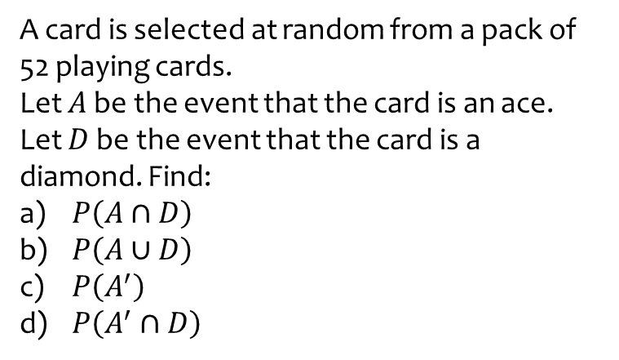
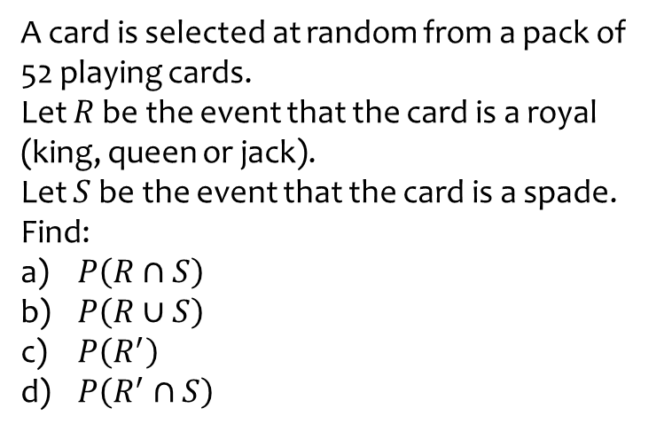

Worked example
Your turn
A card is selected at random from a pack of 52 playing cards.
Let $R$ be the event that the card is a royal (king, queen or jack).
Let $S$ be the event that the card is a spade. Find:
$P\left(R∩S\right)$
$P\left(R∪S\right)$
$P\left(R^{′}\right)$
$P\left(R^{′}∩S\right)$
A card is selected at random from a pack of 52 playing cards.
Let $A$ be the event that the card is an ace.
Let $D$ be the event that the card is a diamond. Find:
$P\left(A∩D\right)$
$P\left(A∪D\right)$
$P\left(A^{′}\right)$
$P\left(A^{′}∩D\right)$
a) $\frac{1}{52}$
b) $\frac{16}{52}$
c) $\frac{48}{52}$
d) $\frac{12}{52}$

Slide 4
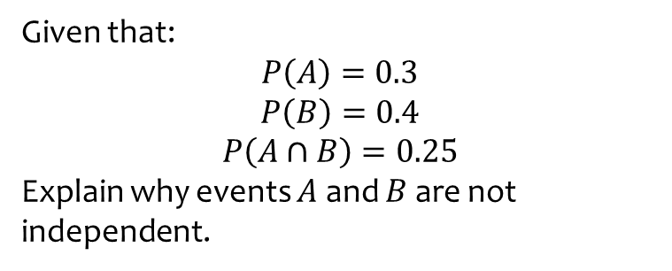
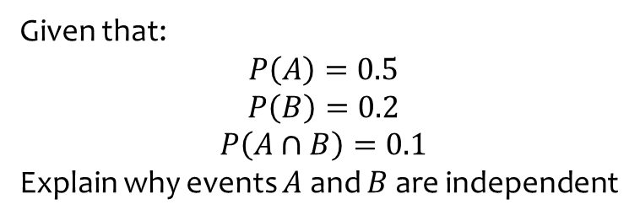
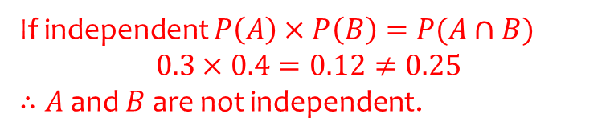
Worked example
Your turn
Given that:
$$P\left(A\right)=0.5$$
$$P\left(B\right)=0.2$$
$$P\left(A∩B\right)=0.1$$
Explain why events $A$ and $B$ are independent
Given that:
$$P\left(A\right)=0.3$$
$$P\left(B\right)=0.4$$
$$P\left(A∩B\right)=0.25$$
Explain why events $A$ and $B$ are not independent.
If independent $P\left(A\right)×P\left(B\right)=P(A∩B)$
$0.3×0.4=0.12≠0.25$
$∴A$ and $B$ are not independent.

Slide 5
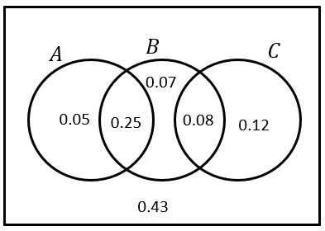
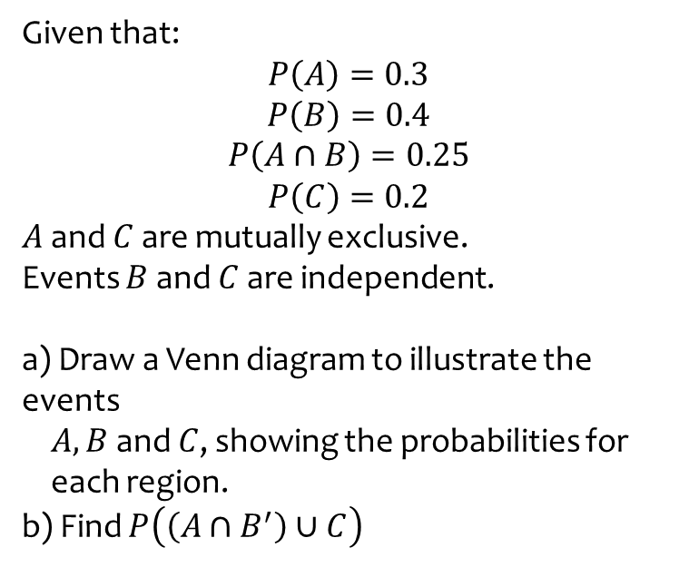
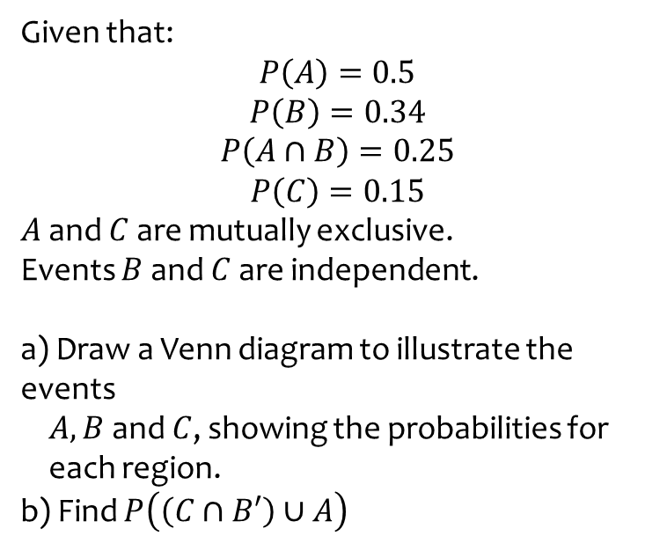

Worked example
Your turn
Given that:
$$P\left(A\right)=0.5$$
$$P\left(B\right)=0.34$$
$$P\left(A∩B\right)=0.25$$
$$P\left(C\right)=0.15$$
$A$ and $C$ are mutually exclusive.
Events $B$ and $C$ are independent.
a) Draw a Venn diagram to illustrate the events
$A, B$ and $C$, showing the probabilities for
each region.
b) Find $P\left(\left(C∩B′\right)∪A\right)$
Given that:
$$P\left(A\right)=0.3$$
$$P\left(B\right)=0.4$$
$$P\left(A∩B\right)=0.25$$
$$P\left(C\right)=0.2$$
$A$ and $C$ are mutually exclusive.
Events $B$ and $C$ are independent.
a) Draw a Venn diagram to illustrate the events
$A, B$ and $C$, showing the probabilities for
each region.
b) Find $P\left(\left(A∩B^{′}\right)∪C\right)$
a)
b) $0.25$
Diagrams/Graphs used with permission from DrFrostMaths: https://www.drfrostmaths.com/

Slide 6
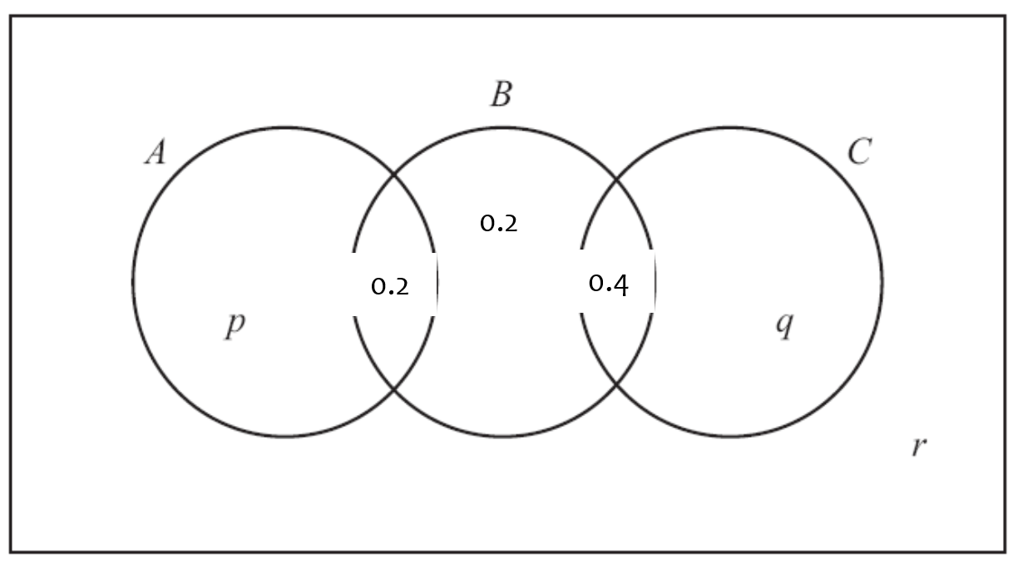
Worked example
Your turn
The events A and B are independent.
Find the value of p.
The events A and B are independent.
Find the value of p.
$$p=0.15$$

Slide 7
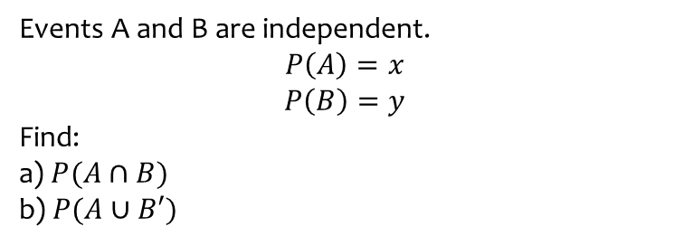
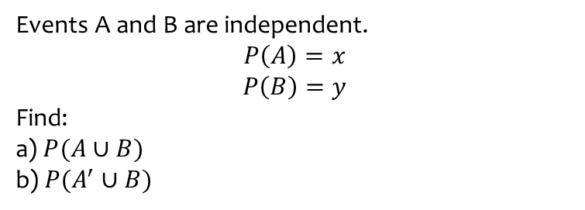
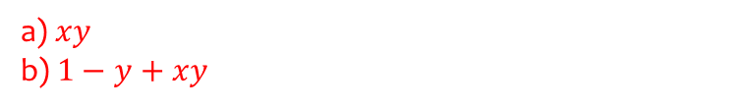
Worked example
Your turn
Events A and B are independent.
$$P\left(A\right)=x$$
$$P\left(B\right)=y$$
Find:
a) $P(A∪B)$
b) $P(A^{′}∪B)$
Events A and B are independent.
$$P\left(A\right)=x$$
$$P\left(B\right)=y$$
Find:
a) $P(A∩B)$
b) $P(A∪B′)$
a) $xy$
b) $1−y+xy$

Slide 8
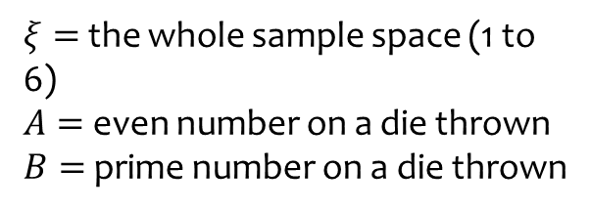


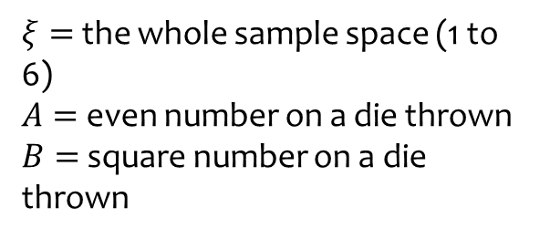





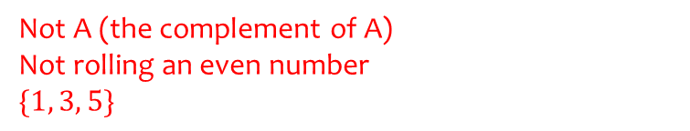

Worked example
Your turn
State what it means in this context, and the resulting set of outcomes:
$$A′$$
State what it means in this context, and the resulting set of outcomes:
$$A′$$
$$ξ$$
$$ξ$$
$$A$$
$$B$$
$$A$$
$$B$$
2
1
4
3
4
3
2
1
6
6
5
5
$ξ=$ the whole sample space (1 to 6)
$A=$ even number on a die thrown
$B=$ square number on a die thrown
$ξ=$ the whole sample space (1 to 6)
$A=$ even number on a die thrown
$B=$ prime number on a die thrown
Not A (the complement of A)
Not rolling an even number
$$\{1, 3, 5\}$$
Diagrams/Graphs used with permission from DrFrostMaths: https://www.drfrostmaths.com/

Slide 9



Worked example
Your turn
State what it means in this context, and the resulting set of outcomes:
$$B′$$
State what it means in this context, and the resulting set of outcomes:
$$B′$$
$$ξ$$
$$ξ$$
$$A$$
$$B$$
$$A$$
$$B$$
2
1
4
3
4
3
2
1
6
6
5
5
$ξ=$ the whole sample space (1 to 6)
$A=$ even number on a die thrown
$B=$ square number on a die thrown
$ξ=$ the whole sample space (1 to 6)
$A=$ even number on a die thrown
$B=$ prime number on a die thrown
Not B (the complement of B)
Not rolling a prime number
$$\{1, 4, 6\}$$
Diagrams/Graphs used with permission from DrFrostMaths: https://www.drfrostmaths.com/

Slide 10


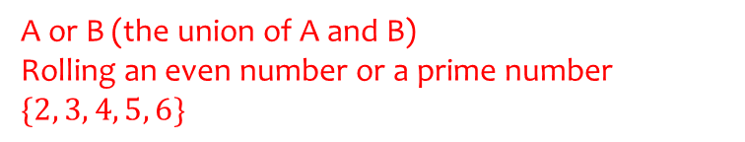
Worked example
Your turn
State what it means in this context, and the resulting set of outcomes:
$$A∪B$$
State what it means in this context, and the resulting set of outcomes:
$$A∪B$$
$$ξ$$
$$ξ$$
$$A$$
$$B$$
$$A$$
$$B$$
2
1
4
3
4
3
2
1
6
6
5
5
$ξ=$ the whole sample space (1 to 6)
$A=$ even number on a die thrown
$B=$ square number on a die thrown
$ξ=$ the whole sample space (1 to 6)
$A=$ even number on a die thrown
$B=$ prime number on a die thrown
A or B (the union of A and B)
Rolling an even number or a prime number
$$\{2, 3, 4, 5, 6\}$$
Diagrams/Graphs used with permission from DrFrostMaths: https://www.drfrostmaths.com/

Slide 11


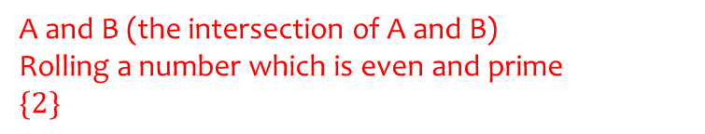
Worked example
Your turn
State what it means in this context, and the resulting set of outcomes:
$$A∩B$$
State what it means in this context, and the resulting set of outcomes:
$$A∩B$$
$$ξ$$
$$ξ$$
$$A$$
$$B$$
$$A$$
$$B$$
2
1
4
3
4
3
2
1
6
6
5
5
$ξ=$ the whole sample space (1 to 6)
$A=$ even number on a die thrown
$B=$ square number on a die thrown
$ξ=$ the whole sample space (1 to 6)
$A=$ even number on a die thrown
$B=$ prime number on a die thrown
A and B (the intersection of A and B)
Rolling a number which is even and prime
$$\{2\}$$
Diagrams/Graphs used with permission from DrFrostMaths: https://www.drfrostmaths.com/

Slide 12


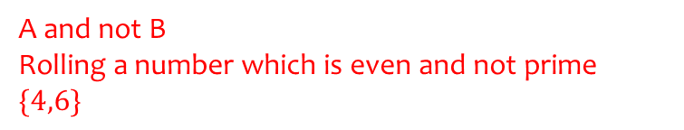
Worked example
Your turn
State what it means in this context, and the resulting set of outcomes:
$$A∩B′$$
State what it means in this context, and the resulting set of outcomes:
$$A∩B′$$
$$ξ$$
$$ξ$$
$$A$$
$$B$$
$$A$$
$$B$$
2
1
4
3
4
3
2
1
6
6
5
5
$ξ=$ the whole sample space (1 to 6)
$A=$ even number on a die thrown
$B=$ square number on a die thrown
$ξ=$ the whole sample space (1 to 6)
$A=$ even number on a die thrown
$B=$ prime number on a die thrown
A and not B
Rolling a number which is even and not prime
$$\{4,6\}$$
Diagrams/Graphs used with permission from DrFrostMaths: https://www.drfrostmaths.com/

Slide 13


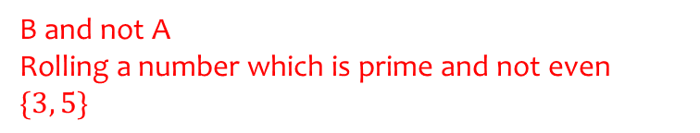
Worked example
Your turn
State what it means in this context, and the resulting set of outcomes:
$$A′∩B$$
State what it means in this context, and the resulting set of outcomes:
$$A′∩B$$
$$ξ$$
$$ξ$$
$$A$$
$$B$$
$$A$$
$$B$$
2
1
4
3
4
3
2
1
6
6
5
5
$ξ=$ the whole sample space (1 to 6)
$A=$ even number on a die thrown
$B=$ square number on a die thrown
$ξ=$ the whole sample space (1 to 6)
$A=$ even number on a die thrown
$B=$ prime number on a die thrown
B and not A
Rolling a number which is prime and not even
$$\{3, 5\}$$
Diagrams/Graphs used with permission from DrFrostMaths: https://www.drfrostmaths.com/

Slide 14


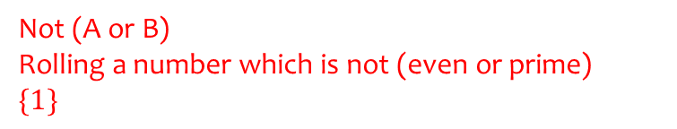
Worked example
Your turn
State what it means in this context, and the resulting set of outcomes:
$$(A∪B)′$$
State what it means in this context, and the resulting set of outcomes:
$$(A∪B)′$$
$$ξ$$
$$ξ$$
$$A$$
$$B$$
$$A$$
$$B$$
2
1
4
3
4
3
2
1
6
6
5
5
$ξ=$ the whole sample space (1 to 6)
$A=$ even number on a die thrown
$B=$ square number on a die thrown
$ξ=$ the whole sample space (1 to 6)
$A=$ even number on a die thrown
$B=$ prime number on a die thrown
Not (A or B)
Rolling a number which is not (even or prime)
$$\{1\}$$
Diagrams/Graphs used with permission from DrFrostMaths: https://www.drfrostmaths.com/

Slide 15


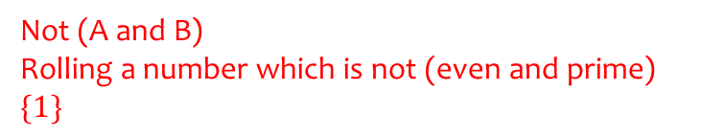
Worked example
Your turn
State what it means in this context, and the resulting set of outcomes:
$${\left(A∩B\right)}^{′}$$
State what it means in this context, and the resulting set of outcomes:
$${\left(A∩B\right)}^{′}$$
$$ξ$$
$$ξ$$
$$A$$
$$B$$
$$A$$
$$B$$
2
1
4
3
4
3
2
1
6
6
5
5
$ξ=$ the whole sample space (1 to 6)
$A=$ even number on a die thrown
$B=$ square number on a die thrown
$ξ=$ the whole sample space (1 to 6)
$A=$ even number on a die thrown
$B=$ prime number on a die thrown
Not (A and B)
Rolling a number which is not (even and prime)
$$\{1\}$$
Diagrams/Graphs used with permission from DrFrostMaths: https://www.drfrostmaths.com/

Slide 16
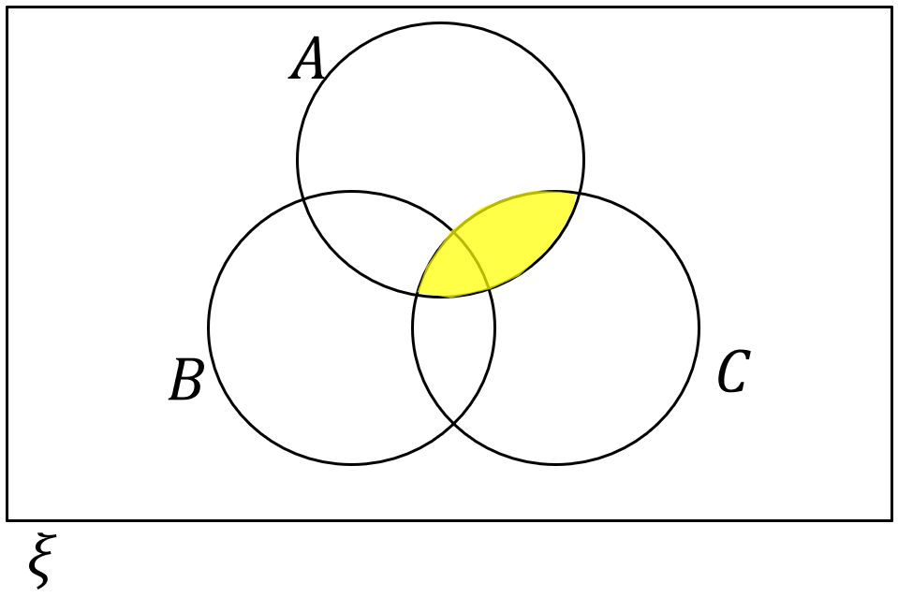
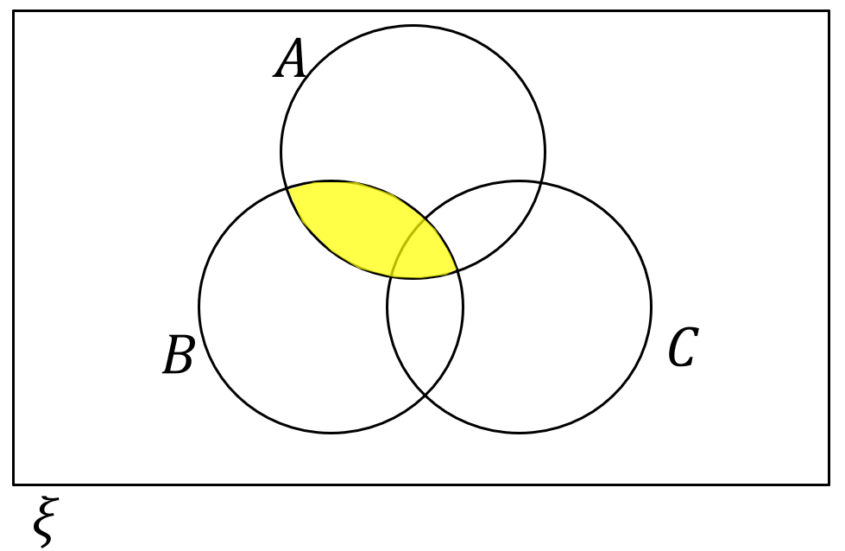
Worked example
Your turn
Describe the area indicated using set notation:
Describe the area indicated using set notation:
$$A∩B$$
Diagrams/Graphs used with permission from DrFrostMaths: https://www.drfrostmaths.com/

Slide 17
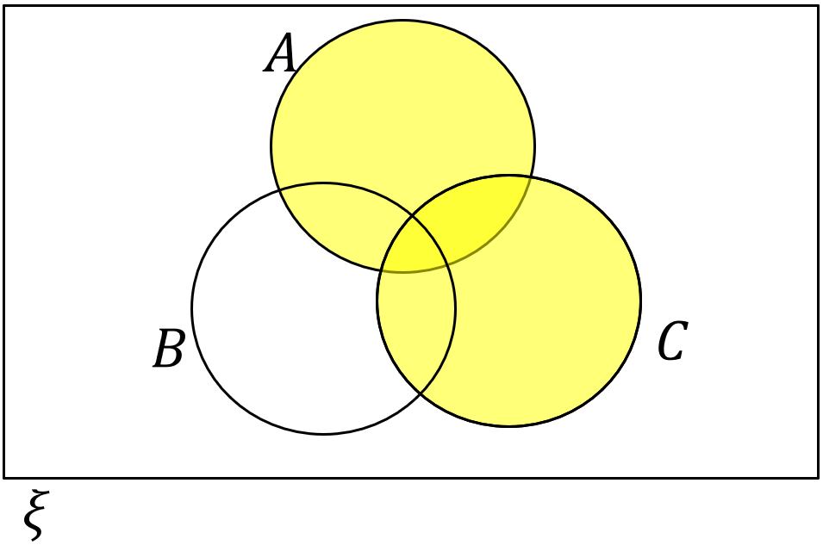
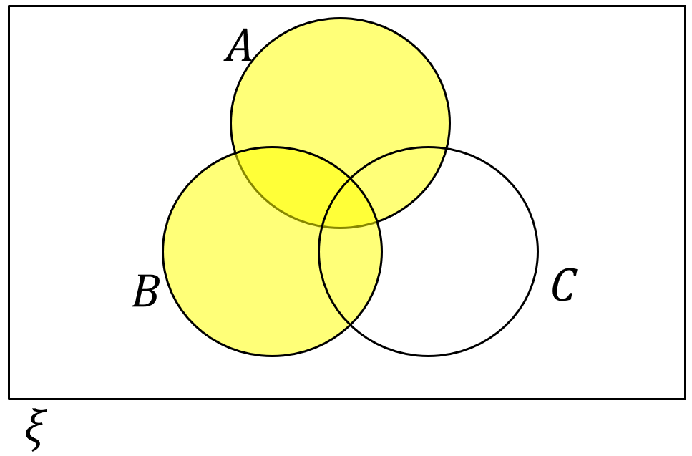
Worked example
Your turn
Describe the area indicated using set notation:
Describe the area indicated using set notation:
$$A∪B$$
Diagrams/Graphs used with permission from DrFrostMaths: https://www.drfrostmaths.com/

Slide 18
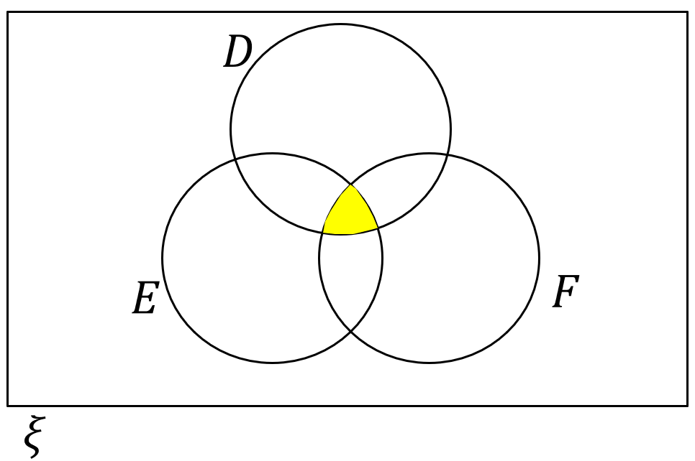
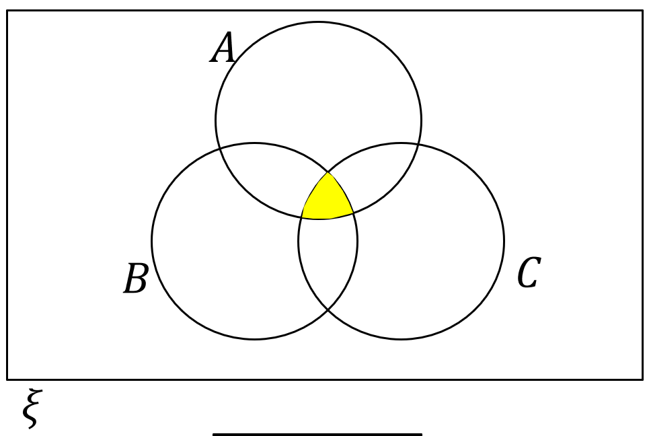
Worked example
Your turn
Describe the area indicated using set notation:
Describe the area indicated using set notation:
$$A∩B∩C$$
Diagrams/Graphs used with permission from DrFrostMaths: https://www.drfrostmaths.com/

Slide 19
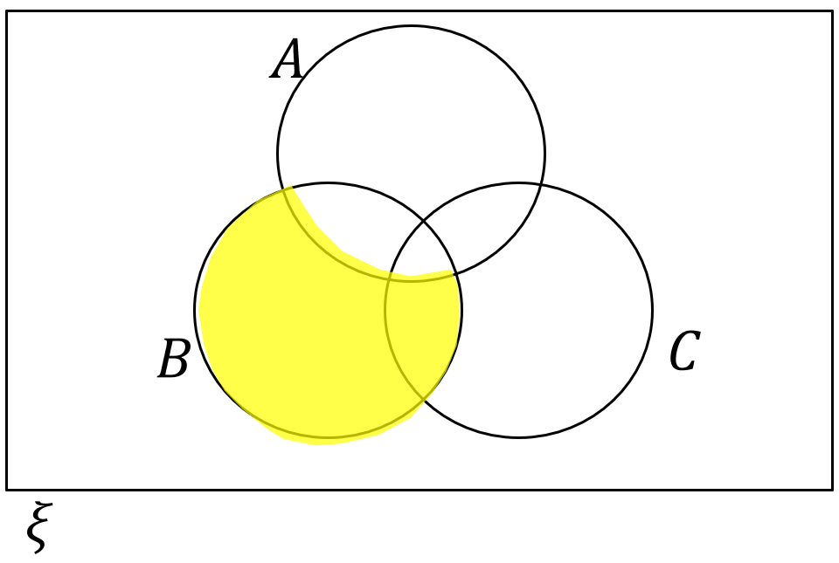
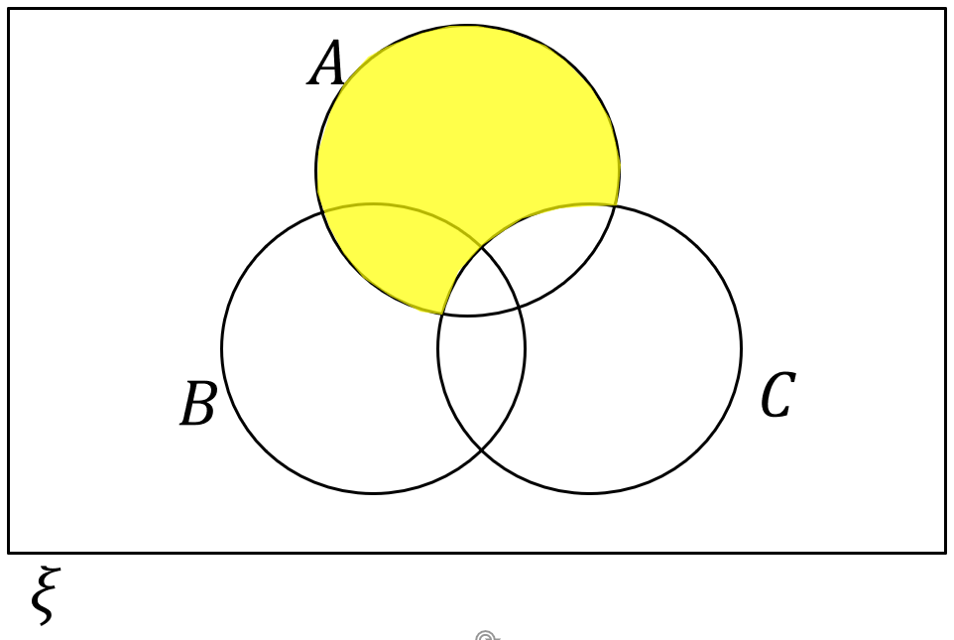
Worked example
Your turn
Describe the area indicated using set notation:
Describe the area indicated using set notation:
$$A∩C^{′}$$
Diagrams/Graphs used with permission from DrFrostMaths: https://www.drfrostmaths.com/

Slide 20
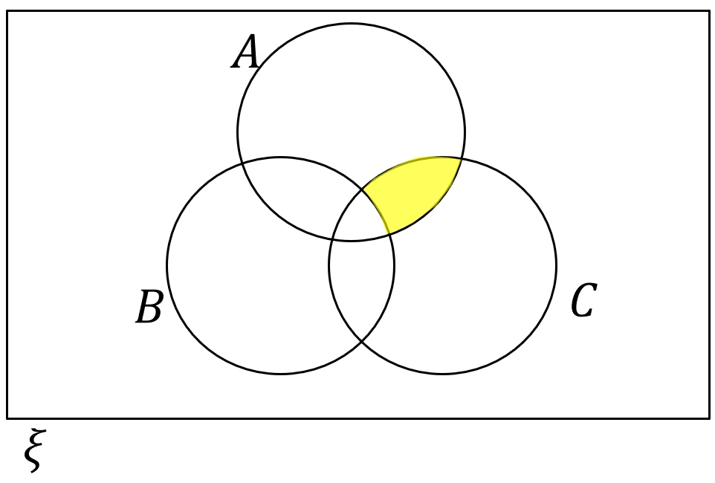
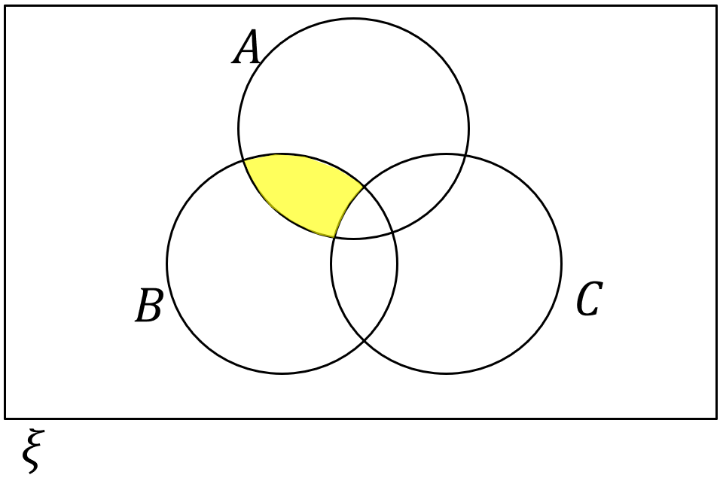
Worked example
Your turn
Describe the area indicated using set notation:
Describe the area indicated using set notation:
$$A∩B∩C^{′}$$
Diagrams/Graphs used with permission from DrFrostMaths: https://www.drfrostmaths.com/

Slide 21
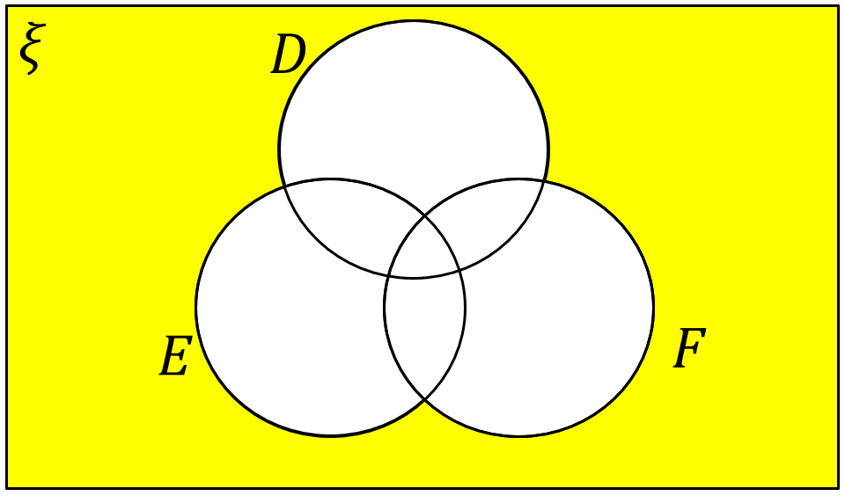

Worked example
Your turn
Describe the area indicated using set notation:
Describe the area indicated using set notation:
$A^{′}∩B^{′}∩C^{′}$ or ${\left(A∪B∪C\right)}^{′}$
Diagrams/Graphs used with permission from DrFrostMaths: https://www.drfrostmaths.com/

Slide 22


Worked example
Your turn
Describe the area indicated using set notation:
Describe the area indicated using set notation:
$$A′$$
Diagrams/Graphs used with permission from DrFrostMaths: https://www.drfrostmaths.com/

Slide 23


Worked example
Your turn
Describe the area indicated using set notation:
Describe the area indicated using set notation:
$$A∩{\left(B∩C\right)}^{′}$$
Diagrams/Graphs used with permission from DrFrostMaths: https://www.drfrostmaths.com/

Slide 24


Worked example
Your turn
Describe the area indicated using set notation:
Describe the area indicated using set notation:
$$A∩B^{′}∩C′$$
Diagrams/Graphs used with permission from DrFrostMaths: https://www.drfrostmaths.com/

Slide 25


















Worked example
Your turn
$ξ$ = $\left\{Days of the week\right\}$
$$A\text{ = }\left\{Tuesday, Thursday\right\}$$
B = $\left\{Days starting with S or T\right\}$
Draw a Venn diagram to represent this information.
$ξ$ = $\left\{Months of the year\right\}$
$$A\text{ = }\left\{Months starting with A\right\}$$
B = $\left\{Months with six letters\right\}$
Draw a Venn diagram to represent this information.
$$ξ$$
$$ξ$$
$$January$$
$$February$$
$$March$$
$$May$$
$$June$$
$$A$$
$$B$$
$$A$$
$$B$$
$$April$$
$$August$$
$$July$$
$$September$$
$$October$$
$$November$$
$$December$$

Slide 26






Worked example
Your turn
On the Venn diagram, shade the region representing:
$$C∩D$$
On the Venn diagram, shade the region representing:
$$A∩B$$
$$ξ$$
$$C$$
$$D$$
$$A$$
$$B$$

Slide 27

Worked example
Your turn
On the Venn diagram, shade the region representing:
$$C∪D$$
On the Venn diagram, shade the region representing:
$$A∪B$$
$$ξ$$
$$C$$
$$D$$
$$A$$
$$B$$

Slide 28

Worked example
Your turn
On the Venn diagram, shade the region representing:
$$D′$$
On the Venn diagram, shade the region representing:
$$A′$$
$$ξ$$
$$C$$
$$D$$
$$A$$
$$B$$

Slide 29

Worked example
Your turn
On the Venn diagram, shade the region representing:
$$C∩D′$$
On the Venn diagram, shade the region representing:
$$A′∩B$$
$$ξ$$
$$C$$
$$D$$
$$A$$
$$B$$

Slide 30

Worked example
Your turn
On the Venn diagram, shade the region representing:
$(C∪D)′$ or $C′∩D′$
On the Venn diagram, shade the region representing:
$(A∪B)′$ or $A′∩B′$
$$ξ$$
$$C$$
$$D$$
$$A$$
$$B$$

Slide 31







Worked example
Your turn
On the Venn diagram, shade the region representing:
$$D∩E∩F$$
On the Venn diagram, shade the region representing:
$$A∩B∩C$$
$$ξ$$
$$D$$
$$E$$
$$A$$
$$B$$
$$F$$
$$C$$

Slide 32

Worked example
Your turn
On the Venn diagram, shade the region representing:
$$D∪E∪F$$
On the Venn diagram, shade the region representing:
$$A∪B∪C$$
$$ξ$$
$$D$$
$$E$$
$$A$$
$$B$$
$$F$$
$$C$$

Slide 33

Worked example
Your turn
On the Venn diagram, shade the region representing:
$$D∩E′∩F$$
On the Venn diagram, shade the region representing:
$$A′∩B∩C$$
$$ξ$$
$$D$$
$$E$$
$$A$$
$$B$$
$$F$$
$$C$$

Slide 34

Worked example
Your turn
On the Venn diagram, shade the region representing:
$$(D∪E∪F)′$$
On the Venn diagram, shade the region representing:
$$(A∪B∪C)′$$
$$ξ$$
$$D$$
$$E$$
$$A$$
$$B$$
$$F$$
$$C$$

Slide 35

Worked example
Your turn
On the Venn diagram, shade the region representing:
$$(D∪E)∩F′$$
On the Venn diagram, shade the region representing:
$$(A∪B)∩C′$$
$$ξ$$
$$D$$
$$E$$
$$A$$
$$B$$
$$F$$
$$C$$

Slide 36

Worked example
Your turn
On the Venn diagram, shade the region representing:
$$(D∩F)∪(E∩F^{′})$$
On the Venn diagram, shade the region representing:
$$(B∩C)∪(A^{′}∩C)$$
$$ξ$$
$$D$$
$$E$$
$$A$$
$$B$$
$$F$$
$$C$$

Slide 37

Worked example
Your turn
On the Venn diagram, shade the region representing:
$$(D′∪F)∩(D∪E′)$$
On the Venn diagram, shade the region representing:
$$(A′∪B)∩(B^{′}∪C)$$
$$ξ$$
$$D$$
$$E$$
$$A$$
$$B$$
$$F$$
$$C$$

Slide 38


Worked example
Your turn
Represent as a Venn diagram:
$ξ=$Positive integers between $1$ and $10$ inclusive
$A=\{$Multiples of $2\}$
$B=\{$Multiples of $4\}$
Represent as a Venn diagram:
$ξ=$Positive integers between $10$ and $20$ inclusive
$A=\{$Multiples of $3\}$
$B=\{$Multiples of $6\}$
$$ξ$$
$$A$$
$$10$$
$$11$$
$$13$$
$$14$$
$$15$$
$$16$$
$$17$$
$$19$$
$$20$$
$$B$$
$$12$$
$$18$$

Slide 39
Worked example
Your turn
In a group of 28 scientists:
20 have degrees in Physics.
18 have degrees in Chemistry.
Some have degrees in both
4 scientists have degrees which are neither Physics nor Chemistry.
Find the number of scientists who have degrees in both Physics and Chemistry.
In a group of 30 mathematicians:
15 have studied Calculus.
22 have studied Topology.
Some have studied both.
3 mathematicians have not yet studied either Calculus or topology
Find the number of mathematicians who have studied both Calculus and Topology.
$$10$$

Slide 40
2.2) Conditional probability
Chapter CONTENTS

Slide 41




Worked example
Your turn
A group is made up of $62$ men and $48$ women.
$32$ of the men and $46$ of the women are right-handed.
Draw a two-way table to show this information.
One person is chosen at random. Find:
i) $P($right-handed)
ii) $P($right-handed | woman)
iii) $P($man | right-handed)
A group is made up of $42$ men and $68$ women.
$36$ of the women and $24$ of the men are left-handed.
Draw a two-way table to show this information.
One person is chosen at random. Find:
i) $P($left-handed)
ii) $P($left-handed | man)
iii) $P($woman | left-handed)
a)
b)
i) $\frac{60}{110}=\frac{6}{11}$
ii) $\frac{24}{42}=\frac{4}{7}$
iii) $\frac{36}{60}=\frac{3}{5}$
 | $$L$$ | $$L′$$
$$M$$ | 24 | 18
$$W$$ | 36 | 32

Slide 42





Worked example
Your turn
The following two-way table shows what foreign language students in Year 9 study.
$G$ is the event that the student is a girl.
$S$ is the event they chose Spanish as their language.
Determine:
a) $P\left(S′ | G\right)$
b) $P\left(G′ | S\right)$
The following two-way table shows what foreign language students in Year 9 study.
$B$ is the event that the student is a boy.
$F$ is the event they chose French as their language.
Determine:
a) $P\left(F | B^{′}\right)$
b) $P\left(B | F^{′}\right)$
 | $$G$$ | $$G′$$
$$S$$ | 18 | 34
$$S′$$ | 16 | 32
 | $$B$$ | $$B′$$
$$F$$ | 14 | 38
$$F′$$ | 26 | 22
a) $\frac{38}{60}$
b) $\frac{26}{48}$

Slide 43
2.3) Conditional probabilities in Venn diagrams
Chapter CONTENTS

Slide 44





Worked example
Your turn
Using the Venn diagram, determine:
a) $P\left(A | B\right)$
b) $P\left(A′ | B′\right)$
c) $P\left(A | A∪B\right)$
Using the Venn diagram, determine:
a) $P\left(A | B\right)$
b) $P\left(A′ | B′\right)$
c) $P\left(B | A∪B\right)$
a) $\frac{1}{3}$
b) $\frac{1}{3}$
c) $\frac{1}{2}$

Slide 45


Worked example
Your turn
Given that $P\left(X\right)=0.7$ and $P\left(X∩Y\right)=0.2$, determine:
$$P\left(Y | X\right)$$
Given that $P\left(A\right)=0.5$ and $P\left(A∩B\right)=0.3$, determine:
$$P\left(B | A\right)$$
$$0.6$$

Slide 46



Worked example
Your turn
Given that $P\left(B\right)=0.7$ and $P\left(A∩B\right)=0.2$,
determine:
$P\left(A^{′} | B\right)$
Given that $P\left(Y\right)=0.6$ and $P\left(X∩Y\right)=0.4$,
determine:
$P\left(X^{′} | Y\right)$
$$\frac{1}{3}$$

Slide 47


Worked example
Your turn
Given that $P\left(X\right)=0.4$, $P\left(Y\right)=0.4$ and $P\left(X∩Y\right)=0.3$, determine:
$P\left(Y | X^{′}\right)$
Given that $P\left(A\right)=0.5$, $P\left(B\right)=0.5$ and $P\left(A∩B\right)=0.4$, determine:
$P\left(B | A^{′}\right)$
$$0.2$$

Slide 48



Worked example
Your turn
Given that
$$P\left(E\right)=0.24$$
$$P\left(E∪F\right)=0.79$$
$$P\left(E∩F^{′}\right)=0.12$$
Draw a Venn diagram to illustrate the probabilities of each region.
Given that
$$P\left(E\right)=0.28$$
$$P\left(E∪F\right)=0.76$$
$$P\left(E∩F^{′}\right)=0.11$$
Draw a Venn diagram to illustrate the probabilities of each region.

Slide 49



Worked example
Your turn
Given that
$$P\left(A∩B^{′}\right)=0.3$$
$$P\left(A∪B\right)=0.65$$
Determine:
a) $P(B)$
b) $P\left(A^{′}∩B^{′}\right)$
Given that
$$P\left(A∩B^{′}\right)=0.4$$
$$P\left(A∪B\right)=0.75$$
Determine:
a) $P(B)$
b) $P\left(A^{′}∩B^{′}\right)$
a) $0.35$
b) $0.25$

Slide 50



Worked example
Your turn
Given that
$$P\left(A^{′}\right)=0.6,$$
$$P\left(B^{′}\right)=0.15$$
$$P\left(A∩B^{′}\right)=0.05$$
Determine:
a) $P(A∪B′)$
b) $P\left(B|A′\right)$
Given that
$$P\left(A^{′}\right)=0.7,$$
$$P\left(B^{′}\right)=0.2$$
$$P\left(A∩B^{′}\right)=0.1$$
Determine:
a) $P(A∪B′)$
b) $P\left(B|A′\right)$
a) $0.4$
b) $\frac{6}{7}$

Slide 51



Worked example
Your turn
The events A and B are independent.
$P\left(B | C\right)=\frac{10}{11}$,
Find the values of $p, q$ and $r$
Find $P(A∪C|B)$
The events A and B are independent.
$P\left(B | C\right)=\frac{5}{11}$,
Find the values of $p, q$ and $r$
Find $P(A∪C|B)$
a) $p=0.15, q=0.24, r=0.21$
b) $0.75$

Slide 52
2.4) Probability formulae
Chapter CONTENTS

Slide 53



Worked example
Your turn
Two events $A$ and $B$ are independent.
$$P\left(A\right)=\frac{1}{5}$$
$$P\left(B\right)=\frac{1}{6}$$
Find:
a) $P(A∩B)$
b) $P(B|A)$
c) $P(A∪B)$
Two events $A$ and $B$ are independent.
$$P\left(A\right)=\frac{1}{3}$$
$$P\left(B\right)=\frac{1}{4}$$
Find:
a) $P(A∩B)$
b) $P(A|B)$
c) $P(A∪B)$
a) $\frac{1}{12}$
b) $\frac{1}{3}$
c) $\frac{1}{2}$

Slide 54



Worked example
Your turn
$A$ and $B$ are two events such that
$$P\left(A\right)=0.3$$
$$P\left(B\right)=0.4$$
$$P\left(A | B\right)=0.2$$
Find:
a) $P\left(A∩B\right)$
b)$P\left(B | A\right)$
c) $P\left(A∪B\right)$
$C$ and $D$ are two events such that
$$P\left(C\right)=0.2$$
$$P\left(D\right)=0.6$$
$$P\left(C | D\right)=0.3$$
Find:
a) $P\left(C∩D\right)$
b)$P\left(D | C\right)$
c) $P\left(C∪D\right)$
a) $0.18$
b) $0.9$
c) $0.62$

Slide 55



Worked example
Your turn
$C$ and $D$ are two independent events such that
$$P\left(C\right)=\frac{1}{3}$$
$$P\left(C∪D\right)=\frac{3}{5}$$
Find:
a) $P\left(D\right)$
b)$P(C^{′}∩D)$
c) $P(D^{′}|C)$
$A$ and $B$ are two independent events such that
$$P\left(A\right)=\frac{1}{4}$$
$$P\left(A∪B\right)=\frac{2}{3}$$
Find:
a) $P\left(B\right)$
b)$P(A^{′}∩B)$
c) $P(B^{′}|A)$
a) $\frac{5}{9}$
b) $\frac{5}{12}$
c) $\frac{4}{9}$

Slide 56



Worked example
Your turn
There are three events: $A$, $B$ and $C$.
$A$ and $C$ are mutually exclusive.
$A$ and $B$ are independent.
$$P\left(A\right)=0.4$$
$$P\left(C\right)=0.3$$
$$P\left(A∪B\right)=0.6$$
Find:
a) $P(A|B)$
b) $P(A∪C)$
c) $P(B)$
There are three events: $A$, $B$ and $C$.
$A$ and $B$ are mutually exclusive.
$A$ and $C$ are independent.
$$P\left(A\right)=0.2$$
$$P\left(B\right)=0.4$$
$$P\left(A∪C\right)=0.7$$
Find:
a) $P(A|C)$
b) $P(A∪B)$
c) $P(C)$
a) $0.2$
b) $0.6$
c) $0.625$

Slide 57

Worked example
Your turn
Write out the law for conditional probability:
“Given John runs to school, find the probability that he’s not late…”
“Given an even number is rolled on a die, find the probability that the number is prime…”
Write out the law for conditional probability:
“Given Bob walks to school, find the probability that he’s not late…”
$$P\left(L^{′} | W\right)=\frac{P\left(L^{′}∩W\right)}{P\left(W\right)}=…$$

Slide 58

Worked example
Your turn
Write out the relevant probability laws:
C and D are independent events.
C and D are mutually exclusive events.
Write out the law for independent events:
A and B are independent events.
C and D are mutually exclusive events.
$$P\left(A∩B\right)=P\left(A\right)P\left(B\right) \\ P\left(A | B\right)=P(A)$$
$$P\left(C∩D\right)=0$$
$$P\left(C∪D\right)=P\left(C\right)+P(D)$$

Slide 59
2.5) Tree diagrams
Chapter CONTENTS

Slide 60



Worked example
Your turn
A bag contains $7$ green beads and $3$ yellow beads.
A bead is taken from the bag at random, the colour is recorded and it is not replaced.
A second bead is then taken from the bag and its colour recorded.
Given that both balls are the same colour, find the probability that they are both green.
A bag contains $6$ green beads and $4$ yellow beads.
A bead is taken from the bag at random, the colour is recorded and it is not replaced.
A second bead is then taken from the bag and its colour recorded.
Given that both balls are the same colour, find the probability that they are both yellow.
$$\frac{2}{7}$$

Slide 61

Worked example
Your turn
There are two bags.
Bag A contains 5 red balls and 5 blue balls
Bag B contains 3 red balls and 6 blue balls.
One ball is taken from bag A and placed in bag B. Then one ball is taken from bag B.
Find the probability that:
A blue ball is taken from bag B.
Given that a blue ball is taken from bag B, the ball taken from bag A was also blue.
There are two bags.
Bag A contains 5 red balls and 5 blue balls
Bag B contains 3 red balls and 6 blue balls.
One ball is taken from bag A and placed in bag B. Then one ball is taken from bag B.
Find the probability that:
A red ball is taken from bag B.
Given that a red ball is taken from bag B, the ball taken from bag A was also red.
a) $\frac{7}{20}$
b) $\frac{4}{7}$

Slide 62



Worked example
Your turn
On a randomly chosen day the probability that a person travels to work by bus, train or motorbike is $\frac{2}{5},\frac{1}{4}$ and $\frac{7}{20}$ respectively.
The probability of being late when using these methods of travel is $\frac{1}{3},\frac{2}{7}$ and $\frac{3}{8}$ respectively.
Given that the person is late, find the probability that they did not travel by bus.
On a randomly chosen day the probability that a person travels to school by car, bicycle or on foot is $\frac{1}{2},\frac{1}{6}$ and $\frac{1}{3}$ respectively.
The probability of being late when using these methods of travel is $\frac{1}{5},\frac{2}{5}$ and $\frac{1}{10}$ respectively.
Given that the person is late, find the probability that they did not travel on foot.
$$\frac{5}{6}$$

Slide 63



Worked example
Your turn
A bag contains $9$ blue balls and $3$ red balls.
A ball is selected at random from the bag and its colour is recorded.
The ball is not replaced.
A second ball is selected at random and its colour is recorded.
Find the probability that:
The second ball selected is blue
Both balls selected are blue, given that the second ball selected is blue.
A bag contains $9$ blue balls and $3$ red balls.
A ball is selected at random from the bag and its colour is recorded.
The ball is not replaced.
A second ball is selected at random and its colour is recorded.
Find the probability that:
The second ball selected is red
Both balls selected are red, given that the second ball selected is red.
a) $\frac{1}{4}$
b) $\frac{2}{11}$

Slide 64
Worked example
Your turn
In bag A there are 2 white and 5 red counters.
In bag B there are 7 white counters and 3 red counters.
A person takes at random one counter from A and one counter from B.
Find the probability that the counters are the same colour
In bag A there are 5 white and 2 red counters.
In bag B there are 3 white counters and 7 red counters.
A person takes at random one counter from A and one counter from B.
Find the probability that the counters are the same colour
$$\frac{29}{70}$$

Slide 65
Worked example
Your turn
In bag A there are 2 white and 5 red counters.
In bag B there are 7 white counters and 3 red counters.
A person takes at random one counter from A and one counter from B.
Find the probability that the counters are different colours
In bag A there are 5 white and 2 red counters.
In bag B there are 3 white counters and 7 red counters.
A person takes at random one counter from A and one counter from B.
Find the probability that the counters are different colours
$$\frac{41}{70}$$

Slide 66
Worked example
Your turn
A person plays a game of tennis and then a game of golf.
They can only win or lose each game.
The probability of winning tennis is $0.3$
The probability of winning golf is $0.7$
The results of each game are independent of each other.
Calculate the probability that the person wins at least one game
A person plays a game of tennis and then a game of golf.
They can only win or lose each game.
The probability of winning tennis is $0.6$
The probability of winning golf is $0.35$
The results of each game are independent of each other.
Calculate the probability that the person wins at least one game
$$\frac{37}{50}=0.74$$

Slide 67
Worked example
Your turn
The table shows 100 students, who each study one language.
Two students are chosen at random.
Calculate the probability that the two chosen students study the same language.
The table shows 50 students, who each study one language.
Two students are chosen at random.
Calculate the probability that the two chosen students study the same language.
 | French | German
Female | 26 | 30
Male | 10 | 34
 | Japanese | Spanish
Female | 13 | 15
Male | 5 | 17
$$\frac{64}{245}$$

Slide 68

Worked example
Your turn
There are two bags with numbered discs as shown.
A person chooses a disc at random from bag 1.
If it is labelled 2, he puts the disc in bag 2.
If it is labelled 1, he does not put the disc in bag 2.
He then chooses a disc at random from bag 2.
He then adds the numbers of the two discs he selected to give his score.
Find the probability that his score is 5.
There are two bags with numbered discs as shown.
A person chooses a disc at random from bag 1.
If it is labelled 1, he puts the disc in bag 2.
If it is labelled 2, he does not put the disc in bag 2.
He then chooses a disc at random from bag 2.
He then adds the numbers of the two discs he selected to give his score.
Find the probability that his score is 4.
$$\frac{23}{80}$$
Questions used with permission from Corbettmaths: https://corbettmaths.com/

