Slide 1
2) Quadratics
2.1) Solving quadratic equations
2.2) Completing the square
2.3) Functions
2.4) Quadratic graphs
2.5) The discriminant
2.6) Modelling with quadratics

Slide 2
2.1) Solving quadratic equations
Chapter CONTENTS

Slide 3
Worked example
Your turn
Solve:
$${\left(2x−3\right)}^{2}=4$$
Solve:
$${\left(3x−5\right)}^{2}=9$$
$$x=\frac{2}{3},x=\frac{8}{3}$$

Slide 4
Worked example
Your turn
Solve:
$$x−8\sqrt{x}+15=0$$
Solve:
$$x−6\sqrt{x}+8=0$$
$$x=4, x=16$$

Slide 5
Worked example
Your turn
Solve:
$$3x+2\sqrt{x}−8=0$$
Solve:
$$2x+\sqrt{x}−1=0$$
$$x=\frac{1}{4}$$

Slide 6
Worked example
Your turn
Solve:
$$\sqrt{x+6}=x−6$$
Solve:
$$\sqrt{x+3}=x−3$$
$x=6$ only

Slide 7
Worked example
Your turn
Solve:
$${\left(2x−3\right)}^{2}=4$$
Solve:
$${\left(3x−5\right)}^{2}=9$$
$$x=\frac{2}{3},x=\frac{8}{3}$$

Slide 8
Worked example
Your turn
Solve:
$${2x}^{2}−1=17$$
$$45+2x^{2}=5x^{2}−3$$
$$1−x^{2}=−6x^{2}+6$$
Solve:
$${3x}^{2}+49=7x^{2}+13$$
$$x=±3$$

Slide 9
Worked example
Your turn
Solve:
$$2x^{2}=18$$
$${\left(2x\right)}^{2}=4$$
Solve:
$$3x^{2}=48$$
$${\left(3x\right)}^{2}=36$$
$$x=±4$$
$$x=±2$$

Slide 10
Worked example
Your turn
Solve:
$$2x^{2}=\frac{32}{25}$$
$$3x^{2}=\frac{27}{49}$$
Solve:
$$5x^{2}=\frac{45}{121}$$
$$x=±\frac{3}{11}$$

Slide 11
Worked example
Your turn
Solve:
$$4^{x}−12\left(2^{x}\right)+32=0$$
$${16}^{x}−5\left(4^{x}\right)+4=0$$
Solve:
$$9^{x}−10\left(3^{x}\right)+9=0$$
$$x=2, x=0$$

Slide 12
Worked example
Your turn
Solve:
$x^{4}−5x^{2}+4=0$
$$x^{4}−13x^{2}+36=0$$
Solve:
$$x^{4}−17x^{2}+16=0$$
$$x=±4, x=±1$$

Slide 13
Worked example
Your turn
Solve:
$x^{6}−35x^{3}+215=0$
Solve:
$$x^{6}−9x^{3}+8=0$$
$$x=2, x=1$$

Slide 14
Worked example
Your turn
Solve $6x^{\frac{2}{3}}+5x^{\frac{1}{3}}−4=0$
Solve ${3y}^{\frac{2}{3}}+2y^{\frac{1}{3}}−1=0$
$$y=\frac{1}{27}, y=−1$$

Slide 15
Worked example
Your turn
Solve:
$$x+\frac{2}{x}=3$$
$$x−\frac{3}{x}=5$$
Solve:
$$x+\frac{4}{x}=5$$
$$x=4, x=1$$

Slide 16
Worked example
Your turn
Solve:
$$\frac{3}{x^{2}}+\frac{2}{x}=1$$
$$\frac{2}{x^{2}}−\frac{7}{x}=3$$
Solve:
$$\frac{2}{x^{2}}−\frac{5}{x}=3$$
$$x=\frac{1}{3}, x=−2$$

Slide 17
Worked example
Your turn
Solve:
$$x^{3}+2x^{2}−8x=0$$
Solve:
$$x^{3}−3x^{2}−10x=0$$
$$x=0, x=5, x=−2$$

Slide 18
Worked example
Your turn
Solve by factorising:
$$x^{2}+6x+9=0$$
$$x^{2}+8x+16=0$$
$$x^{2}+10x+25=0$$
$$x^{2}+2x+1=0$$
Solve by factorising:
$$x^{2}+12x+36=0$$
$$x=−6$$

Slide 19
Worked example
Your turn
Solve by factorising:
$$x^{2}−6x+9=0$$
$$x^{2}−8x+16=0$$
$$x^{2}−10x+25=0$$
$$x^{2}−2x+1=0$$
Solve by factorising:
$$x^{2}−12x+36=0$$
$$x=6$$

Slide 20
Worked example
Your turn
Solve by factorising:
$$x^{2}+17x+16=0$$
$$x^{2}+10x+16=0$$
$$x^{2}+8x+16=0$$
$$x^{2}−8x+16=0$$
Solve by factorising:
$$x^{2}+37x+36=0$$
$$x^{2}+20x+36=0$$
$$x^{2}+15x+36=0$$
$$x^{2}+13x+36=0$$
$$x^{2}+12x+36=0$$
$$x=−36, x=−1$$
$$x=−18, x=−2$$
$$x=−12, x=−3$$
$$x=−9, x=−4$$
$$x=−6$$

Slide 21
Worked example
Your turn
Solve by factorising:
$$x^{2}+10x+9=0$$
$$x^{2}+10x+16=0$$
$$x^{2}+10x+25=0$$
$$x^{2}+10x=0$$
Solve by factorising:
$$x^{2}+12x+11=0$$
$$x^{2}+12x+27=0$$
$$x^{2}+12x+36=0$$
$$x^{2}+12x=0$$
$$x=−11, x=−1$$
$$x=−9, x=−3$$
$$x=−6$$
$$x=0, x=−12$$

Slide 22
Worked example
Your turn
Solve by factorising:
$$3x^{2}+10x+3=0$$
$$3x^{2}+10x+8=0$$
$$3x^{2}+14x+8=0$$
Solve by factorising:
$$5x^{2}+8x+3=0$$
$$5x^{2}+16x+12=0$$
$$5x^{2}+32x+12=0$$
$$x=−\frac{3}{5}, x=−1$$
$$x=−\frac{6}{5}, x=−2$$
$$x=−\frac{2}{5}, x=−6$$

Slide 23
Worked example
Your turn
Solve by factorising:
$$2x^{2}+8x+6=0$$
$$3x^{2}+21x+30=0$$
$$5x^{2}+5x−30=0$$
Solve by factorising:
$$3x^{2}+15x−42=0$$
$$x=−7, x=2$$

Slide 24
Worked example
Your turn
Solve by factorising:
$$6+5x−x^{2}=0$$
$$3−2x−x^{2}=0$$
Solve by factorising:
$$12−x−x^{2}=0$$
$$x=3, x=−4$$

Slide 25
Worked example
Your turn
Solve:
$$6+5x−x^{2}=0$$
$$−6+5x−x^{2}=0$$
Solve:
$$6−5x−x^{2}=0$$
$$x=−6, x=1$$

Slide 26
Worked example
Your turn
Solve with the quadratic formula:
$${2x}^{2}+x−3=0$$
$$3x^{2}+x−10=0$$
Solve with the quadratic formula:
$$5x^{2}+13x−6=0$$
$$x=\frac{2}{5}, x=−3$$

Slide 27
Worked example
Your turn
Solve with the quadratic formula:
$${2x}^{2}+x−4=0$$
$$3x^{2}+x−11=0$$
Solve with the quadratic formula:
$$5x^{2}+13x−7=0$$
$$x=\frac{−13+\sqrt{309}}{10}, x=\frac{−13−\sqrt{309}}{10}$$

Slide 28
Worked example
Your turn
Solve with the quadratic formula:
$$x^{2}+x−11=0$$
$$−{2x}^{2}+x+3=0$$
Solve with the quadratic formula:
$$−x^{2}+13x−7=0$$
$$x=\frac{13+\sqrt{141}}{2}, x=\frac{13−\sqrt{141}}{2}$$

Slide 29
Worked example
Your turn
The solutions to a quadratic equation are $x=\frac{5±\sqrt{25+24}}{6}$
What is the quadratic equation?
The solutions to a quadratic equation are $x=\frac{6±\sqrt{36+8}}{2}$
What is the quadratic equation?
$$x^{2}−6x−2=0$$

Slide 30
Worked example
Your turn
How many real roots are there to:
$$x^{2}+6x+8=0$$
$$x^{2}+6x+9=0$$
$$x^{2}+6x+10=0$$
How many real roots are there to:
$$x^{2}+8x+12=0$$
$$x^{2}+8x+16=0$$
$$x^{2}+8x+17=0$$
Two: $x=−6, x=−2$
One: $x=−4$
No real roots

Slide 31
Worked example
Your turn
Solve:
$$x+\frac{2}{x}=3$$
$$x−\frac{3}{x}=5$$
Solve:
$$x+\frac{4}{x}=5$$
$$x=4, x=1$$

Slide 32
Worked example
Your turn
Solve:
$$\frac{3}{x^{2}}+\frac{2}{x}=1$$
$$\frac{2}{x^{2}}−\frac{7}{x}=3$$
Solve:
$$\frac{2}{x^{2}}−\frac{5}{x}=3$$
$$x=\frac{1}{3}, x=−2$$

Slide 33
Worked example
Your turn
Solve by completing the square:
$$x^{2}+8x+3=0$$
$$x^{2}+10x−4=0$$
Solve by completing the square:
$$x^{2}+6x+4=0$$
$$x=−3+\sqrt{5}, x=−3−\sqrt{5}$$

Slide 34
Worked example
Your turn
Solve by completing the square:
$$2x^{2}−8x+3=0$$
$${3x}^{2}−10x−4=0$$
Solve by completing the square:
$${5x}^{2}−6x−2=0$$
$$x=\frac{3+\sqrt{19}}{5}, x=\frac{3−\sqrt{19}}{5}$$

Slide 35
Worked example
Your turn
Solve using three methods:
$$x^{2}+6x+8=0$$
$$x^{2}+6x+8=0$$
$$x^{2}+6x+8=0$$
Solve using three methods:
$$x^{2}+6x+5=0$$
$$x=−5, x=−1$$

Slide 36
Worked example
Your turn
The area of the rectangle is equal to $32$ square units. Find $x$
The area of the rectangle is equal to $28$square units. Find $x$
$$x−3$$
$$x−7$$
$$x−5$$
$$x−2$$
$$x=9$$

Slide 37
Worked example
Your turn
The area of the triangle is equal to $16$square units. Find $x$
The area of the triangle is equal to $24$square units. Find $x$
$$4\sqrt{5}$$
$$10$$
$$2x−8$$
$$x−1$$
$$x+2$$
$$2x−6$$
$$x=7$$

Slide 38
Worked example
Your turn
Two numbers have a difference of $3$ and a product of $88$. Find the two numbers.
Two numbers have a difference of $5$ and a product of $14$. Find the two numbers.
Two numbers have a difference of $4$ and a product of $12$. Find the two numbers.
$$x=6, y=2$$
$$x=−2, y=−6$$

Slide 39
2.2) Completing the square
Chapter CONTENTS

Slide 40
Worked example
Your turn
Complete the square for:
$$x^{2}+4x$$
$$x^{2}−6x$$
$$x^{2}+8x−7$$
Complete the square for:
$$x^{2}−10x+3$$
$${\left(x−5\right)}^{2}−22$$

Slide 41
Worked example
Your turn
Complete the square for:
$$x^{2}+6x+5$$
$$x^{2}+8x+3$$
Complete the square for:
$$x^{2}+10x+1$$
$${\left(x+5\right)}^{2}−24$$

Slide 42
Worked example
Your turn
Complete the square for:
$$x^{2}−6x+5$$
$$x^{2}−8x−3$$
Complete the square for:
$$x^{2}−10x+1$$
$${\left(x−5\right)}^{2}−24$$

Slide 43
Worked example
Your turn
Complete the square for:
$$x^{2}+9x+5$$
$$x^{2}+7x+3$$
Complete the square for:
$$x^{2}+5x+1$$
$${\left(x+\frac{5}{2}\right)}^{2}−\frac{21}{4}$$

Slide 44
Worked example
Your turn
Complete the square for:
$$x^{2}−5x−3$$
$$x^{2}−x+2$$
Complete the square for:
$$x^{2}−3x−2$$
$${\left(x−\frac{3}{2}\right)}^{2}−\frac{17}{4}$$

Slide 45
Worked example
Your turn
Complete the square for:
$${2x}^{2}+12x+1$$
$$3x^{2}+12x+2$$
Complete the square for:
$$5x^{2}+40x+3$$
$$5{\left(x+4\right)}^{2}−77$$

Slide 46
Worked example
Your turn
Complete the square for:
$${2x}^{2}+5x+1$$
$$3x^{2}+7x+2$$
Complete the square for:
$$5x^{2}+9x+3$$
$$5{\left(x+\frac{9}{10}\right)}^{2}−\frac{21}{20}$$

Slide 47
Worked example
Your turn
Complete the square for:
$${2x}^{2}−5x+3$$
$$5x^{2}−3x+1$$
Complete the square for:
$$3x^{2}−7x+2$$
$$3{\left(x−\frac{7}{6}\right)}^{2}−\frac{25}{12}$$

Slide 48
Worked example
Your turn
Express in the form $a{\left(x+b\right)}^{2}+c$:
$${2x}^{2}−5x+3$$
Express in the form $a{\left(x+b\right)}^{2}+c$:
$$3x^{2}−7x+2$$
$$3{\left(x−\frac{7}{6}\right)}^{2}−\frac{25}{12}$$

Slide 49
Worked example
Your turn
Complete the square for:
$$3+5x−x^{2}$$
$$2−3x−x^{2}$$
Complete the square for:
$$5−7x−x^{2}$$
$$−{\left(x+\frac{7}{2}\right)}^{2}+\frac{69}{4}$$

Slide 50
Worked example
Your turn
Complete the square for:
$$3+5x−{2x}^{2}$$
$$2−3x−{5x}^{2}$$
Complete the square for:
$$5−7x−{3x}^{2}$$
$$−3{\left(x+\frac{7}{6}\right)}^{2}+\frac{109}{12}$$

Slide 51
Worked example
Your turn
Solve by completing the square:
$$x^{2}+8x+3=0$$
$$x^{2}+10x−4=0$$
Solve by completing the square:
$$x^{2}+6x+4=0$$
$$x=−3+\sqrt{5}, x=−3−\sqrt{5}$$

Slide 52
Worked example
Your turn
Solve by completing the square:
$$2x^{2}−8x+3=0$$
$${3x}^{2}−10x−4=0$$
Solve by completing the square:
$${5x}^{2}−6x−2=0$$
$$x=\frac{3+\sqrt{19}}{5}, x=\frac{3−\sqrt{19}}{5}$$

Slide 53
Worked example
Your turn
Solve using three methods:
$$x^{2}+6x+8=0$$
$$x^{2}+6x+8=0$$
$$x^{2}+6x+8=0$$
Solve using three methods:
$$x^{2}+6x+5=0$$
$$x=−5, x=−1$$

Slide 54
Worked example
Your turn
By completing the square, explain why the curve $y=2x^{2}−8x+9$ does not intersect the $x$-axis
By completing the square, explain why the curve $y=2x^{2}−20x+51$ does not intersect the $x$-axis
$$y=2{\left(x−5\right)}^{2}+1$$
Turning point at $(5, 1)$

Slide 55
Worked example
Your turn
A sequence has the n^{th} term
$n^{2}−6n+10$.
By completing the square, show that every term is positive.
A sequence has the n^{th} term
$n^{2}−10n+27$.
By completing the square, show that every term is positive.
$$n^{2}−10n+27={\left(n−5\right)}^{2}+2$$
$$k^{2}≥0$$
$${\left(n−5\right)}^{2}≥0$$
$${\left(n−5\right)}^{2}+2≥2$$

Slide 56
2.3) Functions
Chapter CONTENTS

Slide 57
Worked example
Your turn
If $f\left(x\right)=x^{2}+3$, evaluate:
$f\left(4\right)$ $f\left(−2\right)$
If $g\left(x\right)=x^{3}−5$, evaluate:
$g\left(4\right)$ $g\left(−2\right)$
If $h\left(x\right)=x^{2}+4$, evaluate:
$$h\left(5\right)$$
$$h\left(−2\right)$$
$$29$$
$$8$$

Slide 58
Worked example
Your turn
$$f\left(x\right)=4x−8, x∈ℝ$$
$$g\left(x\right)=x^{2}−4, x∈ℝ$$
Find:
a) $f(−2)$
b) $g(0)$
c) The value of $x$ for which $f\left(x\right)=g(x)$
$$f\left(x\right)=2x−10, x∈ℝ$$
$$g\left(x\right)=x^{2}−9, x∈ℝ$$
Find:
a) $f(5)$
b) $g(10)$
c) The value of $x$ for which $f\left(x\right)=g(x)$
a) $0$
b) $91$
c) $x=1$

Slide 59
Worked example
Your turn
Determine the minimum/maximum value of the function and state the value of $x$ for which this minimum occurs:
$$f\left(x\right)=x^{2}+8x+17$$
$$g\left(x\right)=x^{2}−8x+17$$
$$h\left(x\right)=17−x^{2}$$
$$i\left(x\right)=17−8x−x^{2}$$
Determine the minimum/maximum value of the function and state the value of $x$ for which this minimum occurs:
$$f\left(x\right)=x^{2}+6x+10$$
$$g\left(x\right)=x^{2}−6x+10$$
$$h\left(x\right)=10−x^{2}$$
$$i\left(x\right)=10−6x−x^{2}$$
Minimum of $19$ when $x=−3$
Minimum of $1$ when $x=3$
Maximum of $10$ when $x=0$
Maximum of $19$ when $x=−3$

Slide 60
Worked example
Your turn
Find the roots of the function:
$$f\left(x\right)=x^{4}+x^{2}−6$$
Find the roots of the function:
$$f\left(x\right)=x^{4}−x^{2}−6$$
$$x=±\sqrt{3}$$

Slide 61
Worked example
Your turn
Find the roots of the function:
$$f\left(x\right)=x^{6}−7x^{3}−8$$
Find the roots of the function:
$$f\left(x\right)=x^{6}+7x^{3}−8$$
$$x=−2, x=1$$

Slide 62
Worked example
Your turn
$$f\left(x\right)=4x−8, x∈ℝ$$
$$g\left(x\right)=x^{2}−4, x∈ℝ$$
Find:
a) $f(−2)$
b) $g(0)$
c) The value of $x$ for which $f\left(x\right)=g(x)$
$$f\left(x\right)=2x−10, x∈ℝ$$
$$g\left(x\right)=x^{2}−9, x∈ℝ$$
Find:
a) $f(5)$
b) $g(10)$
c) The value of $x$ for which $f\left(x\right)=g(x)$
a) $0$
b) $91$
c) $x=1$

Slide 63
Worked example
Your turn
$$f\left(x\right)=5x+4$$
Find:
$f\left(x+3\right)$ $f(x−4)$
$f\left(5x\right)$ $f(\frac{1}{6}x)$
$$g\left(x\right)=3x+2$$
Find:
$g\left(x+2\right)$ $g(x−2)$
$g\left(2x\right)$ $g(\frac{1}{2}x)$
$$3x+8$$
$$3x+4$$
$$6x+2$$
$$\frac{3}{2}x+2$$

Slide 64
Worked example
Your turn
$$f\left(x\right)=3x^{2}−2$$
$f\left(x+2\right)$ $f(x−2)$
$f\left(2x\right)$ $f(\frac{1}{2}x)$
$$g\left(x\right)=5x^{2}+3$$
$g\left(x+4\right)$ $f(x−4)$
$g\left(3x\right)$ $g(\frac{1}{3}x)$
$$5{\left(x+4\right)}^{2}+3$$
$$=5x^{2}+40x+83$$
$$5{\left(x−4\right)}^{2}+3$$
$$=5x^{2}−40x+83$$
$$5{(3x)}^{2}+3$$
$$=45x^{2}+3$$
$$5{\left(\frac{1}{3}x\right)}^{2}+3$$
$$=\frac{5}{9}x^{2}+3$$

Slide 65
Worked example
Your turn
$$f\left(x\right)=3x^{2}−5x−2$$
$f\left(x+2\right)$ $f(x−2)$
$f\left(2x\right)$ $f(\frac{1}{2}x)$
$$g\left(x\right)=5x^{2}−2x+3$$
$g\left(x+4\right)$ $f(x−4)$
$g\left(3x\right)$ $g(\frac{1}{3}x)$
$$5{\left(x+4\right)}^{2}−2\left(x+4\right)+3$$
$$=5x^{2}+38x+75$$
$$5{\left(x−4\right)}^{2}−2\left(x−4\right)+3$$
$$=5x^{2}−42x+91$$
$$5{\left(3x\right)}^{2}−2\left(3x\right)+3$$
$$=45x^{2}−6x+3$$
$$5{\left(\frac{1}{3}x\right)}^{2}−2\left(\frac{1}{3}x\right)+3$$
$$=\frac{5}{9}x^{2}−\frac{2}{3}x+3$$

Slide 66
2.4) Quadratic graphs
Chapter CONTENTS

Slide 67
Worked example
Your turn
Write down the line of symmetry of:
$$y=x^{2}+4x−5$$
$$y=x^{2}−6x+10$$
Write down the line of symmetry of:
$$y=x^{2}+8x−17$$
$$x=−4$$

Slide 68
Worked example
Your turn
Write down the line of symmetry of:
$$y=12x−2x^{2}−5$$
$$y=12x−3x^{2}+5$$
Write down the line of symmetry of:
$$y=4x−2x^{2}−3$$
$$x=1$$

Slide 69
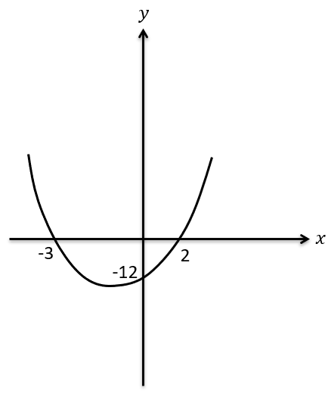
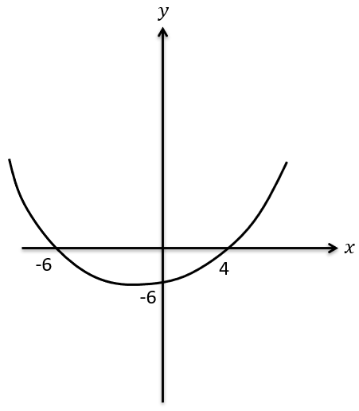
Worked example
Your turn
Determine the equation of this quadratic graph, in the form $y=ax^{2}+bx+c$.
Determine the equation of this quadratic graph, in the form $y=ax^{2}+bx+c$.
$$y=2x^{2}+2x−12$$

Slide 70
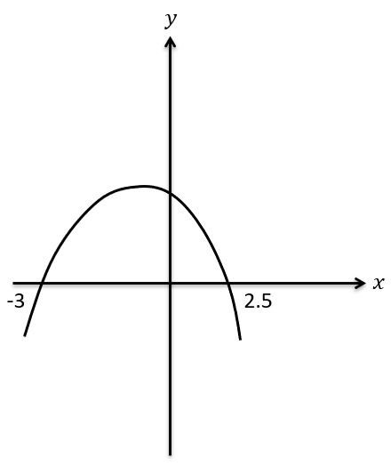
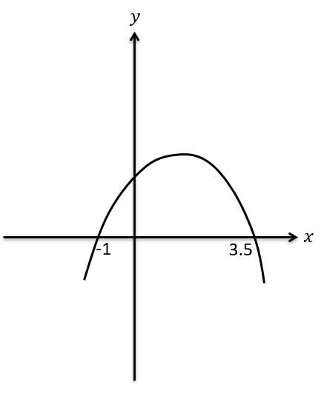
Worked example
Your turn
Determine the equation of this quadratic graph, in the form $y=ax^{2}+bx+c$, where $a,b,c$ are integers.
Determine the equation of this quadratic graph, in the form $y=ax^{2}+bx+c$, where $a,b,c$ are integers.
$$y=−2x^{2}+5x+7$$

Slide 71
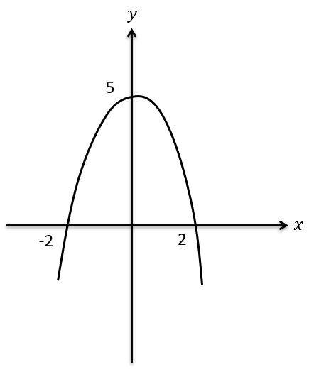
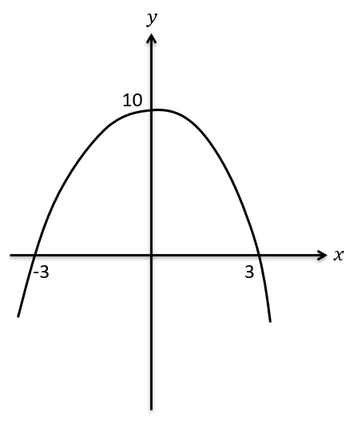
Worked example
Your turn
Determine the equation of this quadratic graph, in the form $y=ax^{2}+bx+c$, where $a,b,c$ are integers.
Determine the equation of this quadratic graph, in the form $y=ax^{2}+bx+c$, where $a,b,c$ are integers.
$$y=\frac{10}{9}(x+3)(3−x)$$

Slide 72
Worked example
Your turn
The graph of $y=ax^{2}+bx+c$ has a minimum at $(3, −5)$ and passes through $(4, 0)$. Find the values of $a, b$ and $c$
The graph of $y=ax^{2}+bx+c$ has a minimum at $(7, −2)$ and passes through $(8, 0)$. Find the values of $a, b$ and $c$
$$a=2, b=−28, c=96$$

Slide 73
Worked example
Your turn
Find the coordinates of the turning point of:
$$y=x^{2}+6x−5$$
$${y=x}^{2}−8x+3$$
Find the coordinates of the turning point of:
$$y=x^{2}+8x−2$$
$$(−4, −18)$$

Slide 74
Worked example
Your turn
Find the coordinates of the turning point of:
$$y={2x}^{2}+6x−5$$
$${y=2x}^{2}−8x+3$$
Find the coordinates of the turning point of:
$$y=2x^{2}+10x−3$$
$$(−\frac{5}{2}, −\frac{31}{2})$$

Slide 75
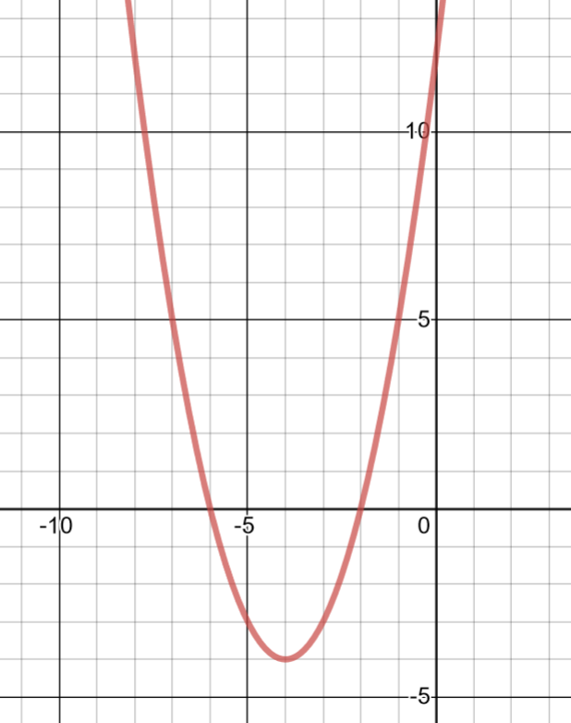
Worked example
Your turn
Sketch $y=x^{2}+6x+8$, labelling the intercepts with the axes and the turning points.
Sketch $y=x^{2}+8x+12$, labelling the intercepts with the axes and the turning points.
$$−6$$
$$−2$$
$$(−4, −4)$$
Graph used with permission from DESMOS: https://www.desmos.com/

Slide 76
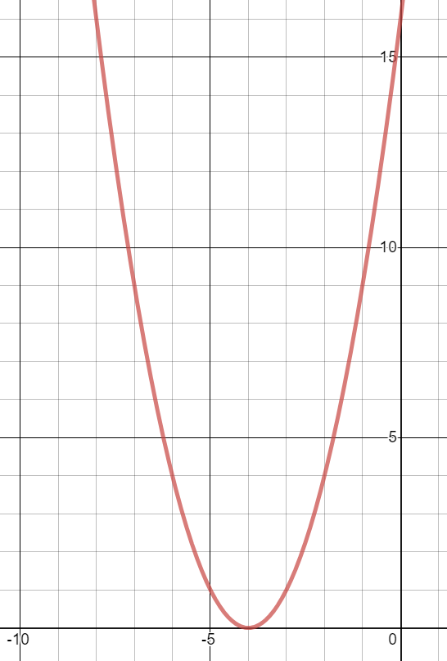
Worked example
Your turn
Sketch $y=x^{2}+6x+9$, labelling the intercepts with the axes and the turning points.
Sketch $y=x^{2}+8x+16$, labelling the intercepts with the axes and the turning points.
Graph used with permission from DESMOS: https://www.desmos.com/

Slide 77
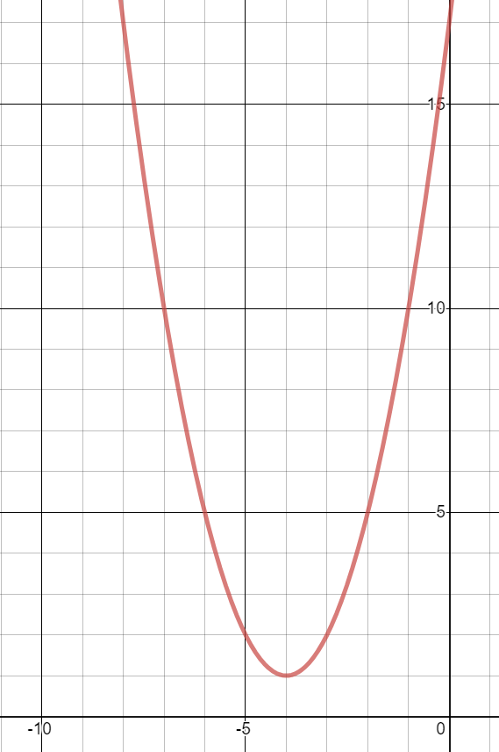
Worked example
Your turn
Sketch $y=x^{2}+6x+10$, labelling the intercepts with the axes and the turning points.
Sketch $y=x^{2}+8x+17$, labelling the intercepts with the axes and the turning points.
Graph used with permission from DESMOS: https://www.desmos.com/

Slide 78
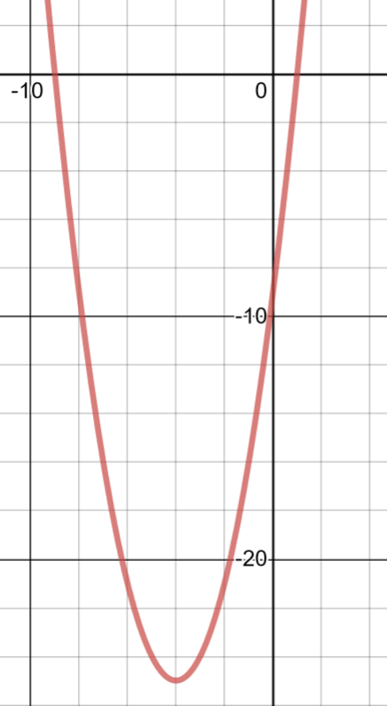
Worked example
Your turn
Sketch $y=x^{2}+6x−7$, labelling the intercepts with the axes and the turning points.
Sketch $y=x^{2}+8x−9$, labelling the intercepts with the axes and the turning points.
$$−9$$
$$1$$
$$(−4, −25)$$
Graph used with permission from DESMOS: https://www.desmos.com/

Slide 79
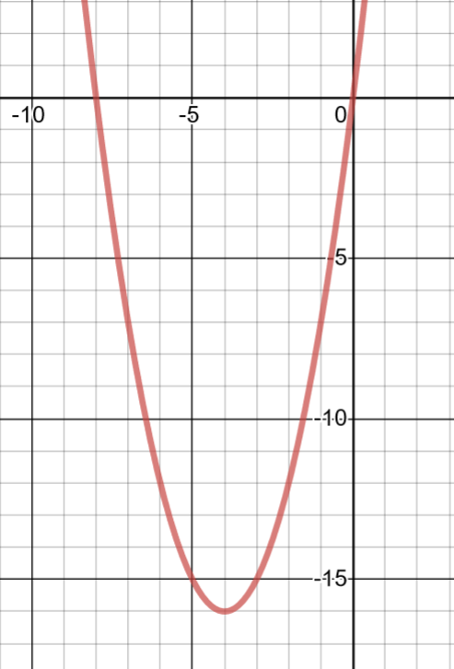
Worked example
Your turn
Sketch $y=x^{2}+6x$, labelling the intercepts with the axes and the turning points.
Sketch $y=x^{2}+8x$, labelling the intercepts with the axes and the turning points.
$$−8$$
$$(−4, −16)$$
Graph used with permission from DESMOS: https://www.desmos.com/

Slide 80
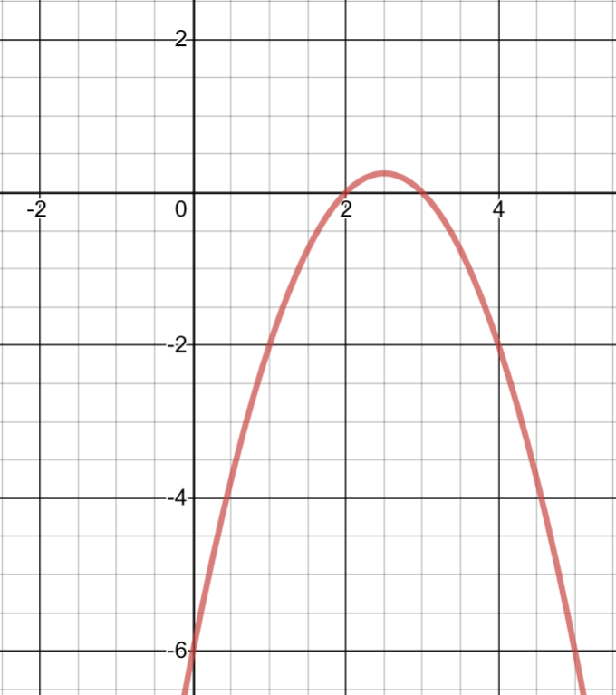
Worked example
Your turn
Sketch $y=−x^{2}+3x−2$, labelling the intercepts with the axes and the turning points.
Sketch $y=−x^{2}+5x−6$, labelling the intercepts with the axes and the turning points.
$$(\frac{5}{2},\frac{1}{4})$$
$$3$$
Graph used with permission from DESMOS: https://www.desmos.com/

Slide 81
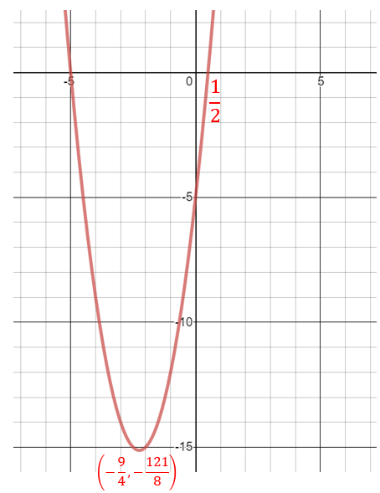
Worked example
Your turn
Sketch $y={2x}^{2}+5x−3$, labelling the intercepts with the axes and the turning points.
Sketch$y={2x}^{2}+9x−5$, labelling the intercepts with the axes and the turning points.
Graph used with permission from DESMOS: https://www.desmos.com/

Slide 82
2.5) The discriminant
Chapter CONTENTS

Slide 83
Worked example
Your turn
How many distinct real solutions do these equations have?
$$x^{2}+6x+8=0$$
$$x^{2}+6x+9=0$$
$$x^{2}+6x+10=0$$
How many distinct real solutions do these equations have?
$$x^{2}+8x+12=0$$
$$x^{2}+8x+16=0$$
$$x^{2}+8x+17=0$$
$$2$$
$1$ (equal roots)
$$0$$

Slide 84
Worked example
Your turn
Find the value of the discriminant:
$$x^{2}+5x+6=0$$
$$x^{2}−5x+6.25=0$$
$$x^{2}−5x+7=0$$
Find the value of the discriminant:
$$x^{2}+3x+2=0$$
$$x^{2}−3x+2.25=0$$
$$x^{2}−3x+4=0$$
$$1$$
$$0$$
$$−7$$

Slide 85
Worked example
Your turn
Find the value of the discriminant:
$$6x^{2}−3x−2=0$$
$$3x^{2}−2x−6=0$$
Find the value of the discriminant:
$$2x^{2}−6x−3=0$$
$$60$$

Slide 86
Worked example
Your turn
Find the value of the discriminant:
$$4+3x−x^{2}$$
$$4−3x−2x^{2}$$
$$4−x^{2}$$
Find the value of the discriminant:
$$9−5x−x^{2}$$
$$9−5x−3x^{2}$$
$$9−x^{2}$$
$$61$$
$$133$$
$$36$$

Slide 87
Worked example
Your turn
Find the range of values of $k$ for which $f\left(x\right)=x^{2}+kx+25$ has equal roots
Find the range of values of $k$ for which $f\left(x\right)=x^{2}+kx+9$ has equal roots
$$k=±6$$

Slide 88
Worked example
Your turn
Find the range of values of $k$ for which $x^{2}+6x+k=0$ has two distinct real solutions
Find the range of values of $k$ for which $x^{2}+4x+k=0$ has two distinct real solutions
$$k<4$$

Slide 89
Worked example
Your turn
The equation $x^{2}+4px+\left(11p+3\right)=0$, where $p$ is a positive constant, has equal roots.
Find the value of $p$
For this value of $p$ solve the equation
The equation $x^{2}+2px+\left(3p+4\right)=0$, where $p$ is a positive constant, has equal roots.
Find the value of $p$
For this value of $p$ solve the equation
a) $p=4$
b) $x=−4$

Slide 90
Worked example
Your turn
$$x^{2}+3kx+\left(6k+12\right)=0$$
where $k$ is a negative constant.
Given that this equation has equal roots, determine the value of $k$.
$$x^{2}+5kx+\left(10k+5\right)=0$$
where $k$ is a negative constant.
Given that this equation has equal roots, determine the value of $k$.
$$k=−\frac{2}{5}$$

Slide 91
Worked example
Your turn
Find the range of values of $k$ for which $5x^{2}−3x+k=0$ has no real solutions.
Find the range of values of $k$ for which $3x^{2}−5x+k=0$ has no real solutions.
$$k>\frac{25}{12}$$

Slide 92
Worked example
Your turn
Prove that the function
$$f\left(x\right)=4x^{2}+\left(k+8\right)x−k$$
has two distinct real roots for all values of $k$
Prove that the function
$$f\left(x\right)=3x^{2}+\left(k+6\right)x+k$$
has two distinct real roots for all values of $k$
Proof

Slide 93
2.6) Modelling with quadratics
Chapter CONTENTS

Slide 94
Worked example
Your turn
A spear is thrown over level ground from the top of a tower.
The height, in metres, of the spear above the ground after $t$ seconds is modelled by the function: $h\left(t\right)=1.65+24.5t−4.9t^{2}, t≥0$
Interpret the meaning of the constant term 12.25 in the model.
After how many seconds does the spear hit the ground?
Write $h(t)$ in the form $A−B{\left(t−C\right)}^{2}$, where $A, B$ and $C$ are constants to be found.
Using your answer to part c or otherwise, find the maximum height of the spear above the ground, and the time at which this maximum height is reached?
A spear is thrown over level ground from the top of a tower.
The height, in metres, of the spear above the ground after $t$ seconds is modelled by the function: $h\left(t\right)=12.25+14.7t−4.9t^{2}, t≥0$
Interpret the meaning of the constant term 12.25 in the model.
After how many seconds does the spear hit the ground?
Write $h(t)$ in the form $A−B{\left(t−C\right)}^{2}$, where $A, B$ and $C$ are constants to be found.
Using your answer to part c or otherwise, find the maximum height of the spear above the ground, and the time at which this maximum height is reached?
a) The height of the tower is $12.25 m$
b) $3.68$ seconds (3 sf)
c) $h\left(t\right)=23.275−4.9{\left(t−1.5\right)}^{2}$
d) Maximum height $=23.275 m$ at $t=1.5$ s

