Slide 1
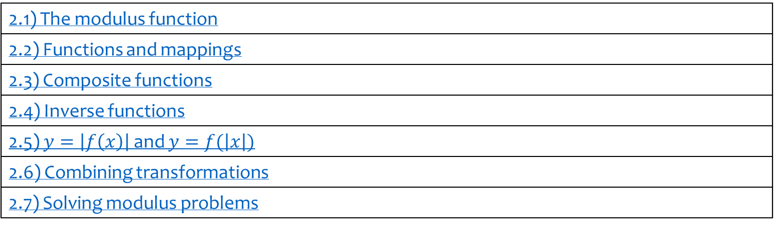
2) Functions and graphs
2.1) The modulus function
2.2) Functions and mappings
2.3) Composite functions
2.4) Inverse functions
2.5) $y=\left|f\left(x\right)\right|$ and $y=f(\left|x\right|)$
2.6) Combining transformations
2.7) Solving modulus problems

Slide 2
2.1) The modulus function
Chapter CONTENTS

Slide 3



Worked example
Your turn
If $f\left(x\right)=\left|4x+5\right|−6$, find:
$f(5)$
$f(−2)$
$f(1)$
If $f\left(x\right)=\left|2x−3\right|+1$, find:
$f(5)$
$f(−2)$
$f(1)$
$$8$$
$$−6$$
$$2$$

Slide 4
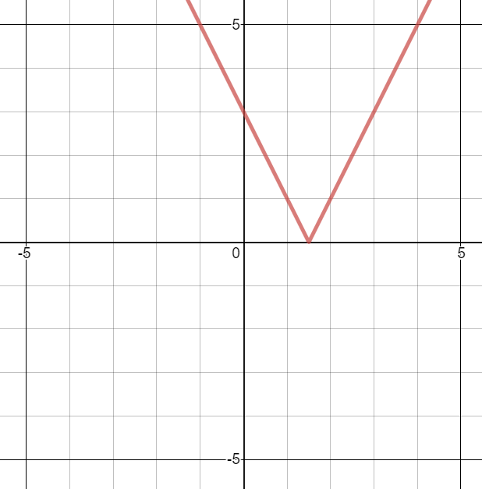


Worked example
Your turn
Sketch:
$$y=|3x−2|$$
$$y=|2−3x|$$
Sketch:
$$y=|2x−3|$$
Graphs used with permission from DESMOS: https://www.desmos.com/

Slide 5


Worked example
Your turn
Solve:
$$\left|3x−2\right|=7$$
$$\left|2−3x\right|=6$$
Solve:
$$\left|2x−3\right|=5$$
$$x=−1, x=4$$

Slide 6
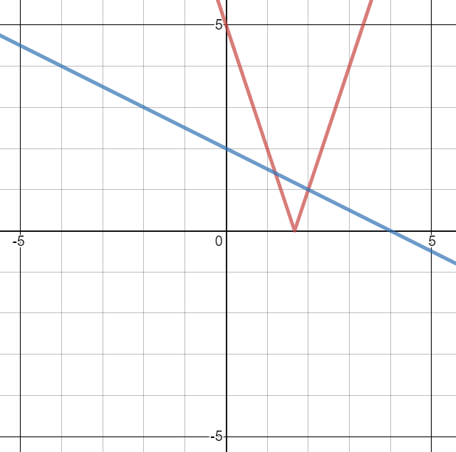
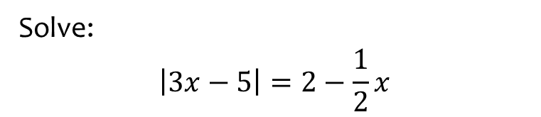


Worked example
Your turn
Solve:
$$\left|5x−2\right|=3−\frac{1}{3}x$$
$$\left|5−3x\right|=\frac{1}{2}x+2$$
Solve:
$$\left|3x−5\right|=2−\frac{1}{2}x$$
$$x=\frac{6}{5}, x=2$$
Graphs used with permission from DESMOS: https://www.desmos.com/

Slide 7
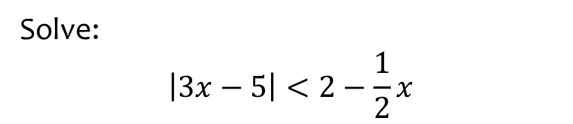


Worked example
Your turn
Solve:
$$\left|5x−2\right|<3−\frac{1}{3}x$$
$$\left|5−3x\right|≤\frac{1}{2}x+2$$
Solve:
$$\left|3x−5\right|<2−\frac{1}{2}x$$
$$\frac{6}{5}<x<2$$
Graphs used with permission from DESMOS: https://www.desmos.com/

Slide 8
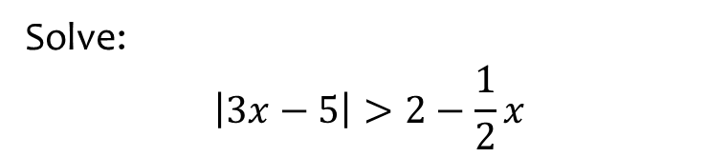


Worked example
Your turn
Solve:
$$\left|5x−2\right|>3−\frac{1}{3}x$$
$$\left|5−3x\right|≥\frac{1}{2}x+2$$
Solve:
$$\left|3x−5\right|>2−\frac{1}{2}x$$
$$x<\frac{6}{5}∪x>2$$
Graphs used with permission from DESMOS: https://www.desmos.com/

Slide 9
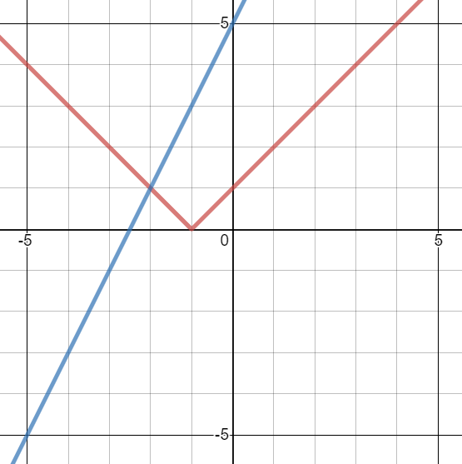


Worked example
Your turn
Solve:
$$\left|x+3\right|=5x+2$$
$$\left|x+3\right|=x+2$$
Solve:
$$\left|x+1\right|=2x+5$$
$$x=−2$$
Graphs used with permission from DESMOS: https://www.desmos.com/

Slide 10
2.2) Functions and mappings
Chapter CONTENTS

Slide 11
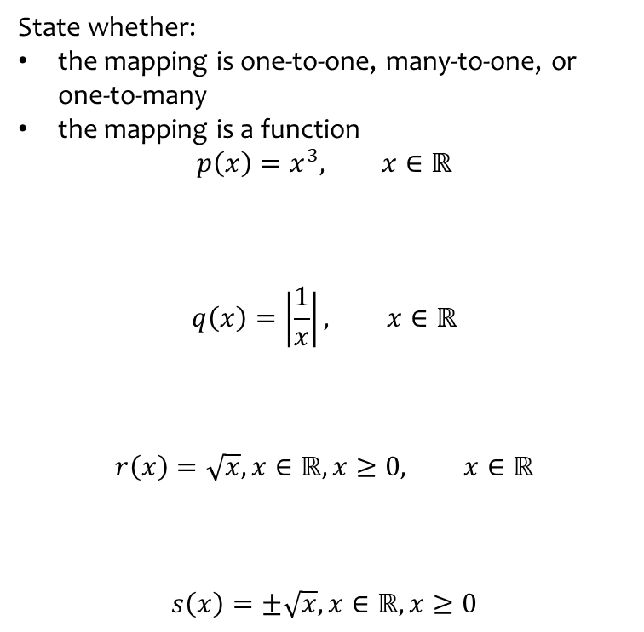

Worked example
Your turn
State whether:
the mapping is one-to-one, many-to-one, or one-to-many
the mapping is a function
$$f\left(x\right)=2x−3, x∈ℝ$$
$$g\left(x\right)=x^{2}, x∈ℝ$$
$$h\left(x\right)=\frac{1}{x}, x∈ℝ$$
$$i\left(x\right)=\sqrt{x}, x∈ℝ$$
State whether:
the mapping is one-to-one, many-to-one, or one-to-many
the mapping is a function
$$p\left(x\right)=x^{3}, x∈ℝ$$
$$q\left(x\right)=\left|\frac{1}{x}\right|, x∈ℝ$$
$$r\left(x\right)=\sqrt{x}, x∈ℝ, x≥0, x∈ℝ$$
$$s\left(x\right)=±\sqrt{x}, x∈ℝ, x≥0$$
One-to-one: a function
Many-to-one: Not a function
One-to-one: a function
One-to-many: Not a function

Slide 12



Worked example
Your turn
Write down the largest possible domain for:
$$f\left(x\right)=\frac{1}{x−3}$$
$$g\left(x\right)=\frac{2}{7x−21}$$
$$h\left(x\right)=\frac{3}{2x^{2}−x−3}$$
$$i\left(x\right)=\frac{4x+5}{x^{2}−64}$$
Write down the largest possible domain for:
$$p\left(x\right)=\frac{6}{x+4}$$
$$q\left(x\right)=\frac{7}{5x+20}$$
$$r\left(x\right)=\frac{8}{3x^{2}+10x−8}$$
$$s\left(x\right)=\frac{9x−10}{x^{2}−16}$$
$$x≠−4$$
$$x≠−4$$
$$x≠\frac{2}{3}, x≠−4$$
$$x≠−4, x≠4$$

Slide 13



Worked example
Your turn
Write down the largest possible domain for:
$$f\left(x\right)=\sqrt{x−3}$$
$$g\left(x\right)=\sqrt{7x−21}$$
$$h\left(x\right)=\sqrt{7x+21}$$
$$i\left(x\right)=\sqrt{21−7x}$$
Write down the largest possible domain for:
$$p\left(x\right)=\sqrt{x+4}$$
$$q\left(x\right)=\sqrt{5x+20}$$
$$r\left(x\right)=\sqrt{5x−20}$$
$$s\left(x\right)=\sqrt{20−5x}$$
$$x≥−4$$
$$x≥−4$$
$$x≥4$$
$$x≤4$$

Slide 14


Worked example
Your turn
Write down the largest possible domain for:
$$f\left(x\right)=\frac{\sqrt{x+3}}{x^{2}−2x}$$
$$g\left(x\right)=\frac{x^{3}−2x^{2}}{\sqrt{x^{2}+5x+6}}$$
Write down the largest possible domain for:
$$h\left(x\right)=\frac{\sqrt{x+4}}{x^{4}−25x^{2}}$$
$$x≥−4, x≠0, x≠5$$

Slide 15



Worked example
Your turn
Find the range of the following functions:
$$f\left(x\right)=2x−3, x=\{1, 2, 3, 4\}$$
$$g\left(x\right)=3−2x, x∈ℝ, x≤0$$
$$h\left(x\right)=3−2x, x∈ℝ, 2<x<5$$
Find the range of the following functions:
$$p\left(x\right)=3x−2, x=\{1, 2, 3, 4\}$$
$$q\left(x\right)=2−3x, x∈ℝ,x>0$$
$$r\left(x\right)=2−3x, x∈ℝ,−3<x≤4$$
$$p\left(x\right)=\{1, 4, 7, 10\}$$
$$q\left(x\right)<2$$
$$−10≤r\left(x\right)<11$$

Slide 16



Worked example
Your turn
Find the range of the following functions:
$$f\left(x\right)=x^{4}, x=\{1, 2, 3, 4\}$$
$$g\left(x\right)=x^{4}, x∈ℝ, x≤0$$
$$h\left(x\right)=x^{4}, x∈ℝ, −2≤x<5$$
Find the range of the following functions:
$$p\left(x\right)=x^{2}, x=\{1, 2, 3, 4\}$$
$$q\left(x\right)=x^{2}, x∈ℝ,x>0$$
$$r\left(x\right)=x^{2}, x∈ℝ,−3<x≤4$$
$$p\left(x\right)=\{1, 4, 9, 16\}$$
$$q\left(x\right)>0$$
$$0≤r(x)≤16$$

Slide 17



Worked example
Your turn
Find the range of the following functions:
$$f\left(x\right)=\frac{1}{x}, x=\{−1, −2, −3, −4\}$$
$$g\left(x\right)=\frac{1}{x−2}, x∈ℝ, x≤1$$
$$h\left(x\right)=\frac{1}{x+3}, x∈ℝ, −2≤x<5$$
Find the range of the following functions:
$$p\left(x\right)=\frac{1}{x}, x=\{1, 2, 3, 4\}$$
$$q\left(x\right)=\frac{1}{x+2}, x∈ℝ,x>−1$$
$$r\left(x\right)=\frac{1}{x−5}, x∈ℝ,−3<x≤4$$
$$p\left(x\right)=\left\{1,\frac{1}{2},\frac{1}{3},\frac{1}{4}\right\}$$
$$q\left(x\right)<1$$
$$−1≤r\left(x\right)<−\frac{1}{8}$$

Slide 18


Worked example
Your turn
Find the range of the following functions:
$$f\left(x\right)=\frac{1}{x}, x∈ℝ, x≠0$$
$$g\left(x\right)=\frac{1}{x}+2, x∈ℝ, x≠0$$
Find the range of the following functions:
$$h\left(x\right)=\frac{1}{x}−3, x∈ℝ, x≠0$$
$$h(x)∈ℝ$$

Slide 19



Worked example
Your turn
Find the range of the following functions:
$$f\left(x\right)=e^{x}+5, x∈ℝ$$
$$g\left(x\right)=e^{x}−4, x∈ℝ, x>0$$
$$h\left(x\right)={−e}^{x}−3, x∈ℝ, x≤0$$
Find the range of the following functions:
$$p\left(x\right)=e^{x}+8, x∈ℝ$$
$$q\left(x\right)=e^{x}−7, x∈ℝ, x<0$$
$$r\left(x\right)={−e}^{x}−6, x∈ℝ, x≥0$$
$$p\left(x\right)>8$$
$$−7<x<−6$$
$$r\left(x\right)≤−7$$

Slide 20


Worked example
Your turn
Find the range of the following functions:
$$f\left(x\right)=\ln{x}+5, x∈ℝ, x>0$$
$$g\left(x\right)=\ln{x}−4, x∈ℝ, x>0$$
Find the range of the following functions:
$$h\left(x\right)=\ln{x}+3, x∈ℝ, x>0$$
$$h(x)∈ℝ$$

Slide 21
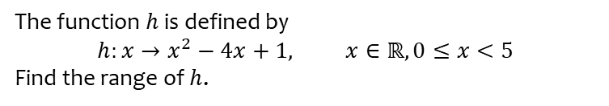

Worked example
Your turn
The function $f$ is defined by
$$f:x→x^{2}−8x+3, x∈ℝ, 0≤x≤5$$
Find the range of $f$.
The function $f$ is defined by
$$g:x→x^{2}+6x−2, x∈ℝ, −5<x≤0$$
Find the range of $f$.
The function $h$ is defined by
$$h:x→x^{2}−4x+1, x∈ℝ, 0≤x<5$$
Find the range of $h$.
$$−3≤h\left(x\right)<6$$

Slide 22
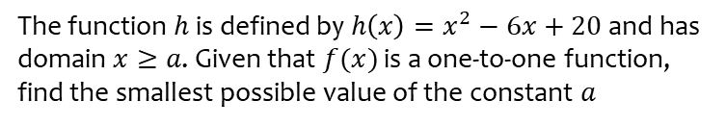

Worked example
Your turn
The function $f$ is defined by $f\left(x\right)=x^{2}−8x+27$ and has domain $x≥a$. Given that $f(x)$ is a one-to-one function, find the smallest possible value of the constant $a$
The function $g$ is defined by $g\left(x\right)=x^{2}+4x+15$ and has domain $x≤a$. Given that $g(x)$ is a one-to-one function, find the smallest possible value of the constant $a$
The function $h$ is defined by $h\left(x\right)=x^{2}−6x+20$ and has domain $x≥a$. Given that $f(x)$ is a one-to-one function, find the smallest possible value of the constant $a$
$$a=3$$

Slide 23
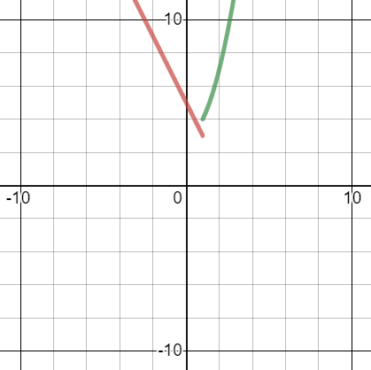
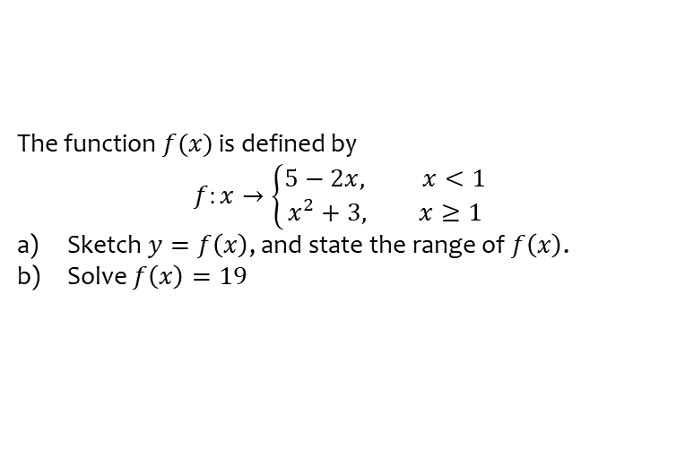
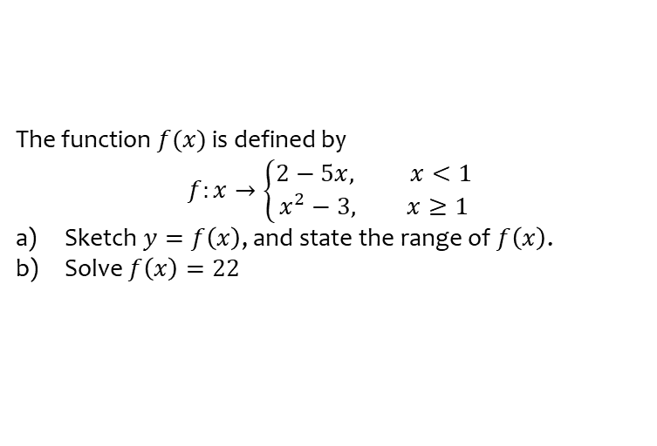
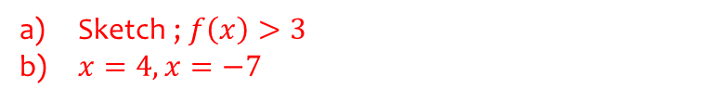
Worked example
Your turn
The function $f(x)$ is defined by
$$f:x→\left\{\begin{aligned}2−5x, x<1 \\ x^{2}−3, x≥1\end{aligned}\right.$$
Sketch $y=f\left(x\right)$, and state the range of $f\left(x\right)$.
Solve $f\left(x\right)=22$
The function $f(x)$ is defined by
$$f:x→\left\{\begin{aligned}5−2x, x<1 \\ x^{2}+3, x≥1\end{aligned}\right.$$
Sketch $y=f\left(x\right)$, and state the range of $f\left(x\right)$.
Solve $f\left(x\right)=19$
Sketch ; $f\left(x\right)>3$
$x=4, x=−7$
Graphs used with permission from DESMOS: https://www.desmos.com/

Slide 24
Worked example
Your turn
Find the inverse function:
$$f\left(x\right)=\frac{2x+3}{4}$$
$$g\left(x\right)=\frac{3x−2}{5}$$
Find the inverse function:
$$h\left(x\right)=\frac{4x−3}{2}$$
$$h^{−1}\left(x\right)=\frac{2x+3}{4}$$

Slide 25
Worked example
Your turn
Find the inverse function:
$$f\left(x\right)=\frac{x}{2}−3$$
$$g\left(x\right)=2+\frac{x}{3}$$
Find the inverse function:
$$h\left(x\right)=5+\frac{x}{4}$$
$$h^{−1}\left(x\right)=4(x−5)$$

Slide 26
Worked example
Your turn
Find the inverse function:
$$f\left(x\right)=\frac{x}{2}−3$$
$$g\left(x\right)=\frac{x−3}{2}$$
Find the inverse function:
$$h\left(x\right)=\frac{x}{5}+4$$
$$h^{−1}\left(x\right)=5(x−4)$$

Slide 27
Worked example
Your turn
Find the inverse function:
$$f\left(x\right)=3(x−2)$$
$$g\left(x\right)=2(x+3)$$
Find the inverse function:
$$h\left(x\right)=5(x+4)$$
$$h^{−1}\left(x\right)=\frac{x}{5}−4$$

Slide 28
Worked example
Your turn
Find the inverse function:
$$f\left(x\right)=2+\frac{3}{x}$$
$$g\left(x\right)=\frac{2}{x}−3$$
Find the inverse function:
$$h\left(x\right)=\frac{5}{x}+4$$
$$h^{−1}\left(x\right)=\frac{5}{x−4}$$

Slide 29
Worked example
Your turn
Find the inverse function:
$$f\left(x\right)=\frac{2}{4x−3}$$
$$g\left(x\right)=\frac{3}{2−5x}$$
Find the inverse function:
$$h\left(x\right)=\frac{4}{5−3x}$$
$$h^{−1}\left(x\right)=\frac{5x−4}{3x}$$

Slide 30
Worked example
Your turn
Find the inverse function:
$$f\left(x\right)=3\sqrt{x}$$
$$g\left(x\right)=5\sqrt[3]{x}$$
Find the inverse function:
$$h\left(x\right)=4\sqrt{x}$$
$$h^{−1}\left(x\right)=\frac{x^{2}}{16}$$

Slide 31
Worked example
Your turn
Find the inverse function:
$$f\left(x\right)=3\sqrt{x}−2$$
$$g\left(x\right)=5\sqrt[3]{x}+3$$
Find the inverse function:
$$h\left(x\right)=4\sqrt{x}−5$$
$$h^{−1}\left(x\right)=\frac{{\left(x+5\right)}^{2}}{16}$$

Slide 32
Worked example
Your turn
Find the inverse function:
$$f\left(x\right)=\sqrt{\frac{x−2}{x+3}}$$
$$g\left(x\right)=\sqrt[3]{\frac{3x−2}{x−4}}$$
Find the inverse function:
$$h\left(x\right)=\sqrt{\frac{5x−4}{x+3}}$$
$$h^{−1}\left(x\right)=\frac{3x^{2}+4}{5−x^{2}}$$

Slide 33
Worked example
Your turn
Find the inverse function:
$$f\left(x\right)=x^{2}+4x−5$$
$$g\left(x\right)=x^{2}−6x+3$$
Find the inverse function:
$$h\left(x\right)=x^{2}+8x−5$$
$$h^{−1}\left(x\right)=−4+\sqrt{x+21}$$
Notes:
Discuss presence of inverse function only if original function one-to-one

Slide 34

Worked example
Your turn
Find the inverse function:
$$f\left(x\right)=2x^{2}−10x+9$$
$$g\left(x\right)=3x^{2}−8x+2$$
Find the inverse function:
$$h\left(x\right)=2x^{2}−12x+3$$
$$h^{−1}\left(x\right)=3+\sqrt{\frac{x+15}{2}}$$
Notes:
Discuss presence of inverse function only if original function one-to-one

Slide 35
2.3) Composite functions
Chapter CONTENTS

Slide 36



Worked example
Your turn
$f\left(x\right)=3x−2$, and $g\left(x\right)=x^{2}−4$
Find:
$$fg\left(x\right)$$
$$gf\left(x\right)$$
$$f^{2}\left(x\right)$$
$$g^{2}\left(x\right)$$
$f\left(x\right)=3x+2$, and $g\left(x\right)=x^{2}+4$
Find:
$$fg\left(x\right)$$
$$gf\left(x\right)$$
$$f^{2}\left(x\right)$$
$$g^{2}\left(x\right)$$
$$fg\left(x\right)=3x^{2}+14$$
$$gf\left(x\right)=9x^{2}+12x+8$$
$$f^{2}\left(x\right)=9x+8$$
$$g^{2}\left(x\right)=x^{4}+8x^{2}+20$$

Slide 37



Worked example
Your turn
$f\left(x\right)=3x−2$, and $g\left(x\right)=x^{2}−4$
Find:
$$fg\left(1\right)$$
$$gf\left(−2\right)$$
$$f^{2}\left(3\right)$$
$$g^{2}\left(−4\right)$$
$f\left(x\right)=3x+2$, and $g\left(x\right)=x^{2}+4$
Find:
$$fg\left(4\right)$$
$$gf\left(−3\right)$$
$$f^{2}\left(2\right)$$
$$g^{2}\left(−1\right)$$
$$62$$
$$53$$
$$26$$
$$29$$

Slide 38



Worked example
Your turn
$f\left(x\right)=3x−2$, and $g\left(x\right)=x^{2}−4$
Solve:
$$fg\left(a\right)=13$$
$$gf\left(b\right)=12$$
$f\left(x\right)=3x+2$, and $g\left(x\right)=x^{2}+4$
Find:
$$fg\left(a\right)=62$$
$$gf\left(b\right)=293$$
$$a=±4$$
$$b=5, b=−\frac{19}{3}$$

Slide 39



Worked example
Your turn
The functions $f$ and $g$ are defined by
$$f:x→\left|3x−12\right| \\ g:x→\frac{x+2}{3}$$
Find $fg\left(2\right)$
Solve $fg\left(x\right)=x$
The functions $f$ and $g$ are defined by
$$f:x→\left|2x−8\right| \\ g:x→\frac{x+1}{2}$$
Find $fg\left(3\right)$
Solve $fg\left(x\right)=x$
a) $4$
b) $x=\frac{7}{2}$

Slide 40



Worked example
Your turn
The function $g$ is defined by
$$g:x→4−3x, x∈ℝ$$
Solve the equation
$$g^{2}\left(x\right)+{\left[g\left(x\right)\right]}^{2}=0$$
The function $g$ is defined by
$$g:x→3−4x, x∈ℝ$$
Solve the equation
$$g^{2}\left(x\right)+{\left[g\left(x\right)\right]}^{2}=0$$
$$x=0, x=\frac{1}{2}$$

Slide 41


Worked example
Your turn
The functions $f$ and $g$ are defined by
$$f:x→e^{x}+3, x∈ℝ \\ g:x→\ln{x}, x>0$$
Find $fg\left(x\right)$, giving your answer in its simplest form.
The functions $f$ and $g$ are defined by
$$f:x→e^{3x}−2, x∈ℝ \\ g:x→4ln{(x+1)}, x>−1$$
Find $fg\left(x\right)$, giving your answer in its simplest form.
The functions $f$ and $g$ are defined by
$$f:x→e^{2x}+4, x∈ℝ \\ g:x→3ln{(x−1)}, x>1$$
Find $fg\left(x\right)$, giving your answer in its simplest form
$$fg\left(x\right)={\left(x−1\right)}^{6}+4$$

Slide 42


Worked example
Your turn
The functions $f$ and $g$ are defined by
$$f:x→2^{x}+3, x∈ℝ \\ g:x→\log_{2}{x}, x>0$$
Find $fg\left(x\right)$, giving your answer in its simplest form.
The functions $f$ and $g$ are defined by
$$f:x→3^{2x}−1, x∈ℝ \\ g:x→4\log_{3}{(x+5)}, x>−5$$
Find $fg\left(x\right)$, giving your answer in its simplest form.
The functions $f$ and $g$ are defined by
$$f:x→2^{3x}+4, x∈ℝ \\ g:x→5\log_{2}{(x−1)}, x>1$$
Find $fg\left(x\right)$, giving your answer in its simplest form
$$fg\left(x\right)={\left(x−1\right)}^{15}+4$$

Slide 43



Worked example
Your turn
$$f\left(x\right)=\frac{1}{x−1}, x≠1$$
Find an expression for $f^{2}(x)$ and $f^{3}(x)$
$$f\left(x\right)=\frac{1}{x+1}, x≠−1$$
Find an expression for $f^{2}(x)$ and $f^{3}(x)$
$$f^{2}\left(x\right)=\frac{x+1}{x+2}, x≠−1, x≠−2$$
$$f^{3}\left(x\right)=\frac{x+2}{2x+3},x≠−1, x≠−2, x≠−\frac{3}{2}$$

Slide 44


Worked example
Your turn
A function $f$ has domain $−3≤x≤12$ and is linear from $(−3, 9)$ to $(0, 6)$ and from $(0, 6)$ to $(12,10)$.
Find the value of $f^{2}(0)$
A function $f$ has domain $−4≤x≤13$ and is linear from $(−4, 9)$ to $(0, 5)$ and from $(0, 5)$ to $(13, 31)$.
Find the value of $f^{2}(0)$
$$15$$

Slide 45
2.4) Inverse functions
Chapter CONTENTS

Slide 46



Worked example
Your turn
Find the inverse functions:
$$f\left(x\right)=4x+3, x∈ℝ$$
$$g\left(x\right)=4−3x, x∈ℝ$$
Find the inverse function:
$$h\left(x\right)=3−4x, x∈ℝ$$
$$h^{−1}\left(x\right)=\frac{3−x}{4}, x∈ℝ$$

Slide 47



Worked example
Your turn
Find the inverse functions:
$$f\left(x\right)=\frac{x−2}{2x+1}\text{, } x≠\frac{1}{2}$$
$$g\left(x\right)=\frac{2x+3}{4x−5}, x≠\frac{5}{4}$$
Find the inverse function:
$$h\left(x\right)=\frac{x+2}{2x−1}\text{, } x≠\frac{1}{2}$$
$$h^{−1}\left(x\right)=\frac{x+2}{2x−1}, x≠\frac{1}{2}$$

Slide 48



Worked example
Your turn
Find the inverse functions:
$$f\left(x\right)=3x^{2}−5, x≥0$$
$$g\left(x\right)=4x^{2}+6, x≥0$$
Find the inverse function:
$$h\left(x\right)=2x^{2}−7, x≥0$$
$$h^{−1}\left(x\right)=\sqrt{\frac{x+7}{2}}, x≥−7$$

Slide 49


Worked example
Your turn
Find the inverse functions:
$$f\left(x\right)=x^{2}+4x+3, x≥−2$$
$$g\left(x\right)=x^{2}−8x−5, x≥5$$
Find the inverse function:
$$h\left(x\right)=x^{2}−6x−5, x≥3$$
$$h^{−1}\left(x\right)=3+\sqrt{x+14}, x≥−14$$

Slide 50



Worked example
Your turn
Find the inverse functions:
$$f\left(x\right)=\frac{2}{x−5}, x∈ℝ, x≠5$$
$$g\left(x\right)=\frac{7}{x+2}, x∈ℝ, x≠−2$$
Find the inverse function:
$$h\left(x\right)=\frac{3}{x−1}, x∈ℝ, x≠1$$
$$h^{−1}\left(x\right)=\frac{3+x}{x}, x≠0$$

Slide 51


Worked example
Your turn
Find the inverse functions:
$$f\left(x\right)=e^{x}−3, x∈ℝ$$
$$g\left(x\right)=e^{x}+4, x∈ℝ$$
Find the inverse function:
$$h\left(x\right)=e^{x}−5, x∈ℝ$$
$$h^{−1}\left(x\right)=\ln\left(x+5\right), x>−5$$

Slide 52


Worked example
Your turn
Find the inverse functions:
$$f\left(x\right)=\ln{x}−3, x>0$$
$$g\left(x\right)=\ln{(x−4)}, x>4$$
Find the inverse function:
$$h\left(x\right)=\ln{(x−5)}, x>5$$
$$h^{−1}\left(x\right)=e^{x}+5, x∈ℝ$$

Slide 53




Worked example
Your turn
$$f\left(x\right)=\sqrt{x−3} \left\{x∈ℝ,x≥3\right\}$$
State the range of $f(x)$
Find the function $f^{−1}(x)$ and state its domain and range
Sketch $y=f\left(x\right)$, $y=f^{−1}(x)$ and $y=x$
$$p\left(x\right)=\sqrt{x−2} \left\{x∈ℝ,x≥2\right\}$$
State the range of $p(x)$
Find the function $p^{−1}(x)$ and state its domain and range
Sketch $y=p\left(x\right)$, $y=p^{−1}(x)$ and $y=x$
a) $p\left(x\right)≥0$
b) $p^{−1}\left(x\right)=x^{2}+2$
Domain: $x∈ℝ, x≥0$
Range: $p^{−1}\left(x\right)≥2$
c) Sketch
Graphs used with permission from DESMOS: https://www.desmos.com/

Slide 54




Worked example
Your turn
$f\left(x\right)=x^{2}−5$, $x∈ℝ$, $x≥0$.
State the range of $f(x)$
Find the function $f^{−1}(x)$ and state its domain and range
Sketch $y=f\left(x\right)$, $y=f^{−1}(x)$ and $y=x$
Solve the equation $f\left(x\right)=f^{−1}\left(x\right)$.
$p\left(x\right)=x^{2}−3$, $x∈ℝ$, $x≥0$.
State the range of $p(x)$
Find the function $p^{−1}(x)$ and state its domain and range
Sketch $y=p\left(x\right)$, $y=p^{−1}(x)$ and $y=x$
Solve the equation $p\left(x\right)=p^{−1}\left(x\right)$.
a) $p\left(x\right)≥−3$
b) $p^{−1}\left(x\right)=\sqrt{x+3}$
Domain: $x∈ℝ, x≥−3$
Range: $p^{−1}\left(x\right)≥0$
c) Sketch
d) $x=\frac{1+\sqrt{13}}{2}$
Graphs used with permission from DESMOS: https://www.desmos.com/

Slide 55
2.5) $y=|f\left(x\right)|$ and $y=f(\left|x\right|)$
Chapter CONTENTS

Slide 56




Worked example
Your turn
$$f\left(x\right)=x^{2}+4x+3$$
Sketch:
$y=|f\left(x\right)|$
$y=f(\left|x\right|)$
$f\left(x\right)=x^{2}−4x+$3
Sketch:
$y=|f\left(x\right)|$
$y=f(\left|x\right|)$
Graphs used with permission from DESMOS: https://www.desmos.com/

Slide 57




Worked example
Your turn
$$f\left(x\right)=x^{2}+3x−10$$
Sketch:
$y=|f\left(x\right)|$
$y=f(\left|x\right|)$
$$f\left(x\right)=x^{2}−3x−10$$
Sketch:
$y=|f\left(x\right)|$
$y=f(\left|x\right|)$
Graphs used with permission from DESMOS: https://www.desmos.com/

Slide 58






Worked example
Your turn
A sketch of $y=f(x)$ is shown.
Sketch $y=|f\left(x\right)|$ and $y=f(\left|x\right|)$ on separate axes.
A sketch of $y=f(x)$ is shown.
Sketch $y=|f\left(x\right)|$ and $y=f(\left|x\right|)$ on separate axes.
Graphs used with permission from DESMOS: https://www.desmos.com/

Slide 59




Worked example
Your turn
$$y=\cos{x}, −2π≤x≤2π$$
Sketch:
$y=|\cos{x}|$
$y=\cos{|x|}$
$$y=\sin{x}, −2π≤x≤2π$$
Sketch:
$y=|\sin{x}|$
$y=\sin{|x|}$
Graphs used with permission from DESMOS: https://www.desmos.com/

Slide 60
2.6) Combining transformations
Chapter CONTENTS

Slide 61





Worked example
Your turn
A sketch of the graph $y=f(x)$ is shown:
Sketch the graph of $y=f\left(x\right)−2$
A sketch of the graph $y=f(x)$ is shown:
Sketch the graph of $y=f\left(x\right)+3$
Correct sketch
New $y$-intercept: $(0, 0)$
New turning points: $(−2, 10)$ and $(1, −1)$

Slide 62



Worked example
Your turn
A sketch of the graph $y=f(x)$ is shown:
Sketch the graph of $y=f\left(x−2\right)$
A sketch of the graph $y=f(x)$ is shown:
Sketch the graph of $y=f\left(x+3\right)$
Correct sketch
New turning points: $(−5, 7)$ and $(−2, −4)$

Slide 63



Worked example
Your turn
A sketch of the graph $y=f(x)$ is shown:
Sketch the graph of $y=3f\left(x\right)$
A sketch of the graph $y=f(x)$ is shown:
Sketch the graph of $y=2f\left(x\right)$
Correct sketch
New $y$-intercept: $(0, −6)$
New turning points: $(−2, 14)$ and $(1, −8)$

Slide 64



Worked example
Your turn
A sketch of the graph $y=f(x)$ is shown:
Sketch the graph of $y=f\left(2x\right)$
A sketch of the graph $y=f(x)$ is shown:
Sketch the graph of $y=f\left(3x\right)$
Correct sketch
New $y$-intercept: $(0, −3)$
New turning points: $(−\frac{2}{3}, 14)$ and $(\frac{1}{3}, −8)$

Slide 65



Worked example
Your turn
A sketch of the graph $y=f(x)$ is shown:
Sketch the graph of $y=−f\left(x\right)$
A sketch of the graph $y=f(x)$ is shown:
Sketch the graph of $y=−f\left(x\right)$
Correct sketch
New $y$-intercept: $(0, 3)$
New turning points: $(−2, −7)$ and $(1, 4)$

Slide 66



Worked example
Your turn
A sketch of the graph $y=f(x)$ is shown:
Sketch the graph of $y=f\left(−x\right)$
A sketch of the graph $y=f(x)$ is shown:
Sketch the graph of $y=f\left(−x\right)$
Correct sketch
New $y$-intercept: $(0, −3)$
New turning points: $(2, −7)$ and $(−1, 4)$

Slide 67



Worked example
Your turn
A sketch of the graph $y=f(x)$ is shown:
Sketch the graph of $y=f\left(x+2\right)+3$
A sketch of the graph $y=f(x)$ is shown:
Sketch the graph of $y=f\left(x−3\right)−2$
Correct sketch
New turning points: $(1, 5)$ and $(4, −6)$

Slide 68



Worked example
Your turn
A sketch of the graph $y=f(x)$ is shown:
Sketch the graph of $y=−f\left(x\right)+3$
A sketch of the graph $y=f(x)$ is shown:
Sketch the graph of $y=−f\left(x\right)−2$
Correct sketch
New $y$-intercept: $(0, 1)$
New turning points: $(−2, −9)$ and $(1, 2)$

Slide 69



Worked example
Your turn
A sketch of the graph $y=f(x)$ is shown:
Sketch the graph of $y=f\left(−x\right)−3$
A sketch of the graph $y=f(x)$ is shown:
Sketch the graph of $y=f\left(−x\right)+2$
Correct sketch
New $y$-intercept: $(0, −1)$
New turning points: $(2, −5)$ and $(−1, 6)$

Slide 70



Worked example
Your turn
A sketch of the graph $y=f(x)$ is shown:
Sketch the graph of $y=3f\left(x\right)+2$
A sketch of the graph $y=f(x)$ is shown:
Sketch the graph of $y=2f\left(x\right)+3$
Correct sketch
New $y$-intercept: $(0, −3)$
New turning points: $(−2, 17)$ and $(1, −5)$

Slide 71



Worked example
Your turn
A sketch of the graph $y=f(x)$ is shown:
Sketch the graph of $y=f\left(2x\right)−3$
A sketch of the graph $y=f(x)$ is shown:
Sketch the graph of $y=f\left(3x\right)−2$
Correct sketch
New $y$-intercept: $(0, −5)$
New turning points: $(−\frac{2}{3}, 5)$ and $(\frac{1}{3}, −6)$

Slide 72



Worked example
Your turn
A sketch of the graph $y=f(x)$ is shown:
Sketch the graph of $y=−f\left(3x\right)+2$
A sketch of the graph $y=f(x)$ is shown:
Sketch the graph of $y=−f\left(2x\right)−3$
Correct sketch
New $y$-intercept: $(0, 0)$
New turning points: $(−1, −10)$ and $(\frac{1}{2}, 1)$

Slide 73



Worked example
Your turn
A sketch of the graph $y=f(x)$ is shown:
Sketch the graph of $y=5f\left(x−2\right)−3$
A sketch of the graph $y=f(x)$ is shown:
Sketch the graph of $y=7f\left(x+3\right)+2$
Correct sketch
New turning points: $(−5, 51)$ and $(−2, −26)$

Slide 74



Worked example
Your turn
A sketch of the graph $y=f(x)$ is shown:
Sketch the graph of $y=−5f\left(x+2\right)+3$
A sketch of the graph $y=f(x)$ is shown:
Sketch the graph of $y=−7f\left(x−3\right)−2$
Correct sketch
New turning points: $(1, −51)$ and $(4, 26)$

Slide 75



Worked example
Your turn
A sketch of the graph $y=f(x)$ is shown:
Sketch the graph of $y=|f\left(x\right)|$
A sketch of the graph $y=f(x)$ is shown:
Sketch the graph of $y=|f\left(x\right)|$
Correct sketch
New $y$-intercept: $(0, 3)$
New turning points: $(−2, 7)$ and $(1, 4)$

Slide 76



Worked example
Your turn
A sketch of the graph $y=f(x)$ is shown:
Sketch the graph of $y=|f\left(−x\right)|$
A sketch of the graph $y=f(x)$ is shown:
Sketch the graph of $y=|f\left(−x\right)|$
Correct sketch
New $y$-intercept: $(0, 3)$
New turning points: $(−1, 4)$ and $(2, 7)$

Slide 77



Worked example
Your turn
A sketch of the graph $y=f(x)$ is shown:
Sketch the graph of $y=f\left(|x|\right)$
A sketch of the graph $y=f(x)$ is shown:
Sketch the graph of $y=f\left(|x|\right)$
Correct sketch
New $y$-intercept: $(0, −3)$
New turning points: $(−1, −4)$ and $(1, −4)$

Slide 78



Worked example
Your turn
A sketch of the graph $y=f(x)$ is shown:
Sketch the graph of $y=−f\left(|x|\right)$
A sketch of the graph $y=f(x)$ is shown:
Sketch the graph of $y=−f\left(|x|\right)$
Correct sketch
New $y$-intercept: $(0, 3)$
New turning points: $\left(−1, 4\right)$and $(1, 4)$

Slide 79
2.7) Solving modulus problems
Chapter CONTENTS

Slide 80




Worked example
Your turn
$$f\left(x\right)=2\left|x+1\right|−3, x∈ℝ$$
Sketch the graph of $y=f\left(x\right)$
State the range of $f$.
Solve the equation $f\left(x\right)=\frac{1}{3}x+2$
$$p\left(x\right)=3\left|x−1\right|−2, x∈ℝ$$
Sketch the graph of $y=p\left(x\right)$
State the range of $p$.
Solve the equation $p\left(x\right)=\frac{1}{2}x+3$
Sketch
$p\left(x\right)≥−2$
$x=−\frac{4}{7}, x=\frac{16}{5}$
Graphs used with permission from DESMOS: https://www.desmos.com/

Slide 81




Worked example
Your turn
$$f\left(x\right)=6−2|x+3|, x∈ℝ$$
Sketch the graph of $y=f\left(x\right)$
State the range of $f$.
Solve the inequality $f\left(x\right)>5$
$$p\left(x\right)=6−2|x+3|, x∈ℝ$$
Sketch the graph of $y=p\left(x\right)$
State the range of $p$.
Solve the inequality $p\left(x\right)>5$
Sketch
$p\left(x\right)≤6$
$−\frac{7}{2}<x<−\frac{5}{2}$
Graphs used with permission from DESMOS: https://www.desmos.com/

Slide 82




Worked example
Your turn
$$f\left(x\right)=6+3|x−2|, x∈ℝ$$
State the range of values of $k$ for which $f\left(x\right)=k$has:
no solutions
exactly one solution
two distinct solutions
$$h\left(x\right)=6−2|x+3|, x∈ℝ$$
State the range of values of $k$ for which $f\left(x\right)=k$has:
no solutions
exactly one solution
two distinct solutions
a) $k>6$
b) $k=6$
c) $k<6$
Graphs used with permission from DESMOS: https://www.desmos.com/

