Slide 1
1.6) Rationalising denominators

Slide 2

Worked example
Your turn
Rationalise the denominator:
$$\frac{1}{\sqrt{2}}$$
$$\frac{2}{\sqrt{3}}$$
$$\frac{3}{\sqrt{5}}$$
Rationalise the denominator:
$$\frac{4}{\sqrt{7}}$$
$$\frac{4\sqrt{7}}{7}$$

Slide 3
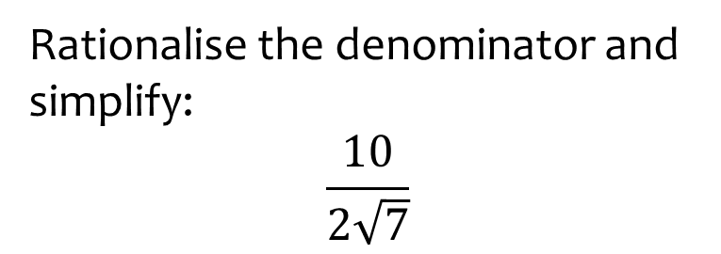
Worked example
Your turn
Rationalise the denominator and simplify:
$$\frac{4}{3\sqrt{2}}$$
$$\frac{6}{5\sqrt{3}}$$
Rationalise the denominator and simplify:
$$\frac{10}{2\sqrt{7}}$$
$$\frac{5\sqrt{7}}{7}$$

Slide 4
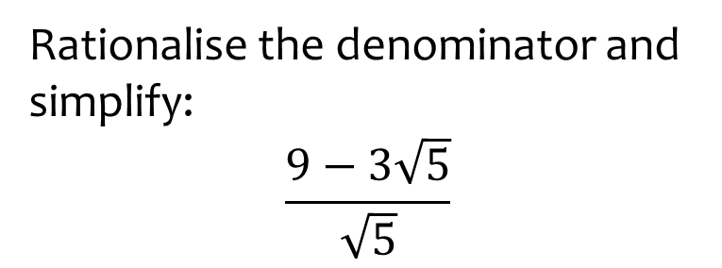
Worked example
Your turn
Rationalise the denominator and simplify:
$$\frac{2−7\sqrt{3}}{\sqrt{3}}$$
$$\frac{3−5\sqrt{11}}{\sqrt{11}}$$
Rationalise the denominator and simplify:
$$\frac{9−3\sqrt{5}}{\sqrt{5}}$$
$$\frac{9\sqrt{5}−15}{5}$$

Slide 5
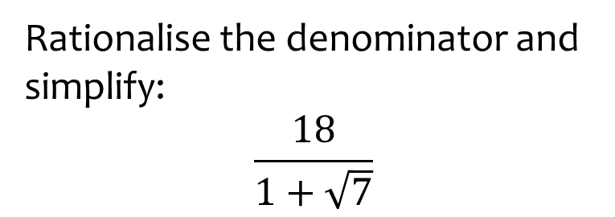
Worked example
Your turn
Rationalise the denominator and simplify:
$$\frac{3}{5+\sqrt{2}}$$
$$\frac{4}{1+\sqrt{3}}$$
Rationalise the denominator and simplify:
$$\frac{18}{1+\sqrt{7}}$$
$$−3+3\sqrt{7}$$

Slide 6
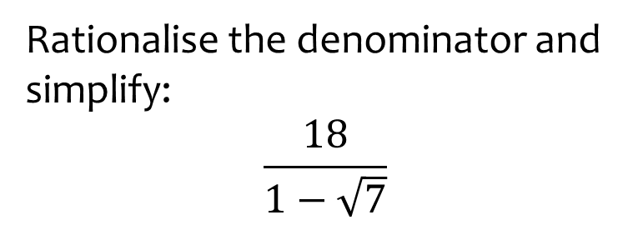
Worked example
Your turn
Rationalise the denominator and simplify:
$$\frac{3}{5−\sqrt{2}}$$
$$\frac{4}{1−\sqrt{3}}$$
Rationalise the denominator and simplify:
$$\frac{18}{1−\sqrt{7}}$$
$$−3−3\sqrt{7}$$

Slide 7
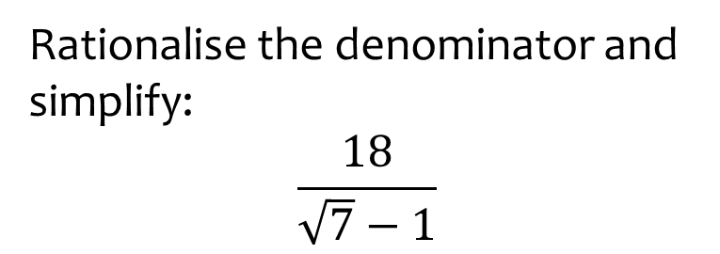
Worked example
Your turn
Rationalise the denominator and simplify:
$$\frac{3}{\sqrt{2}−5}$$
$$\frac{4}{−1+\sqrt{3}}$$
Rationalise the denominator and simplify:
$$\frac{18}{\sqrt{7}−1}$$
$$3+3\sqrt{7}$$

Slide 8
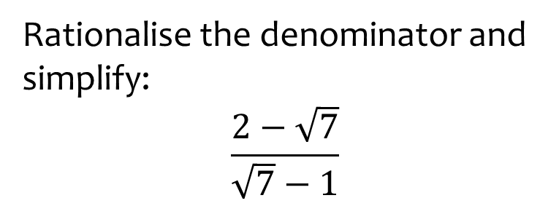
Worked example
Your turn
Rationalise the denominator and simplify:
$$\frac{3+\sqrt{2}}{\sqrt{2}−5}$$
$$\frac{5−\sqrt{3}}{−1+\sqrt{3}}$$
Rationalise the denominator and simplify:
$$\frac{2−\sqrt{7}}{\sqrt{7}−1}$$
$$\frac{−5+\sqrt{7}}{6}$$

Slide 9
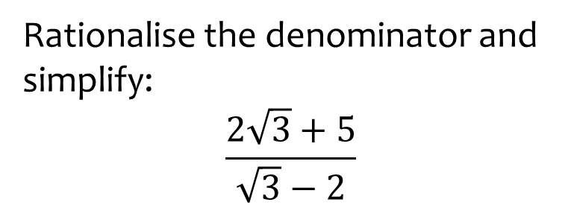
Worked example
Your turn
Rationalise the denominator and simplify:
$$\frac{2\sqrt{3}+5}{\sqrt{3}−2}$$
Rationalise the denominator and simplify:
$$\frac{2\sqrt{2}+1}{\sqrt{2}−3}$$
$$−1−\sqrt{2}$$

Slide 10
Worked example
Your turn
Rationalise the denominator and simplify:
$$\frac{3\sqrt{3}−5}{2\sqrt{3}−7}$$
Rationalise the denominator and simplify:
$$\frac{5\sqrt{5}−2}{2\sqrt{5}−3}$$
$$4+\sqrt{5}$$

Slide 11
Worked example
Your turn
Rationalise the denominator and simplify:
$$\frac{11+3\sqrt{2}}{3\sqrt{7}+5}$$
Rationalise:
$$\frac{7+2\sqrt{3}}{11\sqrt{5}+2}$$
$$\frac{77\sqrt{5}+22\sqrt{15}−4\sqrt{3}−14}{601}$$

Slide 12
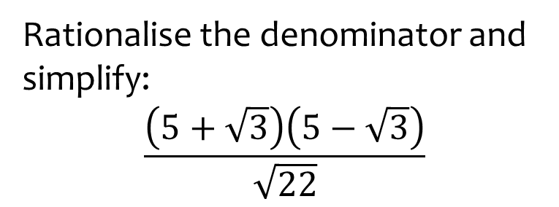
Worked example
Your turn
Rationalise the denominator and simplify:
$$\frac{\left(3+\sqrt{2}\right)\left(3−\sqrt{2}\right)}{\sqrt{7}}$$
$$\frac{\left(7+\sqrt{5}\right)\left(7−\sqrt{5}\right)}{\sqrt{11}}$$
Rationalise the denominator and simplify:
$$\frac{\left(5+\sqrt{3}\right)\left(5−\sqrt{3}\right)}{\sqrt{22}}$$
$$\sqrt{22}$$

Slide 13
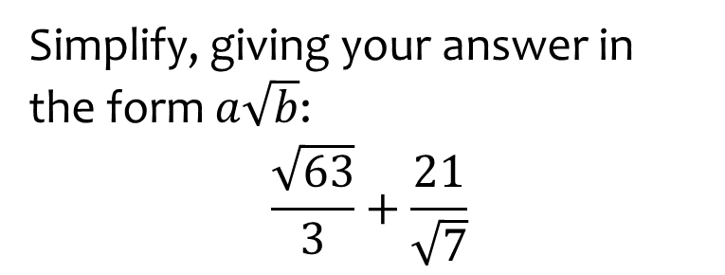
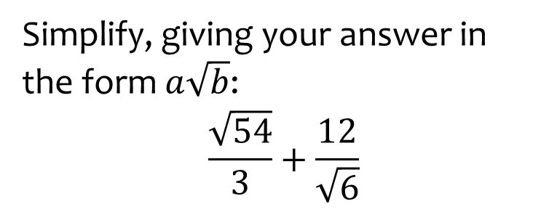
Worked example
Your turn
Simplify, giving your answer in the form $a\sqrt{b}$:
$$\frac{\sqrt{54}}{3}+\frac{12}{\sqrt{6}}$$
Simplify, giving your answer in the form $a\sqrt{b}$:
$$\frac{\sqrt{63}}{3}+\frac{21}{\sqrt{7}}$$
$$4\sqrt{7}$$

Slide 14

Worked example
Your turn
Show that $\frac{1}{\frac{1}{\sqrt{3}}+1}=\frac{3}{2}−\frac{1}{2}\sqrt{3}$
Show that $\frac{1}{1+\frac{1}{\sqrt{2}}}=2−\sqrt{2}$
$$=\frac{\sqrt{2}}{\sqrt{2}+1}$$
$$=\frac{\sqrt{2}}{\sqrt{2}+1}×\frac{\sqrt{2}−1}{\sqrt{2}−1}$$
$$=\frac{2−\sqrt{2}}{2+\sqrt{2}−\sqrt{2}−1}$$
$$=\frac{2−\sqrt{2}}{1}$$
$$=2−\sqrt{2}$$

Slide 15
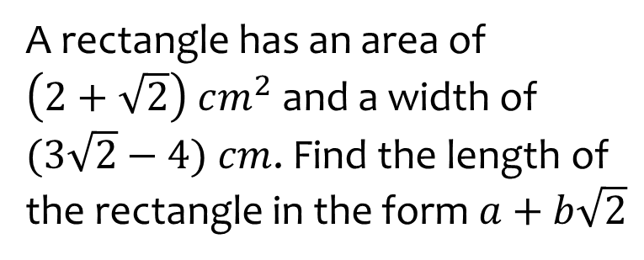
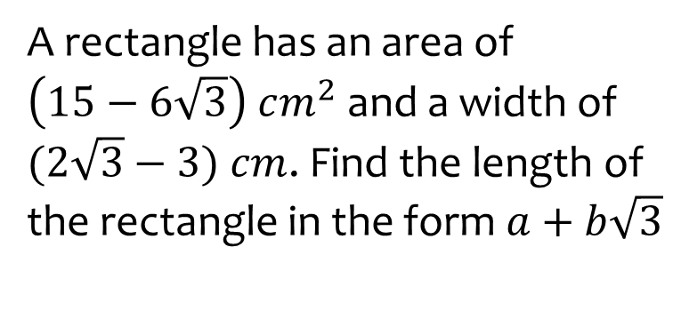
Worked example
Your turn
A rectangle has an area of $\left(15−6\sqrt{3}\right) cm^{2}$ and a width of $(2\sqrt{3}−3)$ $cm$. Find the length of the rectangle in the form $a+b\sqrt{3}$
A rectangle has an area of $\left(2+\sqrt{2}\right) cm^{2}$ and a width of $(3\sqrt{2}−4)$ $cm$. Find the length of the rectangle in the form $a+b\sqrt{2}$
$7+5\sqrt{2}$ $cm$

Slide 16
Worked example
Your turn
Solve $y\left(2+\sqrt{3}\right)−\sqrt{3}=4$
Solve $y\left(1+\sqrt{2}\right)−\sqrt{2}=3$
$$y=2\sqrt{2}−1$$

Slide 17
Worked example
Your turn
Simplify:
$$\frac{\sqrt{a+2}−\sqrt{a}}{\sqrt{a+2}+\sqrt{a}}$$
Simplify:
$$\frac{\sqrt{a+1}−\sqrt{a}}{\sqrt{a+1}+\sqrt{a}}$$
$$2a+1−2\sqrt{a}\sqrt{a+1}$$

Slide 18
Worked example
Your turn
Solve:
$$\frac{\sqrt[5]{8}}{\sqrt[4]{32}}=\sqrt[x]{2}$$
Solve:
$$\frac{\sqrt[4]{9}}{\sqrt[5]{27}}=\sqrt[x]{3}$$
$$x=−10$$

