Slide 1
1.4) Negative and fractional indices

Slide 2
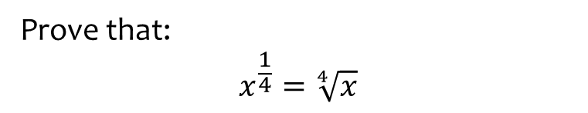

Worked example
Your turn
Prove that:
$$x^{\frac{1}{2}}=\sqrt{x}$$
$$x^{\frac{1}{3}}=\sqrt[3]{x}$$
Prove that:
$$x^{\frac{1}{4}}=\sqrt[4]{x}$$
Proof

Slide 3
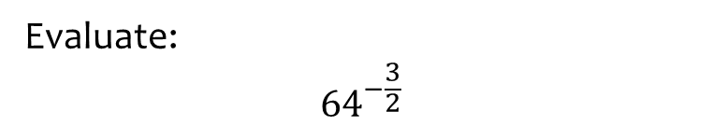


Worked example
Your turn
Evaluate:
$${64}^{−\frac{2}{3}}$$
$${81}^{−\frac{5}{4}}$$
Evaluate:
$${64}^{−\frac{3}{2}}$$
$$\frac{1}{512}$$

Slide 4
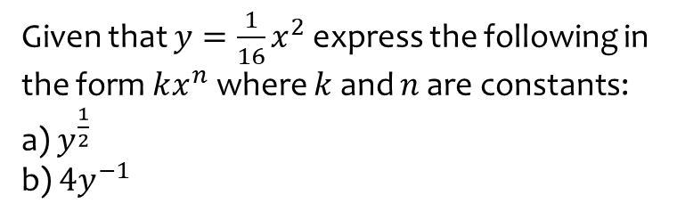
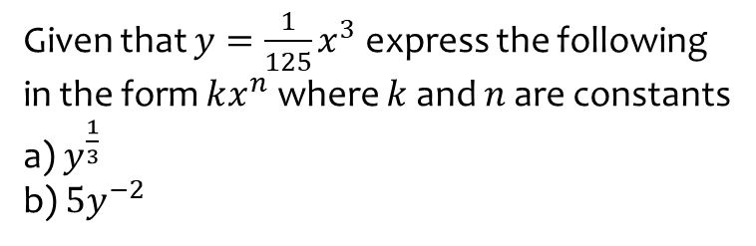
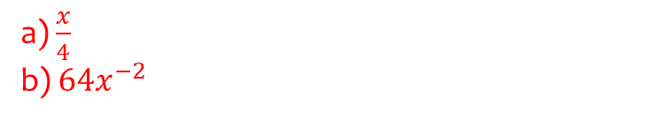
Worked example
Your turn
Given that $y=\frac{1}{125}x^{3}$ express the following in the form $kx^{n}$ where $k$ and $n$ are constants
a) $y^{\frac{1}{3}}$
b) $5y^{−2}$
Given that $y=\frac{1}{16}x^{2}$ express the following in the form $kx^{n}$ where $k$ and $n$ are constants:
a) $y^{\frac{1}{2}}$
b) $4y^{−1}$
a) $\frac{x}{4}$
b) $64x^{−2}$

Slide 5



Worked example
Your turn
If $125\sqrt{5}=5^{k}$, determine the value of $k$.
If $9\sqrt{3}=3^{k}$, determine the value of $k$.
$$k=\frac{5}{2}$$

Slide 6
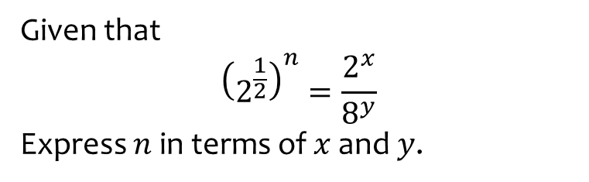
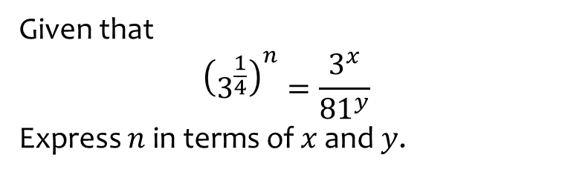

Worked example
Your turn
Given that
$${\left(3^{\frac{1}{4}}\right)}^{n}=\frac{3^{x}}{{81}^{y}}$$
Express $n$ in terms of $x$ and $y$.
Given that
$${\left(2^{\frac{1}{2}}\right)}^{n}=\frac{2^{x}}{8^{y}}$$
Express $n$ in terms of $x$ and $y$.
$$n=2x−6y$$

Slide 7
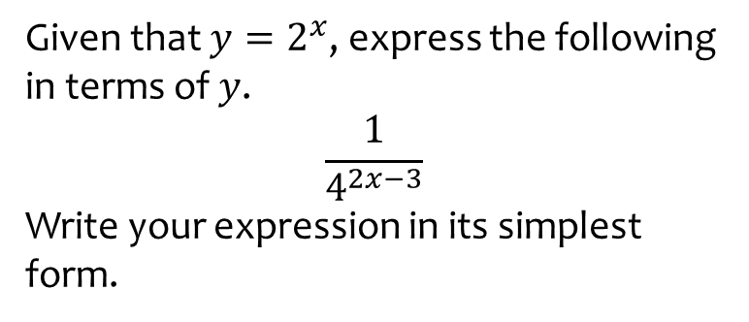
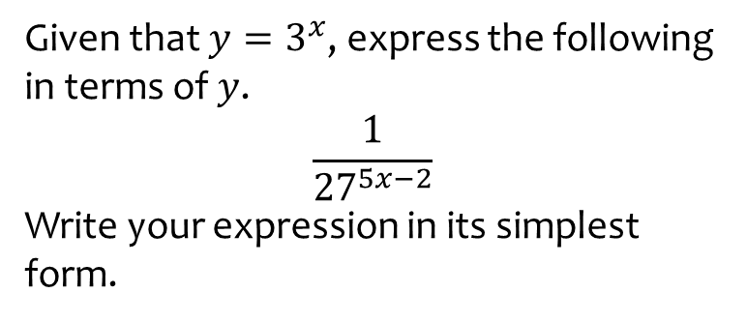

Worked example
Your turn
Given that $y=3^{x}$, express the following in terms of $y$.
$$\frac{1}{{27}^{5x−2}}$$
Write your expression in its simplest form.
Given that $y=2^{x}$, express the following in terms of $y$.
$$\frac{1}{4^{2x−3}}$$
Write your expression in its simplest form.
$$\frac{64}{y^{4}}$$

Slide 8
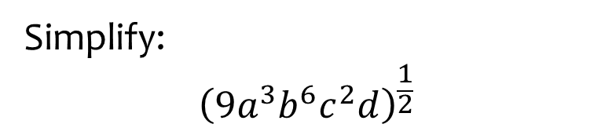


Worked example
Your turn
Simplify:
$${\left(16x^{2}y^{6}z^{4}\right)}^{\frac{1}{2}}$$
$${\left(27x^{4}y^{6}z\right)}^{\frac{1}{3}}$$
Simplify:
$${\left(9a^{3}b^{6}c^{2}d\right)}^{\frac{1}{2}}$$
$$3a^{\frac{3}{2}}b^{3}cd^{\frac{1}{2}}$$

Slide 9
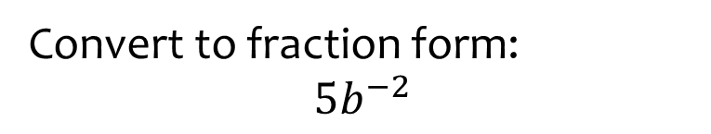


Worked example
Your turn
Convert to fraction form:
$$9^{−1}$$
$$5^{−2}$$
$$2^{−3}$$
$$x^{−5}$$
$$3y^{−4}$$
Convert to fraction form:
$$5b^{−2}$$
$$\frac{5}{b^{2}}$$

Slide 10



Worked example
Your turn
Convert to index form:
$$\frac{1}{2}$$
$$\frac{1}{100}$$
$$\frac{3}{x}$$
$$\frac{9}{x^{2}}$$
$$\frac{15}{\sqrt{x}}$$
Convert to index form:
$$\frac{7}{x^{3}}$$
$$\frac{12}{\sqrt[3]{x}}$$
$$7x^{−3}$$
$$12x^{−\frac{1}{3}}$$

Slide 11



Worked example
Your turn
Evaluate:
$2^{4}$ $3^{5}$
$4^{0}$ $5^{−1}$
$6^{−2}$ $7^{−3}$
$9^{\frac{1}{2}}$ $8^{\frac{1}{3}}$
${16}^{−\frac{1}{2}}$ ${125}^{−\frac{1}{3}}$
${25}^{\frac{3}{2}}$ ${64}^{−\frac{2}{3}}$
Evaluate:
$${36}^{−\frac{1}{2}}$$
$${123456789}^{0}$$
$${27}^{−\frac{4}{3}}$$
$$\frac{1}{6}$$
$$1$$
$$\frac{1}{81}$$

Slide 12



Worked example
Your turn
Write $\frac{1}{243}$ as $3^{n}$
Write $0.04$ as $5^{n}$
Write $0.125$ as $2^{n}$
$$2^{−3}$$

Slide 13
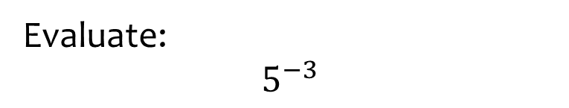


Worked example
Your turn
Evaluate:
$$3^{−4}$$
$$2^{−5}$$
Evaluate:
$$5^{−3}$$
$$\frac{1}{125}$$

Slide 14



Worked example
Your turn
Write as a fraction:
$$x^{−5}$$
$$y^{−4}$$
Write as a fraction:
$$z^{−3}$$
$$\frac{1}{z^{3}}$$

Slide 15



Worked example
Your turn
Write as a fraction:
$${3x}^{−5}$$
$$5y^{−4}$$
Write as a fraction:
$${2z}^{−3}$$
$$\frac{2}{z^{3}}$$

Slide 16
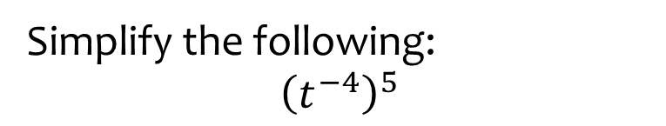


Worked example
Your turn
Simplify the following:
$${\left(r^{−3}\right)}^{4}$$
$${\left(s^{5}\right)}^{−2}$$
Simplify the following:
$${\left(t^{−4}\right)}^{5}$$
$$t^{−20}$$

Slide 17
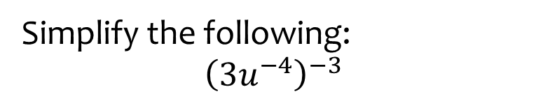


Worked example
Your turn
Simplify the following:
$${\left(2r^{−3}\right)}^{4}$$
$${\left(3s^{−4}\right)}^{−2}$$
$${\left(5t^{−2}\right)}^{3}$$
Simplify the following:
$${\left(3u^{−4}\right)}^{−3}$$
$$\frac{u^{12}}{27}$$

Slide 18
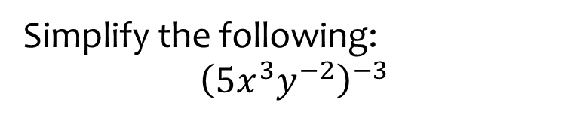


Worked example
Your turn
Simplify the following:
$${\left(2r^{−3}s^{4}\right)}^{5}$$
$${\left(3{t^{−4}u}^{5}\right)}^{−2}$$
Simplify the following:
$${\left(5x^{3}y^{−2}\right)}^{−3}$$
$$\frac{y^{6}}{125x^{9}}$$

Slide 19
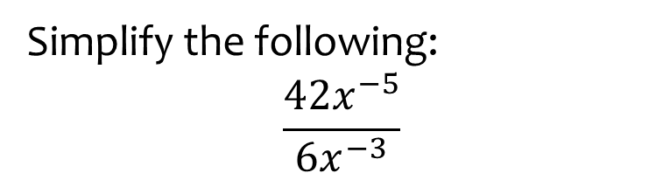


Worked example
Your turn
Simplify the following:
$$\frac{15x^{7}}{3x^{−4}}$$
$$\frac{56y^{−8}}{8y^{−7}}$$
Simplify the following:
$$\frac{42x^{−5}}{6x^{−3}}$$
$$7x^{−2}=\frac{7}{x^{2}}$$

Slide 20
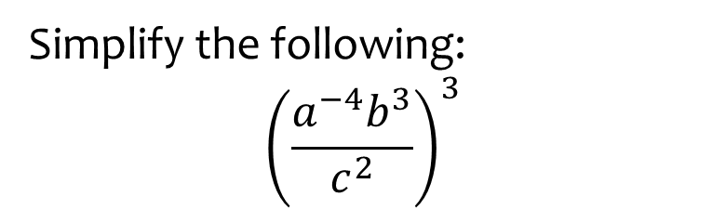
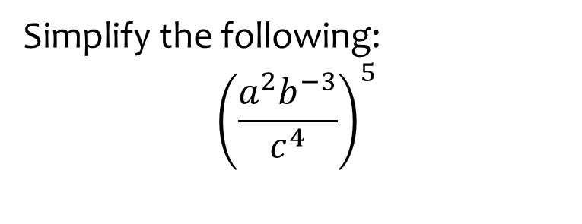

Worked example
Your turn
Simplify the following:
$${\left(\frac{a^{2}b^{−3}}{c^{4}}\right)}^{5}$$
Simplify the following:
$${\left(\frac{a^{−4}b^{3}}{c^{2}}\right)}^{3}$$
$$\frac{b^{9}}{a^{12}c^{6}}$$

Slide 21
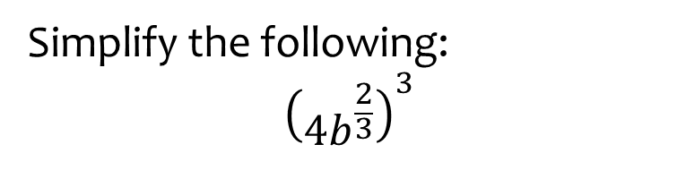
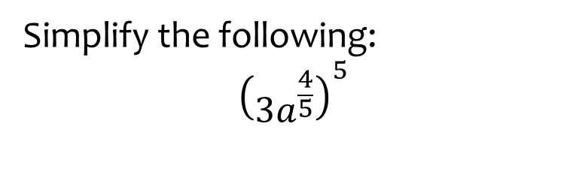

Worked example
Your turn
Simplify the following:
$${\left(3a^{\frac{4}{5}}\right)}^{5}$$
Simplify the following:
$${\left(4b^{\frac{2}{3}}\right)}^{3}$$
$$64b^{2}$$

Slide 22
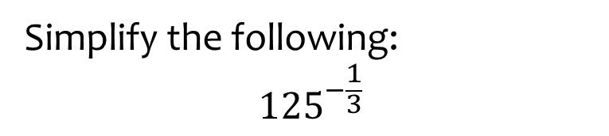


Worked example
Your turn
Evaluate:
$${64}^{\frac{1}{2}}$$
$${64}^{\frac{1}{3}}$$
$${64}^{−\frac{1}{2}}$$
Simplify the following:
$${125}^{−\frac{1}{3}}$$
$$\frac{1}{5}$$

Slide 23
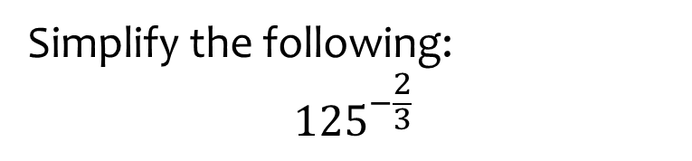


Worked example
Your turn
Evaluate:
$${64}^{\frac{3}{2}}$$
$${64}^{\frac{2}{3}}$$
$${64}^{−\frac{3}{2}}$$
Simplify the following:
$${125}^{−\frac{2}{3}}$$
$$\frac{1}{125}$$

Slide 24
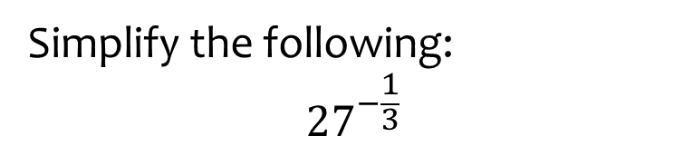


Worked example
Your turn
Evaluate:
$${81}^{\frac{1}{2}}$$
$${81}^{\frac{1}{4}}$$
$${81}^{−\frac{1}{2}}$$
Simplify the following:
$${27}^{−\frac{1}{3}}$$
$$\frac{1}{3}$$

Slide 25
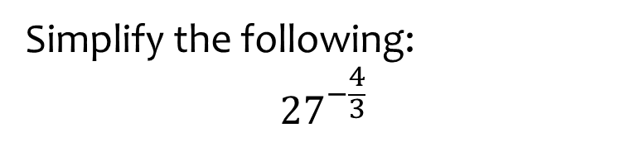


Worked example
Your turn
Evaluate:
$${81}^{\frac{3}{2}}$$
$${81}^{\frac{3}{4}}$$
$${81}^{−\frac{3}{2}}$$
Simplify the following:
$${27}^{−\frac{4}{3}}$$
$$\frac{1}{81}$$

Slide 26
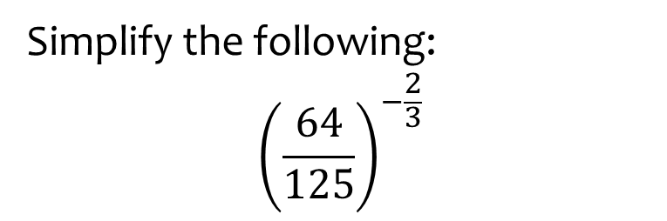
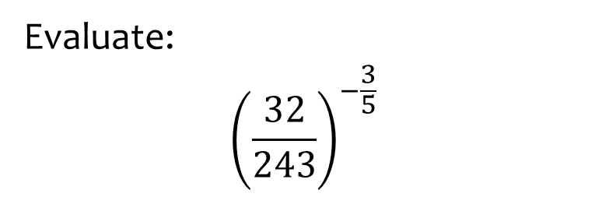

Worked example
Your turn
Evaluate:
$${\left(\frac{32}{243}\right)}^{−\frac{3}{5}}$$
Simplify the following:
$${\left(\frac{64}{125}\right)}^{−\frac{2}{3}}$$
$$\frac{25}{16}$$

Slide 27



Worked example
Your turn
Write in index form:
$$\sqrt[3]{25}$$
$$\sqrt{27}$$
Write in index form:
$$\sqrt[4]{32}$$
$$2^{\frac{5}{4}}$$

Slide 28



Worked example
Your turn
Write in index form:
$$\frac{1}{\sqrt[3]{25}}$$
$$\frac{1}{\sqrt{27}}$$
Write in index form:
$$\frac{1}{\sqrt[4]{32}}$$
$$2^{−\frac{5}{4}}$$

Slide 29



Worked example
Your turn
Simplify:
$${\left(64a^{6}\right)}^{\frac{3}{2}}$$
$${\left(64a^{6}\right)}^{\frac{2}{3}}$$
Simplify:
$${\left(27b^{6}\right)}^{\frac{2}{3}}$$
$$9b^{4}$$

Slide 30



Worked example
Your turn
Evaluate:
$${\left(\sqrt{\frac{3}{2}}\right)}^{4}$$
$${\left(\sqrt{\frac{5}{7}}\right)}^{4}$$
Evaluate:
$${\left(\sqrt{\frac{3}{8}}\right)}^{4}$$
$$\frac{9}{64}$$

Slide 31



Worked example
Your turn
Express $243$ as a power of $9$
Express $32$ as a power of $4$
Express $125$ as a power of $25$
$${25}^{\frac{3}{2}}$$

Slide 32



Worked example
Your turn
Express in index form:
$$\sqrt[3]{x^{4}}$$
$$\sqrt{x^{5}}$$
Express in index form:
$$\sqrt[4]{x^{7}}$$
$$x^{\frac{7}{4}}$$

Slide 33



Worked example
Your turn
Express in index form:
$$\frac{1}{x}$$
$$\frac{1}{x^{2}}$$
$$\frac{1}{x^{3}}$$
Express in index form:
$$\frac{1}{x^{4}}$$
$$x^{−4}$$

Slide 34



Worked example
Your turn
Express in index form:
$$\frac{1}{\sqrt{x}}$$
$$\frac{1}{\sqrt[3]{x}}$$
$$\frac{1}{\sqrt[5]{x}}$$
Express in index form:
$$\frac{1}{\sqrt[7]{x}}$$
$$x^{−\frac{1}{7}}$$

Slide 35



Worked example
Your turn
Express in index form:
$$\frac{2}{x}$$
$$\frac{3}{x^{2}}$$
$$\frac{5}{x^{3}}$$
Express in index form:
$$\frac{7}{x^{4}}$$
$$7x^{−4}$$

Slide 36



Worked example
Your turn
Express in index form:
$$\frac{2}{\sqrt{x}}$$
$$\frac{5}{\sqrt[3]{x}}$$
$$\frac{7}{\sqrt[5]{x}}$$
Express in index form:
$$\frac{3}{\sqrt[7]{x}}$$
$$3x^{−\frac{1}{7}}$$

Slide 37



Worked example
Your turn
Express in index form:
$$\frac{2}{3\sqrt{x}}$$
$$\frac{5}{7\sqrt[3]{x}}$$
$$\frac{1}{4\sqrt[5]{x}}$$
Express in index form:
$$\frac{2}{5\sqrt[7]{x}}$$
$$\frac{2}{5}x^{−\frac{1}{7}}$$

Slide 38



Worked example
Your turn
Simplify fully:
$$\sqrt{a^{\frac{2}{3}}×a^{\frac{4}{7}}}$$
$$\sqrt{b^{\frac{2}{5}}×b^{\frac{6}{7}}}$$
Simplify fully:
$$\sqrt{a^{\frac{3}{4}}×a^{\frac{3}{5}}}$$
$$a^{\frac{27}{40}}$$

Slide 39



Worked example
Your turn
Solve:
$$5^{x}=125$$
$$2^{x}=16$$
$$3^{x}=243$$
Solve:
$$7^{x}=343$$
$$x=3$$

Slide 40



Worked example
Your turn
Solve:
$$5^{x−2}=25$$
$$2^{2x+3}=32$$
$$3^{1−3x}=81$$
Solve:
$$2^{2−5x}=16$$
$$x=−\frac{2}{5}$$

Slide 41



Worked example
Your turn
Solve:
$$5={25}^{x}$$
$$3={27}^{x}$$
$$2={16}^{x−1}$$
Solve:
$$7={343}^{x−2}$$
$$x=\frac{7}{3}$$

Slide 42



Worked example
Your turn
Solve:
$$5^{x}=\frac{1}{125}$$
$$3^{x}=\frac{1}{9}$$
$$2^{x}=\frac{1}{16}$$
Solve:
$$7^{x}=\frac{1}{343}$$
$$x=−3$$

Slide 43



Worked example
Your turn
Solve:
$$5^{−x}=\frac{1}{125}$$
$$3^{−x}=\frac{1}{9}$$
$$2^{−x}=\frac{1}{16}$$
Solve:
$$7^{−x}=\frac{1}{343}$$
$$x=3$$

Slide 44



Worked example
Your turn
Solve:
$$5^{−x}=125$$
$$3^{−x}=9$$
$$2^{−x}=16$$
Solve:
$$7^{−x}=343$$
$$x=−3$$

Slide 45



Worked example
Your turn
Solve:
$${125}^{x}=\frac{1}{5}$$
$$9^{x}=\frac{1}{3}$$
$$8^{x}=\frac{1}{2}$$
Solve:
$${343}^{x}=\frac{1}{7}$$
$$x=−\frac{1}{3}$$

Slide 46



Worked example
Your turn
Solve:
$$2^{3x−2}=\frac{1}{64}$$
$$3^{2−5x}=\frac{1}{81}$$
Solve:
$$5^{3−2x}=\frac{1}{25}$$
$$x=\frac{5}{2}$$

Slide 47



Worked example
Your turn
Solve:
$$2^{x}=\sqrt[3]{16}$$
$$3^{x−2}=\sqrt{27}$$
Solve:
$$5^{x+1}=\sqrt[4]{25}$$
$$x=−\frac{1}{2}$$

Slide 48



Worked example
Your turn
Solve:
$$2^{3x−1}=\sqrt[4]{32}$$
$$3^{2−5x}=\sqrt{243}$$
Solve:
$$5^{3−2x}=\sqrt[3]{25}$$
$$x=\frac{7}{6}$$

Slide 49



Worked example
Your turn
Solve:
$$2^{3x−5}=\frac{16}{\sqrt[5]{64}}$$
Solve:
$$3^{2x−5}=\frac{27}{\sqrt{243}}$$
$$x=\frac{11}{4}$$

Slide 50



Worked example
Your turn
Solve:
$$16×2^{3x−1}=\frac{1}{\sqrt{32}}$$
Solve:
$$27×3^{5x−2}=\frac{1}{\sqrt[3]{9}}$$
$$x=−\frac{1}{3}$$

Slide 51



Worked example
Your turn
Solve:
$${\left({16}^{x}\right)}^{3}=\frac{1}{8}$$
Solve:
$${\left(9^{x}\right)}^{5}=\frac{1}{27}$$
$$x=−\frac{3}{10}$$

Slide 52



Worked example
Your turn
Solve:
$$\sqrt{2}×8^{2x−5}=\frac{1}{16}$$
Solve:
$$\sqrt{3}×9^{4x−3}=\frac{1}{27}$$
$$x=\frac{5}{16}$$

Slide 53



Worked example
Your turn
Solve:
$$\frac{{16}^{4x−3}}{8^{5−2x}}=4$$
Solve:
$$\frac{9^{3−5x}}{{27}^{4x−3}}=81$$
$$x=\frac{1}{2}$$

Slide 54



Worked example
Your turn
Express $y$ in terms of $x$, given:
$$2^{x}×2^{y}=8$$
$$3^{x}×3^{y}=\sqrt{27}$$
Express $y$ in terms of $x$, given:
$$5^{x}×5^{y}=125$$
$$y=3−x$$

Slide 55



Worked example
Your turn
Express $y$ in terms of $x$, given:
$$2^{3x}×8^{5y}=\frac{1}{4}$$
Express $y$ in terms of $x$, given:
$$5^{3x}×{25}^{4y}=\frac{1}{\sqrt{125 }}$$
$$y=−\frac{3}{8}x−\frac{3}{16}$$

Slide 56



Worked example
Your turn
Express $y$ in terms of $x$, given:
$$\frac{2^{3x}}{2^{5y}}=2\sqrt{2}$$
$$\frac{3^{4x}}{3^{2y}}=\frac{1}{27}$$
Express $y$ in terms of $x$, given:
$$\frac{5^{x}}{5^{4y}}=125\sqrt{5}$$
$$y=\frac{x}{4}−\frac{7}{8}$$

Slide 57



Worked example
Your turn
Express $y$ in terms of $x$, given:
$$\frac{2^{3x}}{8^{5y}}=2\sqrt{2}$$
$$\frac{3^{4x}}{9^{2y}}=\frac{1}{27}$$
Express $y$ in terms of $x$, given:
$$\frac{5^{x}}{{25}^{4y}}=125\sqrt{5}$$
$$y=\frac{x}{8}−\frac{7}{16}$$

Slide 58




Worked example
Your turn
Solve ${\left(\frac{1}{2}\right)}^{x}=8$
Solve ${25}^{3−4x}=\frac{1}{125}$
Solve ${\left(\frac{1}{3}\right)}^{x}=9$
Solve $9^{4−3x}=\frac{1}{81}$
$$x=−2$$
$$x=2$$

Slide 59



Worked example
Your turn
Solve $x^{\frac{1}{2}}=5$
Solve $x^{\frac{1}{3}}=6$
Solve $x^{\frac{1}{4}}=2$
$$x=16$$

Slide 60



Worked example
Your turn
Solve $x^{−2}=25$
Solve $x^{−3}=216$
Solve $x^{−4}=16$
$$x=\frac{1}{2}$$

Slide 61



Worked example
Your turn
Given that $5^{−n}=0.4$, find the value of ${\left(5^{3}\right)}^{n}$
Given that $3^{−n}=0.2$, find the value of ${\left(3^{4}\right)}^{n}$
$$625$$

Slide 62



Worked example
Your turn
Express $\frac{{\left(3+\sqrt[3]{x}\right)}^{2}}{x}$ as powers of $x$.
Express $\frac{{\left(2+\sqrt{x}\right)}^{2}}{x}$ as powers of $x$.
$$4x^{−1}+4x^{−\frac{1}{2}}+1$$

Slide 63



Worked example
Your turn
Express $\frac{{\left(x+\sqrt[3]{x}\right)}^{2}}{4\sqrt[3]{x}}$ as powers of $x$.
Express $\frac{{\left(x+\sqrt{x}\right)}^{2}}{2\sqrt{x}}$ as powers of $x$.
$$\frac{1}{2}x^{\frac{3}{2}}+x+\frac{1}{2}x^{\frac{1}{2}}$$

