Slide 1
1.3) Non-random sampling

Slide 2
Worked example
Your turn
Explain how you would use opportunity sampling to survey 30 library users.
Explain how you would use opportunity sampling to survey 50 supermarket shoppers.
Stand outside a supermarket at a specific date and time and survey the first 50 people you see carrying shopping bags.
If the person rejects the survey, repeat until you have surveyed 50 different shoppers.

Slide 3
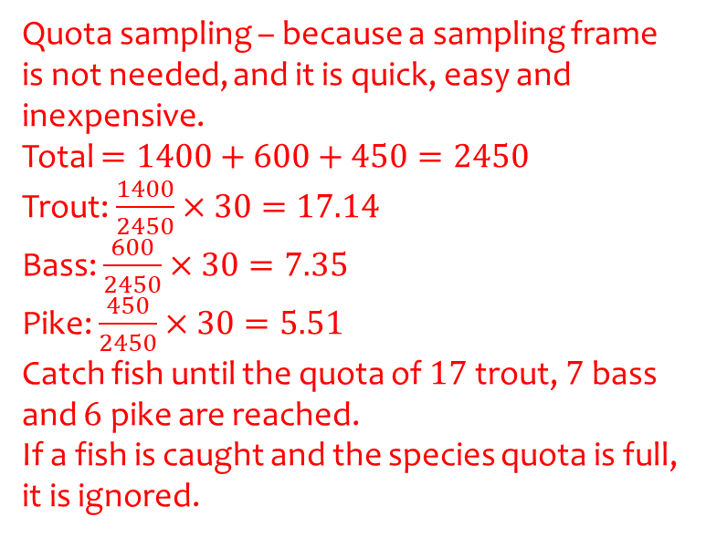
Worked example
Your turn
A lake contains 3 species of fish.
There are estimated to be 700 bream, 1200 carp and 600 roach in the lake.
A survey of the health of the fish in the lake is carried out and a sample of 40 fish chosen.
Explain how you would use an appropriate sampling method.
A lake contains 3 species of fish.
There are estimated to be 1400 trout, 600 bass and 450 pike in the lake.
A survey of the health of the fish in the lake is carried out and a sample of 30 fish chosen.
Explain how you would use an appropriate sampling method.
Quota sampling – because a sampling frame is not needed, and it is quick, easy and inexpensive.
Total $=1400+600+450=2450$
Trout: $\frac{1400}{2450}×30=17.14$
Bass: $\frac{600}{2450}×30=7.35$
Pike: $\frac{450}{2450}×30=5.51$
Catch fish until the quota of $17$ trout, $7$ bass and $6$ pike are reached.
If a fish is caught and the species quota is full, it is ignored.

