Slide 1
1.3) Hypothesis testing for zero correlation

Slide 2
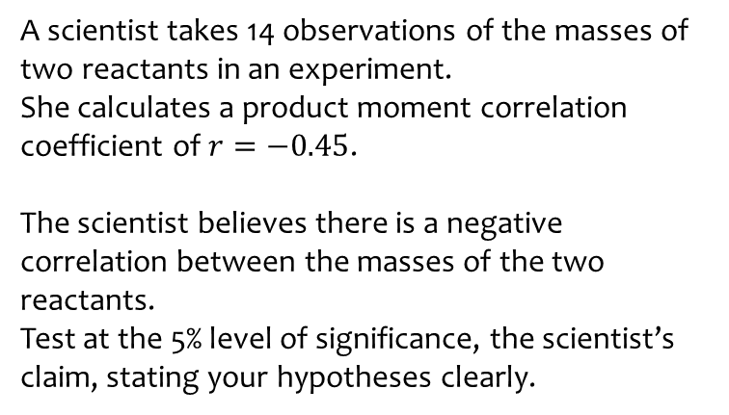
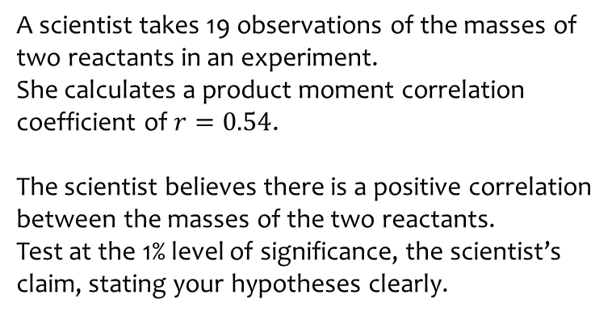
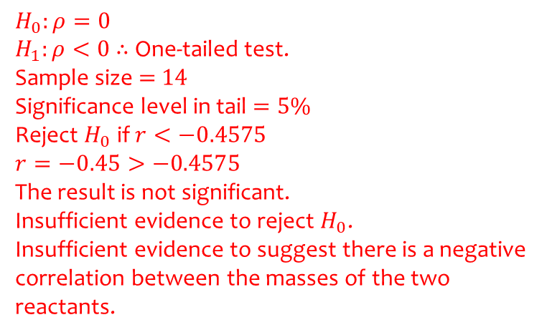
Worked example
Your turn
A scientist takes 19 observations of the masses of two reactants in an experiment.
She calculates a product moment correlation coefficient of $r=0.54$.
The scientist believes there is a positive correlation between the masses of the two reactants.
Test at the 1% level of significance, the scientist’s claim, stating your hypotheses clearly.
A scientist takes 14 observations of the masses of two reactants in an experiment.
She calculates a product moment correlation coefficient of $r=−0.45$.
The scientist believes there is a negative correlation between the masses of the two reactants.
Test at the 5% level of significance, the scientist’s claim, stating your hypotheses clearly.
$$H_{0}:ρ=0$$
$H_{1}:ρ<0$ $∴$ One-tailed test.
Sample size $=$ $14$
Significance level in tail $=5\%$
Reject $H_{0}$ if $r<−0.4575$
$$r=−0.45>−0.4575$$
The result is not significant.
Insufficient evidence to reject $H_{0}$.
Insufficient evidence to suggest there is a negative correlation between the masses of the two reactants.

Slide 3
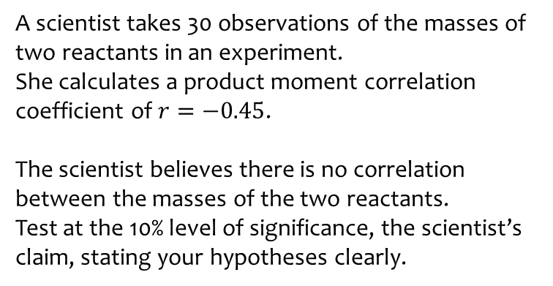
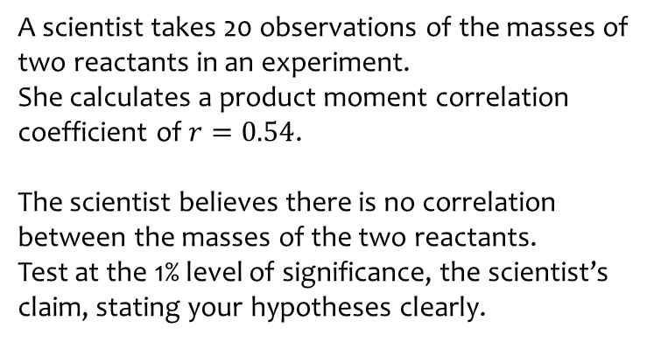
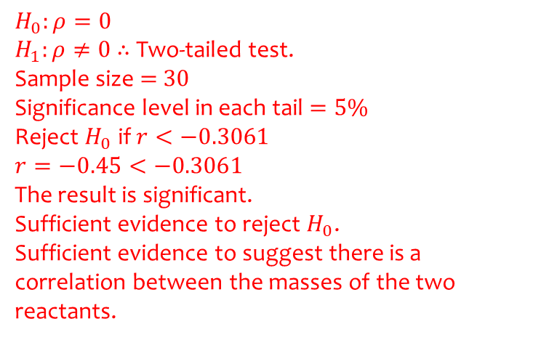
Worked example
Your turn
A scientist takes 20 observations of the masses of two reactants in an experiment.
She calculates a product moment correlation coefficient of $r=0.54$.
The scientist believes there is no correlation between the masses of the two reactants.
Test at the 1% level of significance, the scientist’s claim, stating your hypotheses clearly.
A scientist takes 30 observations of the masses of two reactants in an experiment.
She calculates a product moment correlation coefficient of $r=−0.45$.
The scientist believes there is no correlation between the masses of the two reactants.
Test at the 10% level of significance, the scientist’s claim, stating your hypotheses clearly.
$$H_{0}:ρ=0$$
$H_{1}:ρ≠0$ $∴$ Two-tailed test.
Sample size $=$ $30$
Significance level in each tail $=5\%$
Reject $H_{0}$ if $r<−0.3061$
$$r=−0.45<−0.3061$$
The result is significant.
Sufficient evidence to reject $H_{0}$.
Sufficient evidence to suggest there is a correlation between the masses of the two reactants.

Slide 4
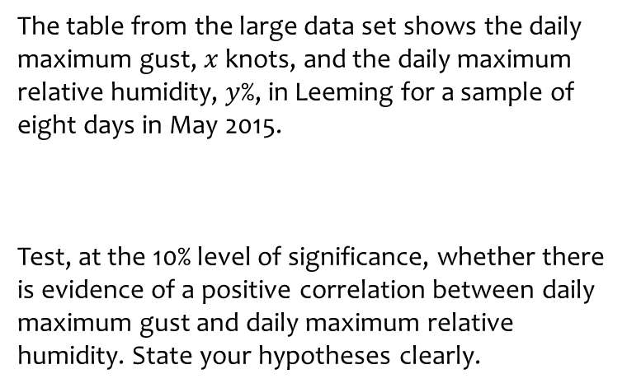
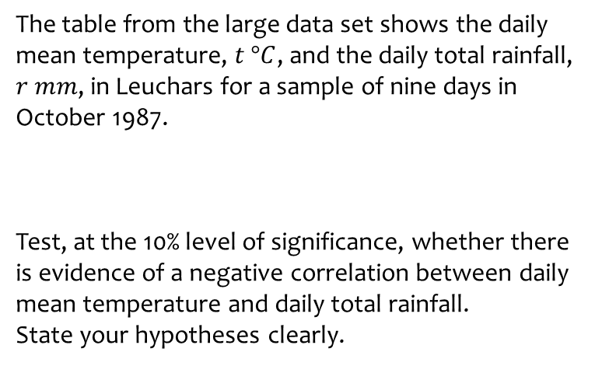
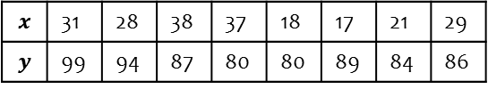
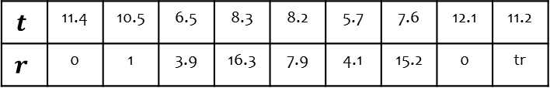
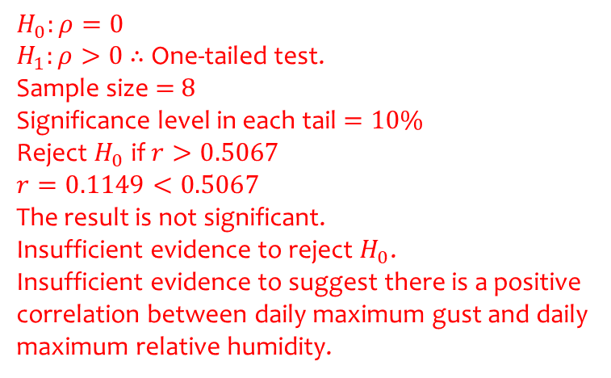
Worked example
Your turn
The table from the large data set shows the daily mean temperature, $t °C$, and the daily total rainfall, $r$ $mm$, in Leuchars for a sample of nine days in October 1987.
Test, at the 10% level of significance, whether there is evidence of a negative correlation between daily mean temperature and daily total rainfall.
State your hypotheses clearly.
The table from the large data set shows the daily maximum gust, $x$ knots, and the daily maximum relative humidity, $y$%, in Leeming for a sample of eight days in May 2015.
Test, at the 10% level of significance, whether there is evidence of a positive correlation between daily maximum gust and daily maximum relative humidity. State your hypotheses clearly.
$$t$$ | 11.4 | 10.5 | 6.5 | 8.3 | 8.2 | 5.7 | 7.6 | 12.1 | 11.2
$$r$$ | 0 | 1 | 3.9 | 16.3 | 7.9 | 4.1 | 15.2 | 0 | tr
$$x$$ | 31 | 28 | 38 | 37 | 18 | 17 | 21 | 29
$$y$$ | 99 | 94 | 87 | 80 | 80 | 89 | 84 | 86
$$H_{0}:ρ=0$$
$H_{1}:ρ>0$ $∴$ One-tailed test.
Sample size $=$ $8$
Significance level in each tail $=10\%$
Reject $H_{0}$ if $r>0.5067$
$$r=0.1149<0.5067$$
The result is not significant.
Insufficient evidence to reject $H_{0}$.
Insufficient evidence to suggest there is a positive correlation between daily maximum gust and daily maximum relative humidity.

