Slide 1
Worked example
Your turn
Simplify:
$$\frac{10x+4}{3x^{2}+4x+1}−\frac{3}{x+1}$$
Simplify:
$$\frac{3x+5}{x^{2}+x−12}−\frac{2}{x−3}$$
$$\frac{1}{x+4}$$

Slide 2

Worked example
Your turn
Write as a single fraction:
$$\frac{5x+2}{3}+\frac{x−3}{2}$$
$$\frac{x−5}{4}+\frac{2x+1}{3}$$
Simplify:
$$\frac{4x+5}{2}+\frac{x−1}{3}$$
$$\frac{14x+13}{6}$$

Slide 3

Worked example
Your turn
Write as a single fraction:
$$\frac{5x+2}{3}+\frac{2}{x−3}$$
$$\frac{x−5}{4}+\frac{3}{2x+1}$$
Simplify:
$$\frac{4x+5}{2}+\frac{3}{x−1}$$
$$\frac{4x^{2}+x+1}{2\left(x−1\right)}$$

Slide 4
Worked example
Your turn
Write as a single fraction:
$$\frac{3}{5x+2}+\frac{2}{x−3}$$
$$\frac{4}{x−5}+\frac{3}{2x+1}$$
Simplify:
$$\frac{2}{4x+5}+\frac{3}{x−1}$$
$$\frac{10x+13}{\left(4x+5\right)\left(x−1\right)}$$

Slide 5

Worked example
Your turn
Write as a single fraction:
$$\frac{5x+2}{3}−\frac{x−3}{2}$$
$$\frac{x−5}{4}−\frac{2x+1}{3}$$
Simplify:
$$\frac{4x+5}{2}−\frac{x−1}{3}$$
$$\frac{10x+17}{6}$$

Slide 6

Worked example
Your turn
Write as a single fraction:
$$\frac{5x+2}{3}−\frac{2}{x−3}$$
$$\frac{x−5}{4}−\frac{3}{2x+1}$$
Simplify:
$$\frac{4x+5}{2}−\frac{3}{x−1}$$
$$\frac{4x^{2}+x−11}{2\left(x−1\right)}$$

Slide 7
Worked example
Your turn
Write as a single fraction:
$$\frac{3}{5x+2}−\frac{2}{x−3}$$
$$\frac{4}{x−5}−\frac{3}{2x+1}$$
Simplify:
$$\frac{2}{4x+5}−\frac{3}{x−1}$$
$$\frac{−10x−17}{\left(4x+5\right)\left(x−1\right)}$$

Slide 8

Worked example
Your turn
Write as a single fraction:
$$\frac{3}{(5x+2)(x−3)}−\frac{2}{x−3}$$
$$\frac{4}{(2x+1)(x−5)}−\frac{3}{2x+1}$$
Simplify:
$$\frac{2}{4x−5}−\frac{3}{(x−1)(4x−5)}$$
$$\frac{2x−5}{\left(x−1\right)\left(4x−5\right)}$$

Slide 9
Worked example
Your turn
Write as a single fraction:
$$3+\frac{5}{2x−1}$$
$$2−\frac{3}{5x+4}$$
Write as a single fraction:
$$5−\frac{3}{x+2}$$
$$\frac{5x+7}{x+2}$$

Slide 10
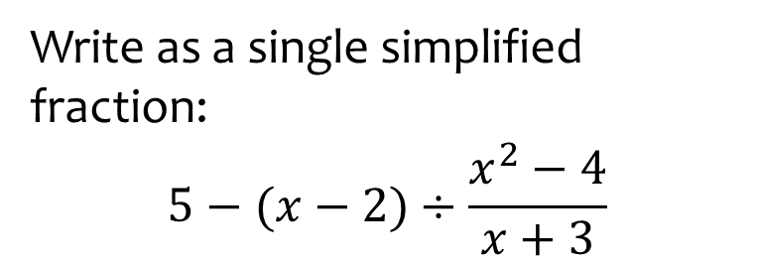
Worked example
Your turn
Write as a single fraction:
$$3−(x−4)÷\frac{x^{2}−16}{x−5}$$
Write as a single simplified fraction:
$$5−(x−2)÷\frac{x^{2}−4}{x+3}$$
$$\frac{4x−13}{x−2}$$

Slide 11

Worked example
Your turn
Write in the form $1+\frac{a}{x+b}$:
$$\frac{x+3}{x−5}$$
$$\frac{x−2}{x+7}$$
Write in the form $1+\frac{a}{x+b}$:
$$\frac{x−5}{x+2}$$
$$1−\frac{7}{x+2}$$

