Slide 1
1.2) Algebraic fractions

Slide 2
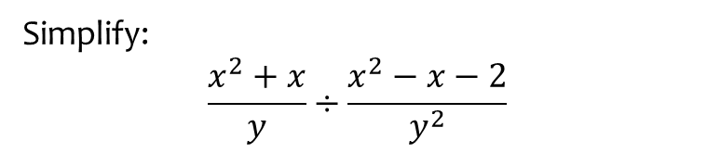
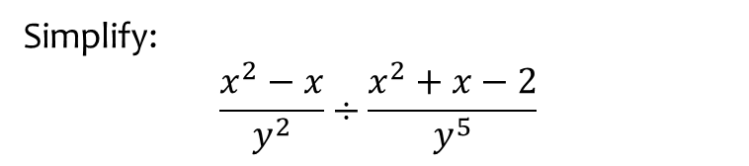

Worked example
Your turn
Simplify:
$$\frac{x^{2}−x}{y^{2}}÷\frac{x^{2}+x−2}{y^{5}}$$
Simplify:
$$\frac{x^{2}+x}{y}÷\frac{x^{2}−x−2}{y^{2}}$$
$$\frac{xy}{x−2}$$

Slide 3

Worked example
Your turn
Simplify:
$$\frac{x^{2}+6x+5}{x^{2}+3x−10}$$
$$\frac{x^{2}−7x−8}{x^{2}−1}$$
Simplify:
$$\frac{x^{2}−6x+5}{x^{2}+4x−5}$$
$$\frac{x−5}{x+5}$$

Slide 4
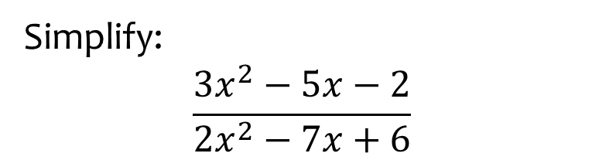

Worked example
Your turn
Simplify:
$$\frac{2x^{2}−5x−3}{3x^{2}−11x+6}$$
$$\frac{3x^{2}−x−10}{x^{2}−4}$$
Simplify:
$$\frac{3x^{2}−5x−2}{2x^{2}−7x+6}$$
$$\frac{3x+1}{2x−3}$$

Slide 5
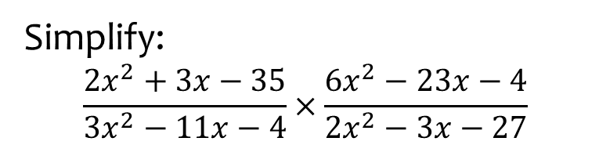

Worked example
Your turn
Simplify:
$$\frac{3x^{2}+2x−8}{6x^{2}−23x−35}×\frac{7x^{2}−29x−30}{4x^{2}+5x−6}$$
$$\frac{6x^{2}+37x−35}{3x^{2}−10x−8}×\frac{3x^{2}+14x+8}{42x^{2}+35x}$$
Simplify:
$$\frac{2x^{2}+3x−35}{3x^{2}−11x−4}×\frac{6x^{2}−23x−4}{2x^{2}−3x−27}$$
$$\frac{\left(x+5\right)\left(2x−7\right)\left(6x+1\right)}{\left(3x+1\right)\left(2x−9\right)\left(x+3\right)}$$

Slide 6
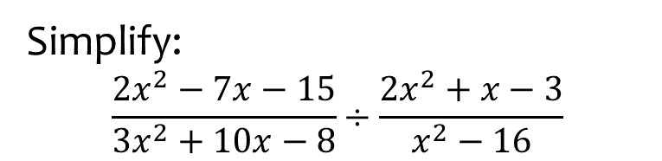
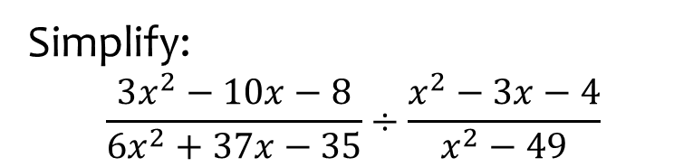
Worked example
Your turn
Simplify:
$$\frac{3x^{2}−10x−8}{6x^{2}+37x−35}÷\frac{x^{2}−3x−4}{x^{2}−49}$$
Simplify:
$$\frac{2x^{2}−7x−15}{3x^{2}+10x−8}÷\frac{2x^{2}+x−3}{x^{2}−16}$$
$$\frac{\left(x−5\right)\left(x−4\right)}{\left(3x−2\right)\left(x−1\right)}$$

Slide 7
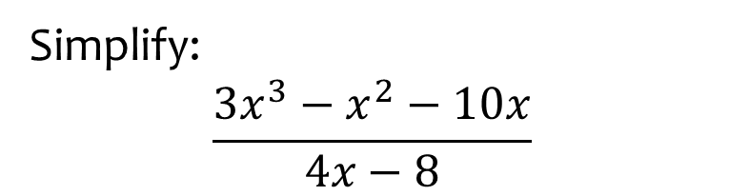
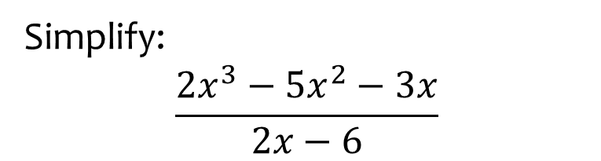
Worked example
Your turn
Simplify:
$$\frac{{2x}^{3}−5x^{2}−3x}{2x−6}$$
Simplify:
$$\frac{3x^{3}−x^{2}−10x}{4x−8}$$
$$\frac{x\left(3x+5\right)}{4}$$

Slide 8
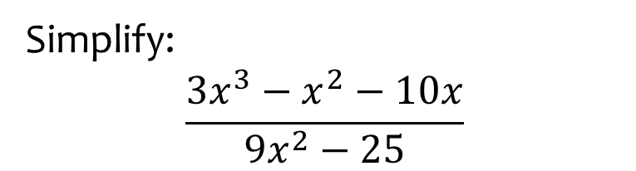
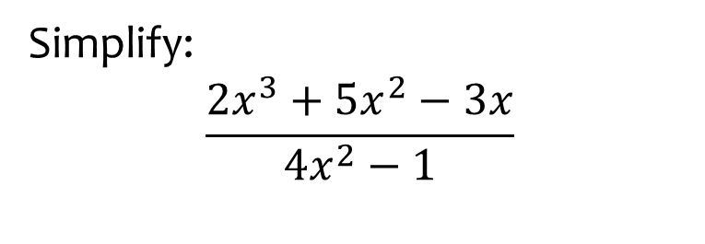
Worked example
Your turn
Simplify:
$$\frac{2x^{3}+5x^{2}−3x}{4x^{2}−1}$$
Simplify:
$$\frac{3x^{3}−x^{2}−10x}{9x^{2}−25}$$
$$\frac{x\left(x−2\right)}{3x−5}$$

