Slide 1
1.2) Conservation of momentum

Slide 2
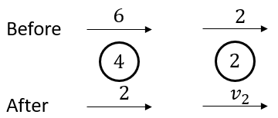
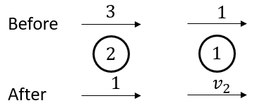
Worked example
Your turn
Calculate the value of the unknown in the following isolated systems. All velocities are marked in $ms^{−1}$ and all masses in $kg$.
Calculate the value of the unknown in the following isolated systems. All velocities are marked in $ms^{−1}$ and all masses in $kg$.
$$v_{2}=5 {ms}^{−1}$$
Diagrams used with permission from DrFrostMaths: https://www.drfrostmaths.com/

Slide 3
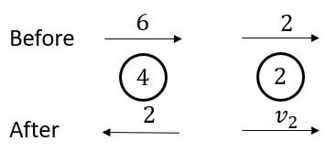
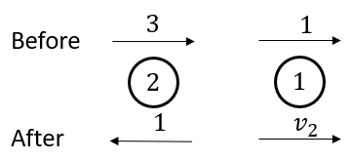
Worked example
Your turn
Calculate the value of the unknown in the following isolated systems. All velocities are marked in $ms^{−1}$ and all masses in $kg$.
Calculate the value of the unknown in the following isolated systems. All velocities are marked in $ms^{−1}$ and all masses in $kg$.
$$v_{2}=9 {ms}^{−1}$$
Diagrams used with permission from DrFrostMaths: https://www.drfrostmaths.com/

Slide 4
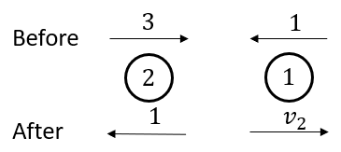
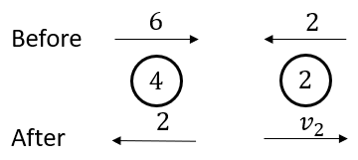
Worked example
Your turn
Calculate the value of the unknown in the following isolated systems. All velocities are marked in $ms^{−1}$ and all masses in $kg$.
Calculate the value of the unknown in the following isolated systems. All velocities are marked in $ms^{−1}$ and all masses in $kg$.
$$v_{2}=7{ ms}^{−1}$$
Diagrams used with permission from DrFrostMaths: https://www.drfrostmaths.com/

Slide 5
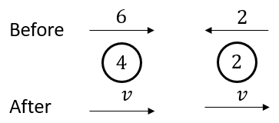
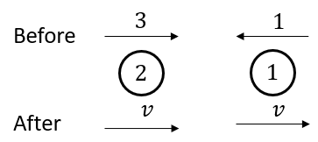
Worked example
Your turn
Calculate the value of the unknown in the following isolated systems. All velocities are marked in $ms^{−1}$ and all masses in $kg$.
Calculate the value of the unknown in the following isolated systems. All velocities are marked in $ms^{−1}$ and all masses in $kg$.
$v=1.67 ms^{−1}$ (3 sf)
Diagrams used with permission from DrFrostMaths: https://www.drfrostmaths.com/

Slide 6
Worked example
Your turn
A particle $P$ of mass $4 kg$ is moving with speed $6 ms^{−1}$ on a smooth horizontal plane.
Particle $Q$ of mass $6 kg$ is at rest on the plane.
Particle $P$collides with particle $Q$ and after the collision $Q$ moves with speed $\frac{14}{3}ms^{−1}$. Find:
a) The speed and direction of motion of $P$after the collision
b) The magnitude of the impulse received by $P$ in the collision
A particle $P$ of mass $2 kg$ is moving with speed $3 ms^{−1}$ on a smooth horizontal plane.
Particle $Q$ of mass $3 kg$ is at rest on the plane.
Particle $P$collides with particle $Q$ and after the collision $Q$ moves with speed $\frac{7}{3}ms^{−1}$. Find:
a) The speed and direction of motion of $P$after the collision
b) The magnitude of the impulse received by $P$ in the collision
a) $0.5 ms^{−1}$ ; direction of motion is reversed.
b) $7 Ns$

Slide 7
Worked example
Your turn
Two particles $A$ and $B$ of masses $2 kg$ and $4 kg$ respectively are moving towards each other in opposite directions along the same straight line on a smooth horizontal surface.
The particles collide.
Before the collision the speeds of $A$ and $B$ are $3 ms^{−1}$ and $2 ms^{−1}$ respectively.
After the collision the direction of motion of $A$ is reversed and its speed is $2 ms^{−1}$. Find:
a) The speed and direction of $B$ after the collision
b) The magnitude of the impulse given by $A$ to $B$ in the collision
Two particles $A$ and $B$ of masses $2 kg$ and $4 kg$ respectively are moving towards each other in opposite directions along the same straight line on a smooth horizontal surface.
The particles collide.
Before the collision the speeds of $A$ and $B$ are $3 ms^{−1}$ and $2 ms^{−1}$ respectively.
After the collision the direction of motion of $A$ is reversed and its speed is $2 ms^{−1}$. Find:
a) The speed and direction of $B$ after the collision
b) The magnitude of the impulse given by $A$ to $B$ in the collision
a) $0.5 ms^{−1}$ ; direction of motion is reversed.
b) $10 Ns$

Slide 8
Worked example
Your turn
Two particles P and Q, of masses 8kg and 4kg respectively, are connected by a light inextensible string.
The particles are at rest on a smooth horizontal plane with the string slack.
Particle P is projected directly away from Q with speed 2$ms^{−1}$.
Find the common speed of the particles after the string goes taut.
Find the magnitude of the impulse transmitted through the string when it goes taught.
Two particles P and Q, of masses 8kg and 2kg respectively, are connected by a light inextensible string.
The particles are at rest on a smooth horizontal plane with the string slack.
Particle P is projected directly away from Q with speed 4$ms^{−1}$.
Find the common speed of the particles after the string goes taut.
Find the magnitude of the impulse transmitted through the string when it goes taught.
a) $3.2 ms^{−1}$
b) $6.4 Ns$

Slide 9
Worked example
Your turn
Two particles $A$ and $B$ of masses $4 kg$and $2 kg$ respectively are moving towards each other in opposite directions along the same straight line on a smooth horizontal surface. The particles collide.
Before the collision the speeds of $A$ and $B$ are $6 ms^{−1}$ and $4 ms^{−1}$ respectively.
Given that the magnitude of the impulse due to the collision is $14 Ns$, find:
The velocity of $A$ after the collision
The velocity of $B$ after the collision
Two particles $A$ and $B$ of masses $2 kg$and $4 kg$ respectively are moving towards each other in opposite directions along the same straight line on a smooth horizontal surface. The particles collide.
Before the collision the speeds of $A$ and $B$ are $3 ms^{−1}$ and $2 ms^{−1}$ respectively.
Given that the magnitude of the impulse due to the collision is $7 Ns$, find:
The velocity of $A$ after the collision
The velocity of $B$ after the collision
a) $0.5 ms^{−1}$ ; direction of motion is reversed
b) $0.25 ms^{−1}$ ; direction of motion is unchanged.

Slide 10
Worked example
Your turn
A truck $P$ of mass $4M$ is moving with speed $U$ on smooth straight horizontal rails. It collides directly with another truck $Q$ of mass $6M$ which is moving with speed $2U$ in the opposite direction on the same rails. The trucks join so that immediately after the collision they move together. By modelling the trucks as particles, find:
The speed of the trucks immediately after the collision
The magnitude of the impulse exerted on P by Q in the collision
A truck $P$ of mass $2M$ is moving with speed $U$ on smooth straight horizontal rails. It collides directly with another truck $Q$ of mass $3M$ which is moving with speed $4U$ in the opposite direction on the same rails. The trucks join so that immediately after the collision they move together. By modelling the trucks as particles, find:
The speed of the trucks immediately after the collision
The magnitude of the impulse exerted on P by Q in the collision
a) $2U$
b) $6MU$

