Slide 1
1.1) Momentum in one direction

Slide 2
Worked example
Your turn
Momentum = Mass x Velocity
Momentum = Mass x Velocity
Mass | Velocity | Momentum
6 kg | 5 m/s
 | 13 ms⁻¹ | 65 kgms⁻¹
523 kg |  | 0 Ns
3kg | 4i + 7j ms⁻¹
Mass | Velocity | Momentum
523 kg |  | 0 Ns
 | 7i + 7j ms⁻¹ | 1.4i + 1.4j kgms⁻¹
0.002 tonnes |  | 6i + 18j Ns
600g | 36 km/h
Mass | Velocity | Momentum
523 kg | 0 ms⁻¹ | 0 Ns
0.2 kg | 7i + 7j ms⁻¹ | 1.4i + 1.4j kgms⁻¹
0.002 tonnes | 3i + 9j ms⁻¹ | 6i + 18j Ns
600g | 36 km/h | 6 Ns

Slide 3
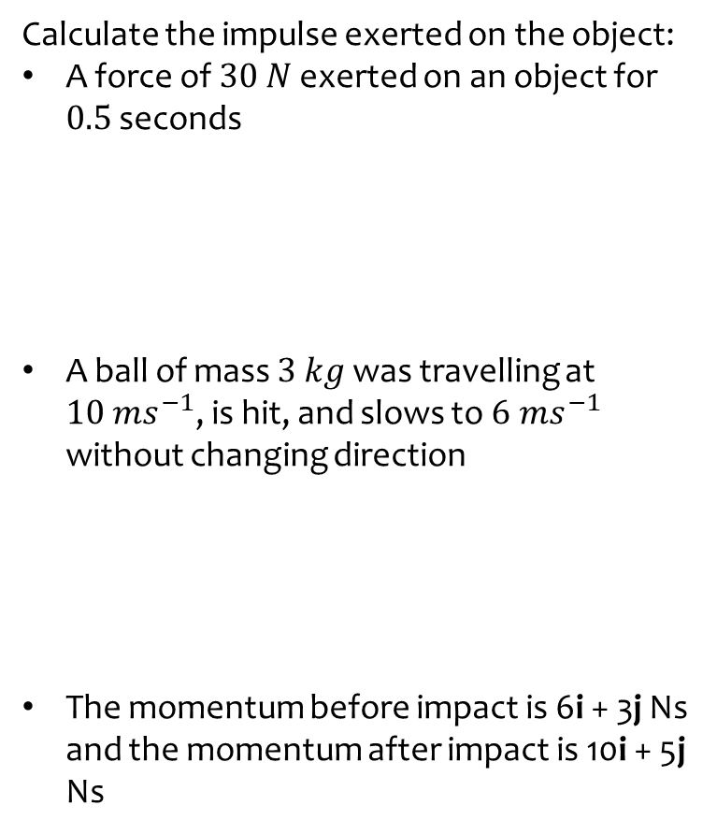

Worked example
Your turn
Calculate the impulse exerted on the object:
A force of $30 N$ exerted on an object for $0.5$ seconds
A ball of mass $3 kg$ was travelling at $10 ms^{−1}$, is hit, and slows to $6 ms^{−1}$ without changing direction
The momentum before impact is 6i + 3j Ns and the momentum after impact is 10i + 5j Ns
Calculate the impulse exerted on the object:
A rocket of mass $100 kg$ travelling at $2000 ms^{−1}$ hits the ground and stops.
A ball of mass $3 kg$ was travelling at $10 ms^{−1}$, is hit and returns in the opposite direction at a speed of $6 ms^{−1}$
The momentum before impact is 6i - 5j Ns and the momentum after impact is -10i + 5j Ns
$$200000 Ns$$
$$48 Ns$$
$$−16i+10j Ns$$

Slide 4
Worked example
Your turn
A ball of mass 0.4 kg hits a vertical wall at right angles with a speed of 7 ms⁻¹.
The ball rebounds with speed 5 ms⁻¹.
Find the magnitude of the impulse exerted on the wall by the ball.
A ball of mass 0.2 kg hits a vertical wall at right angles with a speed of 3.5 ms⁻¹.
The ball rebounds with speed 2.5 ms⁻¹.
Find the magnitude of the impulse exerted on the wall by the ball.
$$1.2 Ns$$

Slide 5
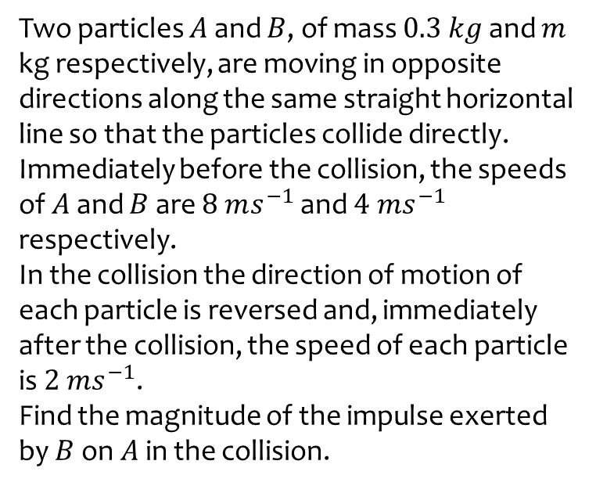
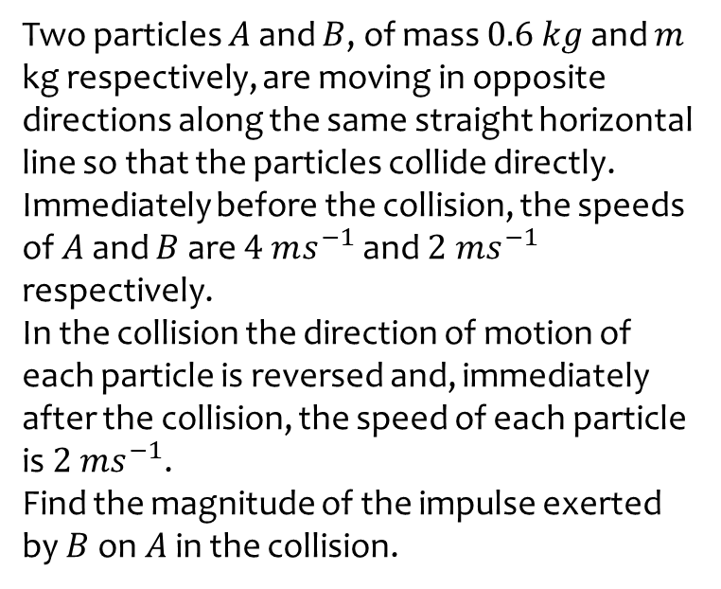
Worked example
Your turn
Two particles $A$ and $B$, of mass $0.6 kg$ and $m$ kg respectively, are moving in opposite directions along the same straight horizontal line so that the particles collide directly.
Immediately before the collision, the speeds of $A$ and $B$ are $4 ms^{−1}$ and $2 ms^{−1}$ respectively.
In the collision the direction of motion of each particle is reversed and, immediately after the collision, the speed of each particle is $2 ms^{−1}$.
Find the magnitude of the impulse exerted by $B$on $A$in the collision.
Two particles $A$ and $B$, of mass $0.3 kg$ and $m$ kg respectively, are moving in opposite directions along the same straight horizontal line so that the particles collide directly.
Immediately before the collision, the speeds of $A$ and $B$ are $8 ms^{−1}$ and $4 ms^{−1}$ respectively.
In the collision the direction of motion of each particle is reversed and, immediately after the collision, the speed of each particle is $2 ms^{−1}$.
Find the magnitude of the impulse exerted by $B$on $A$in the collision.
$$3 Ns$$

