Slide 1
1.1) Index Laws

Slide 2



Worked example
Your turn
Simplify:
$${\left(a^{5}\right)}^{3}×4a^{7}$$
$${\left(5xy^{4}\right)}^{3}$$
Simplify:
$${\left(a^{3}\right)}^{2}×2a^{2}$$
$${\left(4x^{3}y\right)}^{3}$$
$$2a^{8}$$
$$64x^{9}y^{3}$$

Slide 3



Worked example
Your turn
Simplify:
$$7x^{3}\left(6−5x\right)−4x\left(3−2x^{3}\right)$$
$$\frac{5x^{4}+3x^{2}}{6x^{3}}$$
Simplify:
$$2x^{2}\left(3+5x\right)−x\left(4−x^{2}\right)$$
$$\frac{x^{3}−2x}{3x^{2}}$$
$$11x^{3}+6x^{2}−4x$$
$$\frac{1}{3}x−\frac{2}{3x}$$

Slide 4



Worked example
Your turn
Simplify:
$$4^{x}×5^{x}$$
$$7^{x+1}×6^{x+1}$$
Simplify:
$$2^{x−4}×3^{x−4}$$
$$6^{x−4}$$

Slide 5



Worked example
Your turn
Simplify:
$${\left(x^{2}\right)}^{3}$$
$${\left(2x^{3}y^{4}\right)}^{5}$$
$${\left(4ab^{2}c^{4}\right)}^{3}$$
Simplify:
$${\left(5a^{7}bc^{5}\right)}^{3}$$
$$125a^{21}b^{3}c^{15}$$

Slide 6



Worked example
Your turn
Simplify:
$$\sqrt{16x^{2}y^{6}z^{4}}$$
$$\sqrt[3]{27x^{4}y^{6}z}$$
Simplify:
$$\sqrt{9a^{3}b^{6}c^{2}d}$$
$$3a^{\frac{3}{2}}b^{3}cd^{\frac{1}{2}}$$

Slide 7



Worked example
Your turn
Write in index form:
$$32×128$$
$$3×27×81$$
Write in index form:
$$5×25×625$$
$$5^{7}$$

Slide 8


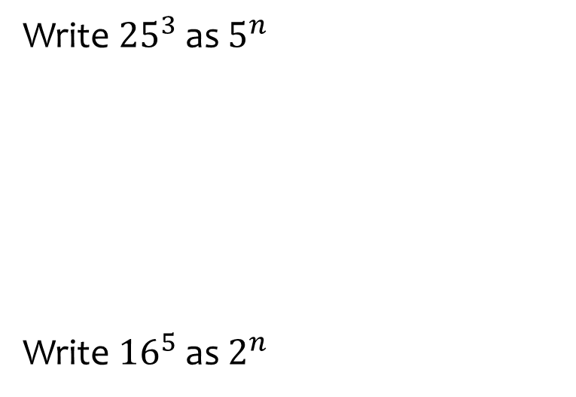
Worked example
Your turn
Write ${25}^{3}$ as $5^{n}$
Write ${16}^{5}$as $2^{n}$
Write${27}^{4}$ as $3^{n}$
$$3^{12}$$

Slide 9



Worked example
Your turn
Write ${81}^{4}×9^{7}$ as $3^{n}$
Write $8^{\frac{1}{2}}×{128}^{−\frac{3}{4}}$ as $2^{n}$
Write ${25}^{\frac{1}{3}}×{125}^{−\frac{2}{5}}$ as $5^{n}$
$$5^{−\frac{8}{15}}$$

Slide 10



Worked example
Your turn
Write ${0.04}^{5}×{0.2}^{3}$ as $5^{n}$
Write ${0.125}^{3}×{0.5}^{7}$ as $2^{n}$
$$2^{−16}$$

Slide 11



Worked example
Your turn
Write $\frac{{81}^{4}}{9^{7}}$ as $3^{n}$
Write $\frac{{16}^{3}}{{32}^{7}}$ as $2^{n}$
Write $\frac{{25}^{4}}{{125}^{6}}$ as $5^{n}$
$$5^{−10}$$

