Slide 1
14.8) Logarithms and non-linear data

Slide 2
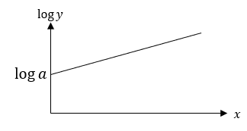
Worked example
Your turn
Use logarithms to convert the non-linear relationship into a linear form and sketch the resulting straight line.
$$y=ax^{n}$$
Use logarithms to convert the non-linear relationship into a linear form and sketch the resulting straight line.
$$y=ab^{x}$$
$$\log{y}=(\log{b)}x+\log{a}$$

Slide 3
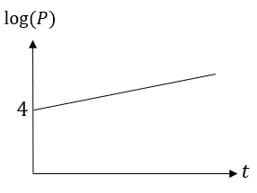
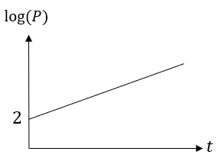
Worked example
Your turn
The graph represents the growth of a population of bacteria, $P$, over $t$ hours.
The graph has a gradient of 0.3 and meets the vertical axis at $\left(0,4\right)$.
A scientist suggest that this growth can be modelled by the equation $P=ab^{t}$, where $a$ and $b$ are constants to be found.
Write down an equation for the line.
Find the values of $a$ and $b$, giving them to 3 sf where necessary.
Interpret the meaning of the constant $a$ in this model.
The graph represents the growth of a population of bacteria, $P$, over $t$ hours.
The graph has a gradient of 0.6 and meets the vertical axis at $\left(0,2\right)$.
A scientist suggest that this growth can be modelled by the equation $P=ab^{t}$, where $a$ and $b$ are constants to be found.
Write down an equation for the line.
Find the values of $a$ and $b$, giving them to 3 sf where necessary.
Interpret the meaning of the constant $a$ in this model.
a) $\log{P}=0.6t+2$
b) $a=100$, $b=3.98$ (3 sf)
c) The initial size of the bacteria population was $100$

Slide 4
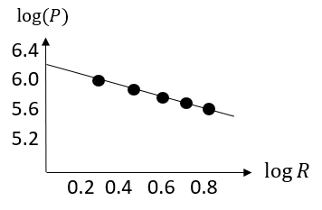
Worked example
Your turn
The table below gives the rank (by size) and population of a country’s largest cities and districts (the capital city is number 1 but has been excluded as an outlier).
The relationship between the rank and population can be modelled by the formula:
$P=aR^{n}$ where $a$ and $n$ are constants.
Draw a table giving values of $\log{R}$ and $\log{P}$ to 2dp.
Plot a graph of $\log{R}$ against $\log{P}$ using the values from your table and draw the line of best fit.
Use your graph to estimate the values of $a$ and $n$ to two significant figures.
The table below gives the rank (by size) and population of the UK’s largest cities and districts in the past (London is number 1 but has been excluded as an outlier).
The relationship between the rank and population can be modelled by the formula:
$P=aR^{n}$ where $a$ and $n$ are constants.
Draw a table giving values of $\log{R}$ and $\log{P}$ to 2dp.
Plot a graph of $\log{R}$ against $\log{P}$ using the values from your table and draw the line of best fit.
Use your graph to estimate the values of $a$ and $n$ to two significant figures.
City | A | B | C | D | E
Rank, $R$ | 2 | 3 | 4 | 5 | 6
Population | 2 000 000 | 1 400 000 | 1 200 000 | 1 000 000 | 900 000
City | Birmingham | Leeds | Glasgow | Sheffield | Bradford
Rank, $R$ | 2 | 3 | 4 | 5 | 6
Population | 1 000 000 | 730 000 | 620 000 | 530 000 | 480 000
a)
b)
c) $a=1600000$, $n=−0.67$ (2 sf)
$$log R$$ | 0.30 | 0.48 | 0.60 | 0.70 | 0.78
$$log P$$ | 6 | 5.86 | 5.79 | 5.72 | 5.68

Slide 5
Worked example
Your turn
A population is increasing exponentially according to the model $P=ab^{t}$, where $a,b$ are constants to be found.
The population is recorded as follows:
Draw a table giving values of $t$ and $\log{P}$ (to 3dp).
A line of best fit is drawn for the data in your new table, and it happens to go through the first data point above (where $t=1.4$) and last (where $t=4.4$). Determine the equation of this line of best fit.
Hence, determine the values of $a$ and $b$ in the model.
Estimate the population in $2020$
A population is increasing exponentially according to the model $P=ab^{t}$, where $a,b$ are constants to be found.
The population is recorded as follows:
Draw a table giving values of $t$ and $\log{P}$ (to 3dp).
A line of best fit is drawn for the data in your new table, and it happens to go through the first data point above (where $t=0.7$) and last (where $t=2.2$). Determine the equation of this line of best fit
Hence, determine the values of $a$ and $b$ in the model.
Estimate the population in $2020$
Years $t$ after $2016$ | $$1.4$$ | $$2.6$$ | $$4.4$$
Population $P$ | $$4706$$ | $$7346$$ | $$14324$$
Years $t$ after $2015$ | $$0.7$$ | $$1.3$$ | $$2.2$$
Population $P$ | $$2353$$ | $$3673$$ | $$7162$$
a)
b) $\log{P}=0.322t+3.147$
c) $a=1403$, $b=2.099$ (4 sf)
d) $57164$
$$t$$ | 0.7 | 1.3 | 2.2
$$log P$$ | 3.372 | 3.565 | 3.855

