Slide 1
14.5) Laws of logarithms

Slide 2
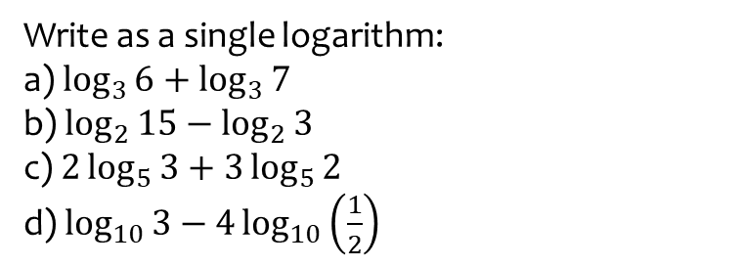
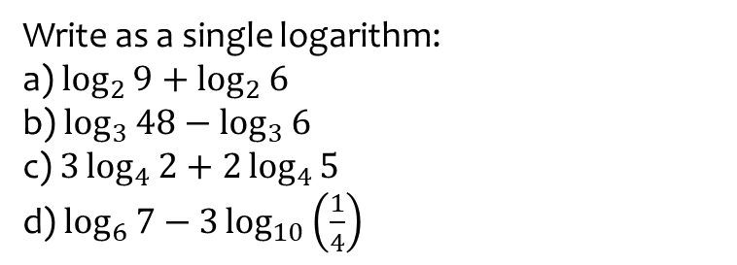
Worked example
Your turn
Write as a single logarithm:
a) $\log_{2}{9}+\log_{2}{6}$
b) $\log_{3}{48}−\log_{3}{6}$
c) $3\log_{4}{2}+2\log_{4}{5}$
d) $\log_{6}{7}−3\log_{10}\left(\frac{1}{4}\right)$
Write as a single logarithm:
a) $\log_{3}{6}+\log_{3}{7}$
b) $\log_{2}{15}−\log_{2}{3}$
c) $2\log_{5}{3}+3\log_{5}{2}$
d) $\log_{10}{3}−4\log_{10}\left(\frac{1}{2}\right)$
a) $\log_{3}{42}$
b) $\log_{2}{5}$
c) $\log^{5}{72}$
d) $\log_{10}48$

Slide 3
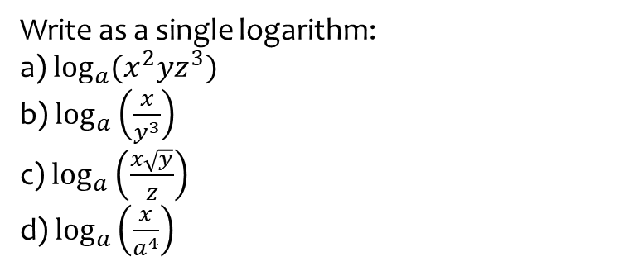
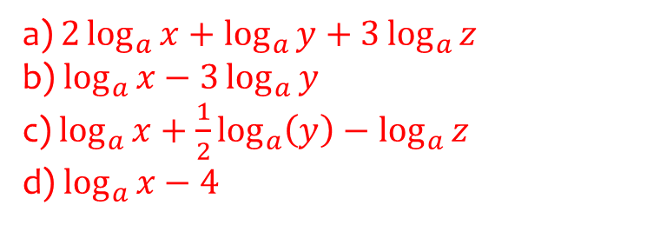
Worked example
Your turn
Write as a single logarithm:
a) $\log_{a}{(x^{4}y^{5}z})$
b) $\log_{a}\left(\frac{x^{3}}{y^{2}}\right)$
c) $\log_{a}\left(\frac{x\sqrt[3]{y}}{z^{2}}\right)$
d) $\log_{a}\left(\frac{x^{2}}{a^{5}}\right)$
Write as a single logarithm:
a) $\log_{a}{(x^{2}yz^{3}})$
b) $\log_{a}\left(\frac{x}{y^{3}}\right)$
c) $\log_{a}\left(\frac{x\sqrt{y}}{z}\right)$
d) $\log_{a}\left(\frac{x}{a^{4}}\right)$
a) $2\log_{a}{x}+\log_{a}{y}+3\log_{a}{z}$
b) $\log_{a}{x}−3\log_{a}{y}$
c) $\log_{a}{x}+\frac{1}{2}\log_{a}\left(y\right)−\log_{a}{z}$
d) $\log_{a}{x}−4$

Slide 4
Worked example
Your turn
Solve the equation:
$$\log_{10}{2}+4 \log_{10}{x}=2.209515015$$
Solve the equation:
$$\log_{10}{4}+2\log_{10}{x}=2$$
$$x=5$$

Slide 5
Worked example
Your turn
Solve the equation:
$$\log_{2}{(x+5)}− \log_{2}{(x−11)}=3$$
Solve the equation:
$$\log_{3}{(x+11)}− \log_{3}{(x−5)}=2$$
$$x=7$$

Slide 6
Worked example
Your turn
Solve the equation:
$$2\log_{4}{(x+3)}− \log_{4}{x}=2$$
Solve the equation:
$$2\log_{2}{(x+15)}− \log_{2}{x}=6$$
$$x=25, x=9$$

