Slide 1
14.4) Logarithms

Slide 2

Worked example
Your turn
Write each statement as a logarithm:
$$2^{3}=8$$
$$7^{2}=49$$
$${64}^{\frac{1}{3}}=4$$
Write each statement as a logarithm:
$$3^{2}=9$$
$$2^{7}=128$$
$${64}^{\frac{1}{2}}=8$$
$$\log_{3}{9}=2$$
$$\log_{2}{128}=7$$
$$\log_{64}{8}=\frac{1}{2}$$

Slide 3


Worked example
Your turn
Write each statement using a power:
$$\log_{4}{64}=3$$
$$\log_{3}{\frac{1}{9}}=−2$$
Write each statement using a power:
$$\log_{3}{81}=4$$
$$\log_{2}{\frac{1}{8}}=−3$$
$$3^{4}=81$$
$$2^{−3}=\frac{1}{8}$$

Slide 4

Worked example
Your turn
Without a calculator, find the value of:
$$\log_{5}{125}$$
$$\log_{5}{5}$$
$$\log_{5}\left(\frac{1}{625}\right)$$
$$\log_{5}{1}$$
Without a calculator, find the value of:
$$\log_{4}{16}$$
$$\log_{4}{1}$$
$$\log_{4}{4}$$
$$\log_{4}\left(\frac{1}{64}\right)$$
$$2$$
$$0$$
$$1$$
$$−3$$

Slide 5

Worked example
Your turn
Without a calculator, find the value of:
$$\log_{5}{125}$$
$$\log_{5}{5}$$
$$\log_{5}\left(\frac{1}{625}\right)$$
$$\log_{5}{1}$$
$$\log_{5}{(−2)}$$
Without a calculator, find the value of:
$$\log_{4}{16}$$
$$\log_{4}{1}$$
$$\log_{4}{4}$$
$$\log_{4}\left(\frac{1}{64}\right)$$
$$\log_{4}{(−3)}$$
$$2$$
$$0$$
$$1$$
$$−3$$
No value

Slide 6
Worked example
Your turn
Without a calculator, find the value of:
$$\log_{5}{5}$$
$$\ln{e^{2}}$$
$$\log{1000}$$
Without a calculator, find the value of:
$$\log_{3}{3}$$
$$\ln{e}$$
$$\log{100}$$
$$1$$
$$1$$
$$2$$

Slide 7

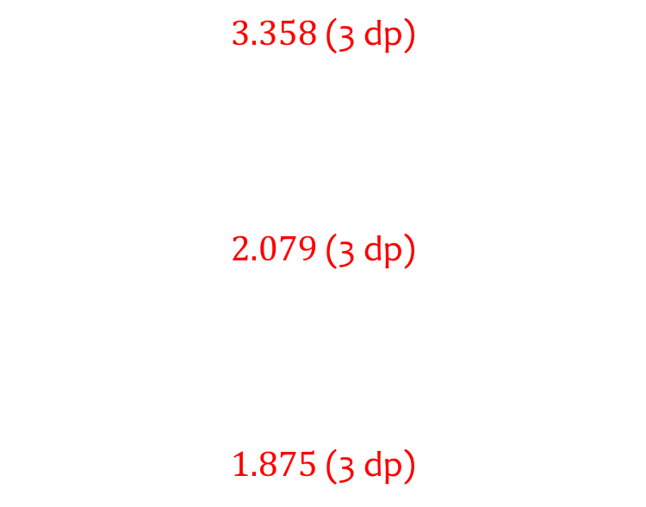
Worked example
Your turn
Use your calculator to find the value of:
$$\log_{5}{40}$$
$$\ln{16}$$
$$\log{25}$$
Use your calculator to find the value of:
$$\log_{3}{40}$$
$$\ln{8}$$
$$\log{75}$$
$3.358$ (3 dp)
$2.079$ (3 dp)
$1.875$ (3 dp)

Slide 8
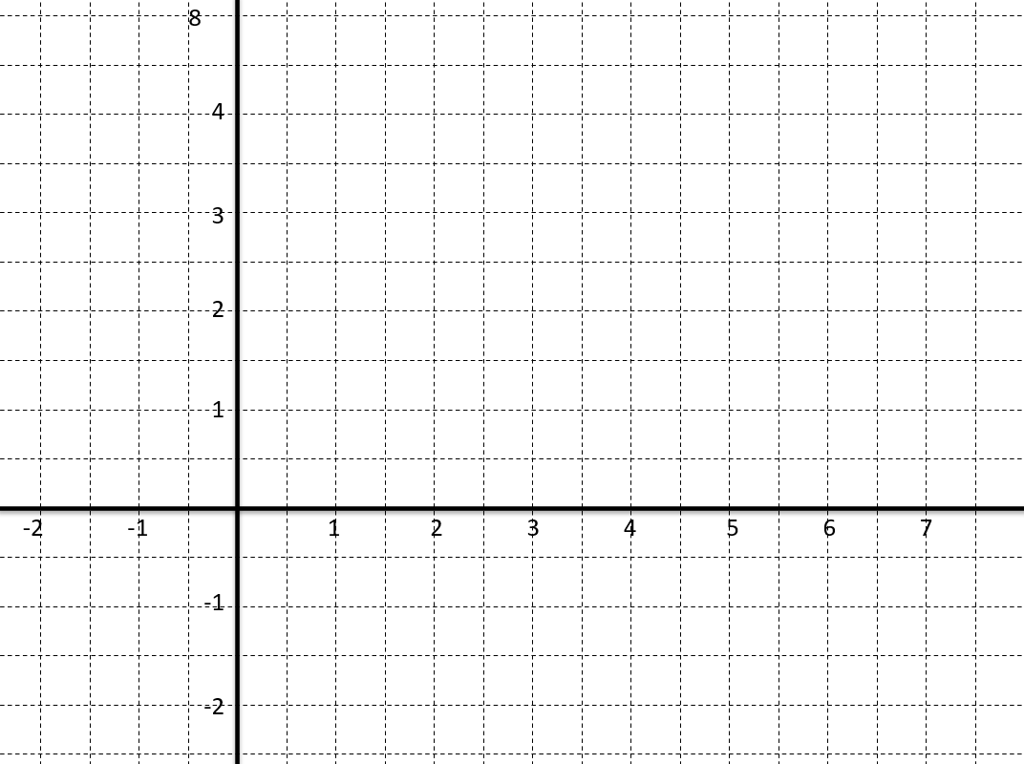
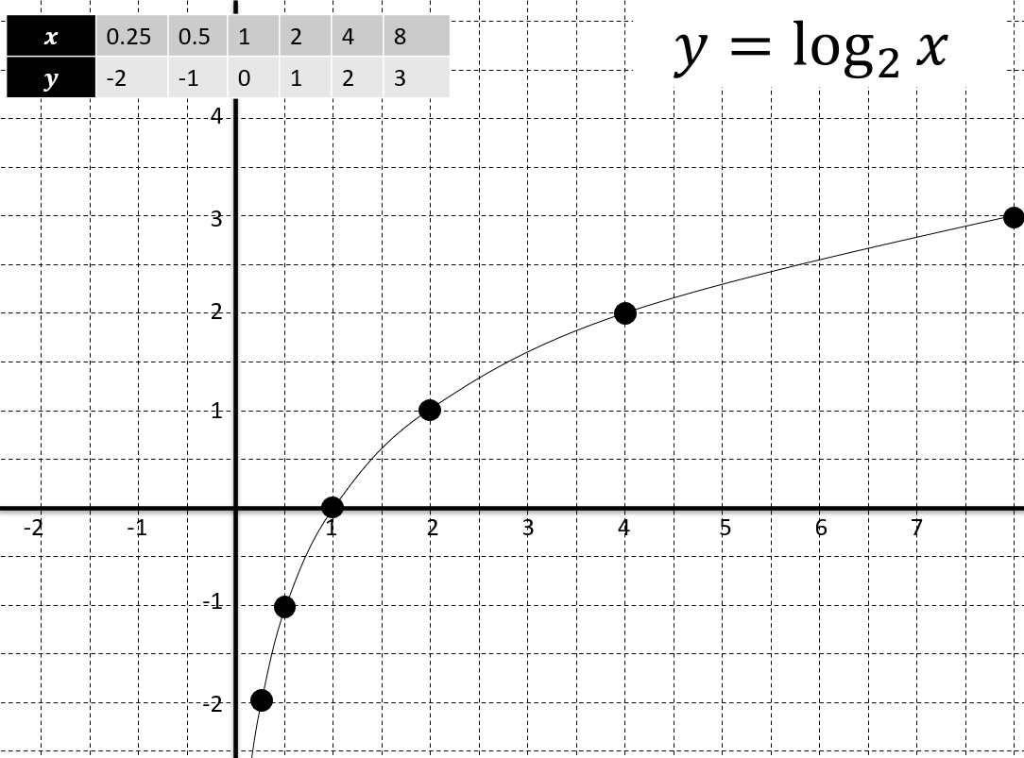
Worked example
Your turn
Using a table of values sketch the graph of $y=\log_{4}{x}$
Using a table of values sketch the graph of $y=\log_{2}{x}$

