Slide 1
14.3) Exponential modelling

Slide 2
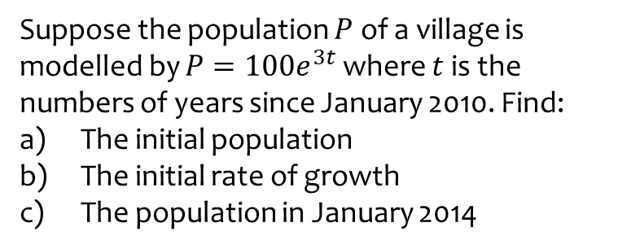
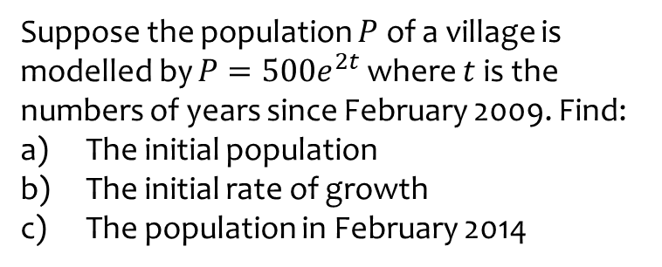
Worked example
Your turn
Suppose the population $P$ of a village is modelled by $P=500e^{2t}$ where $t$ is the numbers of years since February 2009. Find:
The initial population
The initial rate of growth
The population in February 2014
Suppose the population $P$ of a village is modelled by $P=100e^{3t}$ where $t$ is the numbers of years since January 2010. Find:
The initial population
The initial rate of growth
The population in January 2014
a) $100$
b) $\frac{dP}{dt}=300$
c) $16275479$

Slide 3
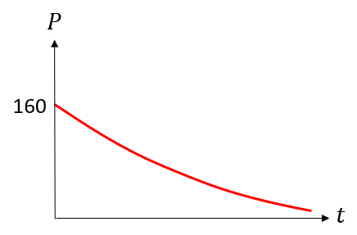
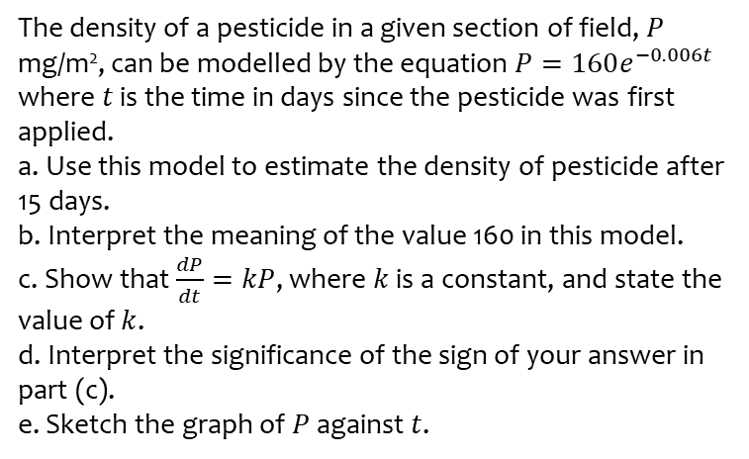
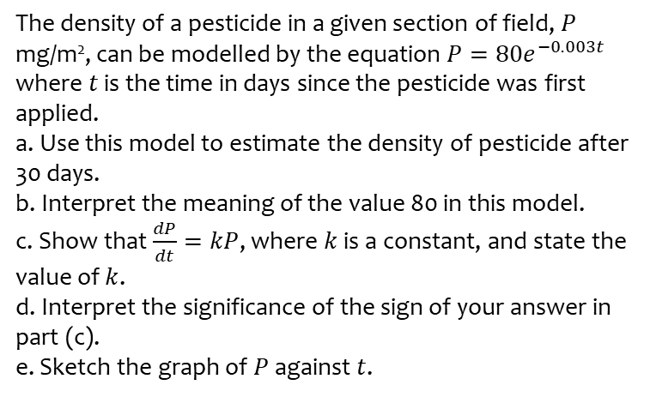
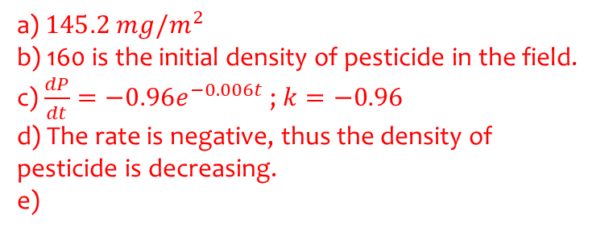
Worked example
Your turn
The density of a pesticide in a given section of field, $P$ mg/m², can be modelled by the equation $P=80e^{−0.003t}$
where $t$ is the time in days since the pesticide was first applied.
a. Use this model to estimate the density of pesticide after 30 days.
b. Interpret the meaning of the value 80 in this model.
c. Show that $\frac{dP}{dt}=kP$, where $k$ is a constant, and state the value of $k$.
d. Interpret the significance of the sign of your answer in part (c).
e. Sketch the graph of $P$ against $t$.
The density of a pesticide in a given section of field, $P$ mg/m², can be modelled by the equation $P=160e^{−0.006t}$
where $t$ is the time in days since the pesticide was first applied.
a. Use this model to estimate the density of pesticide after 15 days.
b. Interpret the meaning of the value 160 in this model.
c. Show that $\frac{dP}{dt}=kP$, where $k$ is a constant, and state the value of $k$.
d. Interpret the significance of the sign of your answer in part (c).
e. Sketch the graph of $P$ against $t$.
a) $145.2 mg/m^{2}$
b) 160 is the initial density of pesticide in the field.
c) $\frac{dP}{dt}=−0.96e^{−0.006t}$ ; $k=−0.96$
d) The rate is negative, thus the density of pesticide is decreasing.
e)

