Slide 1
14.2) $y=e^{x}$

Slide 2

Worked example
Your turn
Differentiate with respect to $x$:
$$e^{2x}$$
$$e^{−3x}$$
$$4e^{5x}$$
$$6e^{\frac{1}{3}x}$$
Differentiate with respect to $x$:
$$8e^{−\frac{1}{4}x}$$
$$−2e^{−\frac{1}{4}x}$$

Slide 3
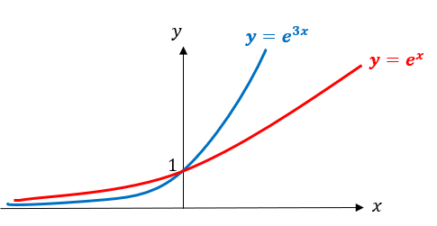
Worked example
Your turn
Sketch:
$$y=e^{2x}$$
Sketch:
$$y=e^{3x}$$

Slide 4
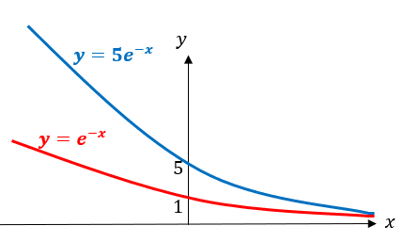
Worked example
Your turn
Sketch:
$$y=10e^{−x}$$
Sketch:
$$y=5e^{−x}$$

Slide 5
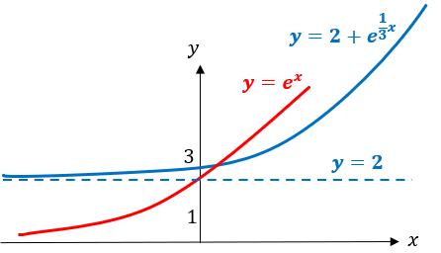
Worked example
Your turn
Sketch:
$$y=3+4e^{\frac{1}{2}x}$$
Sketch:
$$y=2+e^{\frac{1}{3}x}$$

Slide 6
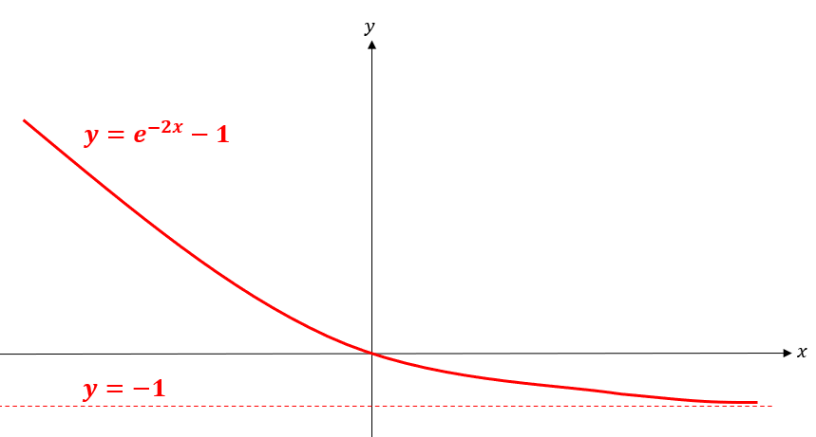
Worked example
Your turn
Sketch:
$$y=e^{−3x}−2$$
Sketch:
$$y=e^{−2x}−1$$

