Slide 1
14.1) Exponential functions

Slide 2
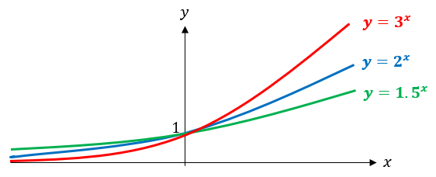
Worked example
Your turn
On the same axes, sketch $y=4^{x}$, $y=5^{x}$ and $y={3.5}^{x}$
On the same axes, sketch $y=2^{x}$, $y=3^{x}$ and $y={1.5}^{x}$

Slide 3
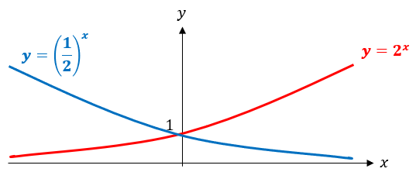
Worked example
Your turn
On the same axes, sketch $y=3^{x}$ and
$y={\left(\frac{1}{3}\right)}^{x}$
On the same axes, sketch $y=2^{x}$ and
$y={\left(\frac{1}{2}\right)}^{x}$

Slide 4
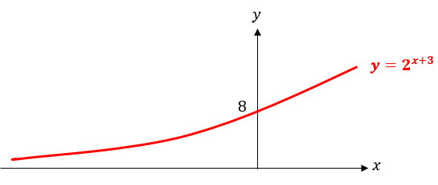
Worked example
Your turn
Sketch $y=3^{x−2}$
Sketch $y=2^{x+3}$

Slide 5
Worked example
Your turn
The graph of $y=ka^{x}$ passes through the points $(4,\frac{16}{3})$ and $(0,\frac{1}{3})$
Find the values of the constants $k$ and $a$
The graph of $y=pq^{x}$ passes through the points $(2, 4.5)$ and $\left(5,\frac{243}{2}\right)$
Find the values of the constants $p$ and $q$
$$p=\frac{1}{2}, q=3$$

