Slide 1
13.7) Areas between curves and lines

Slide 2
Worked example
Your turn
Determine the area bounded by the curve with equation $y=x\left(7−x\right)$ and the line with equation $y=2x$
Determine the area bounded by the curve with equation $y=x\left(4−x\right)$ and the line with equation $y=x$
$$\frac{9}{2}$$

Slide 3
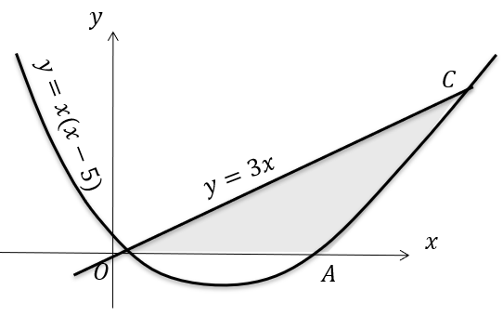
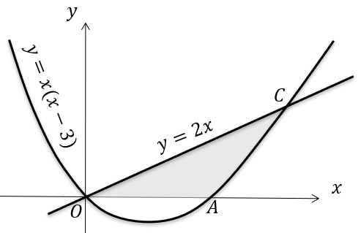
Worked example
Your turn
The diagram shows a sketch of the curve with equation $y=x\left(x−5\right)$ and the line with equation $y=3x$.
Find the area of the shaded region $OAC$.
The diagram shows a sketch of the curve with equation $y=x\left(x−3\right)$ and the line with equation $y=2x$.
Find the area of the shaded region $OAC$.
$$\frac{49}{3}$$

Slide 4
Worked example
Your turn
Determine the area bounded by the curve with equation $y=5x−x^{2}−3$ and the line with equation $y=5−x$
Determine the area bounded by the curve with equation $y=10x−x^{2}−8$ and the line with equation $y=10−x$
$$\frac{343}{6}$$

