Slide 1
13.3) Finding functions

Slide 2
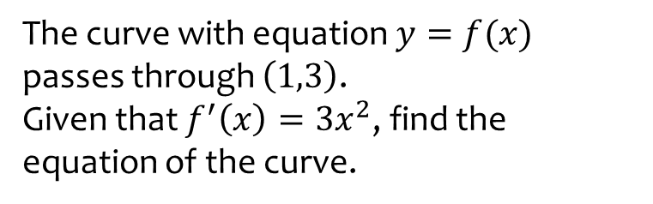
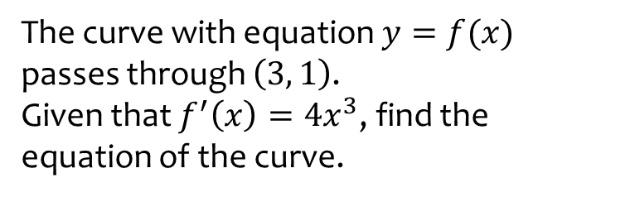

Worked example
Your turn
The curve with equation $y=f(x)$ passes through $\left(3, 1\right)$.
Given that $f^{′}\left(x\right)=4x^{3}$, find the equation of the curve.
The curve with equation $y=f(x)$ passes through $\left(1,3\right)$.
Given that $f^{′}\left(x\right)=3x^{2}$, find the equation of the curve.
$$y=x^{3}+2$$

Slide 3
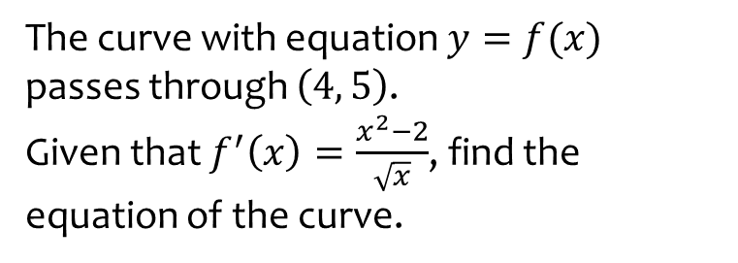
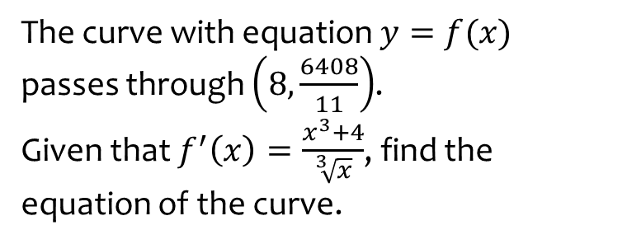

Worked example
Your turn
The curve with equation $y=f(x)$ passes through $\left(8,\frac{6408}{11}\right)$.
Given that $f^{′}\left(x\right)=\frac{x^{3}+4}{\sqrt[3]{x}}$, find the equation of the curve.
The curve with equation $y=f(x)$ passes through $\left(4, 5\right)$.
Given that $f^{′}\left(x\right)=\frac{x^{2}−2}{\sqrt{x}}$, find the equation of the curve.
$$y=\frac{2}{5}x^{\frac{5}{2}}−4x^{\frac{1}{2}}+\frac{1}{5}$$

