Slide 1
12.11) Modelling with differentiation

Slide 2
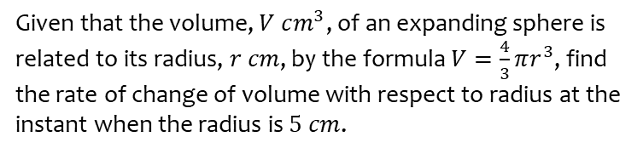
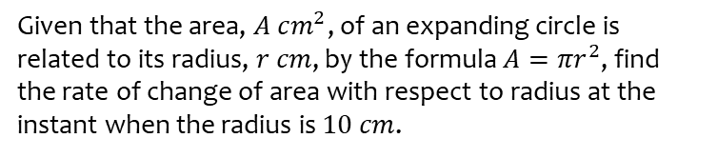
Worked example
Your turn
Given that the area, $A$ $cm^{2}$, of an expanding circle is related to its radius, $r cm$, by the formula $A=πr^{2}$, find the rate of change of area with respect to radius at the instant when the radius is $10 cm$.
Given that the volume, $V$ $cm^{3}$, of an expanding sphere is related to its radius, $r cm$, by the formula $V=\frac{4}{3}πr^{3}$, find the rate of change of volume with respect to radius at the instant when the radius is $5 cm$.
$314 cm^{3}$ per $cm$

Slide 3
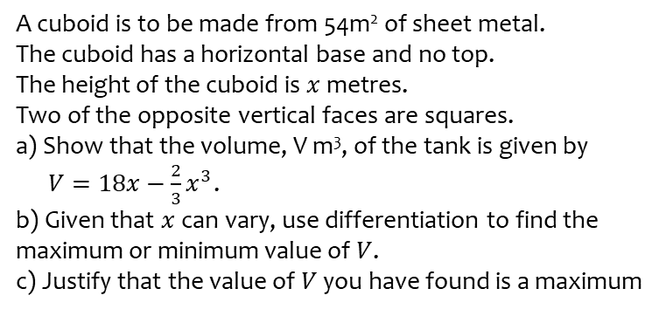
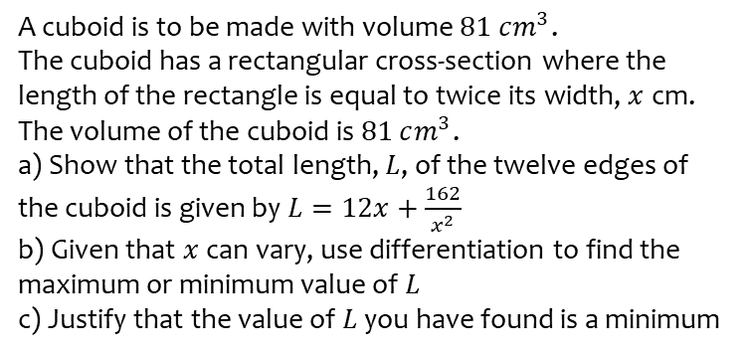
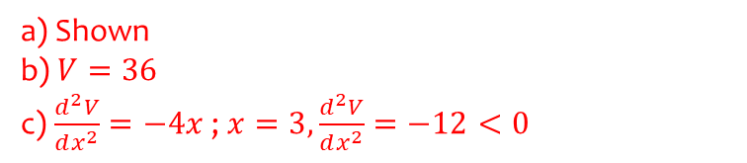
Worked example
Your turn
A cuboid is to be made with volume $81 cm^{3}$.
The cuboid has a rectangular cross-section where the length of the rectangle is equal to twice its width, $x$ cm.
The volume of the cuboid is $81 cm^{3}$.
a) Show that the total length, $L$, of the twelve edges of the cuboid is given by $L=12x+\frac{162}{x^{2}}$
b) Given that $x$ can vary, use differentiation to find the maximum or minimum value of $L$
c) Justify that the value of $L$ you have found is a minimum
A cuboid is to be made from 54m² of sheet metal.
The cuboid has a horizontal base and no top.
The height of the cuboid is $x$ metres.
Two of the opposite vertical faces are squares.
a) Show that the volume, V m³, of the tank is given by
$V=18x−\frac{2}{3}x^{3}$.
b) Given that $x$ can vary, use differentiation to find the maximum or minimum value of $V$.
c) Justify that the value of $V$ you have found is a maximum
a) Shown
b) $V=36$
c) $\frac{d^{2}V}{dx^{2}}=−4x$ ; $x=3,\frac{d^{2}V}{dx^{2}}=−12<0$

