Slide 1
12.10) Sketching gradient functions

Slide 2
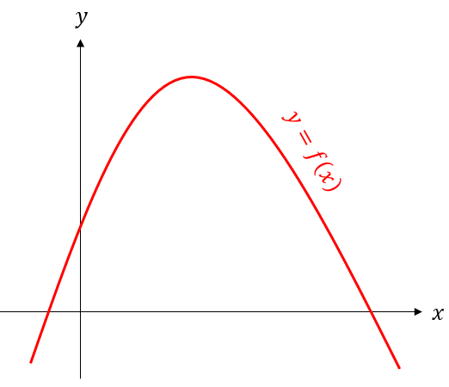
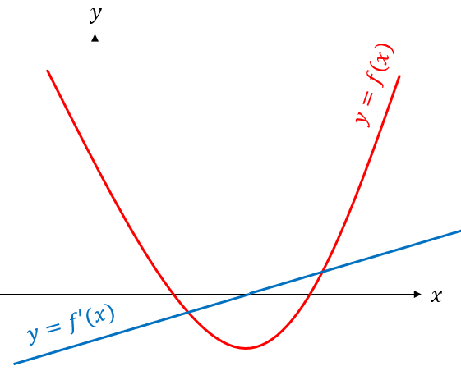
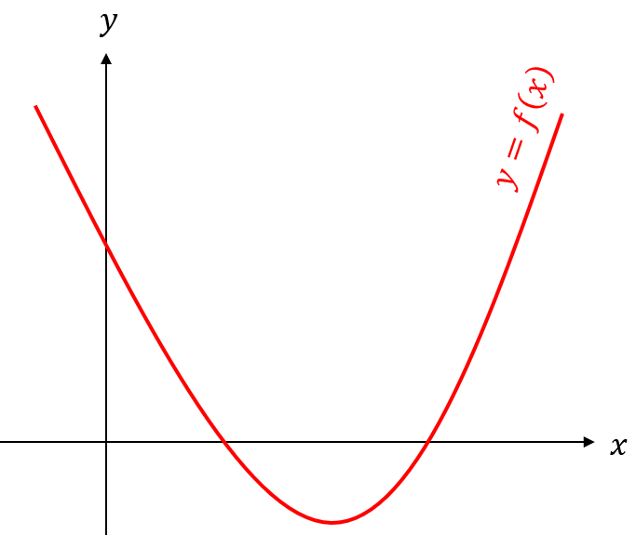
Worked example
Your turn
Sketch $y=f′(x)$ on the same axes
Sketch $y=f′(x)$ on the same axes

Slide 3
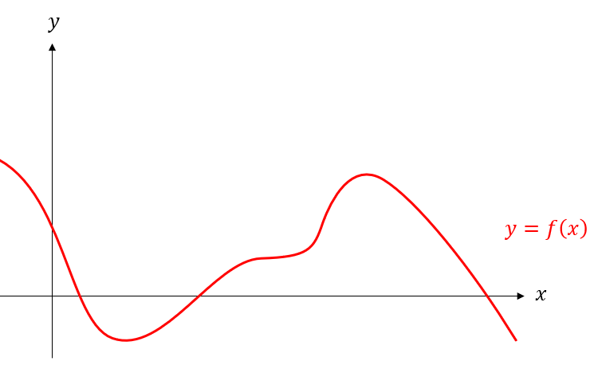
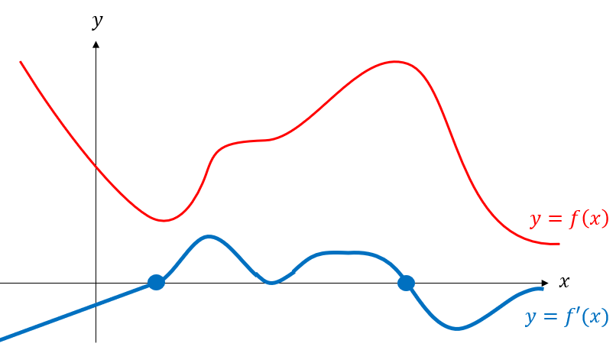
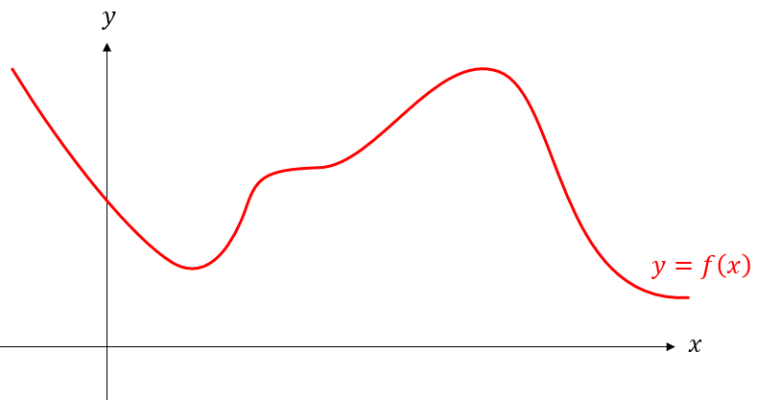
Worked example
Your turn
Sketch $y=f′(x)$ on the same axes
Sketch $y=f′(x)$ on the same axes

Slide 4
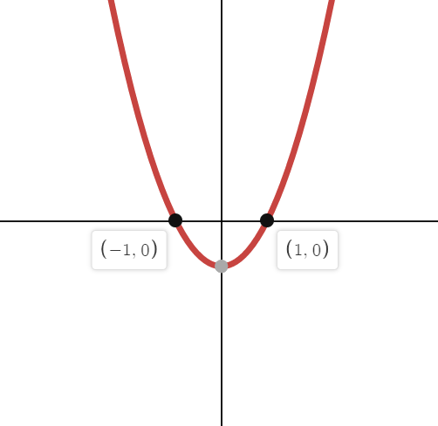
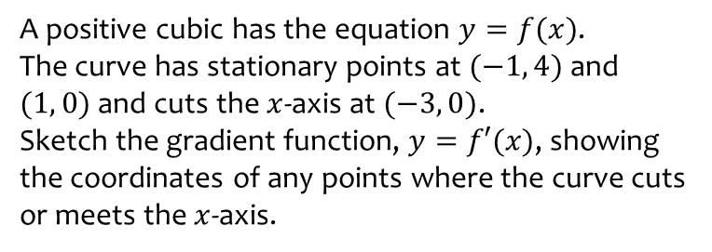
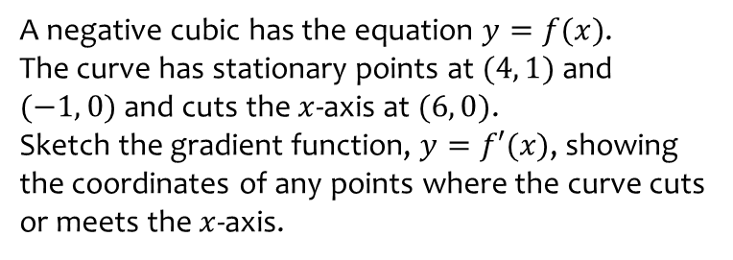
Worked example
Your turn
A negative cubic has the equation $y=f(x)$.
The curve has stationary points at $(4, 1)$ and $(−1, 0)$ and cuts the $x$-axis at $(6, 0)$.
Sketch the gradient function, $y=f′(x)$, showing the coordinates of any points where the curve cuts or meets the $x$-axis.
A positive cubic has the equation $y=f(x)$.
The curve has stationary points at $(−1, 4)$ and $(1, 0)$ and cuts the $x$-axis at $(−3, 0)$.
Sketch the gradient function, $y=f′(x)$, showing the coordinates of any points where the curve cuts or meets the $x$-axis.

